Slide 1
AMNESIA: Analysis and Monitoring for NEutralizing SQL-Injection Attacks
Published by Wiliam Halfond and Alessandro Orso
Presented by El Shibani Omar
CS691 – UCCS – S2012
April 30, 2012

Slide 2
Outline
SQL Overview
SQL Injection Attacks Overview
AMNESIA
AMNESIA Work Flow
AMNESIA Implementation
Conclusion

Slide 3
S Q L
Structured Query Language

Slide 4
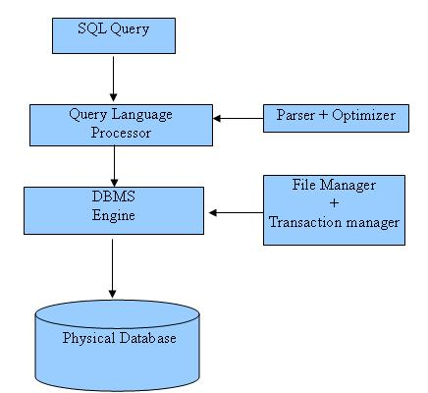
SQL Overview
Structured Query Language
Database language designed for
managing data in RDBMS.
1970s by Dr. Codd.
ANSI: 1st SQL standard in 1986,
ANSI: updates in 1989, …
SQL Uses DML (Data Manipulation Language)
Notes:
1970s by Dr. Codd. Research for IBM
IBM liked SQL IBM began developing commercial products using it
American National Standards Institute - ANSI

Slide 5
SQLIA
SQL Injection Attacks

Slide 6
SQL Injection Attacks
Example of interaction between a user and a typical web application.
A typical web application in which a user on a client machine can access services provided by an application server and an underlying database.

Slide 7
SQL Injection Attacks Con..
SQL servers allow multiple statements.
SQLIAs: Exploiting an application security vulnerability.
SQLIAs: described as one of the most serious security threats to web applications
SQLIAs: Caused by insufficient input validation.
Gartner Group:97% of 300 websites were vulnerable to SQLIAs.
SELECT * FROM `users` WHERE `name` = ‘Al'; SELECT * FROM `users`; DROP TABLE `users`;

Slide 8
SQLIA Example
Users
Name | login | pass | email
Guest | guest |  | N/A
Administrator | admin | 9656387b6542bc9be1b8730b45b49fd8 | admin@site.org
Sean James | sjames | 5b0f32168b20250bb403970287d6e753 | sjames@site.org
Lupaya John | ljohn | 4a8968e60a05cb59308d3c954a8bb00a | ljohn@site.org
SELECT * FROM users WHERE login=’guest’
Guest
Name | login | pass | email
Guest | guest |  | N/A

Slide 9
SQLIA Example Con..
Users
Name | login | pass | email
Guest | guest |  | N/A
Administrator | admin | 9656387b6542bc9be1b8730b45b49fd8 | admin@site.org
Sean James | sjames | 5b0f32168b20250bb403970287d6e753 | sjames@site.org
Lupaya John | ljohn | 4a8968e60a05cb59308d3c954a8bb00a | ljohn@site.org
SELECT * FROM users WHERE login=’admin’ AND pass=’ admin2011’
Admin
MD5(admin2011) = 9656387b6542bc9be1b8730b45b49fd8
Name | login | pass | email
Administrator | admin | ************ | admin@site.org

Slide 10
SQLIA Example con’t
Users
Name | login | pass | email
Guest | guest |  | N/A
Administrator | admin | 9656387b6542bc9be1b8730b45b49fd8 | admin@site.org
Sean James | sjames | 5b0f32168b20250bb403970287d6e753 | sjames@site.org
Lupaya John | ljohn | 4a8968e60a05cb59308d3c954a8bb00a | ljohn@site.org
’ OR 1=1 --
SELECT * FROM users WHERE login=’ ’ OR 1=1 --’ AND pass=‘ ‘
Attacker
SELECT * FROM users WHERE login=’ ’ OR 1=1
Name | login | pass | email
Guest | guest |  | N/A
Administrator | admin | 243c4149757fc95e9bfab0a7c5bcb3a8 | admin@site.org
Sean James | sjames | 5b0f32168b20250bb403970287d6e753 | sjames@site.org
Lupaya John | ljohn | 4a8968e60a05cb59308d3c954a8bb00a | ljohn@site.org

Slide 11
Methods to prevent SQLIAs
Input Validation Techniques:
But can prevent some vulnerabilities
Least Privilege
Limitations, less permissions, inflexible
Static query statement
Not good when use dynamic query
Intrusion Detection Systems (IDS):
Provide little or no protection (e.g., firewalls, proxy, Gateway)
Analysis-based Techniques:
Static techniques: imprecise or only focus on a specific aspect of the problem.
Dynamic techniques: Produce false negatives.
Notes:
The web application has open access to the database to return requests.

Slide 12
AMNESIA Definition
AMNESIA → Analysis and Monitoring for NEutralizeing SQL-Injection Attacks
AMNESIA is generally combining static analysis and runtime monitoring.

Slide 13
AMNESIA Work Flow
AMNESIA consists of four steps:
Identifying hotspots
Building SQL-query models
Instrumenting application
Runtime monitoring

Slide 14
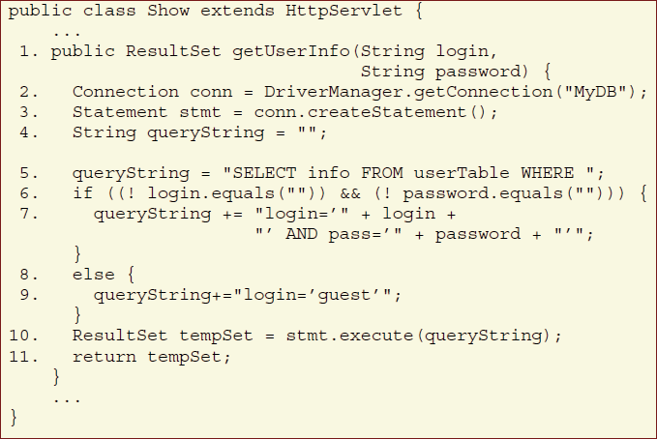
AMNESIA Work Flow con’t
Step1: Identify Hotspots: This step performs a simple scanning of the application code to identify hotspots points in the application code that issue SQL queries to the underlying database.
hotspots point

Slide 15
AMNESIA Work Flow Con..
Step2: Build SQL Query Models: For each hotspot, build a model that represents all the possible SQL queries that may be generated at that hotspot. It uses Java String Analysis (JSA).
β = value

Slide 16
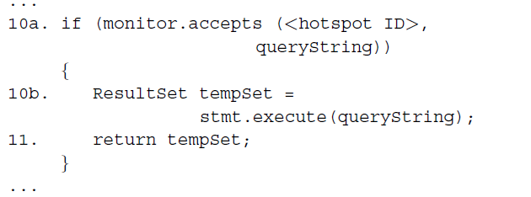
AMNESIA Work Flow Con..
Step3: Instrument Application: In this step, we instrument the application by adding calls to the monitor that check the queries at runtime. For each hotspot, the technique inserts a call to the monitor before the call to the database.
hotspot ID: correlates the hotspot with the specific SQL-query model
queryString: contains the actual query about to be submitted

Slide 17
AMNESIA Work Flow Con..
Step4: Runtime Monitoring: The monitor parses the query string into a sequence of tokens according to the specific SQL syntax considered. Tokens in the query that represent string or numeric constants can match any transition in the SQL-query model.
= Empty = Value
= Empty = Value
Original Query
SQL- query model
Incoming Query
from user

Slide 18
AMNESIA Implementation
Implementation consists of three modules:
1)Analysis module:
implements Steps 1 & 2.
inputs JSP pages and outputs a list of hotspots.
Builds a SQL-query models for each hotspot
2)Instrumentation module:
implements Step 3.
instruments each hotspot with a call to the runtime monitor.
3)Runtime-monitoring module:
implements Step 4.
inputs a query string and the hotspot ID.
retrieves the SQL-query model for that hotspot.
Match SQL-query model with the submitted query string.
Implementation is Java-based.

Slide 19
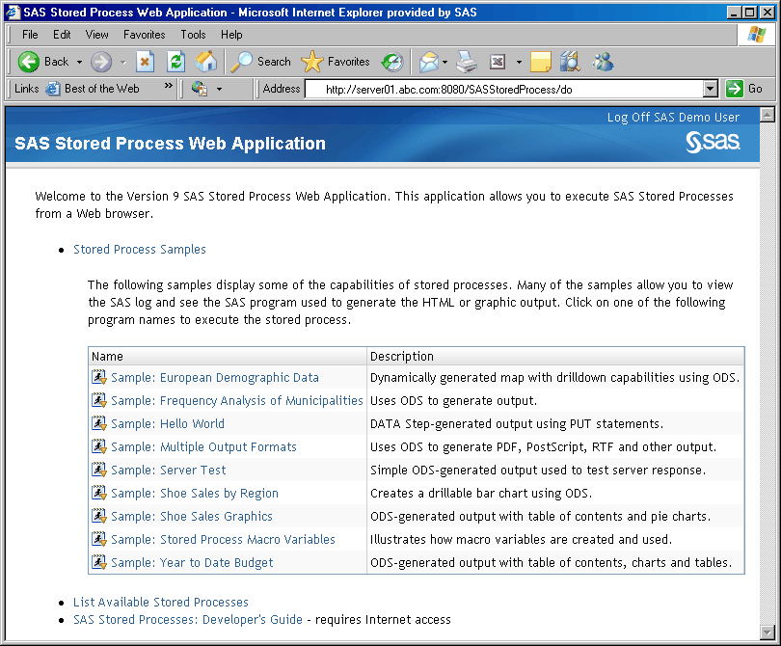
High-level overview of AMNESIA
web applications
AMNESIA Toolset
Instrumented web
application
Instrumentation Module
Instrumented web
application
Instrumented web
application
Instrumented web
application
Instrumented web
application
Analysis Module
SQL- Query Model
SQL- Query Model
SQL- Query Model
SQL- Query Model
SQL- Query Model
Static Analysis

Slide 20
High-level overview of AMNESIA Con..
Database
Data
HTML Data
AMNESIA Toolset
legitimate
input
Instrumented web applications
Legitimate SQL
URL
Runtime Monitoring
Module
SQLIA
Instrumented web applications
Matching…
SQLIAs
SQL- Query Model
Reject & Report
Runtime Monitoring

Slide 21
Conclusion
AMNESIA uses all types of SQLIA defenses.
Responds and reports immediately.
No false positives
No way an attacker can modify SQL statement.
Generalized to various web applications.
Used a set of real web applications.
Real attacks were generated by a real attacker.
AMNESIA is effective, efficient, and precise.

