Slide 1
Honeycomb – Creating Intrusion Detection Signatures Using Honeypots
Greg Williams CS691 Summer 2011

Slide 2
Honeycomb
Introduction
Preceding Work
Important Points
Analysis
Future Work

Slide 3
Introduction
Why I chose this
Universities are targets
Since we have a class B network (2¹⁶ hosts), we are a large target
How can we know our adversaries and improve security

Slide 4
Introduction - Definitions
Intrusion Detection System (IDS)
Intrusion Prevention System (IPS)
Pattern Detection
Longest Common Substring (LCS)
Intrusion Detection Signatures
Honeypot
Honeynet

Slide 5
Preceding Work - Honeypots
Been around since the 1990’s
Used to either hide more valuable resources of a network or to analyze attacks of intruders
High Interaction
Low Interaction
Variety of software
Can be put on a physical system or virtualized

Slide 6
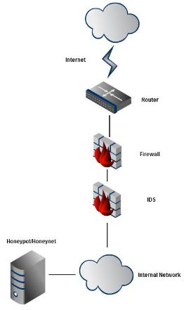
Honeypot/Honeynet

Slide 7
Preceding Work – IDS/IPS
Also have been around since the 1990’s
Bro and Snort are the 2 main open-source IDS/IPS out there today
Signatures
Signatures can include connection type, byte patterns, URI’s, ports, etc.
Very good at stopping specific attacks and code.

Slide 8
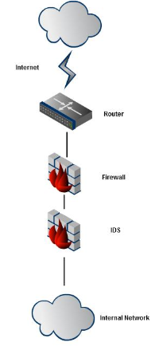
IDS/IPS

Slide 9
Honeycomb
System DOES NOT load signatures upon startup
Spots patterns based upon previous traffic (largest common substring)
Builds suffix trees in linear time

Slide 10
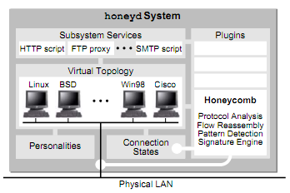
Honeycomb in depth

Slide 11
Honeycomb in depth - Honeyd
Honeycomb is built into the Honeyd honeypot 2 ways – via plugin and via event hooks
Honeycomb needs to analyze packets, so it utilizes libpcap that is already built into Honeyd
Honeyd creates traffic so Honeycomb knows that it created the traffic instead of guessing.

Slide 12
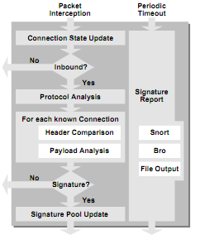
Honeycomb - Signature Creation

Slide 13
Honeycomb - Signature Creation
If there is any existing connection state for the new packet, that state is updated, otherwise new state is created.
If the packet is outbound, processing stops here.
Honeycomb performs protocol analysis at the network and transport layer.

Slide 14
Honeycomb – Signature Creation
For each stored connection:
Honeycomb performs header comparison in order to detect matching IP networks, initial TCP sequence numbers, etc.
If the connections have the same destination port, Honeycomb attempts pattern detection on the exchanged messages.
If no useful signature was created in the previous step, processing stops. Otherwise, the signature is used to augment the signature pool as described in Section III-F.
Periodically, the signature pool is logged in a conﬁgurable manner, for example by appending the Bro representation of the signatures to a ﬁle on disk.

Slide 15
Honeycomb – Connection Tracking
Signature creation is based off comparing new data to old data therefore connections and packets must be maintained for a period of time
Handshake and established connections are kept separate as not to fill up the hashtables.

Slide 16
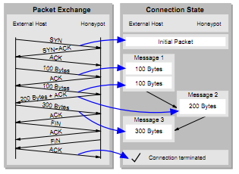
Honeycomb – Connection Tracking

Slide 17
Honeycomb protocol Analysis
After updating connection status, Honeycomb creates a new signature record and fills it with the facts about packets which is updated continuously.
Anomalies are captured instead of corrected
Headers are captured and then compared to previous packets. If there are matches, then a new signature is created.

Slide 18
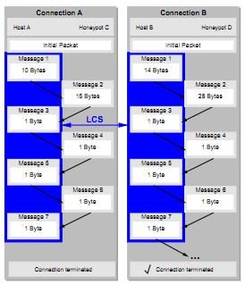
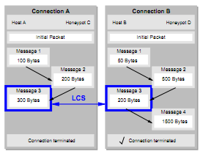
Honeycomb – Pattern Detection
Horizontal detection – happens every n^{th} message and applies LCS algorithm
Vertical detection – concatenates messages then applies LCS algorithm

Slide 19
Honeycomb – Signatures
Signatures are indefinite and can be built upon if they are improved
Signatures are output in Bro and Snort-like signatures

Slide 20
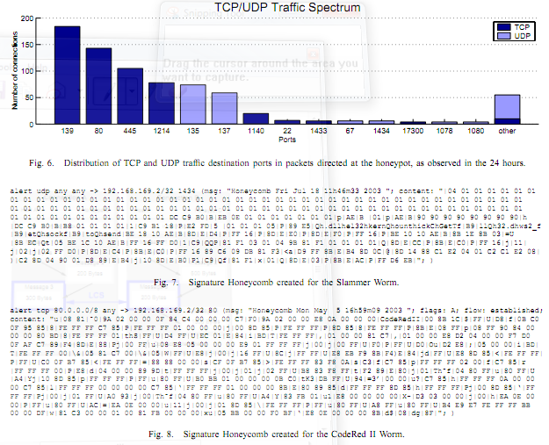
Honeycomb - Testing

Slide 21
Honeycomb - Performance
During the 24-hour period, we captured 224 KB of trafﬁc, comprising 557 TCP connections, 145 UDP connections and 27 ICMP pings. Figure 6 shows the distribution of the ports requested at the honeypot, in terms of numbers of connections.
Honeycomb created 38 signatures for hosts that just probed common ports. 25 signatures were created containing ﬂow content strings. These are relatively long; on average they contain 136 bytes. These were viruses.

Slide 22
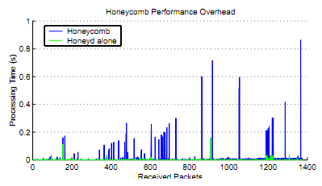
Honeycomb - Performance

Slide 23
Honeycomb – Personal Analysis
No production data other than a home network
Very little results
Didn’t say what hardware was used for processing
Odd that they say plugins are built into Honeyd to lessen impact, however we can see it significantly takes a performance hit
Doesn’t do anything against polymorphic malware

Slide 24
Future of this paper
I haven’t seen any published papers regarding specifically honeycomb since this paper
Project website was updated in 2009 supposedly
Project code says .7 but really says .4 in the source code

Slide 25
Signature generation today
Polygraph (2005) looked at invariant content on network flows and tried to match disjoint content strings
Symantec’s Hancock (2008) – compares known byte sequences of legitimate programs with those of other executables analyzing every 48th byte sequence
Fireeye (current)

Slide 26
Questions?

