Slide 1
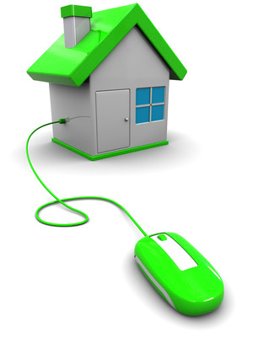
Home Security
In Smart Grids
By:
Abdullah Almurayh
CS691
Summer 2011
University of Colorado at Colorado Springs

Slide 2
Outline
Introduction to Smart Grid
Smart Grid Architecture
Smart Grid Communications
Controller Area Network
Home Automation
Smart Grid Security
Conclusion
2 Almurayh/CS691/Home Security 7/27/2011

Slide 3
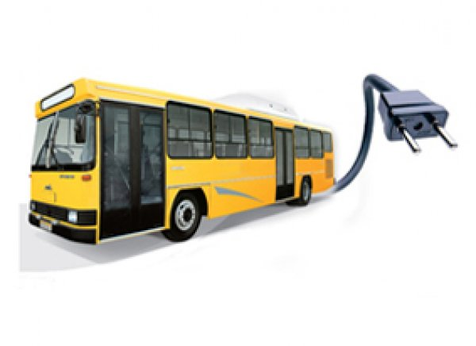
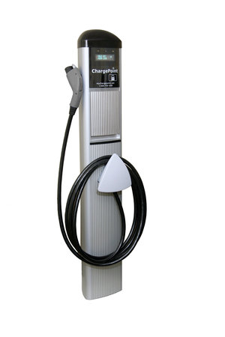
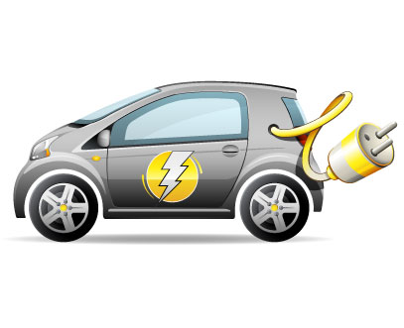



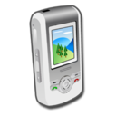
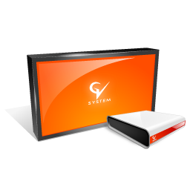
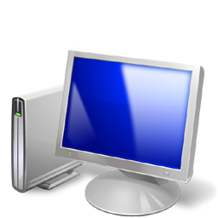


The Electricity Crisis
Population of Electric devices has grown
More Electricity demanding
3 Almurayh/CS691/Home Security 7/27/2011

Slide 4
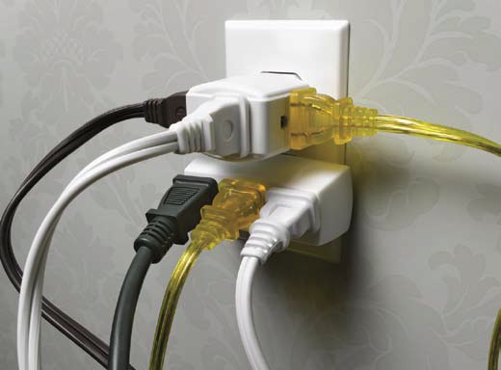
The Electricity Crisis
4 Almurayh/CS691/Home Security 7/27/2011

Slide 5
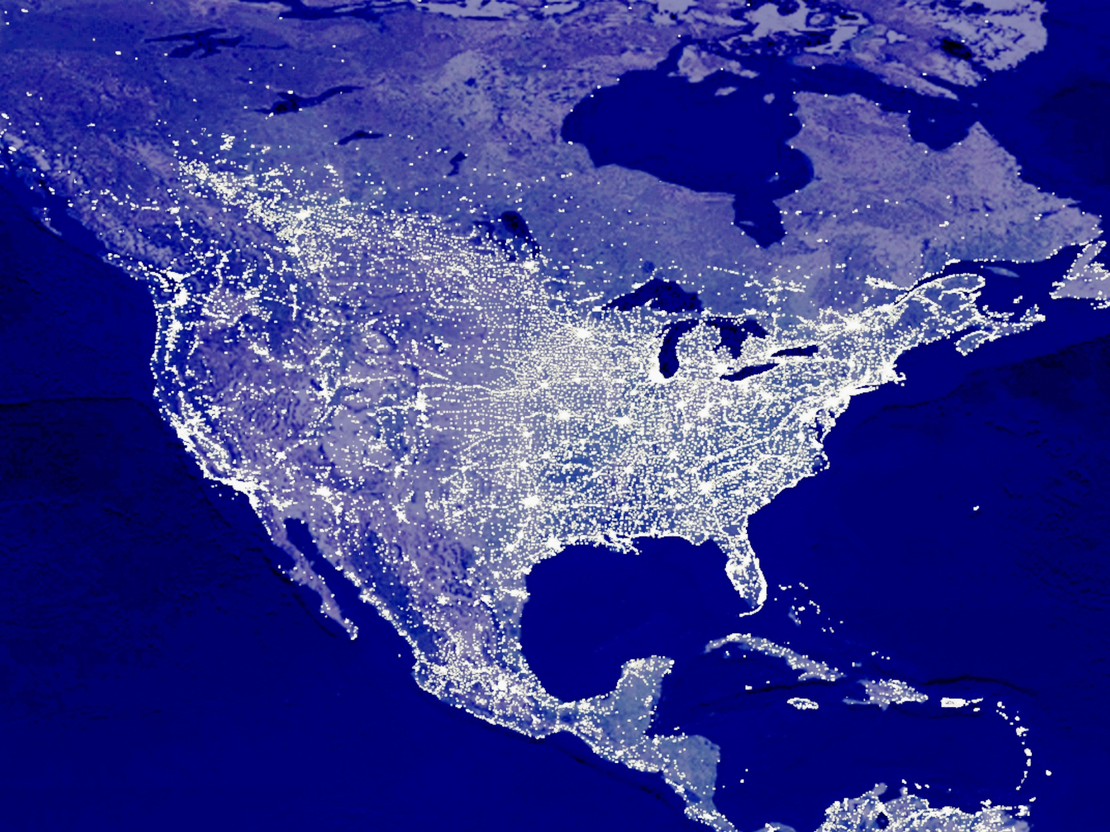

The Electricity Crisis
2009
5 Almurayh/CS691/Home Security 7/27/2011

Slide 6
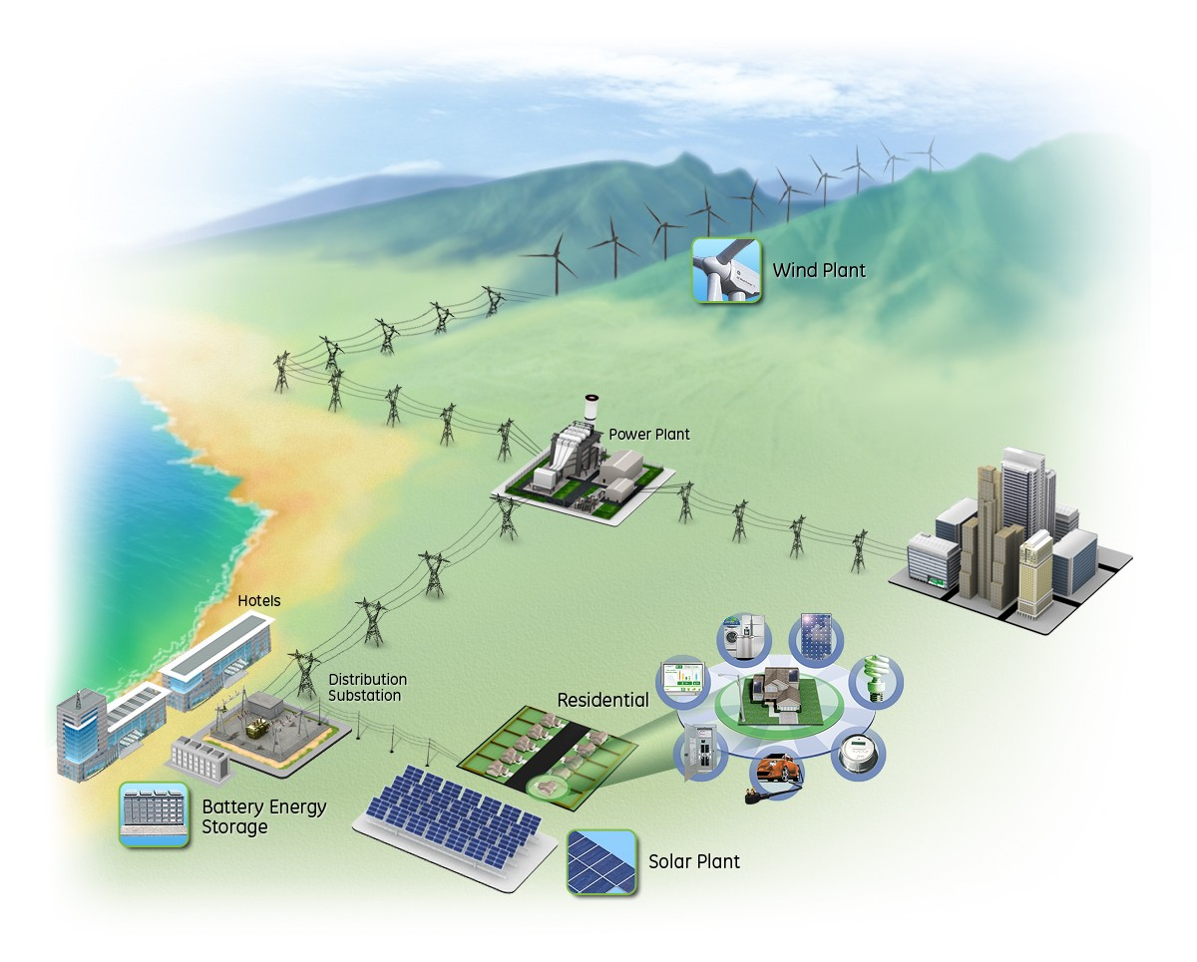
The Smart Grid
Smart grid is an electrical grid that intelligently predicts and responds to the behaviors of electric power users
So, it efficiently delivers reliable, economic, and maintainable electricity services.
6 Almurayh/CS691/Home Security 7/27/2011

Slide 7
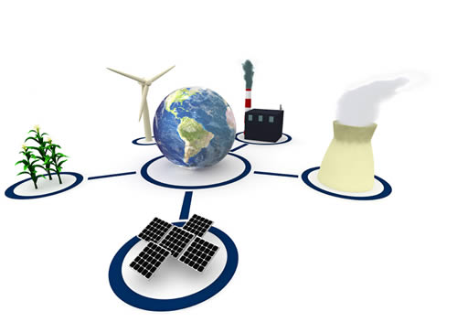
The Smart Grid
Revelation
Future
Challenge
Intelligence
Economic Efficiency
World Connectivity
People Interactivity
More Opportunity and choices
Living Improvement
More Greening
Security Enhancement!
7 Almurayh/CS691/Home Security 7/27/2011

Slide 8
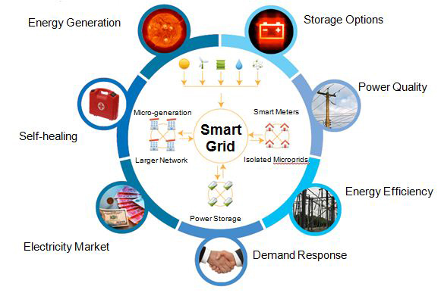

Smart Grids Achievement
Three important components needed:
  Governments
  Companies: Utilities Companies and Vendors
  Customers: Owners, Residents.
8 Almurayh/CS691/Home Security 7/27/2011

Slide 9
Convincing about Smart Grid
Governments need to be convinced about implementing Smart Grids in their countries.
Utilities Companies need to be required to implement Smart Grids in their services.
Consumers need to be convinced to involve in smart grids and allow for more privileges.
  convinced through:
    Education [ Schools, Universities]
    Media [ TV, Radio, Papers, Internet]
    Scientists [ inventions, conferences, statistics]
9 Almurayh/CS691/Home Security 7/27/2011

Slide 10
Smart Grid in the US
Key:
red=electricity, green=gas, blue=water,
triangle=trial , circle=project
AMR: Automatic Meter Reading
AMI: Advanced Metering Infrastructure
2009
10 Almurayh/CS691/Home Security 7/27/2011

Slide 11
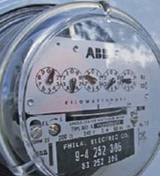
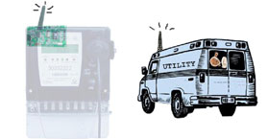
Advanced Metering devices
AMR: Automatic Meter Reading
A technology for automatically collecting real-time consumption and status data from metering devices
Meter Reader: collects meter readings from an AMR.
"walk-by“ or "drive-by" mobile meter reading
11 Almurayh/CS691/Home Security 7/27/2011

Slide 12
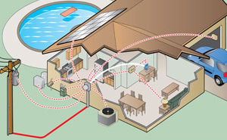
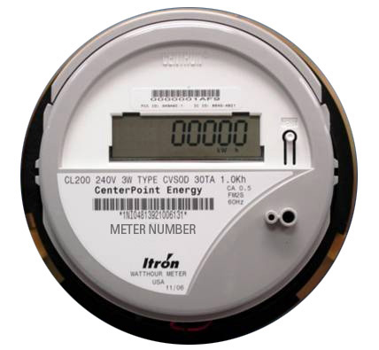
Advanced Metering devices
AMI: Advanced Metering Infrastructure
A device for a utility or the customer to monitor and control energy usage.
It transmits data on energy use back to the utility instead of driving by and reading.
12 Almurayh/CS691/Home Security 7/27/2011

Slide 13
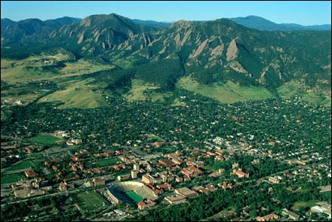
Smart Grid Focus
Xcel Energy has started Smart Grid trial projects to transform Boulder, Colorado into Smart Grid city. When completed, Boulder will be the first Smart City in the world.
The Xcel pilot builds on the following technology options:
option 1: "Smart plugs" that allows customers to control their appliances remotely.
option 2: Xcel turns down power to household appliances when power peaks.
option 3: Xcel runs appliances when more energy is being produced by alternative sources.
13 Almurayh/CS691/Home Security 7/27/2011

Slide 14
Key developments
Almost every utility in the US has some of Smart Grid focus or project going on .
All major Tech US companies including IBM (Smart Planet), Cisco(Smart Grid products), GE (ecomagination), Google (PowerMeter), Microsoft(Hohm), Itron, Accenture have strong Smart Grid focus
National Institute of Science and Technology, IEEE, Department of Energy are actively collaborating with the stakeholders to set up Smart Grid standards
More than 10 Smart Grid organization (GridWise Architecture, GridWise Alliance, ZigBee Alliance, Smart Grid Consumer Coalition) have been established and are actively following Smart Grid related development.
Smart Grid Clearing house and www.smartgrid.gov provide comprehensive information about smart grid
The US and 15 other countries have launched International Smart Grid Action Network for global smart grid collaboration.
14 Almurayh/CS691/Home Security 7/27/2011

Slide 15
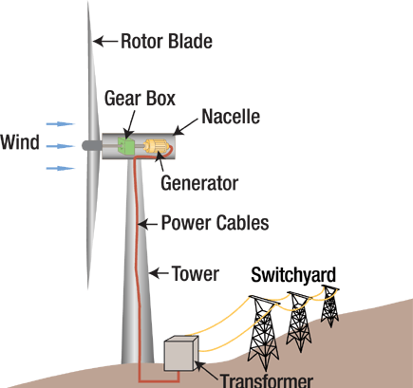
Power Sources for Smart Grid
Wind Plant
Hydropower
Solar power
Nuclear power

Slide 16
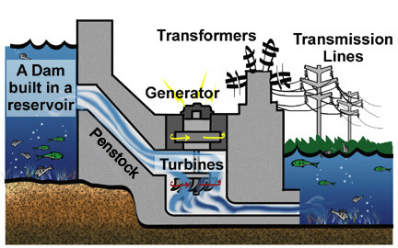
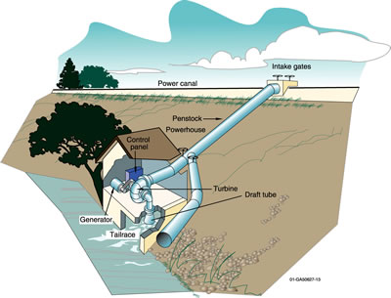
Power Sources for Smart Grid
Wind Plant
Hydropower
Solar power
Nuclear power
Micro Hydro

Slide 17
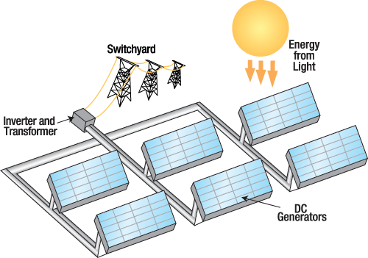
Power Sources for Smart Grid
Wind Plant
Hydropower Plant
Solar power
Nuclear power

Slide 18
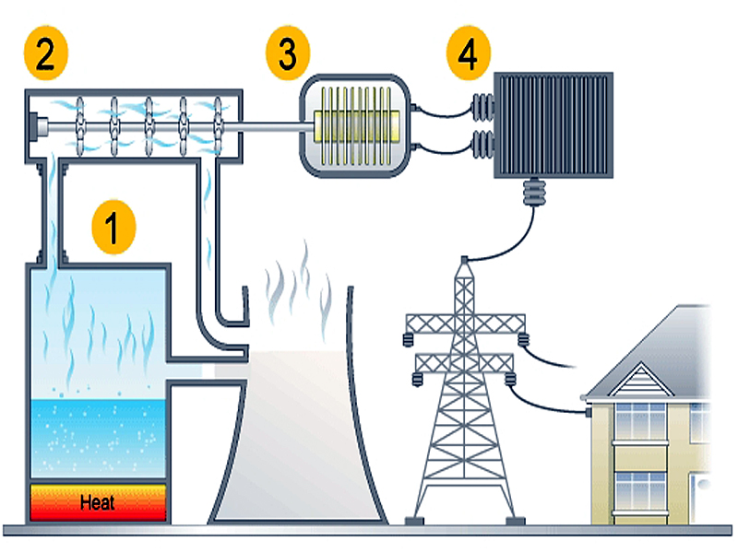
Power Sources for Smart Grid
Wind Plant
Hydropower Plant
Solar power
Nuclear power

Slide 19
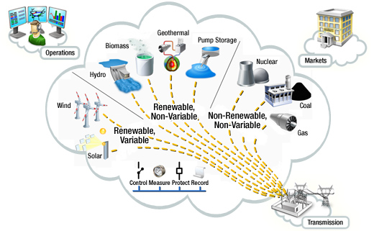
Power Sources for Smart Grid
Wind Plant
Hydropower Plant
Solar power
Nuclear power
Others

Slide 20
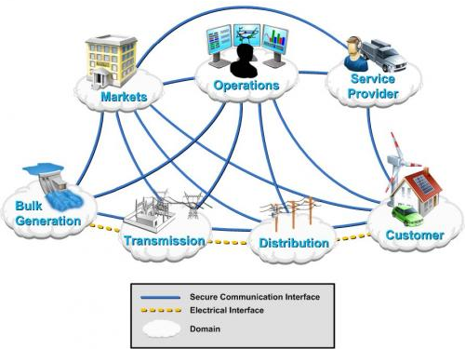
Smart Grids Conceptual Model
20 Almurayh/CS691/Home Security 7/27/2011

Slide 21
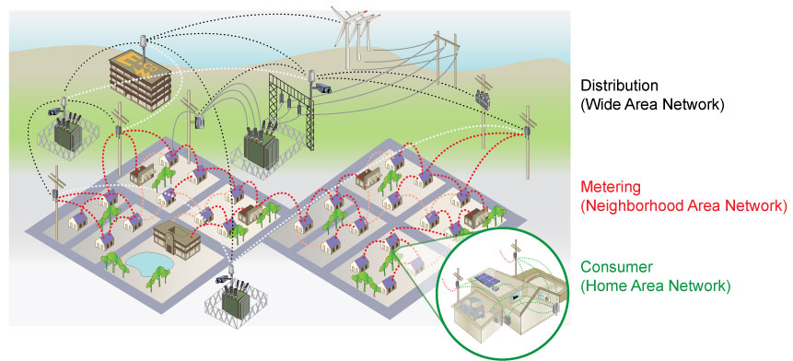
Multi-Tier Smart Grid Architecture
Smart Grids consists of Multi-Tier Network:
WAN (distribution)→ Miles
NAN (metering) → Meters
HAN (consumer) → Yards
21 Almurayh/CS691/Home Security 7/27/2011

Slide 22
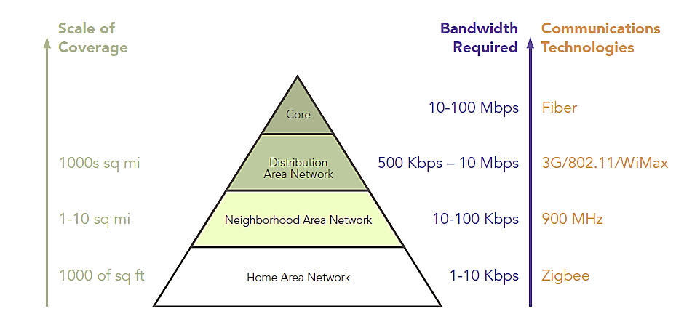
Multi-Tier Smart Grid Architecture
22 Almurayh/CS691/Home Security 7/27/2011

Slide 23
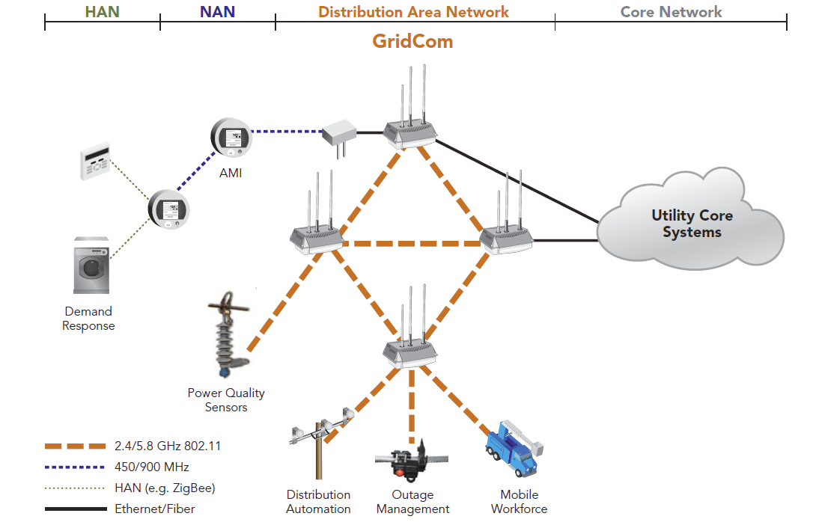
Multi-Tier Smart Grid Architecture
23 Almurayh/CS691/Home Security 7/27/2011

Slide 24
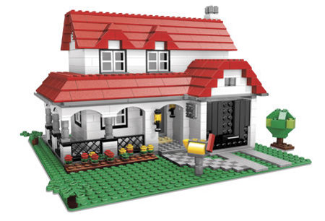
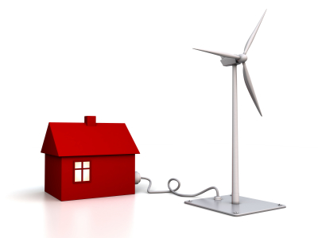
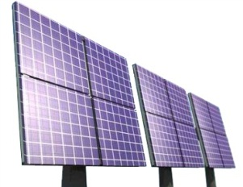
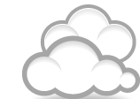
Consumer invests power in Smart Grids
Save money & make Money ☺
Home Power Generating
Power
Router
Smart Grid
Power Storage
24 Almurayh/CS691/Home Security 7/27/2011

Slide 25
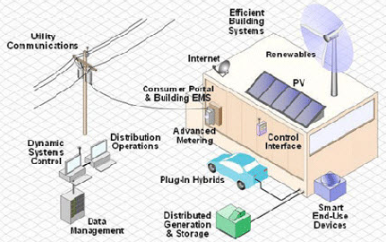
Relationship in Smart Grids
No master-slave relationship
Pairing relationship.
( I need things from you and you need things from me)
25 Almurayh/CS691/Home Security 7/27/2011

Slide 26
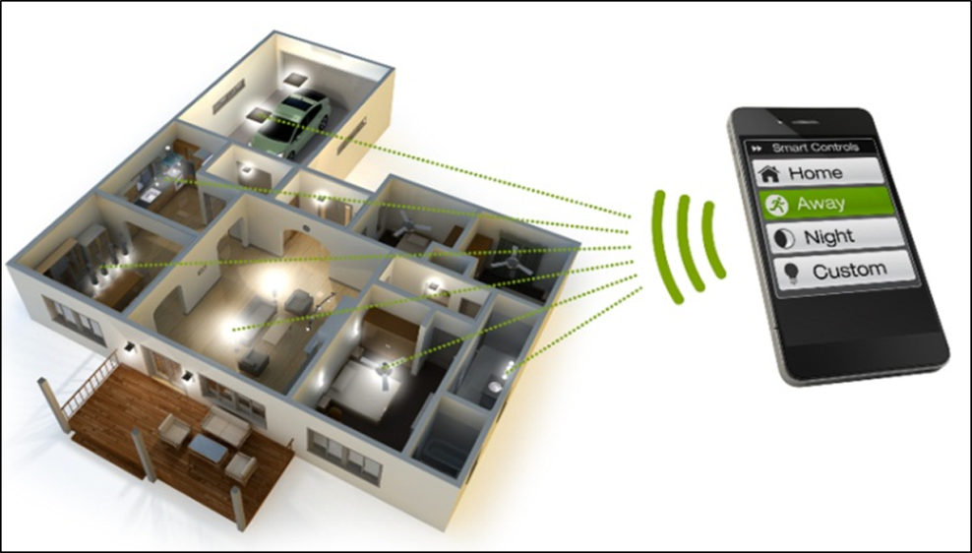
Controller Area Network
Allows smart devices to communicate
Developed in the automotive industry as an in-vehicle
In 1993, CAN became the international standard known as ISO 11898
26 Almurayh/CS691/Home Security 7/27/2011

Slide 27
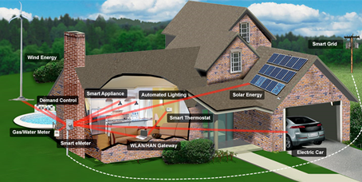
Controller Area Network
27 Almurayh/CS691/Home Security 7/27/2011

Slide 28

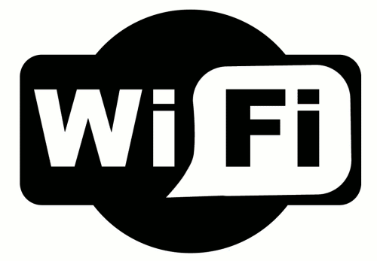

Controller Area Network
Communications Protocols in CAN:
wireless networks
IEEE 802 specifications
low-cost
low power characteristics
low rate
radio waves that easily travel through walls
targets smart grid applications [smart meters, home appliances, computers, video game consoles, smartphones, or digital audio players and plug-in electric hybrid vehicles.]
Examples:
ZigBee
Wi-Fi
Z-Wave
28 Almurayh/CS691/Home Security 7/27/2011

Slide 29
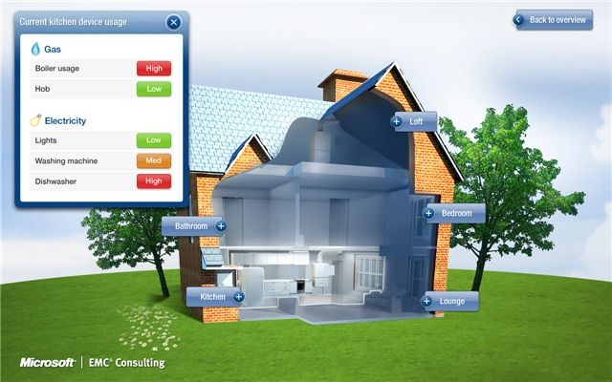
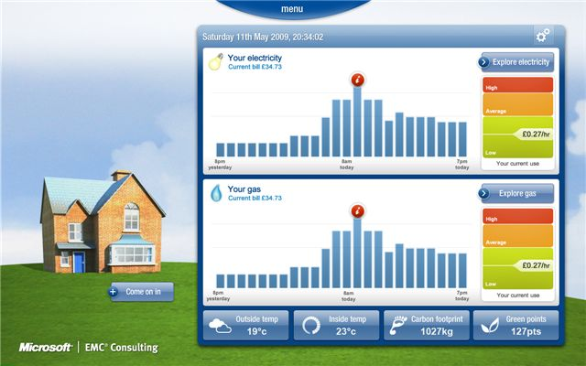
Home Automation in Smart Grid
Meters ( electric, gas, and water )
29 Almurayh/CS691/Home Security 7/27/2011

Slide 30
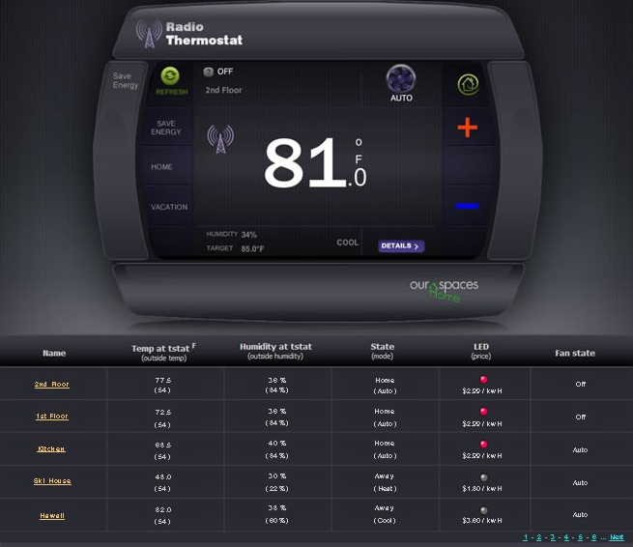
Home Automation in Smart Grid
A consumers can remotely monitor and control his home energy.
30 Almurayh/CS691/Home Security 7/27/2011

Slide 31
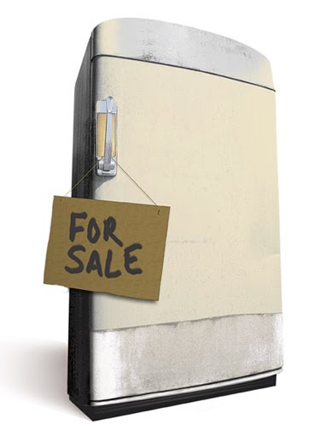
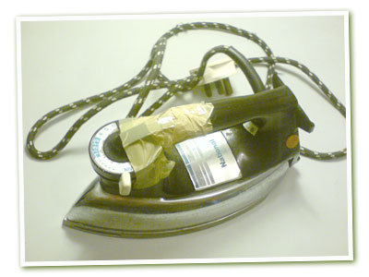
Home Automation in Smart Grid
Old appliance!
31 Almurayh/CS691/Home Security 7/27/2011

Slide 32
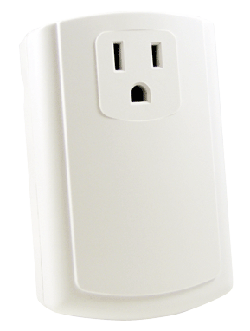
Home Automation in Smart Grid
Smart Plug:
allows control of appliances and lighting based on Demand Response and Price events.
32 Almurayh/CS691/Home Security 7/27/2011

Slide 33
Security attacks in Smart Grid
Large-scale attack [Core network]
Small-scale attack [ HAN, CAN]
Current Risk of Attack through Smart Grid Technology
Attackers may use entry points physically unprotected.
Wireless networks can be easily monitored by attackers.
Wireless networks may be vulnerable to Man-in-the-Middle attacks.
There may be weaknesses in preventing unauthorized communication.
Vulnerable appliances can be easily attacked and compromised to attack other appliances or smart grids
Vulnerabilities exist, not discovered yet.
No significant risks at this time, but the risk grows as the deployment of smart grids grows .
33 Almurayh/CS691/Home Security 7/27/2011

Slide 34
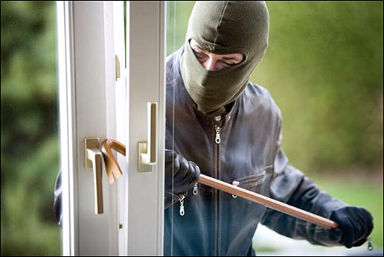
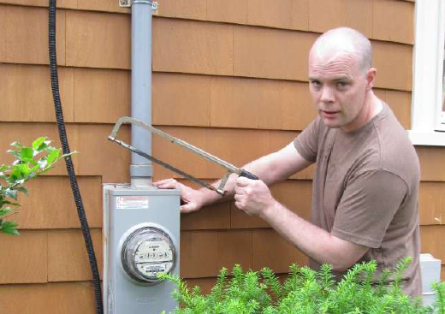
Attack Methodologies
A: Physical attack:
exists when a criminal physically attacks home security
34 Almurayh/CS691/Home Security 7/27/2011

Slide 35
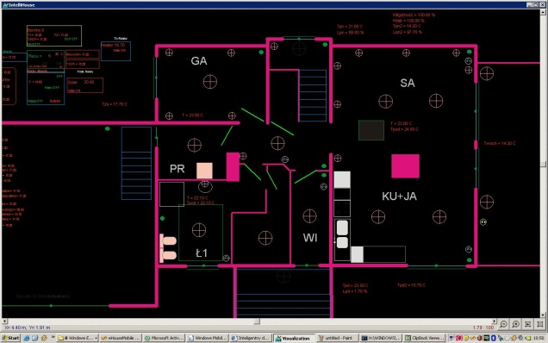
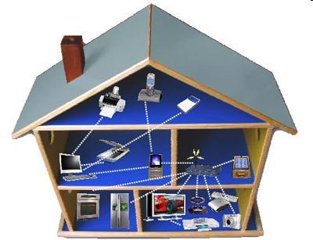

Attack Methodologies
B: Cyber-attack:
exists when accessible information gets attacked causing a compromise to the home controller or appliances
35 Almurayh/CS691/Home Security 7/27/2011

Slide 36
Conclusion
Smart Grid becomes an ideal solution to provide efficiently and intelligently more electricity
Home controller enables home automation, a customer can remotely control his appliances.
CAN Gateway opens NAN and CAN to the internet.
Home automation increases Home security requirements .
Home security and Smart Grid risks grow as their deployment grows .
36 Almurayh/CS691/Home Security 7/27/2011

Slide 37

Questions
37 Almurayh/CS691/Home Security 7/27/2011

Slide 38
References
[1] D. G. Hart, "Using AMI to Realize the Smart Grid," in Power and Energy Society General Meeting - Conversion and Delivery of Electrical Energy in the 21st Century, IEEE, Pittsburgh, PA, 2008.
[2] J. A. Momoh, "Smart Grid Design for Efficient and Flexible Power Networks Operation and Control," in Power Systems Conference and Exposition, 2009. PSCE '09. IEEE/PES , Seattle, WA , April 2009 .
[3] Nedap, "PowerRouter," Nedap N.V. , [Online]. Available: http://www.powerrouter.com. [Accessed July 2011].
[4] T. NETWORKS, "Networking the Smart Grid," 2011. [Online]. Available: http://www.tropos.com/pdf/whitepapers/SmartGridWP_A7.pdf.
[5] E. P. R. I. Inc, "Advanced Metering Infrastructure (AMI)," 2007 . [Online]. Available: http://www.ferc.gov/eventcalendar/Files/20070423091846-EPRI%20-%20Advanced%20Metering.pdf.
[6] J. Yoshida, "NXP's foray into 'Internet of things' starts with light bulbs," 18 May 2011. [Online]. Available: http://www.techonlineindia.com/article/11-05-18/NXP_s_foray_into_Internet_of_things_starts_with_light_bulbs.aspx.
[7] ZigBee, "ZigBee Alliance," ZigBee, [Online]. Available: http://www.zigbee.org/. [Accessed 10 July 2011].
[8] Wi-Fi, "Wi-Fi Alliance," Wi-Fi, [Online]. Available: http://www.wi-fi.org/. [Accessed 10 July 2011].
[9] Z-wave, "Z-Wave Alliance," [Online]. Available: http://www.z-wave.com/modules/ZwaveStart/. [Accessed 10 July 2011].
[10] Z. Wang, Z. Liu and L. Shi, "The smart home controller based on zigbee," in Mechanical and Electronics Engineering (ICMEE), 2010 2nd International Conference on , Shanghai, China, Aug. 2010 .
[11] O. Yang-Xin, J. Hong, L. Yang and S. Chun-Yan, "Research on smart appliances control protocol," in 2010 Second International Workshop on Education Technology and Computer Science, IEEE, 2010, 2010.
[12] A. Schmidt and K. van Laerhoven, "How to build smart appliances?," in Personal Communications, IEEE , August 2001.
[13]http://www.ti.com/ww/en/smart_grid_solutions/smart_grid_home_automation.htm#
[14] http://www.trilliantinc.com/solutions/multi-tier-architecture/
[15]http://www.xcelenergy.com/About_Us/Energy_News/News_Archive/Xcel_Energy_displays_first_fully_integrated_SmartGridCity%E2%84%A2_house_in_Boulder
[16] http://industrial-embedded.com/wi-fi-u-snap-smart-grid-adoption-homes#ixzz1RuUhZTec
[17] http://csus-dspace.calstate.edu/xmlui/bitstream/handle/10211.9/849/Masters%20Project%20-%20Adithya%20Shreyas_Final.pdf
[18] http://www.inl.gov/scada/publications/d/securing_the_smart_grid_current_issues.pdf
[19] http://www.nationalgridus.com/niagaramohawk/non_html/eff_elec-demand.pdf
38 Almurayh/CS691/Home Security 7/27/2011

