Slide 1
KEY MANAGEMENT SYSTEM
CS691 M2009 Semester Project
PHILIP HUYNH

Slide 2
Outline of the Talk
Key Management System
IEEE P1619.3 Standard Key Management Infrastructure for Cryptographic Protection of Stored Data
Strongkey Symmetric Key Management System (SKMS)
OASIS Key Management Interoperability Protocol (KMIP)

Slide 3
KEY MANAGEMENT SYSTEMS
Motivations
Functionalities
Security

Slide 4
Key Management System
Motivations for Key Management
  The keys must be kept secret. While the encryption algorithm should be public.
  Whoever has access to the key, can also access the information, assume someone else's identity, etc.

Slide 5
Key Management System
Key Management Functionalities
  Generation
  Distribution
  Storage
  Replacement / Exchange
  Usage
  Destruction

Slide 6
Key Management System
Key Management System Security
  Prevent intruder from obtaining a key
  Avoid unauthorized use of keys, deliberate modification and other forms of manipulation of keys
  Once the reliability of a key is impaired, its use must be terminated immediately

Slide 7
IEEE P1619.3 STANDARD
Problems
Solution

Slide 8
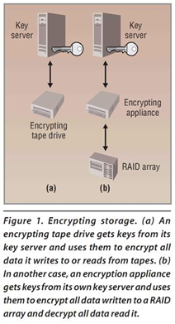
IEEE P1619.3 Standard
Encrypting Storage Problems
We can’t always expect a tape drive to be able to get keys from an encryption appliance’s key server, or for an encryption appliance to be able to get keys from a tape drive’s key server because there is very little interoperability between vendors’ key management systems.
We can’t expect a storage device to be able to get keys from a distant key server. If we encrypt a backup tape in New York data center and send the tape to an offsite backup facility we can’t always expect that the data can be decrypted at the backup facility because the storage device there may be unable to reach the key server that provide the decryption key.

Slide 9
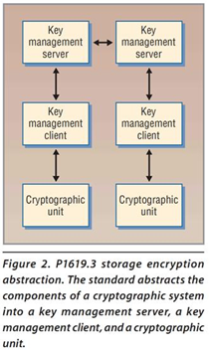
IEEE P1619.3 Standard
The goal
  Eliminate all the key management problems
  Make interoperable key management possible.
Abstracts the components of a cryptographic system into
  Key management server
  Key management client
  Cryptographic unit.
The standard also defines operations between the key management servers.

Slide 10
IEEE P1619.3 Standard
The abstraction components roles and responsibilities
Key management server creates and distributes keys as well as the policies covering their use.
Key management clients get keys and policies from a key management server on behalf of a cryptographic unit.
Cryptographic units perform the actual encryption and decryption operations with the keys the key management clients manage.

Slide 11
STRONGKEY SYMMETRIC KEY MANAGEMENT SYSTEM
Problems
Solution

Slide 12
Strongkey Symmetric Key Management System (SKMS)
Why is symmetric key management a problem?
  Many encryption application Vendors provide different KM Systems. As a result, IT Operation Staffs have to manage many different KM Systems.
  The complexity of KMS management raises the TCO, and causes the potential danger of a vulnerability in the security strategy.
Solution
  Client/Server KM System for encryption applications
  Symmetric Key Server – implements the KM functions that are abstracted from the applications
  Symmetric Key Client – provides API that can make requests for symmetric key services.

Slide 13
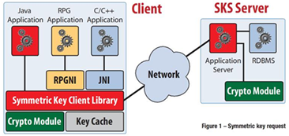
Strongkey SKMS Architecture
SKS server
A server-class computer running an OS – Linux, UNIX, or Windows that has JVM available for it
A relational database for storing the symmetric encryption keys.
A J2EE compliant application server to response to the requests over the network
A JCE-compliant cryptographic provider to perform the cryptographic operations of key generation, key protection, digital signing, verification,…
An optional, Hardware security module (HSM) or Trusted Platform Module (TPM) for securely storing the cryptographic keys that protect the database’s content
The SKS server software, consisting of an Enterprise Archive (EAR) and a Web archive (WAR) file for administration console
SKCL Client
A client computer running an OS – Linux, UNIX, Windows, and OS/400 that has JVM available for it
A JCE-compliant cryptographic provider to perform the cryptographic operations of key generation, key protection, digital signing, verification,…

Slide 14
Strongkey SKMS Architecture
SKCL Client (continued)
An optional, Trusted Platform Module (TPM), smartcard, or other USB-based cryptographic token for securely storing the cryptographic keys that protect client’s authentication credentials.
The SKCL software, consisting of an API callable by Java applications for communicating with the SKS server and performing cryptographic functions. Non-Java applications have the option of either using a JNI library to call the SKCL, or communicating with the SKS server directly using the SKSML protocol.
SKSML Protocol
A call from the client to request a symmetric key – new o existing – from the SKS server.
A call from the client to request key-caching policy information from the SKS server.
A response from the SKS server containing the symmetric key and key’s use policy.
A response from the SKS server containing the key-caching policy.
A fault message from the SKS server, if either of the two calls doesn’t succeed.

Slide 15
OASIS KEY MANAGEMENT INTEROPERABILITY PROTOCOL
Problems
Solution

Slide 16
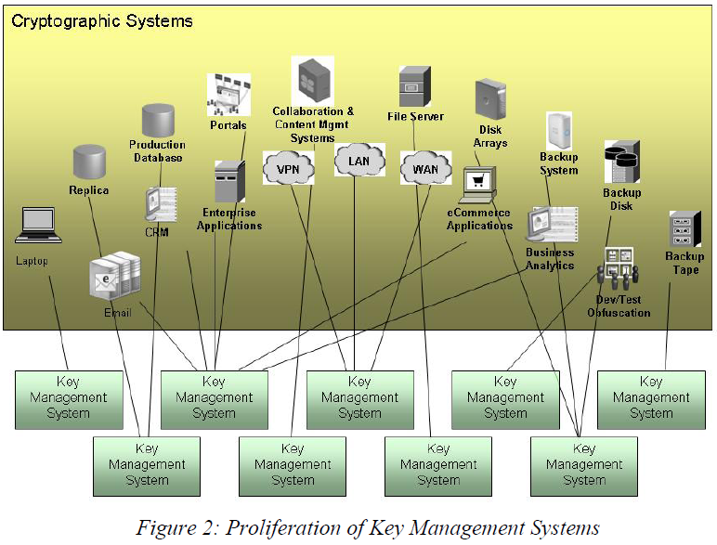
OASIS Key Management Interoperability Protocol (KMIP)
Why is key management a problem?
The proliferation of key management system result in higher operational and infrastructure costs of enterprise using encryption, certificates, asymmetric key pairs, and other encryption technologies

Slide 17
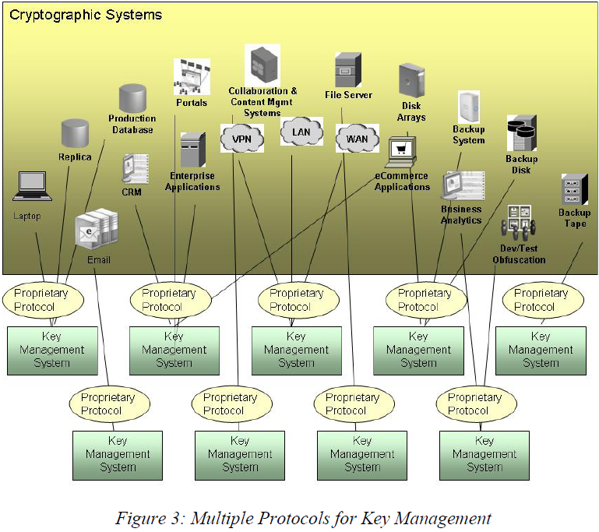
OASIS Key Management Interoperability Protocol (KMIP)
Why is key management a problem?
The proliferation of protocols, even when supported by a single enterprise key manager, results in a higher costs for developing and supporting the key manager.

Slide 18
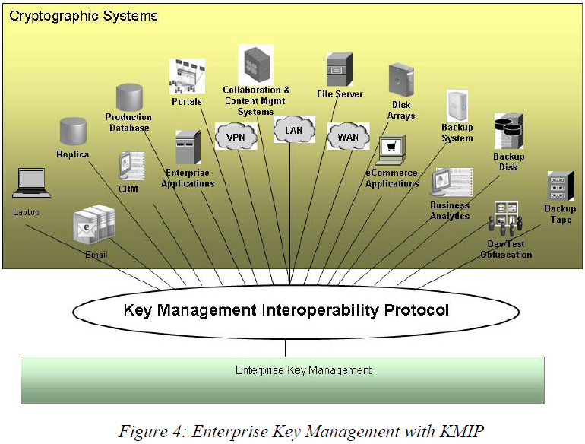
OASIS Key Management Interoperability Protocol (KMIP)
Solution
Single protocol for communication between enterprise key management server and cryptographic clients.
By defining a protocol that can be used any cryptographic clients, KMIP enables enterprise key management servers to communicate via a single protocol to all cryptographic clients supporting that protocol.
Through vendor support KMIP, an enterprise will be able to consolidate key management in a single enterprise key management system, reducing operation and infrastructure costs while strengthening operational controls and governance of security policy.

Slide 19
Conclusions
Strongkey SKMS is open source in JAVA language. It is useful for IT staffs to study and SW developers to customize their own SKM systems.
P1619.3 Standard is for storage protection.
KMIP gives the encryption clients from different vendors, or different technologies the ability to talk to a single KM system by using a single protocol.

Slide 20
References
Basic Methods of Cryptography Jan C.A. VAN DER LUBBE, Cambridge University Press, 1999.
Symmetric Key Management System Arshard Noor, ISSA Journal, 01/2007.
Key Management Infrastructure for Protecting Storage Data Luther Martin, Computer, 07/2008.
Key Management Interoperability Protocol version 1.0, OASIS, 05/2009.

