Slide 1
Network Monitoring as a Layer of Security
CS 691 Advanced System Security Design
University of Colorado – Colorado Springs
July 28th 2009
Jeff Miller

Slide 2
Introduction
Overview
“Your doctor is watching for danger signs as blood flows through vessels, valves and chambers of the heart, while your network monitoring systems are tracking data moving along cables and through servers, switches, connections and routers.”
– CIO magazine
Basic Definition
A vital activity where one or more computers monitor network traffic, infrastructure devices, and other computer systems. The system notifies administrators with alerts (email, pager, cell phone, etc.) when a problem exists.

Slide 3
Introduction Continued
What it is
A system that collects data and alerts the admin when other systems or services are unavailable, or when a predefined threshold is reached (system resources, bandwidth usage, etc.)
What it isn’t
Network Monitoring is not an Intrusion Prevention System (IPS) or Intrusion Detection System (IDS)
Critical Availability
Always On – dedicated power, ePower (generator) ideal at a minimum battery backup system

Slide 4
Practical Application
Smart Grid
Internet Service Providers (ISPs)
Large Corporations
Hospitals
Military Networks
Everyone!?! Why not?

Slide 5
Monitoring Techniques
Passive
SNMP – Protocol for communicating – most basic and most popular
Device based
Limited information gathered
Management Information Base (MIB)
Monitor and Agents(s)
RMON – requires more expensive hardware (more cpu cycles, memory, etc.)
Flow based
Specific SNMP MIB
Console and Probe(s)
Netflow – developed by CISCO – Juniper Network has JFlow
Collector and probe(s)
Traffic Sniffers
Active
Generate and injection of test packets into the network. Test data send to devices, servers, and or applications. Volume of traffic is fully adjustable.
Good way to test Service Level Agreements (SLAs)

Slide 6
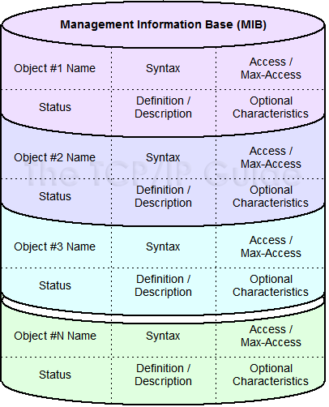
SNMP
Management Information Base (MIB)
Hierarchical collection of information that is accessed using SNMP
Comprised of managed objects
Follow Internet Engineering Taskforce (IEFT) and IEEE standards

Slide 7
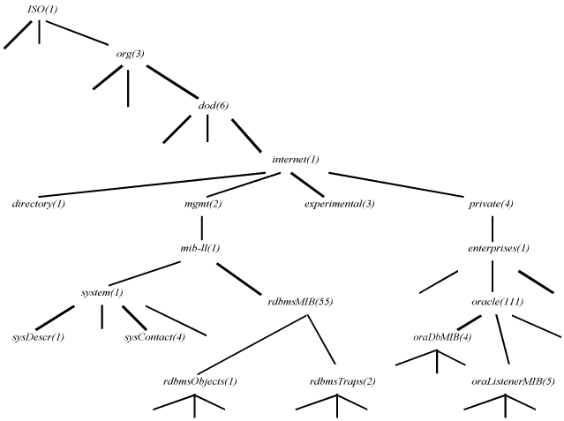
MIB Tree
Example: Oracle Database MIB

Slide 8
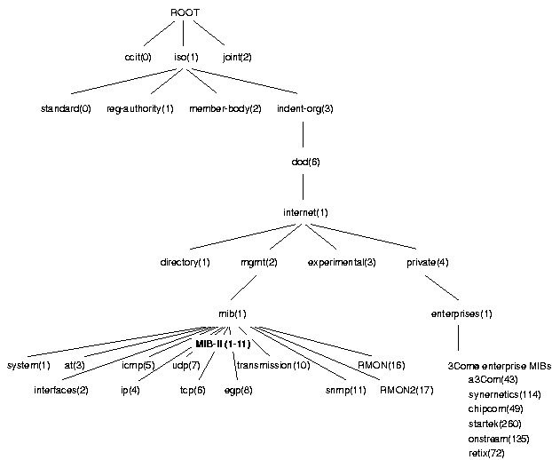
MIB Tree
Example: 3Com Network
Device MIB

Slide 9
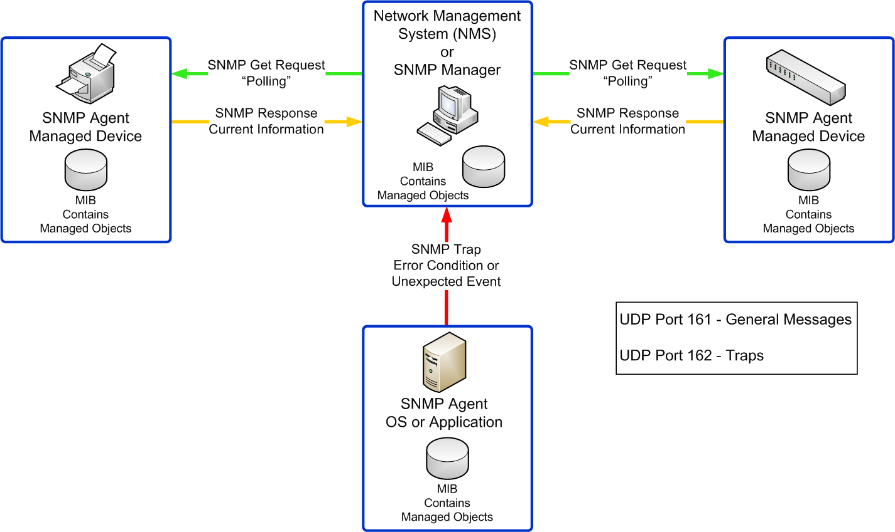
Monitoring via SNMP

Slide 10
Benefits
No IDS, IPS, or Firewall guaranteed to prevent or detect all attacks
The more information we have about our network the easier we can identify potential problems and get alerts when something bad happens
General Benefits
Spot overloaded equipment before it can bring down a network
Help determine employee productivity
Identify weak wide-area-network links and other bottlenecks
Measure latency or the delayed transfer of data
Provides executives the ammo they need to justify network upgrades
Prove SLA are being met
Security Considerations
Detect anomalous internal traffic that might indicate a security threat such as a DDOS attack
Detect overloaded systems, crashed servers, lost network connections, virus or malware infections, and power outages

Slide 11
Network Monitoring Solutions
Commercial – hardware appliances, software solutions and even outsourced service solutions (range from thousands to hundreds of thousands of dollars).
HP OpenView – $$$
CISCOWorks - $$$
SolarWinds Orion - $$
OpManager - $
WhatsUpGold - $
PRTG - $
Open Source - innovative, inexpensive, and numerous – everyone likes free! – (limited support – more difficult to setup)
Nagios – (free with optional support license)
MRTG

Slide 12
Test Bed
Nagios 3.1.2
Open Source / GPL / Free
Network services like smtp, http, dns, and ftp can be easily monitored without the use of client add-ons
3 Part Setup
Core
Plugins
NSClient++
Add-ons
Perl scripts, MIB info, etc.

Slide 13
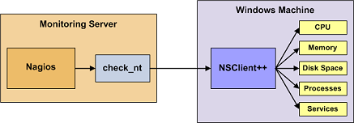
NSClient++
NSClient++
Easily monitor hosts, devices, services, protocols, and applications with Nagios

Slide 14
Test Bed
Network Management System
Ubuntu Desktop 9.04
Apache 2
PHP 5
GCC Compiler and development libraries
GD graphics library
Nagios 3.1.2 source code - sourceforge
Sample Clients
Linux Server, 2 XP Laptops, 1 Networked Printer, 1 Linux Router/Switch

Slide 15
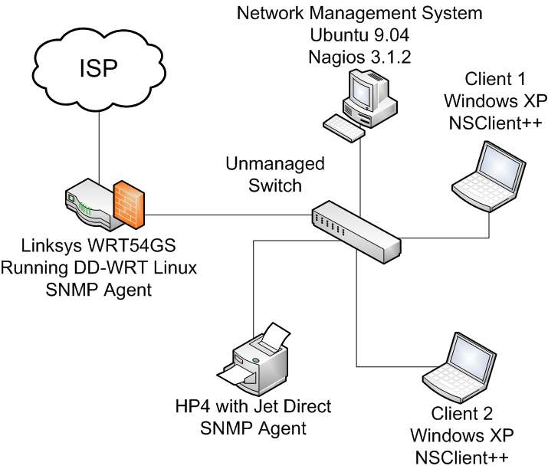
Test Bed Continued…

Slide 16
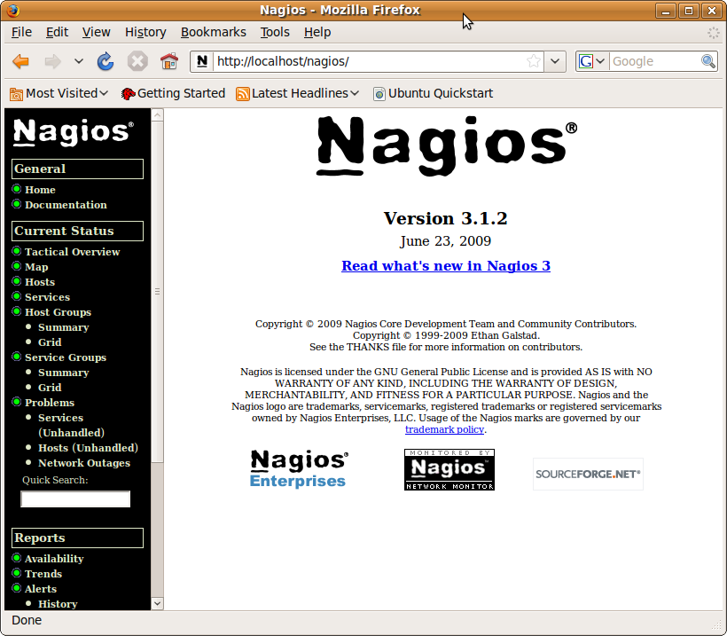

Slide 17
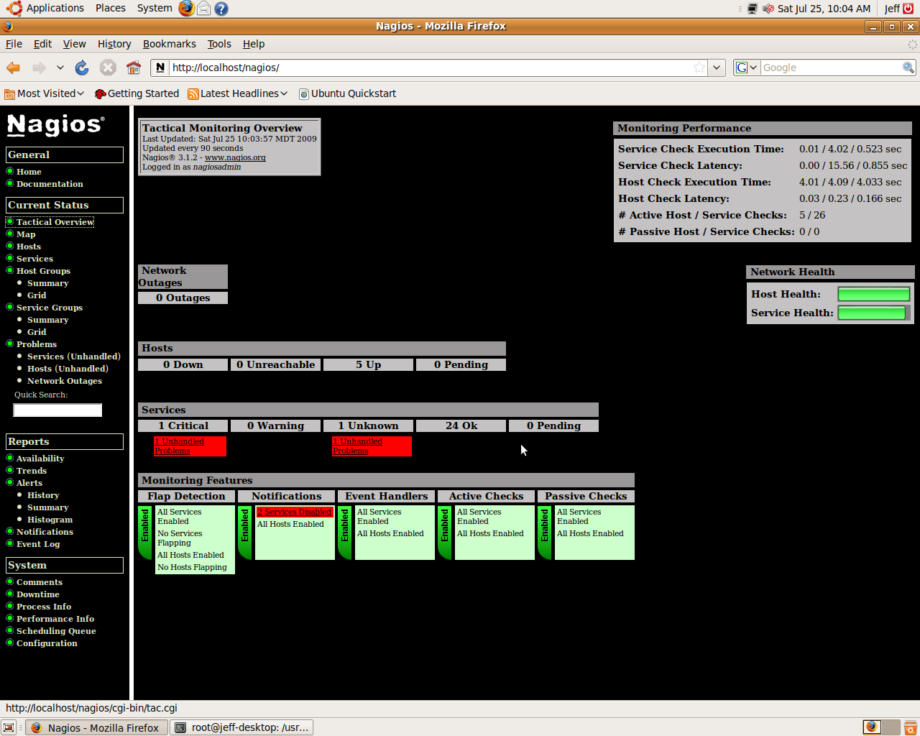

Slide 18
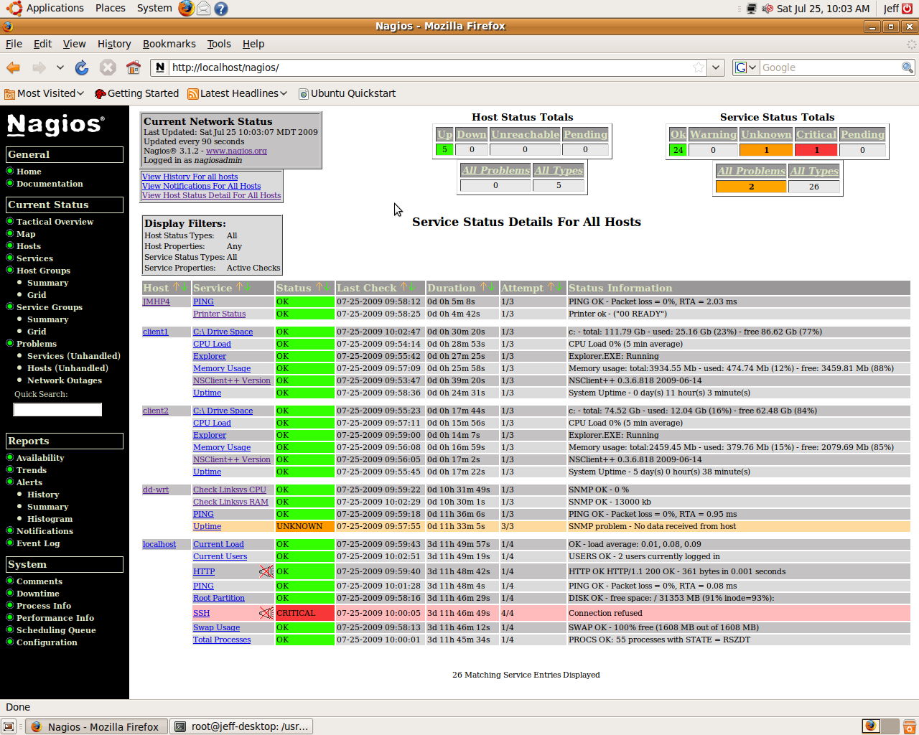

Slide 19
Linksys WRT54GS – DD-WRT
CPU check
define command{ command_name check_linksys_cpu command_line $USER1$/check_snmp -H $HOSTADDRESS$ -C public -o 1.3.6.1.4.1.2021.10.1.5.1 -u % - w 60 -c 70 }
RAM check
define command{ command_name check_linksys_ram command_line $USER1$/check_snmp -H $HOSTADDRESS$ -C public -o 1.3.6.1.2.1.25.2.3.1.6.101 -u kb -w 27000 -c 28000 }

Slide 20
Conclusion
Nagios as a monitoring solution
Large company with a big budget - commercial product would be easy to configure and support
Small to medium size company with a limited budget and enjoy the flexibility to completely customize your solution consider Nagios or another OpenSource/GPL product
Requires Linux knowledge
Requires more in-depth configuration and possibly custom coding to support specific devices
In general I would recommend a monitoring solution as an extra layer of security for any network
ROI analysis – costs will drive the solution

Slide 21
References
[1] CIO Magazine (5 Jun 2009) Network Monitoring Definition and Solutions. Retrieved Jul 13, 2009 from http://www.cio.com/article/133700/Network_Monitoring_Definition_and_Solutions
[2] Ipswitch (14 Nov 2007) White Paper: THE VALUE OF NETWORK MONITORING: Why It’s Essential to Know Your Network. Retrieved Jul 29, 2009 from http://www.whatsupgold.com/resources/whitepapers/Value_of_Network_Monitoring.pdf
[3] Landis +Gyr (2009) White Paper: Securing the Smart Grid: Gridstream Security Architecture. Retrieved June 6, 2009 from http://www.landisgyr.com/en/pub/home.cfm
[4] EMS Satcom (2008) Blue Force Tracking: System Nuances and EMS SATCOM’s Contributions. Retrieve Jul 20, 2009 from http://www.emssatcom.com/newsletters/2008/Nov/bus2.aspx
[5] Stanford SLAC (11 Mar 2001) Passive vs. Active Monitoring. Retrieved Jul 13, 2009 from http://www.slac.stanford.edu/comp/net/wan-mon/passive-vs-active.html
[6] TCPIP Guide (?) SNMP MIB Graphic. Retrieved Jul 29, 2009 from www.tcpipguide.com
[7] HP Website
[8] Wikipedia (27 Jul 2009) Comparison of network monitoring systems. Retrieved Jul 29, 2009 from http://en.wikipedia.org/wiki/Comparison_of_network_monitoring_systems
[9] Nagios (2009) Nagios. Retrieved July, 13 2009 from http://www.nagios.org/
[10] NSClient++ () Installing NSClient++. Retrieved July 23, 2009 from http://nsclient.org/nscp/
[11] Nagios () Nagios Quickstart Installation Guides. Retrieve July 23, 2009 from http://nagios.sourceforge.net/docs/3_0/quickstart.html

