Slide 1
Cloud Security
CS591
Troy Hutchison

Slide 2
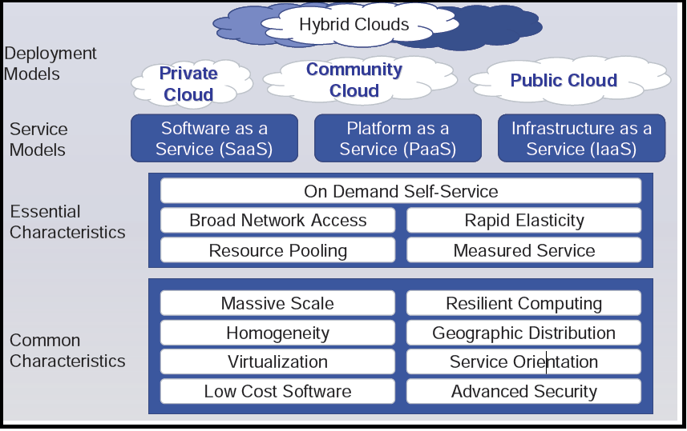
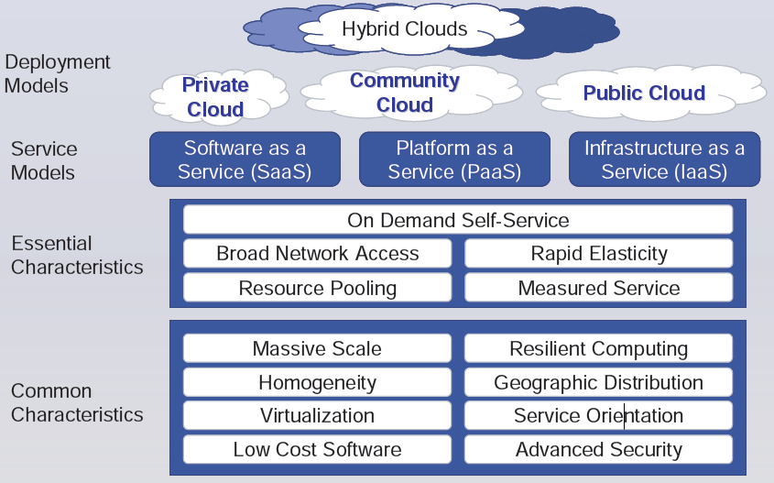
What is the Cloud

Slide 3
Certifications and Accreditations
ISO 27000 series of standards have been specifically reserved by ISO for information security matters.
Health Insurance Portability and Accountability Act of 1996 (HIPAA) Privacy and Security Rules
Federal Information Security Management Act (FISMA)

Slide 4
Pros
Improve availability through massive and redundant compute, storage, and backup facilities capable of handling bursts or spikes in utilization.
Better security than some small to medium-size businesses (SMBs) could afford to deploy themselves.
Relieve customers from the Security Management.
Include outsourced security services, such as reputation, multiple engine malware scanning, and other offerings that have potential scale economies or that benefit from cost sharing across multiple customers.

Slide 5
CONS
Multiple, conflicting “cloud” definitions
Vendor hype
Inadequate service level agreements
Lack of interoperability
Vendor lock-in
Poor transparency on security from the vendors
Inability to audit and assess

Slide 6
Recommendations
Pick your vendor wisely
Start Small
Shared responsibilities

Slide 7
Questions

