Slide 1
Overview of Digital Stenography
Sheila Jeruto Magut
CS5910,Fall 2010

Slide 2
Table of Contents
Introduction
What is Stenography
History
Stenographic Techniques
Digital Steganography Methods
Practical Uses
Comparison with Cryptography
Detection and Countermeasures
Conclusion

Slide 3
Introduction
Definition : The art and science of writing hidden messages in such a way that no one, apart from the sender and intended recipient, suspects the existence of the message
http://en.wikipedia.org/wiki/Steganography
A form of security through obscurity

Slide 4
History
Early Steganography
Early Greeks used Steganography :
Shaved head of slave and tattooed a message. When hair grew back, slave sent to deliver the message.
Inscribed message on wooden tablet and covered it with wax

Slide 5
Stenography Techniques
Physical steganography
Using a physical medium to hide messages with
Network steganography
Involves taking advantage of communication protocols
Printed steganography
Example : picture you stare at for a long time trying to see the image and your eyes finally adjust to it and you see a different shape appear out of the image

Slide 6
Stenography Techniques contd..
Digital Steganography : hiding data within data(i.e document file, image file, program or protocol)
Replacing bits/bytes that are not hidden with secret information

Slide 7
Digital Steganography Methods
Steganography in Images
Hiding information in pictures
Uses LSB (Least Significant Byte) method
Red, Green, and Blue (8 bits each) for every pixel in Bitmap image
replace last bit(s) of each RGB value with bit(s) from the secret message
or replace every nth pixel with value of message

Slide 8
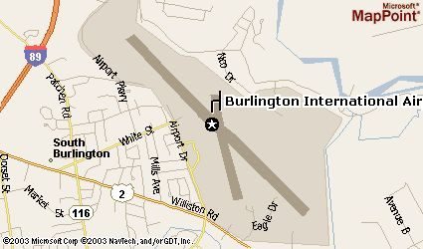
Digital Steganography Methods
Steganography in Images contd…
Example: this map of an airport……….

Slide 9
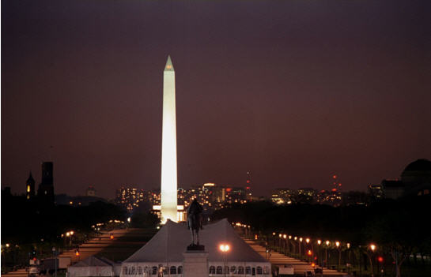
Digital Steganography Methods
Steganography in Images contd…
is embedded in this image

Slide 10
Digital Steganography Methods
Steganography in Audio
Depending on type of file
Replace last bit(s) with bit(s) from the secret message
Encode during compression

Slide 11
Digital Steganography Methods
Steganography in Other ways
Text (Null Ciphers)
Use normal text to but change every n^{th} letter of every m^{th} work
Example : “To human eyes, data usually contains known forms, like images, e-mail, sounds, and text. Most Internet data naturally includes gratuitous headers, too. These are media exploited using new controversial logical encodings: steganography and marking”
Take first letter of every word. Reads “The duck flies at midnight. Tame uncle sam”
Combining Cryptography with Steganography

Slide 12
Practical Uses
Watermarking
Identifier hidden in an image to track source
Branding/Copyright
Example: HP and Xerox printers. Tiny dots containing printer serial numbers on pages
Alleged use by terrorist
Alleged use in planning of 9/11 attacks
Alleged use by intelligence services
Alleged used by Russian foreign intelligence service to communicate with spies

Slide 13
Comparison with Cryptography
Unlike cryptography, steganography conceals the fact that hidden information exists
Different goals:
Cryptography: prevent unintended recipient from knowing intended meaning of the message
Steganography: prevent unintended recipient from suspecting that the hidden message even exists

Slide 14
Detection and Countermeasures
Very difficult to do.
Steganalysis : detection of steganographically encoded packages in computing
Some tools available
Stegdetect : compares images sets
Gargoyle : determine probability of a medium being encoded

Slide 15
Conclusion
Steganography ancient but still very much in use
Digital advancement brings new methods of digital steganography
Not to be confused with cryptography
Cryptography : security through encryption
Steganography : security through obscurity

