Slide 1
Tor: anonymous browsing
By:
Bryan Carey
Randy Cook
Richard Jost

Slide 2
Anonymity online
Protect personal freedom and privacy
Defend yourself against network surveillance and traffic analysis
Circumvent and avoid censorship from governments/parties in power
Claimed to be used by: Common users, businesses, activists, media, and military

Slide 3
Tor
Open source
A network of virtual tunnels
Solves 3 important privacy problems:
Prevents websites and other services from learning your location
Prevents eavesdroppers from learning what information you’re fetching and where from
Routes connections through multiple Tor servers so no single server can learn what you’re up to

Slide 4
How it works
User will obtain a list of all Tor nodes from a directory server
In doing this, network transactions are distributed over several places on the Internet
Once a list of Tor nodes are obtained, a random path is taken via several relays that cover your tracks
An observer at any single point cannot tell where the data came from or where it’s going
No single relay ever knows the complete path a data packet has taken
For efficiency, Tor will use the same path for connections that happen within the same 10 minutes. Later requests are given a new path

Slide 5
HOW IT WORKS (CONT)
Uses multi-layer encryption so that anywhere within the Tor network the packet cannot be deciphered (without proper keys)
Creates a SOCKS proxy so that any application that can take advantage of SOCKS can send it’s traffic through the Tor network thus encrypting the data and obfuscating the point of origin.

Slide 6
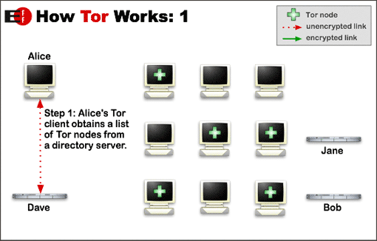
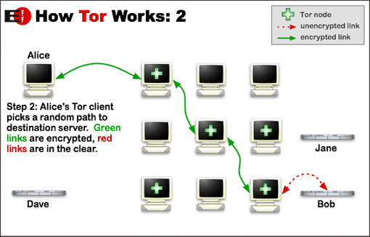
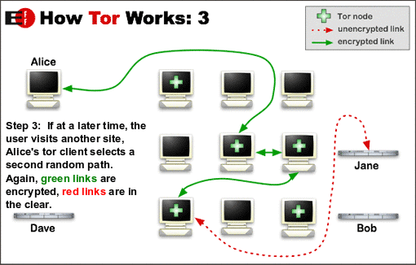
How it works (CONT)

Slide 7
Hidden services
Services such as instant messaging or web publishing can be made hidden with Tor
Using Tor “rendezvous points,” other Tor users can connect to these services without knowing the other’s network identity
For example:
A website could be hosted by a Tor user. He or she would not have to worry about censorship, because no one would be able to determine who was offering the site, and nobody who offered the site would know who’s posting to it.

Slide 8
HIDDENT SERVICES (CONT)
Server IP is actually never revealed by the use of Psuedo Top Level Domains (TLD)
These TLDs cannot be accessed without a Tor client (so visiting them in a normal browser will present a 404 error)
Allows a server to host a service in a potentially censored environment without compromising the server’s location and the identity of the administrator

Slide 9
Staying anonymous
Although it helps greatly, Tor can’t solve all anonymity problems
You still obviously need to have common sense.
Tor does not magically anonymize all traffic
Tor only provides protection for the transport of data, so you can be affected by:
Things you say (ie: posting personal information)
Information applications you use leak about you (Java, Flash, ActiveX, JavaScript)
Cookies (if you were browsing without using Tor, then started using Tor again)

Slide 10
Risks
The Tor network is still relatively small, and it’s probably possible that a powerful attacker could trace users, although it’s obviously much safer than using direct connections
Malicious or misconfigured Tor nodes can send you to a wrong page, or send you malicious applets disguised as domains you may trust
“End-To-End Correlation” - Relating the time a packet was sent from a node and received by a client.

Slide 11
RISKS (CONT)
Exit-Node Monitoring – If a user doesn’t use an SSL connection and logs into an email/bank/etc account it’s possible for the operator of the Exit Node to capture that information
In 2007 Dan Egerstad (Swedish security consultant), revealed that he had intercepted usernames and passwords for a large number of email accounts by operating and monitoring Tor Exit Nodes.
Essentially the same amount of danger of connecting to an “open” un-secure and un-encrypted wifi and accessing the same data

