Slide 1
Electronic Voting (E-Voting) An introduction and review of technology
Written By:
Larry Brachfeld
CS591, December 2010

Slide 2
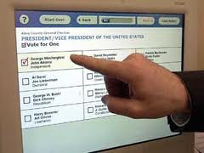
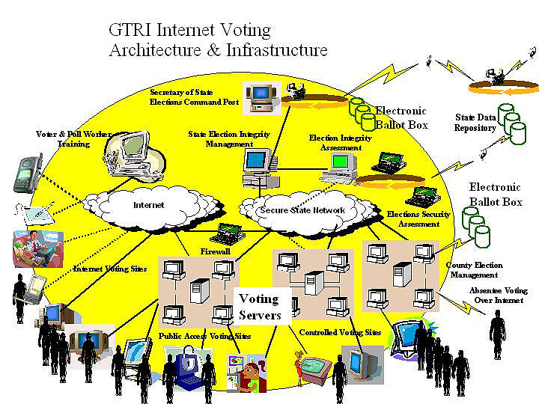
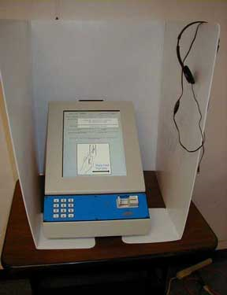
Electronic Voting Examples
Notes:
Example from Georgia Tech Research News, 2001

Slide 3
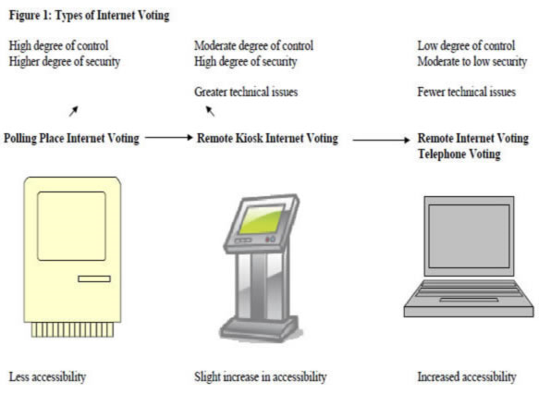
Types of Electronic Voting
Notes:
Kiosk Internet Voting: Voting at your designated polling location using a computer under the physical control of election officials to cast a ballot over the Internet
Polling Place Internet Voting: Voting at any valid polling location using a computer under the physical control of election officials to cast a ballot over the Internet
Remote Internet Voting: Voting by using a computer that is not under the physical control of election officials and the ballot is cast over an Internet connection
There are no assurances that non-internet based voting systems, to include voter registration, poll site voting, and absentee voting systems are “secure”

Slide 4
Internet Voting Issues
Voter authentication: determining that a ballot arriving at the vote server really is from the registered voter it purports to be from;
Ballot privacy: preserving the secrecy of the ballot that no unauthorized person can read the ballot, and no one can associate a ballot with the person who cast it;
Ballot integrity: guaranteeing that ballots cannot be surreptitiously changed by any software agent or third party;
Reliable vote transport and storage: guaranteeing that no ballot is either created or destroyed (lost) anywhere from the vote client to the vote server without detection, and no ballots at all are created or destroyed (lost) at all from the vote servers to the vote canvass computers;
Prevention of multiple voting: no more than one ballot may be counted for any one voter;
Defense against attacks on the client: guaranteeing that there is no malicious software (Trojan horse, virus, etc.) on the client that can affect the integrity or privacy of the ballot;
Defense against denial of service attacks on vote servers: dealing with deliberate attacks intended to control, crash, or overload the vote servers or the networks they are attached to.
Notes:
Kiosk Internet Voting: Voting at your designated polling location using a computer under the physical control of election officials to cast a ballot over the Internet
Polling Place Internet Voting: Voting at any valid polling location using a computer under the physical control of election officials to cast a ballot over the Internet
Remote Internet Voting: Voting by using a computer that is not under the physical control of election officials and the ballot is cast over an Internet connection
There are no assurances that non-internet based voting systems, to include voter registration, poll site voting, and absentee voting systems are “secure”

Slide 5
Electronic Voting Requirements
Functional (General) Requirements
Provide all required services for organizing and conducting the voting process
Support all users
Support different types of voting processes (e.g. General elections and primaries)
Scalable for multiple elections
Ensure only eligible voters vote, only 1 vote per person, vote is secret, every vote is counted

Slide 6
Electronic Voting Requirements
Security Specific Requirements
Accuracy/Correctness: Votes are unalterable, all valid votes are included in the final tally
Privacy: Nobody should be able to link a voter’s identity to the vote
Zero-proof: Sometimes called Uncoercibility; no voter should be able to prove to others how he voted (even if he wants to) and you shouldn’t be coerced into revealing your vote
Verifiability: There are mechanisms for auditing the election to ensure it has been properly conducted

Slide 7
Commercially Available E-Voting Systems
VoteHere.net is a private company established in 1996 as a provider of Internet voting (www.VoteHere.net )
BigPulse excels with difficult and complex high security online voting and elections when no others can satisfy (bigpulse.com)
Australian System called eVACS, or Electronic Voting and Counting System created by a company called Software Improvements to run on Linux
based on specifications set by independent election officials who posted the code on the Internet for all to see and evaluate. What's more, it was accomplished from concept to product in six months. It went through a trial run in an Australian state election in 2001
Election Systems & Software an industry leader in providing end-to-end integrated election solutions — supporting every phase of the election process (ESSVote.com)

Slide 8
Internet Voting PKI & Biometric Opportunities
Using PKI & Biometrics to mitigate the security specific requirements
Accuracy/Correctness: PKI with the addition of a Biometric factor provides more confidence that the vote you cast is in fact yours and has not been altered, non-repudiation
Privacy: Using a combination of both PKI and Biometrics to encrypt the vote will help ensure that nobody can read your vote, however there will be assurance that the vote you cast is yours

Slide 9
Electronic Voting
Summary
From a technological perspective, Electronic Voting is no different from traditional voting
There is a ballot, vote recording mechanism, ballot boxes, and vote counting equipment
However, given how critical our voting system is to our Democratic way of life, it requires significant public assurance that it is at least as safe as current voting methods
A combination of PKI and Biometric Technology with an Electronic Voting System may accomplish this

