Slide 1
Vulnerability Scanning
Greg Williams

Slide 2
IT Security Program
Objective is to maintain integrity of University systems
Minimum Security Standard

Slide 3
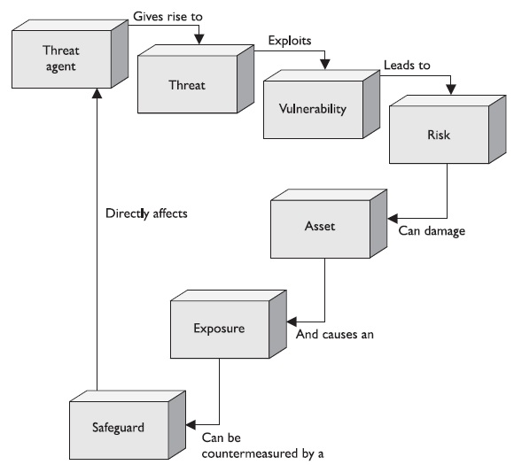
Why Scan? An example

Slide 4
Planning for a scan
Is the scan going to be on production services?
How do I want it scanned?
Do I have the man power to fix something right away (you knew about it, why didn’t you fix it)?
What monitoring do I have in place and how do I watch it in case something goes wrong?
Are there subnets that have specialized servers that need to be scanned for compliance?

Slide 5
Nessus
Vulnerability Scanner
Scans Windows, *nix, network infrastructures for known vulnerabilities
Web scanning – directory traversal, CGI vulnerability scanning
Compliance scanning – PCIDSS, DISA, CERT, NIST, GLBA, HIPAA
Ability to scan zero-day exploits

Slide 6
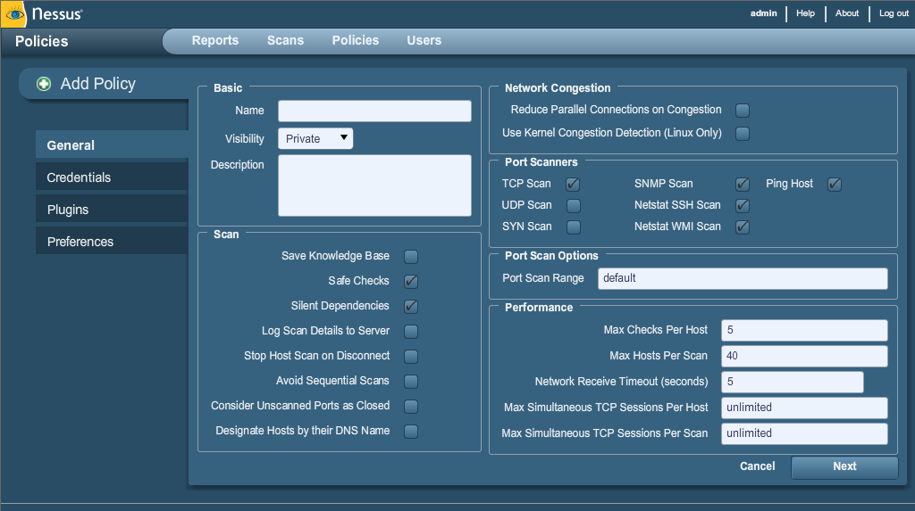
Nessus con’t

Slide 7
Nessus con’t
Safe Checks – Turns off possibly unsafe operations performed during scan.
Authentication – Ability to check the server fully via SMB, Kerberos, Windows, SSH
Plugins – Turn on or off specific types of scans
Preferences – Granular checks (DB, Web including HTTP form authentication, CGI scans, etc)

Slide 8
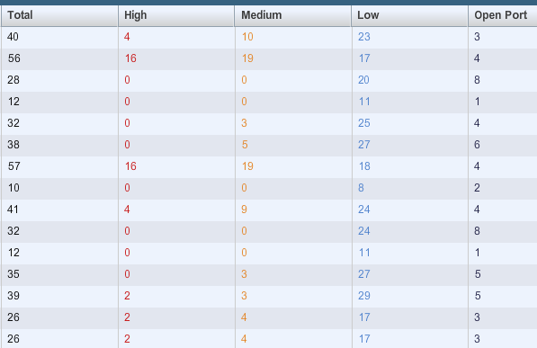
Nessus Reporting

Slide 9
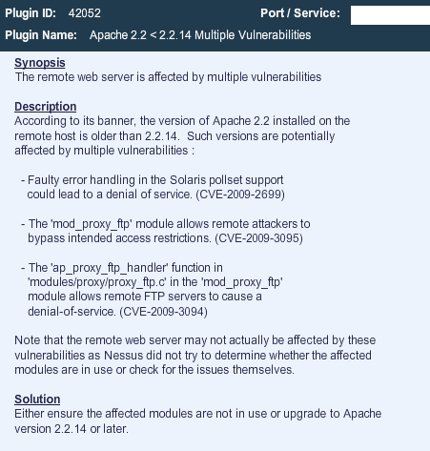
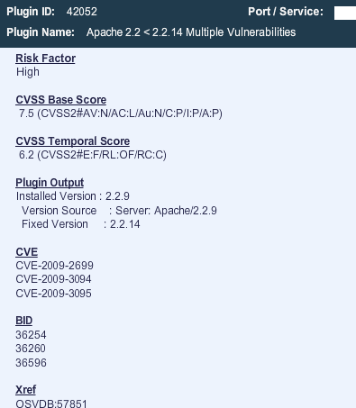
Nessus Reporting con’t

Slide 10
What do you do after reporting
OS Patching
Coding changes
Turn off ports

Slide 11
Maintain integrity
Fine tune scanning – if you aren’t logging into the server to check for vulnerabilities, you should be
Setup a scanning schedule, include systems that aren’t a high risk. Scan after a patch (2 days after Microsoft Tuesday)
Develop a baseline and scan immediately after a server comes online

Slide 12
Questions?

