Slide 1
Vulnerability Scanning
Greg Williams

Slide 2
IT Security Program
Objective is to maintain integrity of University systems
Minimum Security Standard

Slide 3
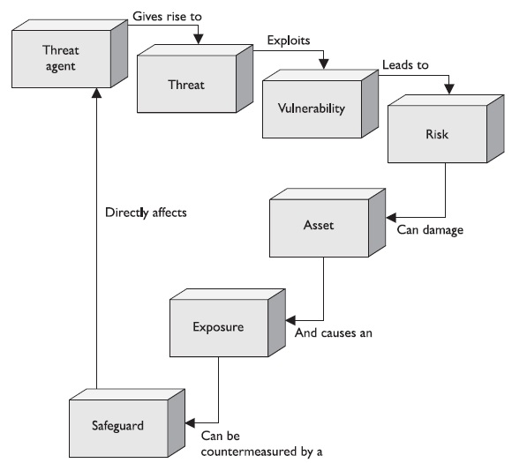
Why Scan? An example

Slide 4
Planning for a scan
Questions to consider:
Is the scan going to be on production services?
How do I want it scanned?
Do I have the man power to fix something right away (you knew about it, why didn’t you fix it)?
What monitoring do I have in place and how do I watch it in case something goes wrong?

Slide 5
Nessus
Vulnerability Scanner
Scans Windows, *nix, network infrastructures for known vulnerabilities
Web scanning – directory traversal, CGI vulnerability scanning
Compliance scanning – PCIDSS, DISA, CERT, NIST, GLBA, HIPAA

Slide 6
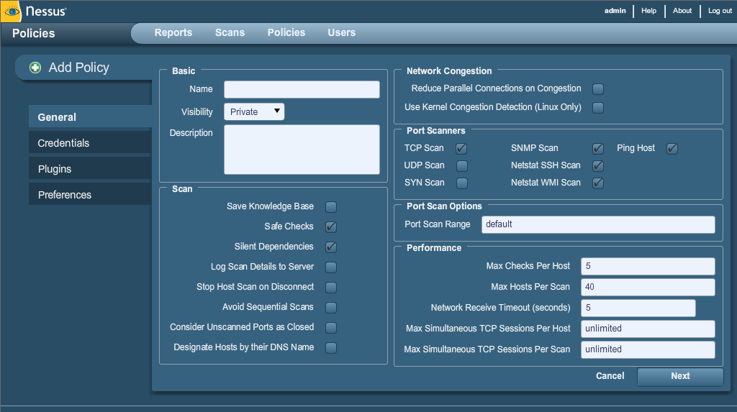
Nessus con’t

Slide 7
Nessus con’t
Safe Checks – Turns off possibly unsafe operations performed during scan.
Authentication – Ability to check the server fully via SMB, Kerberos, Windows, SSH
Plugins – Turn on or off specific types of scans
Preferences – Granular checks (DB, Web including HTTP form authentication, CGI scans, etc)

Slide 8
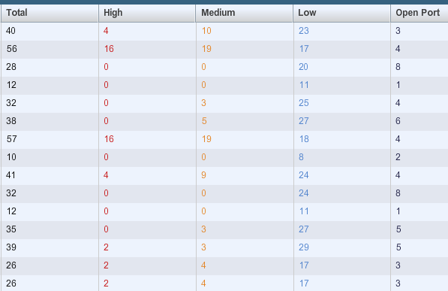
Nessus Reporting

Slide 9
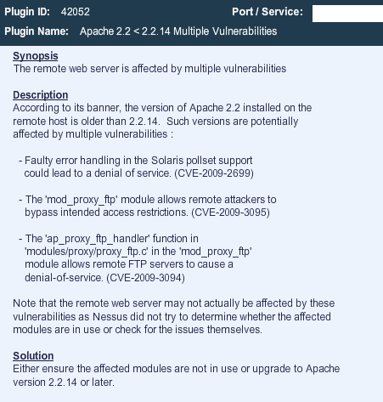
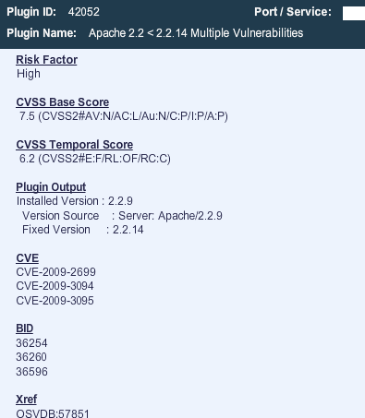
Nessus Reporting con’t

Slide 10
What do you do after reporting
OS Patching
Coding changes
Turn off ports
Develop metrics

Slide 11
Questions?

