Slide 1
State of RFID Security
Presentation for CS 5910 – Network Security
UCCS, Fall Semester 2010
Presented by Robin Kimzey & George Mudrak

Slide 2
What is RFID?
Radio Frequency Identification
Roots in WWII radar systems discovered by Sir Robert Alexander Watson-Watt in 1935. Initially passive.
Uses radio waves to convey data between a reader and transmitter.
Comes in three flavors:
Passive – requires power and prompt
Semi-passive – self-powered and requires prompt
Active – self-powered and always broadcasts
Commercial tracking technology
4 Operating Frequencies
Very low frequency (LF) 50 500 Khz
High frequency (HF) 13.56 Mhz
Ultra high frequency (UHF) 860 960 Mhz
Microwave 0.9 2.5 Ghz
UCCS CS 591 Network Security, Fall 2010
Robin Kimzey and George Mudrak

Slide 3
RFID Attributes?
Type
Passive – needs power – antenna/reader, requires a ‘start’ signal
Semi-Passive - self-powered – battery, requires a ‘start’ signal
Active - self-powered – battery, openly broadcasts
Memory
Read-only, read/write, WORM (write once, read many)
Capacities – 20+ bits, can go to 128 Mb!*
FeRAM (FerroElectric Ram)
Magnetic safe, fast write, low power needs, non-volatile, keeps state without power.
Detection Range
Minimum range ~1 foot. (Supposed) maximum range: 300 feet.
To increase your detection range, typically increase power to your antenna. Also using a higher frequency aids.
Typical ranges are in the 1 foot to 100 foot range.
*TOSHIBA develops world’s highest-bandwidth, highest density non-volatile RAM. 2009 article.
UCCS CS 591 Network Security, Fall 2010
Robin Kimzey and George Mudrak

Slide 4
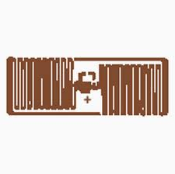
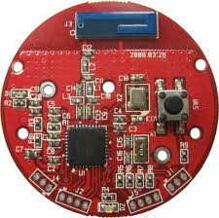
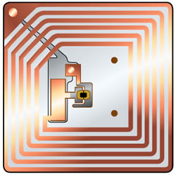
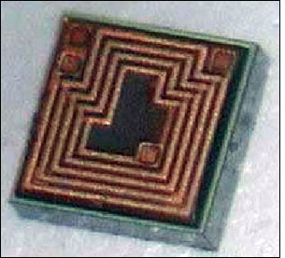
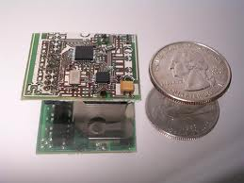
What do they look like?
Passive Tags
Active Tags*
.
Gen2 Tag
*Active tags are not that far off from being embedded controllers. To better understand the impact of embedded controllers, you can read “Embedded Systems Security” by Michael Kopps and George Mudrak.
UCCS CS 591 Network Security, Fall 2010
Robin Kimzey and George Mudrak

Slide 5
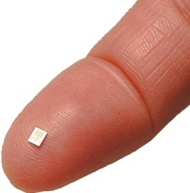
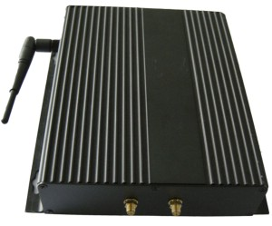
Passive Tag Example
RFID Tag (transponder)
RFID Antenna
Processing computer
RFID Transceiver
UCCS CS 591 Network Security, Fall 2010
Robin Kimzey and George Mudrak

Slide 6
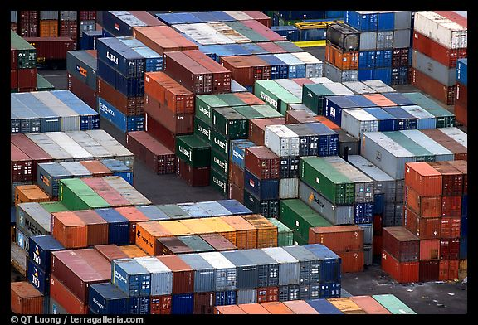
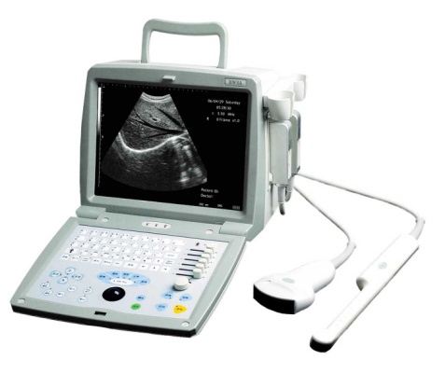
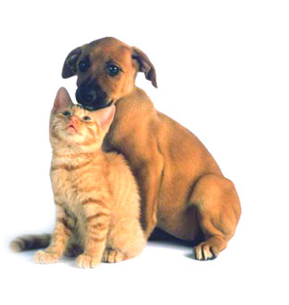
Where is it used?
UCCS CS 591 Network Security, Fall 2010
Robin Kimzey and George Mudrak

Slide 7
How secure & robust is it?
Not very*…
Robust
Active tags be drained by repeated query.
Easy to interfere with – radio frequencies.
Tamper Proof
Easy physical access
Easy to circumvent - easily removed, damaged
Physically circumvented – put different products in container
Secure
Consumer tags do not have encryption.
Tags cannot discriminate between readers.
Tags can be scanned without your knowledge.
Never designed to transmit secure data.
* The original intent and design of RFID was never meant to account for how it is used today…data carriers, micro-tagging, etc.
UCCS CS 591 Network Security, Fall 2010
Robin Kimzey and George Mudrak

Slide 8
How can it be hacked?
Specific frequencies necessary for some products. known range - faster to hack. i.e. low & high freq in metal / water.
“Zombie” tags that can re-activate.
“Sniffer” can activate a passive tag and capture it’s data.
Tags with writable memory can be written to.
RF card writers are available, writer simply has to be in proximity of the tag and not physically in possession.
Physically remove the tag!!
UCCS CS 591 Network Security, Fall 2010
Robin Kimzey and George Mudrak

Slide 9
Why should you care?
Your privacy is at stake!
New forms of identity theft
corporate you
International you
New forms of profiling you.
What you buy.
What you have on you.
Law Enforcement
Financial
“in the open” credit cards (secure code not a plus).
‘impersonation’ transactions.
To prevent active tag’s can refresh the key with every transaction.
Our thought – new RFID transaction details generated and ‘submitted later’.
UCCS CS 591 Network Security, Fall 2010
Robin Kimzey and George Mudrak

Slide 10
For Real?!
Organic Ink*
We are impressed with organic ink! We will be more impressed if it is implemented thereby saving much money for RFID tags. Parelec Inc. has developed ink chemistry that suspends the metallization in an organic carrier that decomposes after printing leaving a 99% pure metal coating. The company states that their organic ink is “3 to 10 times more conductive than polymer-based inks.”
Kovio, a San Francisco firm, says that it expects to create printed-silicon high-frequency RFID chips by the end of 2008, paving the way to low-cost tags.
*http://www.rfidnews.org/2008/10/14/recent-advances-in-rfid
UCCS CS 591 Network Security, Fall 2010
Robin Kimzey and George Mudrak

Slide 11
Questions?
UCCS CS 591 Network Security, Fall 2010
Robin Kimzey and George Mudrak

