Slide 1

“Cloud Computing”
Is your INFORMATION secure
Beaulah Aloysius
CS591 – Fall 2010
Prof: Dr. Chow
Semester Project Presentation

Slide 2
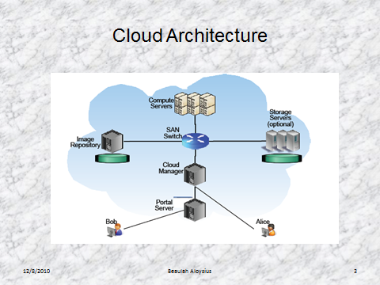
Why Cloud ?
Based on 5 important attributes:
Multi-tenancy ( shared resources)
Massive Scalability
Elasticity
Pay as you go
Self-Provisioning of resources

Slide 3
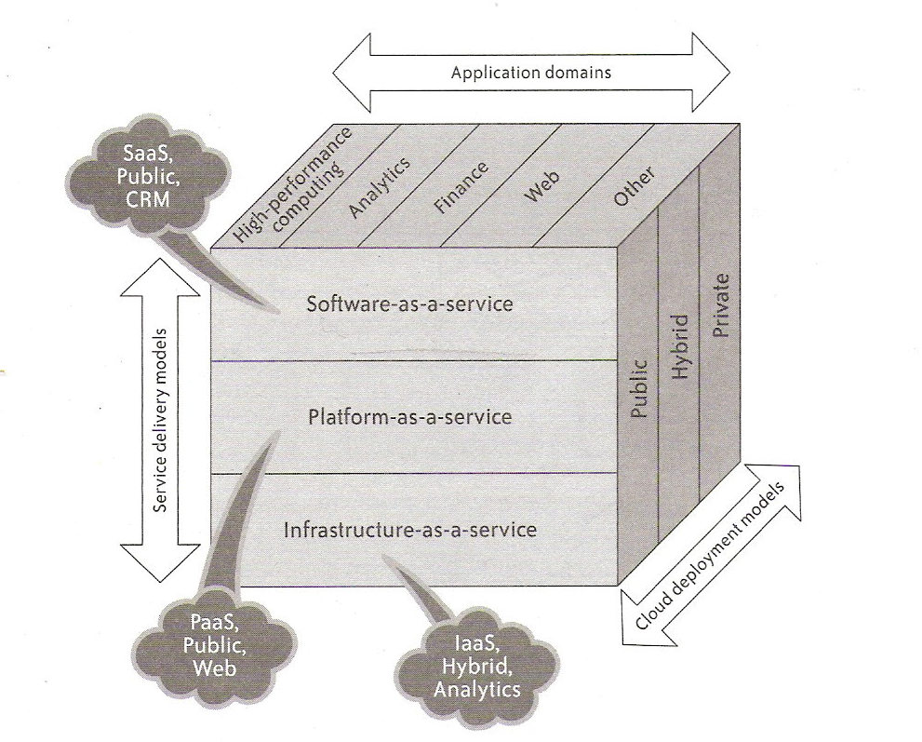
SPI Model

Slide 4
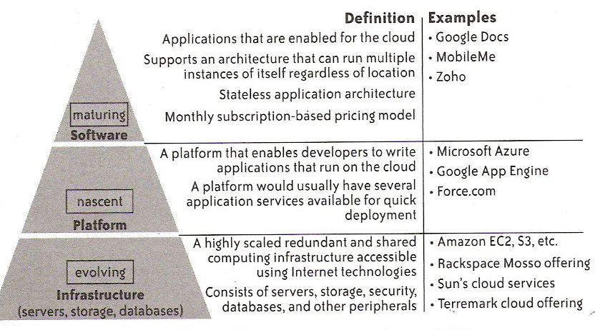
Cloud Launches

Slide 5
Security
Infrastructure Security
  Network Level
  Host Level
  Application Level
Data Security
  Data-in-Transit
  Data-at-Rest
  Data lineage
  Data Provenance
  Data Remanence

Slide 6
Threats
Abuse and Nefarious Use of Cloud Computing
Ex: Anyone with valid credit card
2. Insecure Interfaces and APIs
Ex: Reusable Tokens, improper authorization
3. Malicious Insider
4. Shared Technology Issues
Ex: No Isolation
5. Data Loss or Leakage
Ex: Insufficient authentication

Slide 7
Exploring Information Leakage in Third-Party Compute Clouds – M.I.T Test Bed
Determine where in the cloud infrastructure an instance is located
Easily determine if two instances are co-resident on the same physical machine
Attacker launch instances that will be co-resident with other user’s instances
Attacker exploit cross-VM information leakage once co-resident
Amazon : EC2
2-regions
3-availability Zones
5 instance type:
  m1.small
  c1.medium
  m1.large
  m1.xlarge
  c1.xlarge

Slide 8
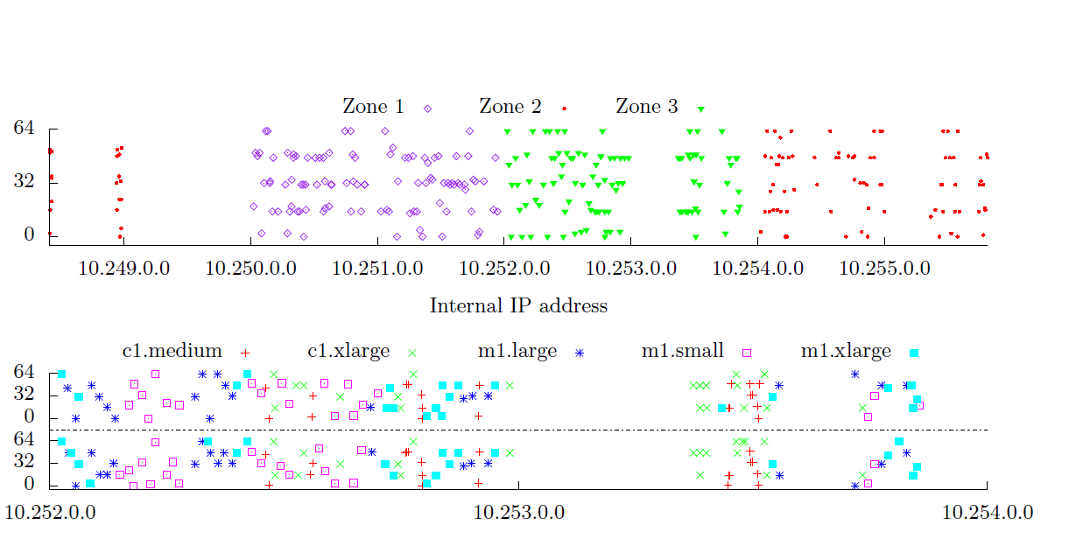
-more
Network probing ( nmap, hping, wget) – both to identify public services hosted on EC2 and to provide evidence of co-residence.
EC2 map – Cloud cartography (internal Ip address are statically associated to avail zone and instance type )

Slide 9
Co- residence check
Namely, instances are likely co-resident if they have
(1) matching Dom0 IP address,
(2) small packet round-trip times, or
(3) numerically close internal IP addresses
EC2:
No 2 instance of same account running simultaneously( so n instance run in n separate machines)
no more than 8 instance could be co-resident ( small )
Placement Locality:
Sequential – Instance running sequentially are assigned to same physical machine
Parallel – 2 diff instance run at the same time, assigned to same physical machine
VM-Leakage:
Not just the data cache but any physical machine resources - network access, CPU branch predictors and instruction cache ,DRAM memory bus, CPU pipelines, scheduling of CPU cores and time slices, disk access ,etc

Slide 10
VM-Leakage
VM-Leakage:
Not just the data cache but any physical machine resources - network access, CPU branch predictors and instruction cache ,DRAM memory bus, CPU pipelines, scheduling of CPU cores and time slices, disk access ,etc
Methods:
Measuring cache utilization : Prime+Probe technique
Estimate the traffic rates
Key stroke attack – timing when typing the password and recover it

Slide 11
Incidents
Example:
WWW.Dropbox.com
Security Issue:
Open door for vulnerability
Proposed
Filters on publisher and user Virtual Image
Isolated VM watcher along with VMM

Slide 12
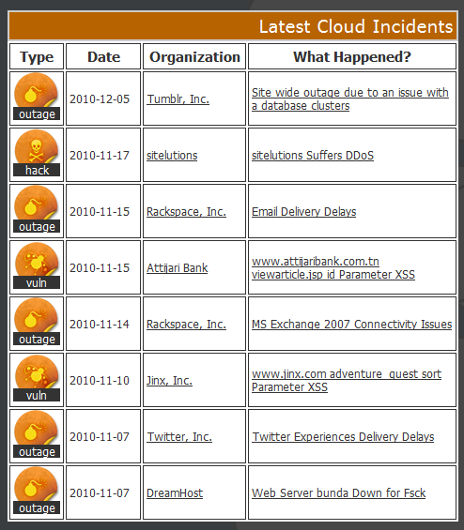
Incidents

Slide 13
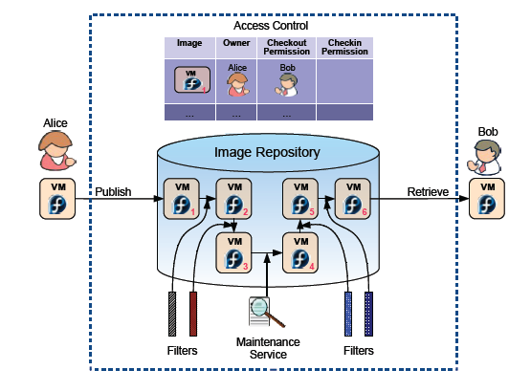
IBM - Proposed

Slide 14
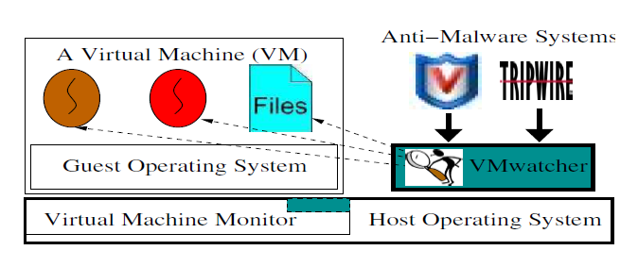
VM Watcher

Slide 15
Suggested Reading
Hey, You, Get Off of My Cloud: Exploring Information Leakage in Third-Party Compute Clouds, CCS’2009.
http://cseweb.ucsd.edu/~hovav/dist/cloudsec.pdf

