Slide 1
Elliptic Curve Cryptography:
Keeping the Smart Grid Secure

Slide 2
What is the Smart Grid?
A smart grid delivers electricity from suppliers to consumers using digital technology to monitor (and optionally control) appliances at consumers' homes.
Utilize devices that connect a power source (e.g. a wall outlet) to an appliance. These devices would report:
times an appliance was used
reporting the amount of energy consumed

Slide 3
Current Government Funding
US Government has awarded smart grid grants providing for the installation of:
more than 2.5 million smart meters.
more than 1 million in-home energy displays
170,000 smart thermostats
more than 200,000 smart transformers,

Slide 4
Privacy Concerns
Consumer electronics devices now consume over half the power in a typical US home.
The ability to shut down or hibernate devices when they are not being used could be a major factor in cutting energy use.
This would mean the electric company has information on personal consumer habits.
Theelectric company could begin making educated guesses on what appliances can be adjusted.

Slide 5
Example
A computer is left on twenty-four hours a day.
Is the computer being used?
Is it simply a screen saver?
The electric company could, at their discretion, decide your computer is not being used and turn it off for you.

Slide 6
Residential Smart Grid Architecture
Basic client-server scheme
Monitoring device failure should not have an adverse effect on the rest of the network
Computing power of the residential SGD must minimal
Must allow for potentially long periods of hibernation

Slide 7
ZigBee End Device (ZED)
The ZED contains just enough functionality to wirelessly talk to the parent node
extremely low power consumption
ability to accommodate long hibernation times
simplicity
low cost
Wi-Fi and Bluetooth provide a greater bandwidth, ZigBee's lower power consumption/long battery life make up for the slower 250 kbps.

Slide 8
Securing the Wireless SGDs
wireless transmission of power usage relegated to within the house
personal information must be made secure
data encryption, which uses symmetric key 128-bit advanced encryption standard
To make encryption less processor intensive, use Elliptic Curve Cryptography

Slide 9
The Math Behind the Ellipse
An elliptic curve over real numbers may be defined as the set of points (x,y) which satisfy an elliptic curve equation of the form:
y² = x³ + ax + b
For example, let constants a= - 4 and
b = 0.67, yielding the equation:
y² = x³ - 4x + 0.67

Slide 10
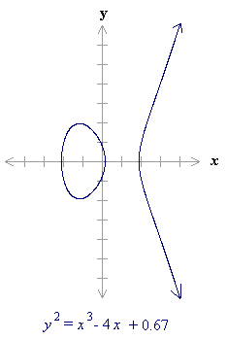

Slide 11
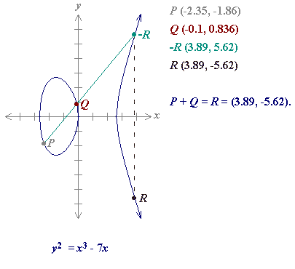
adding distinct points P and Q

Slide 12
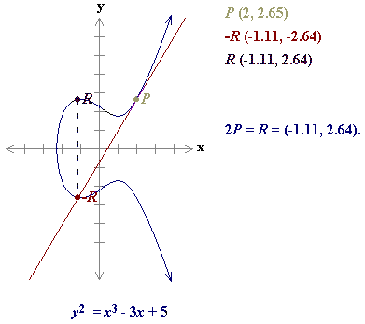
Doubling the point P
P + P = 2P = R

Slide 13
The Discrete Logarithm Problem
At the heart of every encryption/decryption system is a very difficult math problem.
The success of a cryptosystem lies in the extreme low probability that a hacker can solve the problem in a timely manner.
The Discrete Logarithm Problem is such a mathematical problem and is the basis of the Elliptic Curve Cryptosystem.
"discrete" means we are working with integers

Slide 14
The Discrete Logarithm Problem
If we are given an elliptic curve group, we are interested in determining the elliptic curve discrete logarithm problem.
Equivalent to finding a scalar multiple of point P.
Given points P and Q in the group, find a number, k, such that Pk = Q.
Here, the value k is called the discrete logarithm of Q to the base P.

Slide 15
Discrete Logarithm Example
y² = x³ + 9x + 17 over F₂₃
Q = (4,5)
P = (16,5)
Determine the discrete logarithm k
Although intractable, this problem is small, so we can determine a solution by listing out the first few multiples of P until we come up with Q.

Slide 16
Multiples of P
P = (16,5)
2P = (20,20)
3P = (14,14)
4P = (19,20)
5P = (13,10)
6P = (7,3)
7P = (8,7)
8P = (12,17)
9P = (4,5)
9P = (4,5) = Q
we can conclude that the discrete logarithm of Q to the base P is k = 9.

Slide 17
Another Example
consider the elliptic curve group described by y² = x³ - 5x +4.
We must find the discrete logarithm of the following points:
Q_{x} = -.35, Q_{y} = 2.39
P_{x} = -1.65, P_{y} = -2.79
In other words, Q = (-.35, 2.39)
P = (-1.65, -2.79)

Slide 18
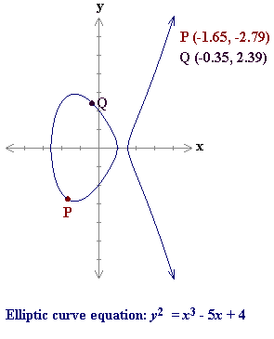

Slide 19
Using point P, we then double this point to give 2P.
P + 2P = 3P
We continue this process until we find (hopefully) the point Q, our final solution.
P + 6P = 7P = (-.35,2.39) → (take my word for it).
Therefore, the logarithm is 7.

Slide 20
Example of Using Elliptical Curve Public-Key Cryptography
Bob
Jane
k is randomly chosen private key
Elliptic Curve
P
Pk = Q
Q
Jane gets public-key from Bob

Slide 21
Example of Using Elliptical Curve Public-Key Cryptography
Jane gets Bob’s public key and generates her own temporary key pair.
Jane uses her private key and Bob’s public key to generate a secret point on the curve.
Jane uses the x-coordinate of this new point as a session id.
To read an encrypted message, Bob needs the session key, which he gets by combining his private key with Jane’s temporary public key.

