Slide 1
SELinux using SLIDE
Shane Jahnke
CS591
December 7, 2009

Slide 2
Overview
What is SELinux?
Changing SELinux Policies
What is SLIDE?
Reference Policy
SLIDE
Installation and Configuration
Irssi Example
Conclusions

Slide 3
What is SELinux?
SELinux (Security-enhanced Linux)
Developed by the NSA
Research Partners: NAI Labs, SCC, MITRE
Reference policy of the Flask security architecture
Enforces mandatory access control policies
Type Enforcement (TE)
Role-based Access Control (RBAC)
Multi-level Security (MLS)
Availability
Mainstreamed into Debian, Ubuntu, RHEL, Fedora, Gentoo
Ported to Solaris and FreeBSD

Slide 4
SELinux Contexts
Processes and files are assigned a context.
User: identity known to policy that is authorized for a specific set of rules
Role: users are authorized for roles, and roles are authorized for domains
Type: defines a domain for processes, and a type for files.
Level: (optional) used with MLS restrictions

Slide 5
Changing SELinux Policies
To make policy changes:
Use Booleans, if possible
Runtime change, no need to reload/recompile
Configurable without knowledge of policy writing
Example: httpd using NFS/Samba file types
Match file context with domain
Use man <httpd,nfs,samba>_selinux
Example: sharing directory using Samba

Slide 6
Changing SELinux Policies (cont.)
To make policy changes:
Audit2allow
Allows rule from logs of denied by Access Vector Cache (AVC)
Example: audit2allow -w -a (creates packaged policy file for installation)
Create policy (using SLIDE)

Slide 7
What is SLIDE?
SELinux Policy Integrated Development Environment
Developed by Tresys Technology
Eclipse Plugin
Integrates with Reference Policy
Makes SELinux policy development easier

Slide 8
SLIDE Features
Project/Module creation wizards
Auto-completion of interface names
Simplifies compilation and building module packages
Integrated remote policy installation and audit log monitoring
Supports both modular and monolithic policy development

Slide 9
Reference Policy (refpolicy)
Based on NSA example policy
Actively developed by Tresys Technology
Complete SELinux policy
Basis for creating policies within SLIDE

Slide 10
Installation & Configuration
Installed Fedora 12 distribution
Packages Needed:
eclipse-slide (Eclipse with plugin)
slideRemote-moduler (for policy testing)
SSH Server (for policy testing)
setools-console (optional GUI console)
Used selinux-policy-3.6.32-49
Downloaded src (refpolicy) for use with SLIDE

Slide 11
Irssi Tutorial Example
Text-mode IRC client
Create new “irssi” policy module using reference policy

Slide 12
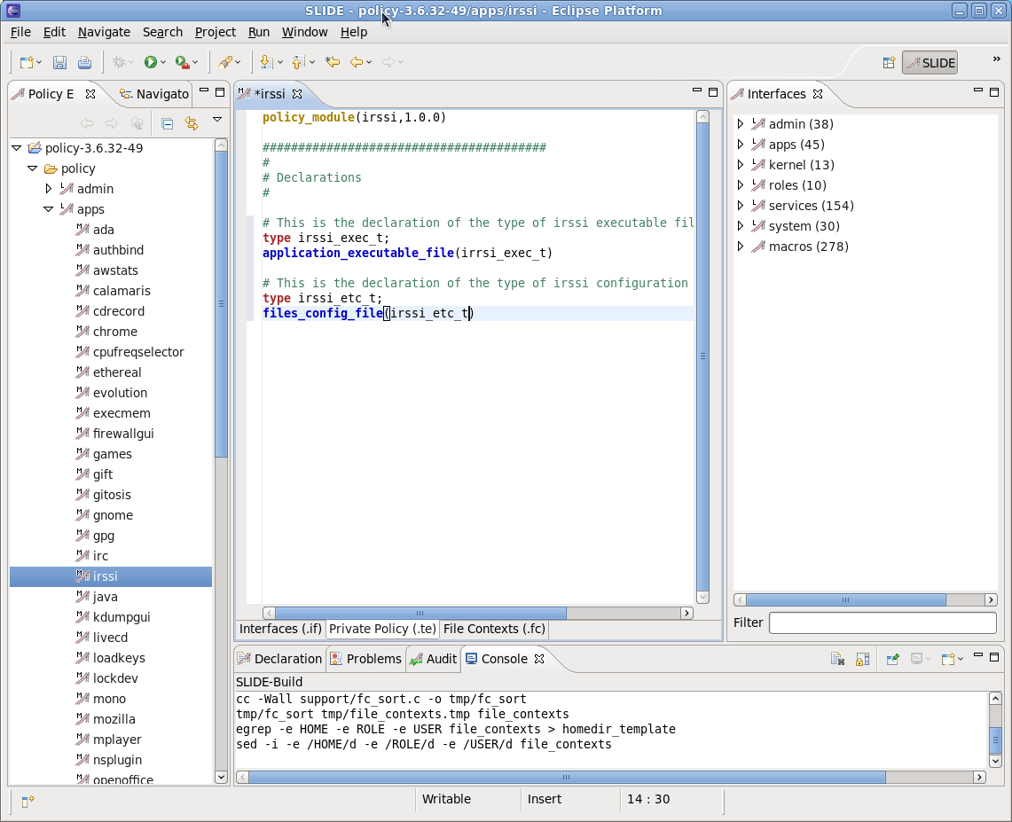
Private Policy Tab
Policy Explorer
Layer
Module
Editor Tabs
Build Output

Slide 13
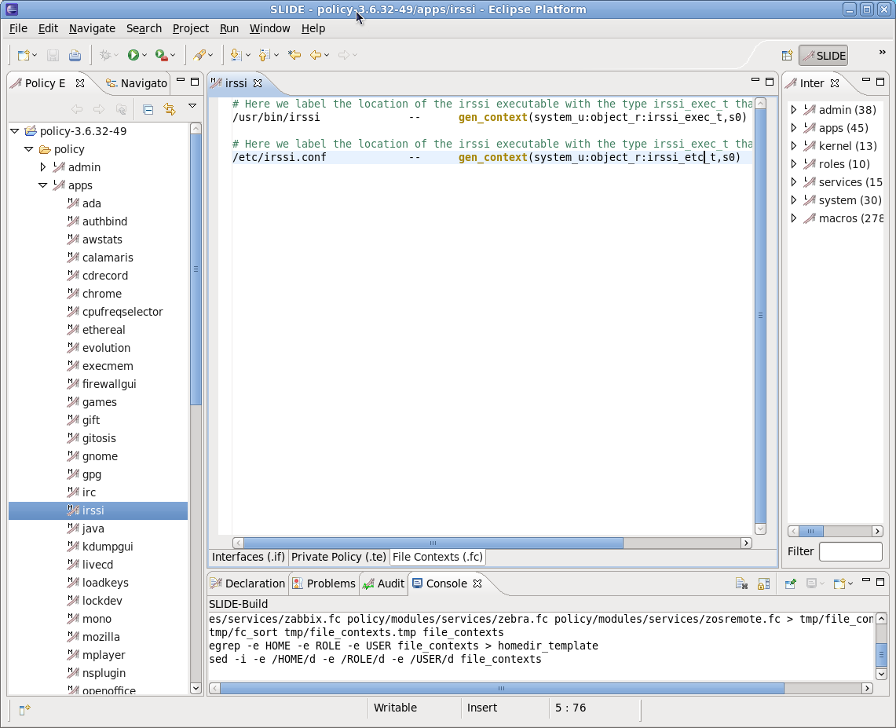
File Contexts Tab

Slide 14
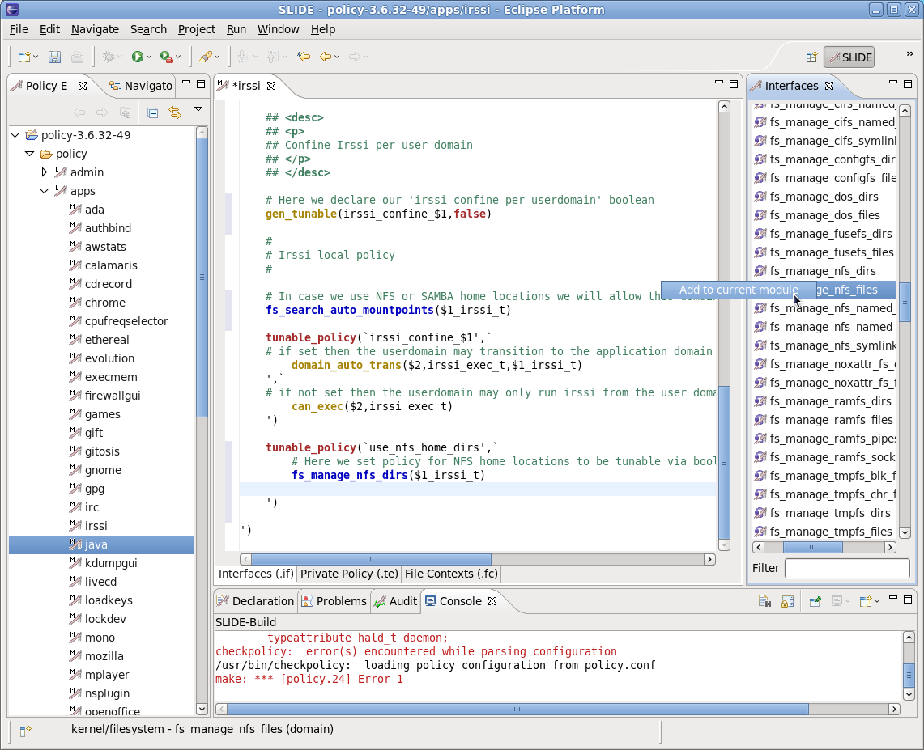
Interfaces Tab

Slide 15
Conclusions
SELinux is complicated and requires extensive knowledge of the reference policy.
SLIDE indeed makes developing policies by performing difficult tasks such as compiling, packaging, and installing policies remotely.

Slide 16
References
http://www.nsa.gov/research/selinux/
http://docs.fedoraproject.org/selinux-user-guide/f11/en-US/
http://oss.tresys.com/projects
http://domg472.blogspot.com/2008/05/how-to-create-integrate-and-rebuild.html
http://selinuxproject.org/page/User_Resources

