Slide 1
Subnet Flooding Detection and DDoS Defenses Angela Cearns
Lan Nguyen
Mounika Namburu

Slide 2
Overview
DDoS Defense Research
A2D2 Design
Subnet Flooding Detection using Snort
Class -Based Queuing
Multi-level Rate Limiting
A2D2 Implementation Test-bed
A2D2 Test-bed Performance Results
Future Works
Conclusion

Slide 3
DDoS Defense Research
3 main research areas:
Intrusion Prevention
General security policy
Ingress & Egress filtering
Intrusion Detection
Anomaly Detection
Misuse Detection
Intrusion Response
Source Identification
Intrusion Tolerance
Fault Tolerance
Quality of Service (QoS)
Intrusion Tolerant QoS Techniques
Rate Limiting
Class-Based Queuing (CBQ)
Intrusion Tolerant QoS Systems
XenoService
Pushback Mechanisms
Cooperative Intrusion Traceback and Response Architecture (CITRA)

Slide 4
Intrusion Tolerance Research Limitations
Intrusion Tolerance Techniques
Not autonomous
Time-consuming
Require knowledgeable staff
Intrusion Tolerance Systems
Expensive
Worldwide agreements
Extensive Collaboration

Slide 5
A2D2 Design
Autonomous Anti-DDoS Network (A2D2)
A2D2 Target Audience
Home network, small to medium sized networks
Design Principles
Affordable
Manageable
Configurable
Portable
Design of A2D2 is divided into 3 main areas:
Intrusion Detection – Snort (slides 6-10)
Intrusion Response (slides 11-13)
Autonomy System (slide 14)
Research-Oriented
Notes:
Affordable = use free & improve upon existing tech
Manageable = autonomous, don’t need full-time admin on site all the time
Configurable = easy, don’t need lots of knowledge
Portable = can use to defend other type of attacks, not just DDoS

Slide 6
A2D2 IDS Snort Overview
Snort is the only free, open source lightweight IDS and is selected to be the detection component of A2D2
Snort can be operated in 3 modes:
a straight packet sniffer similar to tcpdump
a packet logger
a full-blown network intrusion detection system
As an IDS, Snort performs real-time protocol analysis, content searching and matching, and real-time alert
Attack detection is mainly based on a
signature recognition detection engine
as well as a modular plugin architecture
for more sophisticated behavior analysis.
Detection Engine
(Rule Based)
Preprocessor
(Perform logic)
Notes:
Among all the well recognized and broadly deployed IDSes, Snort is the only free, open source lightweight intrusion detection system and is selected to be the detection component of A2D2
Snort can be operated in three modes: a straight packet sniffer similar to tcpdump, a packet logger, or as a full-blown network intrusion detection system. As an IDS, Snort performs real-time protocol analysis, content searching and matching, and real-time alert
Attack detection is mainly based on a signature recognition detection engine as well as a modular plugin architecture for more sophisticated behavior analysis.

Slide 7
A2D2 Snort Flood Preprocessor
Flood threshold
Flood preprocessor Initiation
Flood preprocessor Data structure
Subnet flood detection
Flood preprocessor logic flow

Slide 8
Subnet Flood Detection
DDoS attack agent sends attack packets with an array of randomly generated source addresses, all of them within the subnet of the attack agent
Each spoofed address is used in a limited number of packets to reduce suspicion

Slide 9
Subnet Flood Detection (cont.)
A2D2 is designed to detect 3 types of generic flooding:
Individual attack host against individual victim host
Subnet attack agents against individual victim host
Subnet attack agents against victim subnet hosts
A2D2 assumes a /24 subnet flood detection
A2D2 also assumes many networks implement ingress and egress filtering

Slide 10
A2D2 IDS Snort Flood Preprocessor
Additional Features
FloodIgnoreHosts Preprocessor
FloodRateLimiter Preprocessor

Slide 11
A2D2 Design (cont.)
Intrusion Response
Security policy
Class Based Queuing
Multi-level Rate Limiting

Slide 12
Class-Based Queuing
CBQ supports a maximum of 8 separate queues, or classes

Slide 13
Multi-Level Rate-Limiting

Slide 14
A2D2 Design (cont.)
Autonomy System
Rate Limiting Configuration & Expiration: config file (defines basic parameters based on which Rate Limiting can be automatically applied)
Snort Customization – FloodRateLimiter Preprocessor
(Keeps track of incoming packet rate from a “presumed” attack source. If arrival rate continues to reach the max allowable rate, send message to firewall , apply stricter rate limiting until block level is reached)
Alert Interface (Snort sends alert messages to UNIX socket. Alert message is parsed for attack host’s source IP address which Multi-level Rate Limiting is then applied to)

Slide 15
A2D2 Implementation Test-bed

Slide 16
A2D2 Implementation Tools
Attack Tool
StacheldrahtV4
stable, sophisticated, & able to launch attacks in ICMP, UDP and TCP protocols
can be downloaded from internet for free
Client Bandwidth Measurement Tools
plot.pl--->written and installed in Linux clients to capture bandwidth usage information
Drawing Tool--->gnuplot version 3.7.1

Slide 17
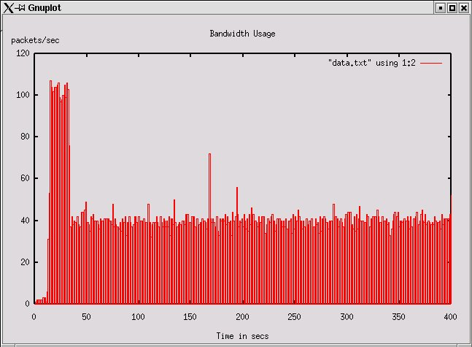
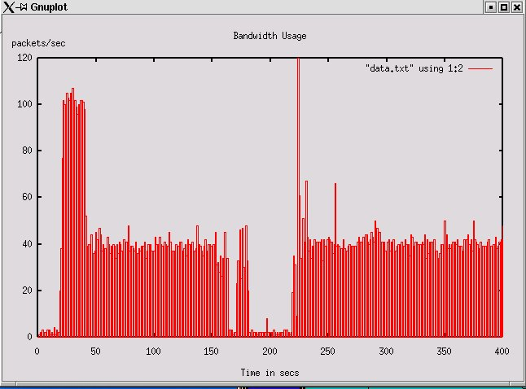
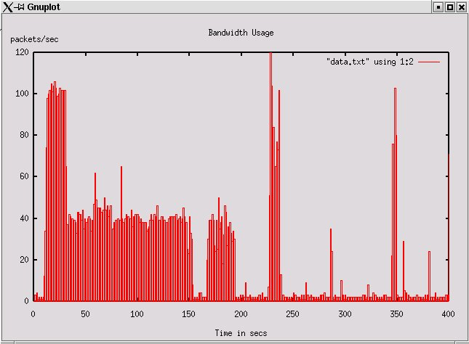
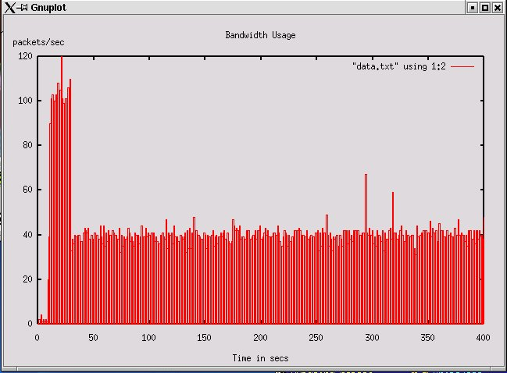
A2D2 Test Results
Baseline
Short 1-minute attack with no mitigation strategy
Non-stop attack with no mitigation strategy
Non-stop UDP attack with security policy
Notes:
QoS = measured by
the number of packets received by the A2D2 clients,
captured in the histogram format

Slide 18
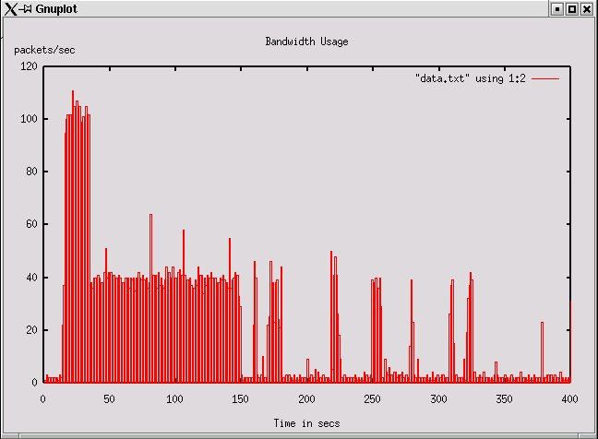
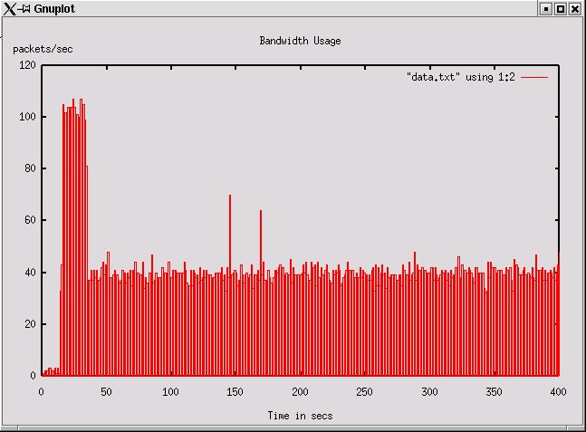
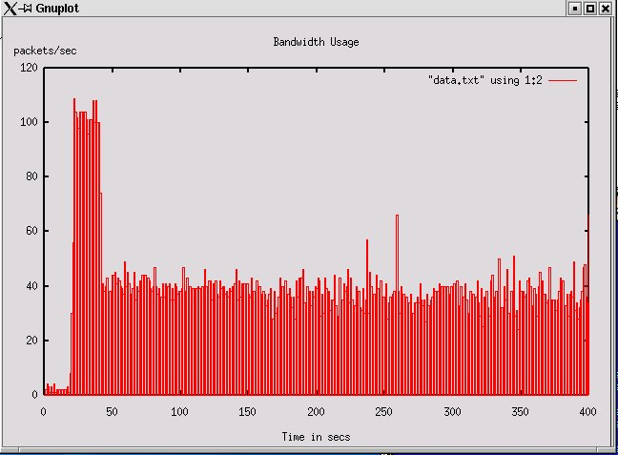
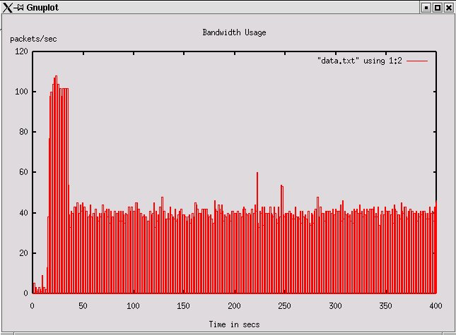
A2D2 Test Results(cont.)
Non-stop ICMP attack with security policy
Non-stop ICMP attack with security policy & CBQ
Non-stop TCP-SYN attack with security policy & CBQ
Non-stop TCP-SYN attack with security policy, CBQ, & autonomous multi-level rate-limiting

Slide 19
Future Works
TCP – SYN Attack
Firewall Processing Speed
Alternate Routing
Scalability
Anomaly Detection
Fault Tolerant

Slide 20
Conclusion
Intrusion Tolerance
A2D2 effectively combines firewall policy, CBQ, multi-level rate-limiting and DDoS flood detection in an autonomous architecture
A2D2 Clients Enjoy QoS during Various Types of Attack

Slide 21
References
http://www.cs.uccs.edu/~gsc/pub/master/acearns/doc
http://www.cs.uccs.edu/~gsc/pub/master/acearns/src
David Moore, Geoffrey M. Voelker and Stefan Savage. Inferring Internet Denial-of-Service Activity. 2001 http://www.cs.ucsd.edu/~savage/papers/UsenixSec01.pdf.
ITWorld.com. CERT hit by DDoS attack for a third day. May 24, 2001. http://www.itworld.com/Sec/3834/IDG010524CERT2/
Steve Bellovin, Marcus Leech, and Tom Taylor. ICMP Traceback Messages. Internet Draft: draft-ieft-itrace-01.txt. Expires April 2002

Slide 22
Questions?

