Slide 1
Topics in Wireless Network Security
James Logan
Michael Menozzi
CS591
Dr. Chow

Slide 2
Contents
Intro to Wireless Network Security Basics
Wireless Security Protocols (Ad Hoc Networks)
Issues With Wireless Ad Hoc Protocols
Advances in Wireless Insecurity

Slide 3
Intro to Wireless Network Security Basics
Three basic wireless Architectures:
Private (Structured Home/Business)
Semi-Structured
Ad Hoc
10 Simple Ways to Additional Security
1. Control Broadcast Area 6. Limit Access Rights
2. Examine Access Points 7. Limit Assigned DHCP
3. Ban Rogue Access Points Addresses
4. Use 128 WEP 8. Authenticate Users
5. Use SSID Wisely 9. Use a Radius Server
10. Use Professional Products

Slide 4
Protocols For Wireless Ad Hoc Networks
First major concern with the architecture:
It is a constant fluctuating architecture
Devices constantly appearing/disappearing
Second major concern with the architecture:
How to determine if a device is misbehaving/corrupted
Two possible protocol solutions
SWAN – Secure Wireless LAN
SAR – Security Aware Routing

Slide 5
Protocols For Wireless Ad Hoc Networks
SWAN Protocol – designed to be generic and makes use
Access Controllers, Global Monitors, and keys (session only).
Access Controller – handles connections, access point designation, and bandwidth assignments
Global Monitor – Maintains network health and ensures the network in functioning correctly
The Big Brother Effect:
SWAN is focused on the behavioral patterns of each device

Slide 6
Protocols For Wireless Ad Hoc Networks
SAR Protocol - Remove the concept of “trust your neighbor” and add the concept of who can provide the security a node wants that it needs to send data
Use security metrics in route request packets to determine if the level of security requested can be met for the route
Shortest/Quickest path is not necessarily the best even though the security requirements are met
Use distributed keys to maintain hierarchy security ratings on nodes
(Designed to prevent lower ranked nodes from seeing more information passed on through higher ranked nodes)

Slide 7
Issues With Wireless Ad Hoc Protocols
Overhead Processing – distributing/maintaining/renewing keys, constant encryption/decryption, constantly updating node trust levels
Inefficiency – if no secure path can be found no connection is made
Global Monitoring – Algorithms/Rule Sets used (limits of the constraints)
Devices – How does the protocol determine that the device is who it says it is (spoofing)

Slide 8
Advances in Wireless Insecurity

Slide 9
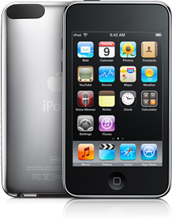
Wireless Security
Recent advances in portability have led to new and innovative ideas
iPod Touch
Wireless G and N
8 to 32 Gb capacity
iPhone OS
Unix/Linux functions

Slide 10
What’s the Problem?
The issues are:
Hackability (not a word, I know)
Jailbreaking
Portability
Don’t know what the user is doing
Easy to disguise activities (music, video)
3rd party developers
Outside Apples “approved” network

Slide 11
Jailbreaking
Allows unlocking of an iPod Touch or iPhone
User can then run unauthorized third-party applications
3 installers currently available
Cydia
Rock
Icy
Process first performed in mid 2007
Quickly adapts to Apple’s thwarting
Used BlackRa1n application
Simply executed and the phone is unlocked or “jailbroken”

Slide 12
The Legal Issues
Murky subject for the legal system
Apple claims it is a violation of the Digital Millennium Copyright Act (DMCA)
The Electronic Frontier Foundation has requested and exemption to the DCMA via the US Copyright Office
Allow users to jailbreak their iPod Touch or iPhone
Apple charges a fee to become a developer
Approves and takes a cut of all software

Slide 13
The Process
Pretty easy
Run the Blackra1n application
Risks
Possible to “brick” the device
Doesn’t appear to be a permanent breakage
Install the Installer
Cydia, Rock or Icy

Slide 14
What to Install
Most important = command line
Mobilecommand
Support files include: adv-cmds, network-cmds, shell-cmds, system-cmds, etc
You now have a very portable Unix/Linux device
FTP, telnet, netstat, traceroute, password, ifconfig and many more

Slide 15
Inherent Security Problem
You have root access
Default password for all iPhone and Touch = alpine
Ssh to the device is successful from any workstation
Use root
Advisable to change the password☺

Slide 16
Tools: Nmap
The tools
Nmap: port scanner that has many capabilities.
Here we found 3 hosts on the network using: nmap –v –sP 192.168.1.0/24
Next we scan one of the hosts for open ports using: nmap –v –sV 192.168.1.100

Slide 17
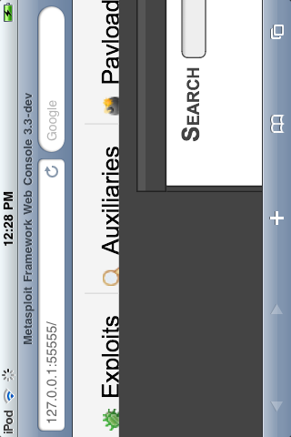
Tools: Metasploit
Metasploit is used for penetration testing, IDS signature development and exploit research
Small processor = takes time to setup, but it does work

Slide 18
Tools: Ngrep
Ngrep is a tool that provides regular expression searching of network captures
Similar to it’s Unix companion grep
Search for google on the Wi-Fi

Slide 19
Tools: Tcpdump and Top
Tcpdump packet sniffer which is capable of capturing all network traffic and saved for later analysis (wireshark)
Top displays what processes are running to include performance information on the system

Slide 20
Conclusion
There is always a cost in securing wireless networks whether it be high overhead processing via protocols or investing in 3rd party solutions
Understand the type of wireless architecture implemented otherwise one's security polices may not be as secure as they think
Although not exploited significantly – this does pose a unique security risk for both home and office
Very portable, almost complete Unix/Linux hacker tool
Further research would include attempting in-depth network penetration testing using only a Touch
Also study further details on the legal frustrations

