Slide 1
Anomalous Payload Based Worm Detection
Ke Wang, Gabriela Cretu, Salvatore Stolfo
Computer Science, Columbia University
Mike Kopps
CS591

Slide 2
Agenda
The Problem
Existing Solutions
Solution
Methodology
Collaboration
Evaluation
Even More Problems
Conclusion

Slide 3
The Problem
Zero Day worms
Signatures not available
Signature detection gives false negative
Traffic pattern analysis cannot detect slow-propagating worms
Wide spread infection rate results
Costly damage to network infrastructure

Slide 4
Existing Solutions
Honeycomb
Honeypot to capture malicious traffic
Longest Common Substring (LCS) generates a worm signature
Autograph
Reassemble suspicious packets, create fingerprints
Earlybird
Similar to Autograph, insert frequency of signatures
Helps reduce false positives
Notes:
Honeycomb
- Host based IDS
- Does not protect anything other than the honeypot
- Otherwise similar
Autograph
- Generates signatures automatically via Rabin fingerprints
- Blacklisting to prevent false positives
- Collaboration only exchanges suspicious IPs and Destination Ports
Earlybird
- Counts source / dest IPs to keep false positive rate low
- Centralized system with little collaboration
All of these imply the detection some time after the worm has propagated itself. PAYL detects new threats immediately

Slide 5
Solution
Anomalous Payload Based Worm Detection and Signature Generation (PAYL)

Slide 6
Solution
Networks will have a nominal traffic signature
Log anomalous traffic that does not match
Worms are self-propagating by nature
Sensors monitoring unusual scanning do not detect slow propagating worms
Analyze payload of incoming anomalous traffic
Similar outgoing traffic likely to be a worm attempting to self propagate
Notes:
Overview of the environment the solution exists in

Slide 7
Solution
Create profile of nominal traffic payloads
Monitor incoming traffic for non-conforming packets
Log this anomalous packet
Create signature automatically
Monitor outgoing traffic for similar data
Block or alert on this traffic
Stops worms at the moment they start propagating

Slide 8
Methodology
N-gram scanning of all packets
Normalized average frequency distribution of each gram in the packet
Comparison with outgoing data (anomalous)
Same port, packet length
Extract a Z-string
String of distinct bytes in order of frequency
Preserves privacy
Not used for detection
Notes:
Generate alerts on some incoming packets
Compare with outgoing data to detect self-propagation at first attempt
- String Equality: outgoing string must be exactly the same as incoming string. Reduces false positives, but creates more false negatives
- Longest Common Substring: Finds the smallest common substring. Longer means more similarity, more likelihood of a match
- Longest Common Subsequence: Similar to LCS, but the similarities need not be contiguous. May detect more polymorphic worms, but more false positives will occur
Z-strings used for message exchange and cross domain correlation of alerts

Slide 9
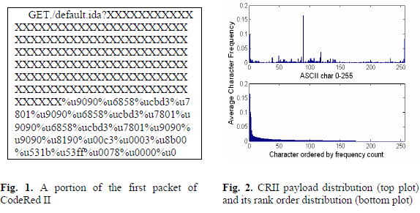
Methodology
CodeRed II packet analysis using Payload based anomaly detection algorithms

Slide 10
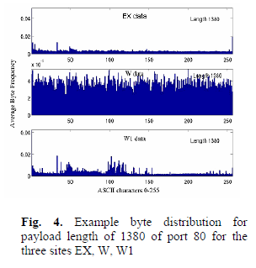
Collaboration
Data Diversity across sites and hosts
Normal profile at one site is normal at another
Attack may be detected at one, normal at others
Worm must be normal at all sites to avoid detection
Corroboration of alerts
Notes:
Hosts can have diverse data such as web: html, images, audio, video, flash, pdf.

Slide 11
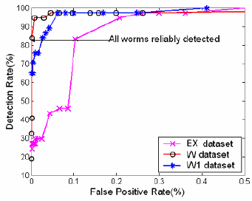
Evaluation
Detected all worms presented
Low false positive rate
Mostly strange packets
Corroboration helps reduce false positive rate
Notes:
For 0.1% false positive rate: EX=5.8 alerts/hr; W1=6alerts/hr; W=8 alerts/hr
Strange packets:
- HTTP Get request with referrer field padded with ‘Y’ characters (provides anonymization)
- Word file upload with byte value E7 as the entire packet

Slide 12
Other Issues
Sanitized Training Datasets
Larger training datasets produce better models
Micro-models
Split large contiguous dataset into micro-datasets
Generate micro-models of normal traffic
Each packet evaluated against each µModel
Normal packets present in all micro-models
Notes:
Training Datasets == Model
Voting amongst collaborators requires hackers to mimic the attack on ALL collaborators. Which means they must know the collaborators first. If multiple systems detect an anomaly, send it to an oracle for thorough evaluation. Human or shadow server system (very high latency)
- false false positive problem reduces efficacy of Anomaly Detection systems

Slide 13
Conclusion
Detection of zero-day worms
Automatic generation of fingerprints
Quick response to new threats
Corroboration reduces false positives

Slide 14
Further Reading
Ke Wang, Gabriela Cretu, Salvatore J. Stolfo "Anomalous Payload-based Worm Detection and Signature Generation" Proceedings of the Eighth International Symposium on Recent Advances in Intrusion Detection(RAID 2005)
Gabriela F. Cretu, Angelos Stavrou, Michael E. Locasto, Salvatore J. Stolfo, Angelos D. Keromytis "Casting out Demons: Sanitizing Training Data for Anomaly Sensors“ In the Proceedings of the IEEE Symposium on Security & Privacy. May 2008, Oakland, CA.
Ke Wang, Janak J. Parekh, Salvatore J. Stolfo "Anagram: A Content Anomaly Detector Resistant To Mimicry Attack" In Proceedings of the Ninth International Symposium on Recent Advances in Intrusion Detection(RAID 2006)

