Slide 1
Flexible Mandatory Access Control (MAC) in Modern Operating Systems
Jeffrey H. Jewell
CS 591
December 7, 2009

Slide 2
Introduction
Background
MAC Architecture
Linux implementation
Fedora Examples
Conclusion

Slide 3
OS Controls
Discretionary Access Control (DAC)
Most commonly used mechanism today
Definition - a means of restricting access to objects based on the identity of subjects and/or groups to which they belong.
Disadvantages
Too much power to users.
Good security practice hard to enforce
Notes:
The Trusted Computer System Evaluation Criteria (TCSEC) definition

Slide 4
Alternative approach - MAC
Definition - a type of access control by which the operating system constrains the ability of a subject or initiator to access or generally perform some sort of operation on an object or target.
Policy controlled by a security administrator
MAC issues
tightly coupled to the DOD multi-level security (MLS) policy
Access decisions in MLS are based on clearances for subjects and classifications for objects.
Considers only confidentiality and not integrity.

Slide 5
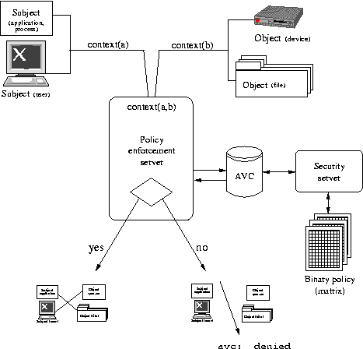
Flask Architecture

Slide 6
Security Enhanced Linux
Linux OS refactored to incorporate Flask architecture.
Selected due to its growing success
Open source development environment
Better feedback due to more users of Linux.
Policy implementation
Based on domain-type model.
Policy built using Reference Policy language.
Platforms
Red Hat, Fedora, Ubuntu, Debian (Linux)
Solaris, FreeBSD (Unix)
Notes:
Domain model – uses a combination of IBAC, RBAC, TE, and optionally MLS models

Slide 7
Reference Policy
Makefile => apache.pp
Apache.te
Apache.fc
Apache.if
Admin
Apps
Kernel
Roles
Services
System
Targeted (default)
MLS
Config files – file contexts
Makefile => policy.VER
Fedora Production Release
Tresys link - http://oss.tresys.com/projects
Notes:
The NSA example policy was refactored using design principles of layering, encapsulation, and abstraction. The smallest component of the policy is called a module. The modules are organized into groups according to their particular function. Currently the groups are admin, apps, kernel, roles, services, and system.
Mention SLIDE – the graphical user interface to Reference creating and testing reference policy.
Needs a Test SELinux development environment.
This Open Source Software site provides a home for collaborative software development of tools and technology sponsored by Tresys Technology. Many of the projects originated in the R&D division at Tresys. Other projects, such as the Security Enhanced Linux Project, started elsewhere but are now hosted here.
Limited support for manipulating policy in production system.

Slide 8
Fedora examples
Notes:
A type is assigned to an object and determines who gets to access that object. The definition for domain is roughly the same, except a domain applies to process and a type applies to objects such as directories, files, sockets, etc.
Every process runs in a domain. A domain directly determines the access a process has. A domain is basically a list of what processes can do, or what actions a process can perform on different types. Think of a domain like a standard Unix uid. Say root has a program and does a chmod 4777 on that program (making it setuid root). Anyone on the system, even the nobody user, can run this program as root thereby creating a security issue. With SE Linux however, if you have a process which triggers a domain transition to a privileged domain, if the role of the process is not authorised to enter a particular domain, then the program can't be run.
But if you look in /proc where most of the process files lives and do an ls –Z you will find that it also has a type. Even though proc represents running processes, the entries under /proc are labeled as types. IMPORTANT CLARIFICATION – the type is also the domain that the process runs in.
Some examples of domains are sysadm_t which is the system administration domain, and user_t which is the general unprivileged user domain. init runs in the init_t domain, and named runs in the named_t domain.

Slide 9
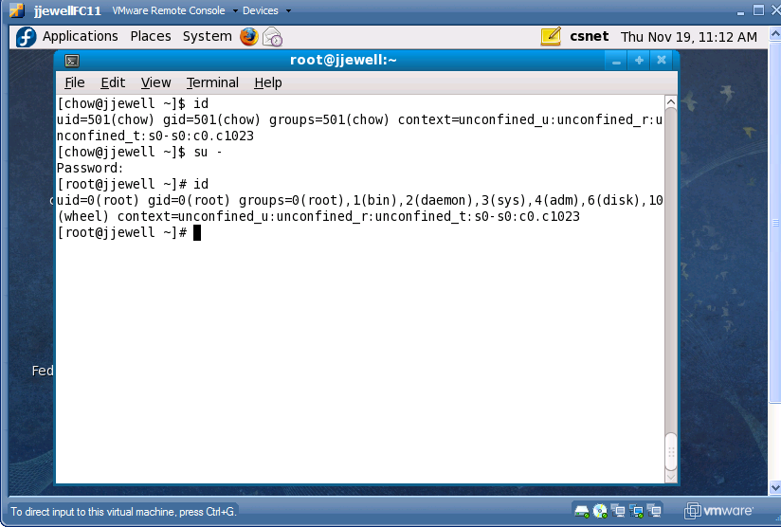
Unconfined domain
Security context:
<user><role><type><mls>
Notes:
Can become superuser but in SELinux world the MAC policy is the deciding factor and not the discretionary.
Need to login as specific role or use newrole to change roles.

Slide 10
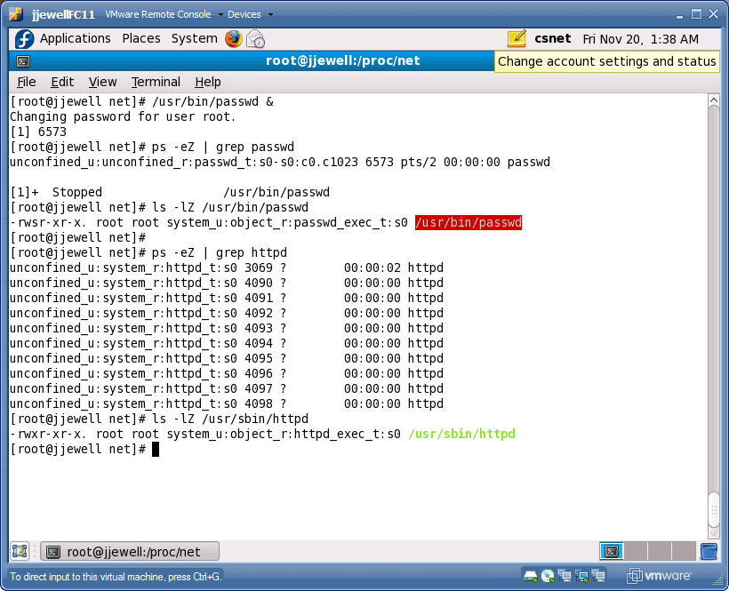
Confined domains
Type distinction between
processes and objects

Slide 11
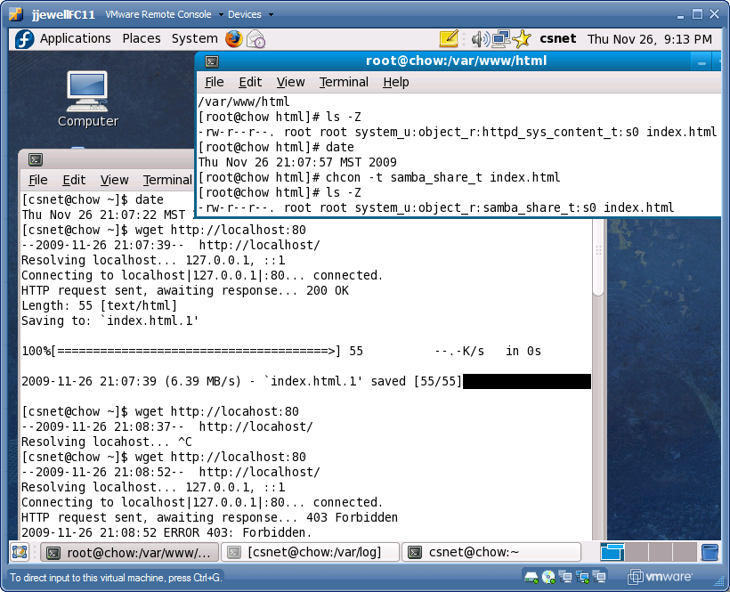
Policy Enforcement
Loaded file
context
Temp mod to
file context
Policy
Enforcement

Slide 12
Conclusion
SELinux Reference Policy allows customizable fine-grained control of all processes and objects in the computer system.
Manipulation of policy in Fedora release still cumbersome.
Need familiarization with Reference Policy.
Limited source code although you can create module executables via the built-in GUI tools.
On-line help still immature.

Slide 13
References
Red Hat documentation (2009). SELinux Architectural Overview. Retrieved Nov. 5, 2009 from http://www.redhat.com/docs/manuals/enterprise/RHEL-4-Manual/selinux-guide/selg-chapter-0013.html#SELG-SECT1-0014
P. Loscocco, Smalley S. Muckelbauer, P, Taylor, R, Turner S., and Farrell, J. The Inevitability of Failure: The Flawed Assumption of Security in Modern Computing Environment. Proceedings of the 21st National Information Systems Security Conference, pages 303-314, October 1998.
P. Loscocco and Smalley S. Integrating Flexible Support for Security Policies into the Linux Operating System. Proceedings of the FREENIX Track: 2001 USENIX Annual Technical Conference (FREENIX '01), June 2001
P. Loscocco and Smalley S. Meeting Critical Security Objectives with Security-Enhanced Linux. Proceedings of the 2001 Ottawa Linux Symposium
J. PeBenito, F. Mayer, and K. MacMillan Reference Policy for Security Enhanced Linux. 2006 Security Enhanced Linux Symposium

Slide 14
References (Cont’d)
Wikipedia (2009). Manadatory Acce Control Retrieved Nov 10, 2009 from http://en.wikipedia.org/wiki/Mandatory_Access_Control
Widipedia (2009). Discretionary Access Control. Retrieved Nov 10, 2009 from http://en.wikipedia.org/wiki/Discretionary_access_control
Tresys Open Source Software (2009). SELinux Reference Policy. Retrieved Nov 10, 2009 from http://oss.tresys.com/projects/refpolicy
(2009) . Writing SE Linux policy HOWTO. Retrieved Nov 15, 2009 from http://www.lurking-grue.org/writingselinuxpolicyHOWTO.html
Fedora Project (2009). Fedora 11 SELinux user’s guide. Retrieved Nov 15, 2009 from http://docs.fedoraproject.org/selinux-user-guide/f11/pdf/Security-Enhanced_Linux.pdf
Wikipedia (2009). Fedora operating system. Retrieved Nov 10, 2009 from http://en.wikipedia.org/wiki/Fedora_(operating_system)
C. Hanson. SELinux and MLS: Putting the pieces together. Proceeding from the 2006 SELinux Symposium.

