Slide 1
Exploring the WebScarab Intercept Proxy
Chris Shuster

Slide 2
Overview
Hacking
White Hat
Black Hat
Web Hacking

Slide 3
Overview (cont)
Web Hacking
OWASP
Intercept Proxies
WebScarab
WebGoat

Slide 4
Research Constraints
Web Hacking
Only intercept proxy related web hacking explored.
Intercept Proxies
Only WebScarab was explored.
WebScarab
Only a subset of WebScarab’s features was explored.

Slide 5
WebScarab
Platform Independent
Java
No installation necessary.
Browser Independent
Acts as a proxy.
No plug-ins needed.
More then an Intercept Proxy

Slide 6
WebScarab (cont)
Beyond an Intercept Proxy
Provides all the features of plug-ins such as HackBar.
Encoding and decoding tools.
Scriptable attacks.

Slide 7
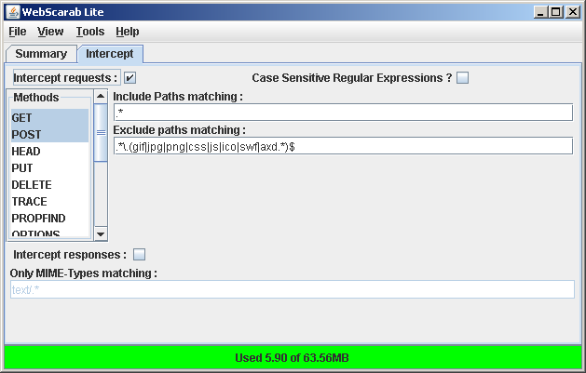
Request Interception
Fine grained control of request interception.
Request Type
Mime Type
Regex
Path Excludes

Slide 8
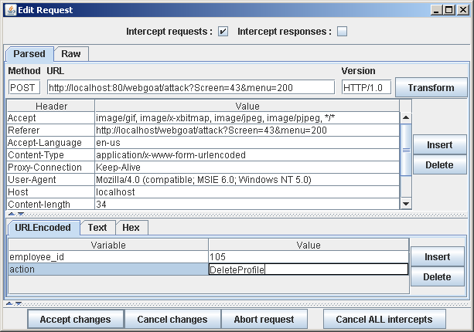
Request Alteration
Parsed or raw.
Edit any part of the request.

Slide 9
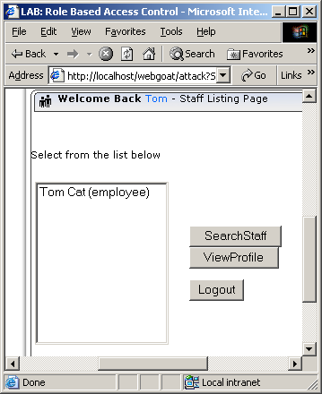
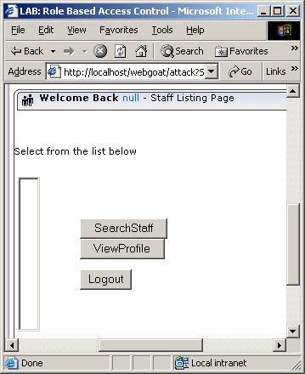
Request Alteration (cont)

Slide 10
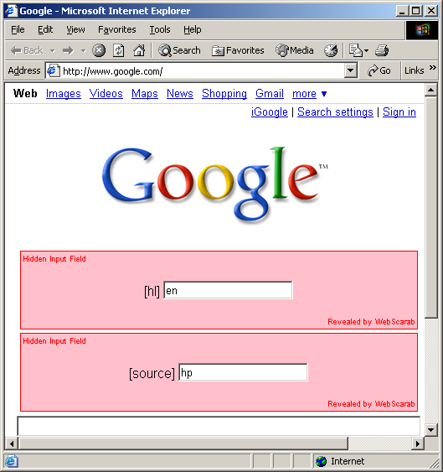
Hidden Fields
Reveals hidden fields.
No browser plug-ins needed.
Alters response HTML.
Alter hidden field values.

Slide 11
Future Research
OWASP Projects
Explore the remaining features not covered of WebScarab.
Fully explore the insecurities of WebGoat.
Web Hacking
Fully explore intercept proxy based hacking activities.
Explorer other web hacking topics.

Slide 12
References
OWASP
About The Open Web Application Security Project
http://www.owasp.org/index.php/About_The_Open_Web_Application_Security_Project
OWASP WebScarab Project
http://www.owasp.org/index.php/Category:OWASP_WebScarab_Project
OWASP WebGoat Project
http://www.owasp.org/index.php/Category:OWASP_WebGoat_Project

Slide 13
References (cont)
ACSAC
The interactive HTTP proxy WebScarab – Installation and Basic Use
http://www.acsac.org/2007/downloads/t5-webscarab-instructions.pdf

