Slide 1
SQL Injection Primer
By Nicole Gray, Cliff McCullough, Joe Hernandez
Notes:
Our research topic was to compile an SQL Injection Primer.
The authors are Nicole Gray, Joe Hernandez, and Cliff McCullough.

Slide 2
Agenda
Overview of SQL Injection
Elaboration
Detection
Prevention
Wrap-up
Notes:
We start with an overview of SQL Injection.
Then elaborate on some methods and tools an adversary might use.
We explain some detection techniques and, most important, some prevention strategies.
We conclude with a summary.

Slide 3
Types of SQL Injection
Three types
In-band: same user interface i.e. webpage
Out-of-band: different communications channel i.e. e-mail
Inferential: can’t see the results of injection i.e. blind SQL injection
Error Based – asking the database questions
a‘ or ‘a’ = ‘a
Answer may be returned as an error
Union Based – combines the results of two SQL statements
SELECT * from lastname UNION SELECT * from office
Blind – asks the database true and false questions may not see specific results
Interrupt or deduce results
Game of 20 questions
Notes:
There are three types of SQL Injection: In-band, Out-of-band, and Inferential.
In-band is a direct attack, for example, exploiting a web page.
Out-of-band could supply information indirectly, for example, by successfully sending an e-mail back to the adversary.
Inferential can return information to the adversary through an error message.

Slide 4
SQL Injection Tools
SQL Map* is a tool that aids in the fingerprinting of a backend database
SQL Ninja* http://sqlninja.sourceforge.net/
Aids in the exploitation of SQL injection vulnerabilities can provide root level command access to system
Automagic SQL Injector*
Designed to work with generic installation of MS SQL
http://scoobygang.org/magicsql/
Videos on SQL injection can be found on the internet one great source
http://securitytube.net/
*Source: EC Council Certified Ethical Hacker Volume 3 Chapter 19
Notes:
Many tools are available to the adversary.
Here we list some of them. The links are provided so you can checkout the tool and get more information.

Slide 5
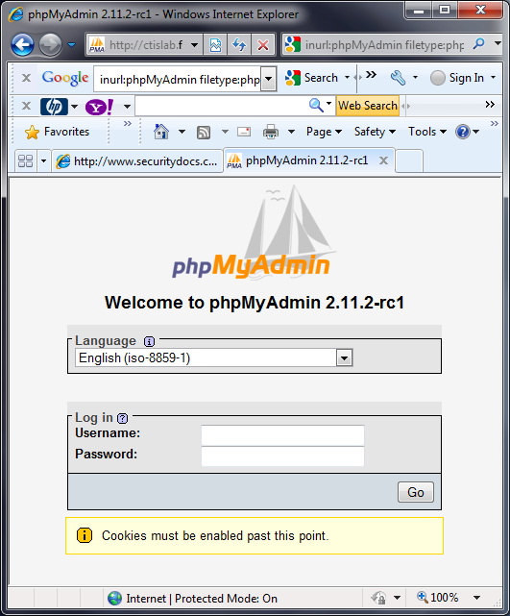
Google Hacking
Use the Google search engine to identify information or web sites with poor security practices Advanced Operators aid the search
Intitle: - restricts the search to text in the title of the page
Ex. intitle: SQL
allintitle: - similar to intitle operator, allows concatenation of key words in title search
Ex. allintitle: SQL Password (is the same as intitle: SQL intitle: Password)
inurl:, allinurl: - will search for keywords in the URL
Ex. inurl: login.aspx
site: - will narrow the search a specific site or domain like uccs.edu or .gov
Ex. site:.uccs.edu
filetype: - used to search for a specific file like doc, php,cgi, or aspx
Ex. filetype:aspx (do not use dot operator to identify the file type, like .doc)
intext: - will identify keywords in the text of the webpage
Ex. intext: SQL Injection
http://johnny.ihackstuff.com/ghdb/
Notes:
Google search engine can be used to identify web sites with poor security practices.
The adversary uses this information to identify weaknesses to exploit.
Some advanced operators listed here aid the search.
Note that these operators can also aid our web searches. They can greatly reduce the "noise" usually returned by a web search.

Slide 6
Detection
Application layer firewalls
Inspects each packet, decides to pass or reject
Easier to update firewall rules than update application program code
Intrusion Detection System (IDS)
Network-based, Systems-based, Host-based
Compares packets to known signatures
Notes:
Application layer firewalls and intrusion detection systems match a list of signatures and patterns to traffic.
A detection system can monitor a network, a system, or a single host computer.
It captures and compares the packet and the activity to a rule-set specified by the security administrator.
Action can include pass the packet, reject the packet, and/or notify the system operator with an alert.
A reactive IDS can even reset a connection or reconfigure the firewall. This is generally referred to as an Intrusion Prevention System (IPS).

Slide 7
Prevention
Mitigate the risk
Review web applications, program code, and back-end system design
SQL queries should be parameterized or stored procedures
Validate user input
Notes:
Many argue that it is impossible to eliminate all risk from SQL injection. Still the risk can be reduced.
Regularly audit and update application layer firewalls.
Regularly review IDS and IPS logs.
Stay up to date with vulnerabilities such as SQL injection, buffer overflow, stack interrogation, or especially anything new.
Unguarded SQL queries use the user input directly in the query. Examples are discussed in our paper. These are generally opportunities for exploit.
Instead, use parameterized SQL queries. They include automatic variable-type checking that can reject many exploit attempts.
Stored SQL procedures achieve much the same thing because the query is not easily altered by an outsider.
Always, always validate user input.

Slide 8
Prevention continued
Restrict privileges
White lists and black lists
Notes:
Restrict access privileges to the database according to account name.
Each account should be restricted to only access necessary information and activities.
This is a fundamental good security practice.
Give the web application its own user account for authentication.
A black list is a list of things that should be denied.
A white list is a list of things that should be accepted. Sometimes a white list is easier to write and maintain.
Consider using both.
There is no one perfect way to stop SQL injections, but by using a combination of preventative methods, the risk can be greatly reduced.

Slide 9
Wrap-up
SQL Injection is increasing in prevalence
Not possible to absolutely defend against all possible attacks
Risk of attack can be reduced:
Maintain firewalls, intrusion detection / prevention systems
Manage access to queries through parameterization and stored procedures
Always validate user input
Restrict accounts
Use whitelists and blacklists.
Notes:
Our paper includes a discussion of databases and includes a simple database for examination and practice exploit.
The paper also discusses and elaborates on everything presented here. See the full paper for more information.

