Slide 1
SQL Injection Primer
By Nicole Gray, Cliff McCullough, Joe Hernandez

Slide 2
Agenda
Overview of SQL Injection
Elaboration
Detection
Prevention
Wrap-up

Slide 3
Vulnerability
Input access to a database
Outsider Exploit
Insider Exploit
Trust no one
Notes:
A Structured Query Language (SQL) injection is a vulnerability in which an adversary exploits an SQL processor.
The SQL processor is used to execute injected commands the owner did not intend, usually leaking or releasing unintended information.
Outsider Exploit
A website asks for a name and e-mail address.
A merchandising company allows the public to search for an item to buy.
A library allows patrons to search for a book title.
Insider Exploit
An on-line company phone number lookup. Hosted by HR, the same database links employee names to other records.
An on-line Purchase Request form. Hosted by Purchasing and Accounting could give access to employee payroll information.
A basic premise of Information Assurance is to trust no one. Generally, any input that can be entered to a computer is an avenue for attack. Once an adversary has access to the host system, the entire system and its records are at the command of the adversary.

Slide 4
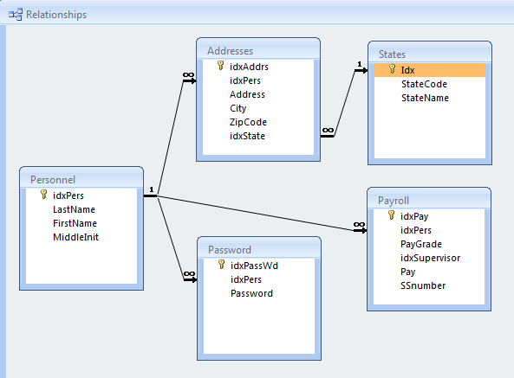
Relational Database
Notes:
Records for a person can link to their addresses, password, pay grade, etc.
A demonstration database is available on the project website.

Slide 5
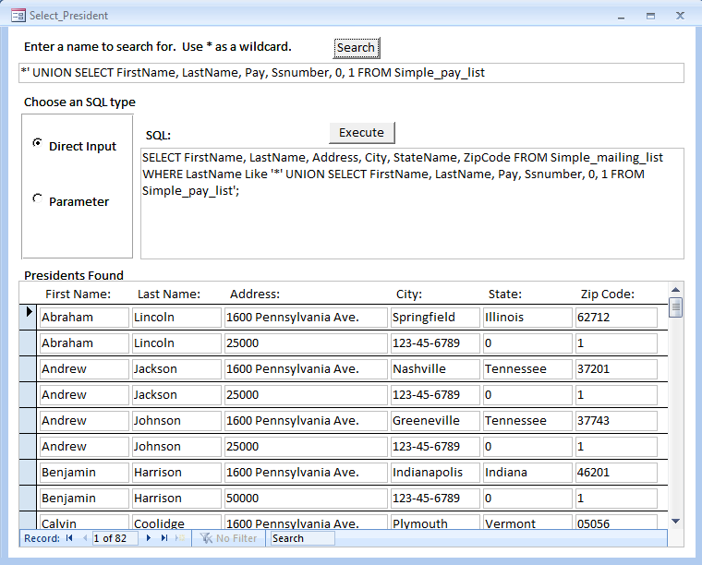
Example Exploit
Notes:
Here, instead of entering a President’s name to search for, the adversary entered a Union statement.
Normally, the name and address information would be retrieved.
In addition to intended information, the adversary also retrieves salary information and social security numbers.

Slide 6
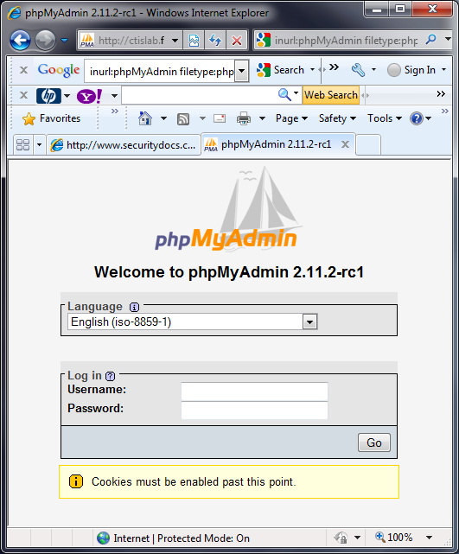
Google Hacking
Use the Google search engine to identify information or web sites with poor security practices Advanced Operators aid the search
Intitle: - restricts the search to text in the title of the page
Ex. intitle: SQL
allintitle: - similar to intitle operator, allows concatenation of key words in title search
Ex. allintitle: SQL Password (is the same as intitle: SQL intitle: Password)
inurl:, allinurl: - will search for keywords in the URL
Ex. inurl: login.aspx
site: - will narrow the search a specific site or domain like uccs.edu or .gov
Ex. site:.uccs.edu
filetype: - used to search for a specific file like doc, php,cgi, or aspx
Ex. filetype:aspx (do not use dot operator to identify the file type, like .doc)
intext: - will identify keywords in the text of the webpage
Ex. intext: SQL Injection
http://johnny.ihackstuff.com/ghdb/
Notes:
Google search engine can be used to identify web sites with poor security practices.
Vulnerabilities may include hidden fields, hidden pages, password files, log files, etc.
The hacker uses this information to identify weaknesses to exploit.
Advanced operators aid the search.
intitle restricts the search to text in the title of the page.
allintitle is a similar operator that allows concatenation of key words in title search.
inurl and allinurl will search for keywords in the URL.
site will narrow the search to a specific site or domain like uccs.edu or .gov.
filetype searches for a specific file like doc, php, cgi, or aspx for example.
intext identifies keywords in the text of a webpage.

Slide 7
Types of SQL Injection
Three types
Inband: same user interface i.e. webpage
Out-of-band: different communications channel i.e. e-mail
Inferential: can’t see the results of injection i.e. blind SQL injection
Error Based – asking the database questions
a‘ or ‘a’ = ‘a
Answer may be returned as an error
Union Based – combines the results of two SQL statements
SELECT * from lastname UNION SELECT * from office
Blind – asks the database true and false questions may not see specific results
Interrupt or deduce results
Game of 20 questions

Slide 8
SQL Injection Tools
SQL Map* is a tool that aids in the fingerprinting of a backend database
SQL Ninja* http://sqlninja.sourceforge.net/
Aids in the exploitation of SQL injection vulnerabilities can provide root level command access to system
Automagic SQL Injector*
Designed to work with generic installation of MS SQL
http://scoobygang.org/magicsql/
Videos on SQL injection can be found on the internet one great source
http://securitytube.net/
*Source: EC Council Certified Ethical Hacker Volume 3 Chapter 19

Slide 9
Detection
Application layer firewalls
Inspects each packet, decides to pass or reject
Easier to update firewall rules than update application program code
Intrusion Detection System (IDS)
Network-based, Systems-based, Host-based
Compares packets to known signatures
Notes:
Application layer firewalls and intrusion detection systems match a list of signatures and patterns to traffic.
A firewall inspects packets and decides to pass the packet or drop the packet based on its rule set.
An intrusion detection system can monitor the network, a system, or a single host computer.
It captures and compares the packet and the activity to its rule set.
Action can include passing the packet, reject the packet, and notify the system operator with an alert.
A reactive IDS can reset a connection or reconfigure the firewall. This is generally referred to as an Intrusion Prevention System (IPS).

Slide 10
Prevention
Mitigate the risk
Review web applications, program code, and back-end system design
SQL queries should be parameterized or stored procedures
Validate user input
Notes:
Many argue that it is impossible to eliminate all risk from SQL injection. Still the risk can be reduced.
Regularly audit and update application layer firewalls.
Regularly review IDS and IPS logs.
Review of web applications, program code, and back-end system design can identify vulnerabilities.
Check for known vulnerabilities such as SQL injection, buffer overflow, or stack interrogation.
Dynamic SQL queries inject the user input directly into the query such as the Example Exploit shown above.
Parameterized SQL queries binds the user input to pre-defined variables before executing the query and retrieving data.
Stored SQL procedures achieve the same thing as parameters because the query is not easily altered by an outsider.
Always validate user input. This is not as easy as it may sound.
Names like O'Brien contain apostrophes.
Surnames can include hyphens.
As much as possible, eliminate special characters.

Slide 11
Prevention continued
Restrict privileges
White lists and black lists
Notes:
Restrict access privileges to the database based on account name.
The web application can have its own user account for authentication.
Each account should be restricted to only access necessary information and activities.
A black list is things that should be denied.
A white list is things that should be accepted. Sometimes a white list is easier to write and maintain.
There is no one perfect way to stop SQL injections, but by using a combination of preventative methods, the risk can be greatly reduced.

Slide 12
Wrap-up
SQL Injection is increasing in prevalence
Not possible to absolutely defend against all possible attacks
Risk of attack can be reduced:
Maintain firewalls, intrusion detection / prevention systems
Manage access to queries through parameterization and stored procedures
Always validate user input
Restrict accounts
Use whitelists and blacklists.
Notes:
SQL Injection is increasing in prevalence.
It is climbing the OWASP list as one of the most dangerous vulnerabilities.
As web applications involve more processing of data, taking a person out of data review, safeguarding from SQL Injection becomes more important.
It is not possible to absolutely defend against all possible attacks.
The risk of attack can be reduced:
Maintain firewalls and intrusion detection and prevention systems
Manage access to SQL processing by using parameterization and stored procedures.
Always validate user input.
Restrict accounts to only that which is needed.
Use whitelists and blacklists. Whitelists are sometimes easier to generate and can be used in addition to blacklists.

