Slide 1
Unlocking the Power of SELinux by Utilizing the CDS Framework IDE
By
Ben Stroud
CS591
Fall 09

Slide 2
Presentation Outline
Background … What is the CDS Framework Anyway and what does it have to do with SELinux?
Benefits of CDS Framework IDE
How to Use the Framework
How does the graphic translate into a policy?
Possible Alternatives
Criticisms
Conclusion

Slide 3
Background: Some Key Terms Defined
Domains
groups of processes, resources, ect, within a system that have the same security level and have access to the same system resources.
Shared Resources
resources shared across different domains
Accesses
The interaction between different domains and their shared resources
Domain Children
sub-domains, shared resources, and accesses between them
Decomposing Domains
Breaking domains down into their children.
Control Resources
special shared resources such as IPC mechanisms (signals, pipes, sockets, ect) that can’t be defined the way other shared resources can.
Domain Transitions
Changing the security level of a process during execution
example: entering a password [1]
Notes:
Control Resources –
In CDSFramework, these object
classes cannot be placed in normal resource definitions and used in shared resources, because instances of
these classes share the creating domain’s type and cannot be separately labeled. These object classes
cannot become part of the domain either, because accesses that use these classes would connect domains
directly to domains.

Slide 4
Background: What is a Cross Domain Solution (CDS)?
A CDS is a method of securely transferring data between different levels of security or trust.
Send information from zone B (untrusted / insecure) to zone A (trusted / secure) through the CDS controlled route
Simple Example:
Connect a machine with sensitive data to the internet to receive email. Data passes through OS services including filters.
Goal: Reduce trust in filter services and secure the system via the policies in the OS (which has SELinux enabled) [2].

Slide 5
Example CDS
Image created by Tresys Technology
The example CDS controls the flow of information between the internal processes as well as the system’s access to the open internet [2].
SELinux gives us a mechanism by which to control this data flow

Slide 6
Background: What is the CDS Framework IDE?
GUI based tool for creating/editing SELinux Policies that allow users to design and build a Cross Domain Solution
Built on top of SLIDE
Is an Eclipse Plug-in
Does not require an in-depth knowledge of SELinux and the policies that make up the CDS [1]
Allows the user to create visual representations of resources and the flow of information through the domains which are then translated into functional policies.
A high level approach to SELinux policy creation with the goal of creating a CDS [3]

Slide 7
Benefits of CDS Framework IDE
Gives the System Admin a powerful tool for tapping in to the full capability of SELinux policies without having to get bogged down in the details of policy editing
Provides a high level, well structured language for CDS policy development
Allows the System Admin to translate an intuitive understanding of how the system should work directly into a graphical representation of the system, which he/she can then convert directly into a functional set of policies [3]

Slide 8
How to Use the Framework
The CDS Framework has the familiar feel of many other IDEs
A CDS has to be part of an Eclipse project
Create a new project or select an existing project
Create a new system within the project (projects can have multiple systems)
Use the graphical editor to design the security architecture for the system. [1]

Slide 9
The IDE consists of 5 major parts
Framework Navigator
Graphical Editor
Palette
Properties
Problems [1]

Slide 10
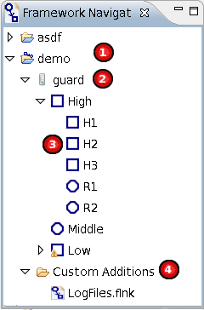
Framework Navigator
Project
System
Multiple systems can exist in a single project
Each system will be translated into an SELinux policy that can be installed on a machine
Policy Items
Broken down by domains into High, Middle, and Low. High and Low are decomposed into other domains and resources.
Custom Additions
Hooks into the SELinux base policy that the project builds on [1]
Image created by Tresys Technology

Slide 11
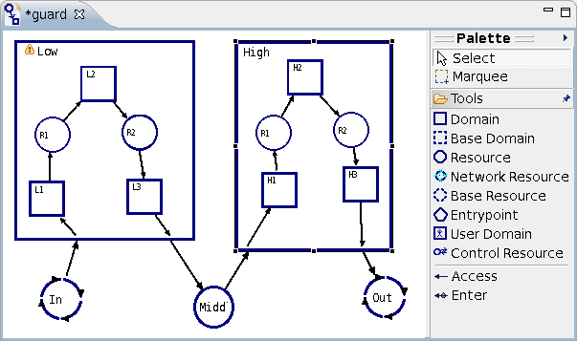
Graphical Editor and Palette
Original images created by Tresys Technology

Slide 12
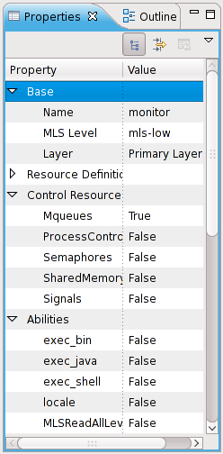
Properties
Display / Edit properties for selected item
Select multiple items at once to modify their properties simultaneously [1]
Image created by Tresys Technology

Slide 13
Problems
Behaves like the error output pane of most IDEs
Displays all errors detected in the user’s CDS at build time
Select an error and the corresponding item within the editor will be selected
Some problems can be solved using the “Quick Fix” option [1]
Image created by Tresys Technology

Slide 14
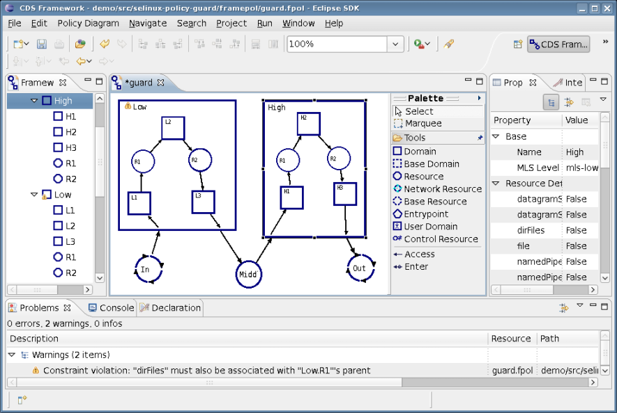
Snapshot of CDSFramework IDE
Image created by Tresys Technology

Slide 15
How does the graphic translate into a policy?
The CDS IDE converts a security architecture diagram created via the editor into an SELinux security policy
The IDE creates an SELinux policy module that SLIDE compiles into the binary policy [4]

Slide 16
Possible Alternatives
SLIDE (Foundation for CDS Framework)
Administrator can write/edit policies at a lower level to create a CDS[5]. We lose the intuitive graphical language, but still have the ability to work within an IDE
SELinux Policy Editor (SEEdit)
GUI based IDE with some optional command line interfaces available [7]
Relatively low level, text based
Some details of raw policy creation is hidden (Simplified Policy Description Language (SPDL)) [6].
Edit the plain text policy with your favorite text editor
Total control of exact shaping of the policy
Steep learning curve and high chance for error

Slide 17
Criticisms of CDSs
Some have said that a CDS is contrary to the original idea of Mandatory Access Control (MAC) which tries to force rigid security rules without room for different interpretations depending on the situation[8].
Implementing a CDS allows the well meaning admin to push through system modifications while focused narrowly on the current problem at hand, potentially overlooking larger system wide security concerns.
People often avoid implementing a CDS on a system until it is absolutely necessary and no other way of accomplishing a goal is possible within the confines of an established MAC based system, which may not be a bad thing.

Slide 18
Conclusion
The CDS Framework IDE is a powerful tool for administrators trying to accomplish specific tasks relying on information sharing within an SELinux environment.
It takes the often complex process of policy creation/editing and simplifies it using an intuitive graphical language that is translated into functional SELinux policies.
Domain isolation exists for a reason. If CDSs are overused they could compromise the security of the overall system.
“With great power comes great responsibility.”

Slide 19
References
[1] Tresys Technology, LLC, “CDS Framework Toolkit Documentation," treysys.com, May. 7, 2009. [Online]. Available: http://oss.tresys.com/projects/cdsframework/chrome/site/helpfiles/webdocs.html. [Last Accessed: Dec. 6 2009].
[2] K. MacMillan, et al., “Lessons Learned Developing Cross-Domain Solutions on SELinux," treysys.com, March 2, 2006. [Online]. Available: http://www.tresys.com/pdf/Lessons-Learned-in-CDS.pdf. [Last Accessed: Dec. 5 2009].
[3] “CDS Framework IDE,“ [Online]. Available: http://oss.tresys.com/projects/cdsframework/. [Last Accessed: Dec. 5 2009].
[4] “CDS Framework Download and Installation Instructions,“ [Online]. Available: http://oss.tresys.com/projects/cdsframework/wiki/download. [Last Accessed: Dec. 5 2009].
[5] “SLIDE Introduction,“ [Online]. Available: http://oss.tresys.com/projects/slide/. [Last Accessed: Dec. 5 2009].
[6] Y. Nakamura and Y. Sameshima, “SELinux for Consumer Electronics Devices," Linux Symposium, July 23rd, 2008. [Online]. Availablehttp://ols.fedoraproject.org/OLS/Reprints-2008/nakamura-reprint.pdf. [Last Accessed: Dec. 5 2009].
[7] “SELinux Policy Editor,” SEEdit, Aug 27, 2008. [Online]. Available: http://seedit.sourceforge.net/ [Last Accessed: Dec. 6 2009].
[8] “Cross Domain Solutions,” Academic dictionaries and encyclopedias, [Online]. Available: http://en.academic.ru/dic.nsf/enwiki/3986437 [Last Accessed: Dec. 6 2009].

Slide 20
Questions?

