Slide 1
Open Source PHP
The Secure Use of
Presented for:
Dr. Edward Chow
By:
Abdullah Almurayh
CS591
Fall2009
UCCS.EDU

Slide 2
Outline
Background
Vulnerabilities
Solutions
Outlook
Demos
Conclusion
References

Slide 3
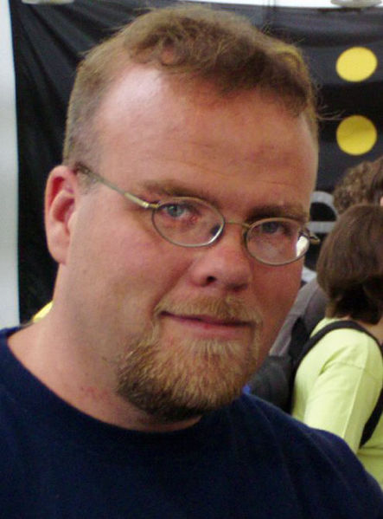
PHP
PHP History:
Created in 1994
PHP: Hypertext Preprocessor
Dynamic web pages
“High-level” languages
Rasmus Lerdorf
Created PHP
PHP can do!
math operations +, /, -, x
logical operations <, >, =, !, |
support databases
control files

Slide 4
PHP
PHP Support:
Operating systems :
Linux, Unix, Solaris, Open BSD, Microsoft Windows, Mac OS X, RISC OS.
Web servers :
Apache, IIS , Personal Web Server, Netscape and iPlanet servers, Oreilly Website Pro server, Caudium, Xitami, OmniHTTPd.

Slide 5
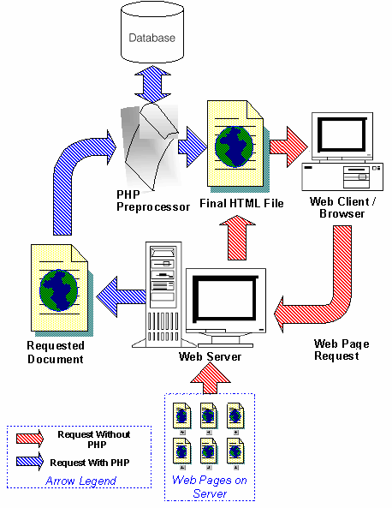
PHP
PHP Work:
Performs programmed actions, and returns HTML code that will then be sent back to your customer's web browser.
Embedded in HTML code:
<html> <body> <?php echo "Hello World"; ?> </body> </html>

Slide 6
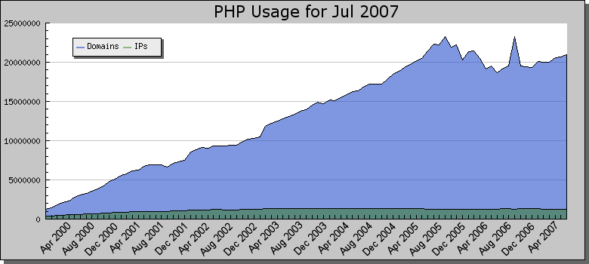
PHP
PHP Usage:

Slide 7
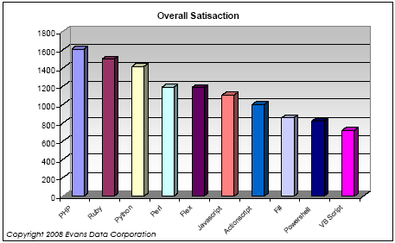
PHP
PHP Usage:

Slide 8
Open Source PHP
Open Source PHP Systems:
Programmed by Organizations
Professional features
Advanced Functions
Secured and Supported
Freeware or shareware

Slide 9
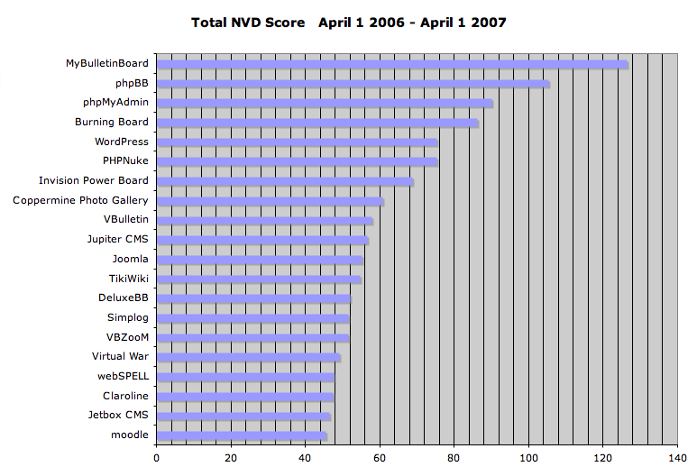
Open Source PHP
Open Source PHP Systems:

Slide 10
Reasons for Being Hacked :
Webmaster:
Careless
inexpertness
Hacker:
Malice
harmfulness

Slide 11
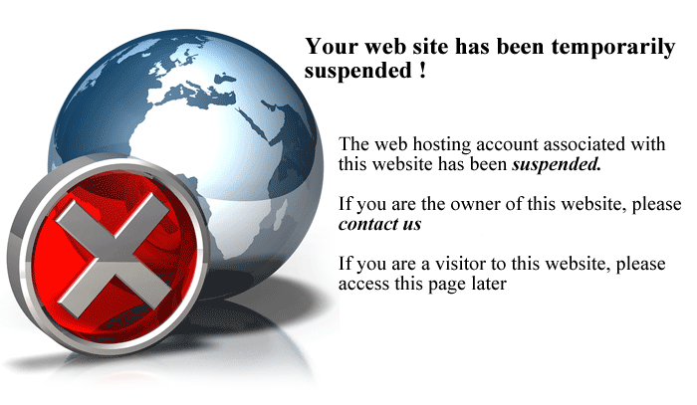
Vulnerabilities :
Cracked Systems:
Crackers create vulnerable codes to
hack your website instead of assisting
you
Bundled Scripts:
Images storage
Uploader
Filestorage

Slide 12
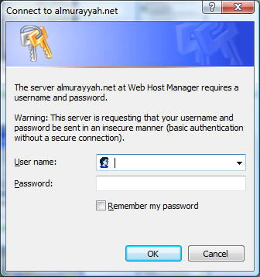
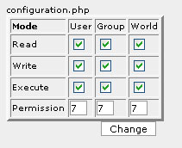
Vulnerabilities :
Firewalls:
Admin directories
Security directories
Configurations directories
Permissions:
Configuration or security files
Readable
Writable
Executable

Slide 13
Vulnerabilities :
Explored Directories:
easy to learn what a directory contains.
Installation Files:
Overwrite the entire website if the installation wizard is launched

Slide 14
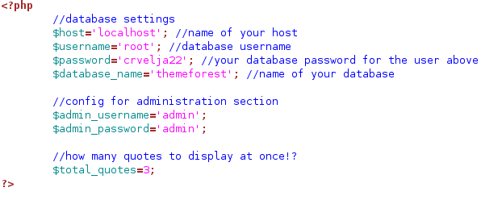
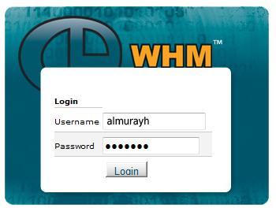
Vulnerabilities :
Configuration Files:
Most of configuration and setting parameters are included in these file.
Guessable Security Information:
•Default passwords: password, default, admin, guest…
•Doubled words: crabcrab, stopstop, treetree, etc
•Common sequences: qwerty, 12345678, 111111 etc
•personal : DL# , ID#, SSN, DOB SID , etc

Slide 15
Vulnerabilities :
Non-protected Computers

Slide 16
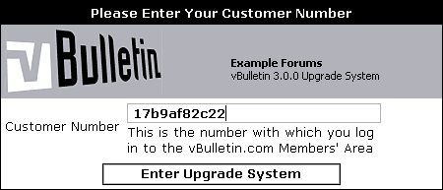
Solutions:
Trusted and Licensed PHP Systems:
Pay and be safe!
Use trusted free Systems
Updating and Upgrading:
Update to patch and secure.
Upgrading for features.

Slide 17
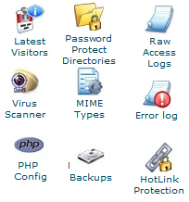
Solutions:
Web protection Tools:
Web Virus Scanning
Visitor log
HOT link protection
Backup
…
Vulnerabilities Scanner:
Errors
Danger functions
Exploits
…

Slide 18
Solutions:
Encryption :
Encrypted files
Use Systems support Encryption mechanisms
…
Disguised Contents:
Hide website contents
Change default paths
…

Slide 19
Solutions:
Website Cleaning
Dump Unused files
Remove installation files
Clean anything causes hacking.
Forbidding and Premising:
administration Dirs.
Security information and settings.
Forbid configuration files from being :
Read
Overwritten
Downloaded

Slide 20
Solutions:
Protecting Our Computers

Slide 21
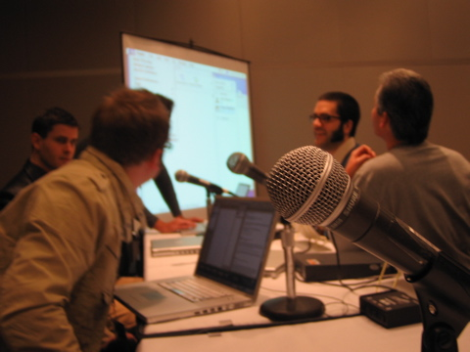
Outlook:
Changeable Variables
Auto:
Cleaning
Maintaining
Continued Support

Slide 22
Demos on vBulletin:
Exploiting Unsecure Scripts
http://www.cs591.edu/uploader/images/my_last_party2009.php.gif
Write an exploit code
Save it as an image
Upload it.
Run the hacking file
Admin gained!

Slide 23
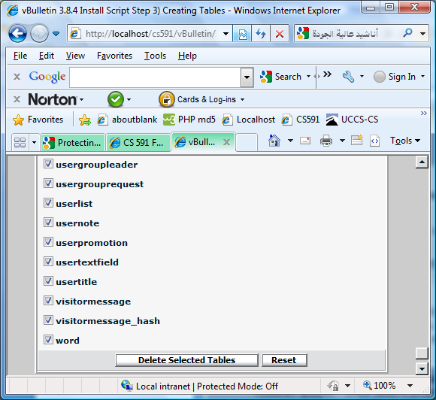
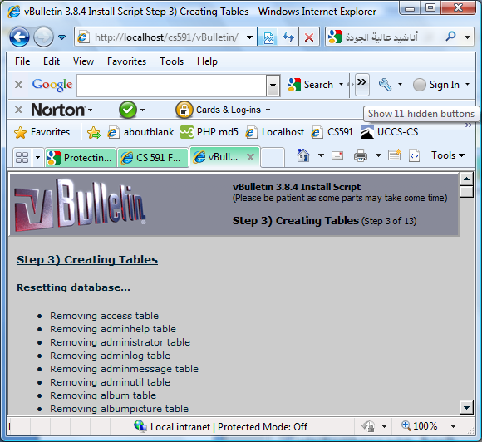
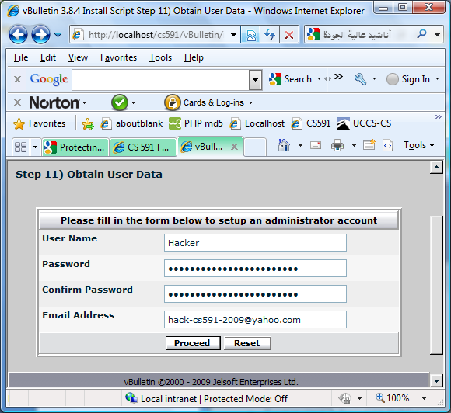
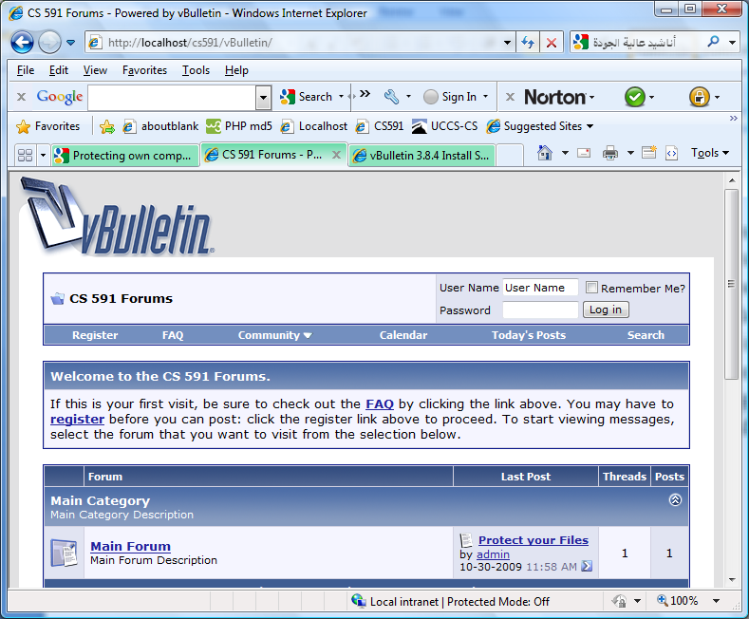
Demos on vBulletin:
Exploiting Installation Wizard
Find the installation Dir.
Run the wizard
Drop & create new.
Admin Gain !
http://www.cs591.edu/vBulletin/install

Slide 24
News:
Vulnerabilities Search Engines:
Uses Google to search for vulnerabilities. Cool! for fresh hackers
http://www.goolag.org/

Slide 25
Conclusion:
Open Source PHP enhance websites’ performance.
Non-expert or careless webmasters inadvertently cause threats for websites.
Hackers exploit possible vulnerabilities to hack or crack websites.
Webmasters need to improve their abilities of website administration.
Webmasters should learn how their websites can be exploited and patch them.

Slide 26
References
?
Book:
[01] UNIX WebMaster Bible by Nabajyoti Barkakati, Naba Barkakati
Web:
[01] http://funkatron.com/
[02] http://www.php.net/
[03] http://en.wikipedia.org/wiki/PHP
[04] http://www.devshed.com/c/a/PHP/
[05] http://www.alberton.info/secure_php_installation.html
[06] http://www.dwheeler.com/secure-programs/Secure-Programs-HOWTO/php.html
[07] http://md5.kokosdesign.de/
[08] http://www.w3schools.com/php/php_secure_mail.asp
[09] http://www.zend.com/en/
[10] http://www.apache.org/
[11] http://www.addedbytes.com/php/writing-secure-php/
[12] http://www.opensource.org/docs/definition.php
[13] http://www.webdesignbooth.com/20-promising-open-source-php-content-management-systemscms/
[14] http://www.sandhill.com/opinion/editorial.php?id=157
[15] http://www.itsmproject.com/
[16] http://php.opensourcecms.com/
[17] http://www.oreillynet.com/pub/a/php/2001/02/22/php_foundations.html
[18] http://www.breakingpointsystems.com/community/blog/php-safe-mode-considered-harmful
[19] http://stateofsecurity.com/?p=554
[20] http://www.learnphp-tutorial.com
[21] http://www.gfi.com/whitepapers/detect-hackers-on-web-server.pdf
[22] http://searchengineland.com/hackers-launch-goolag-a-google-vulnerability-scanner-13444

