Slide 1
OpenID
Single Sign-on Writ Large

Slide 2
What is OpenID?
Open, Decentralized single sign on standard
Allows users to use a single digital identity across multiple sites
Identity is represented by a URL or XRI

Slide 3
Who Supports OpenID?
Yahoo
Google
AOL
VeriSign
BBC
Microsoft
LiveJournal.com
SourceForge.NET

Slide 4
Brief History
Developed May 2005 by Brad Fitzpatrick while at LiveJournal
1.o specification finalized March 2006 as part of the Yadis project
Major Industry players announce support for OpenID

Slide 5
Glossary
End-user
Person seeking to assert identity to a site
Identifier
URL or XRI chosen by end-user
Identity Provider\OpenID Provider
Service provider who authenticates user and registers identifiers
Relying Party
Site seeking to authenticate End-user
Server\Server-Agent
Server verifying end-users identifier
User Agent
Program used to access Identity provider or relying party
eXtensible Resource Identifier (XRI)
Scheme and Resolution Protocol for Abstract compatible with URI’s

Slide 6
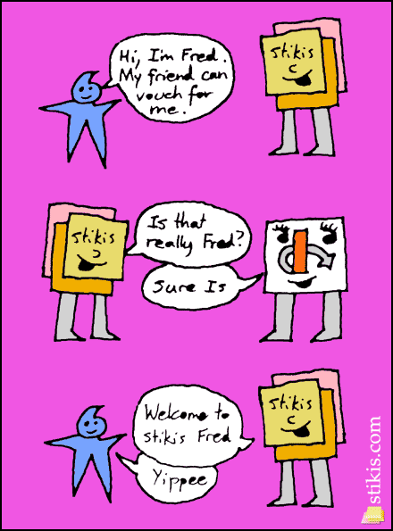
Login Process
Video Explanation

Slide 7
References
YouTube Video (http://www.youtube.com/watch?v=xcmY8Pk-qEk)
.NET Slave (http://blog.madskristensen.dk/post/OpenID-implementation-in-Csharp-and-ASPNET.aspx)
WikiPedia (http://en.wikipedia.org/wiki/OpenID)
OpenID.NET (http://openid.net/what/)
DotNetOpenID at Google Code (http://code.google.com/p/dotnetopenid/)

