Slide 1
Network Protocol Packet Analysis
By: Daniel Ruiz

Slide 2
Overview
How to Capturing Packets
WireShark
Lua
Analyzing Packets
Principle Component Analysis (PCA)

Slide 3
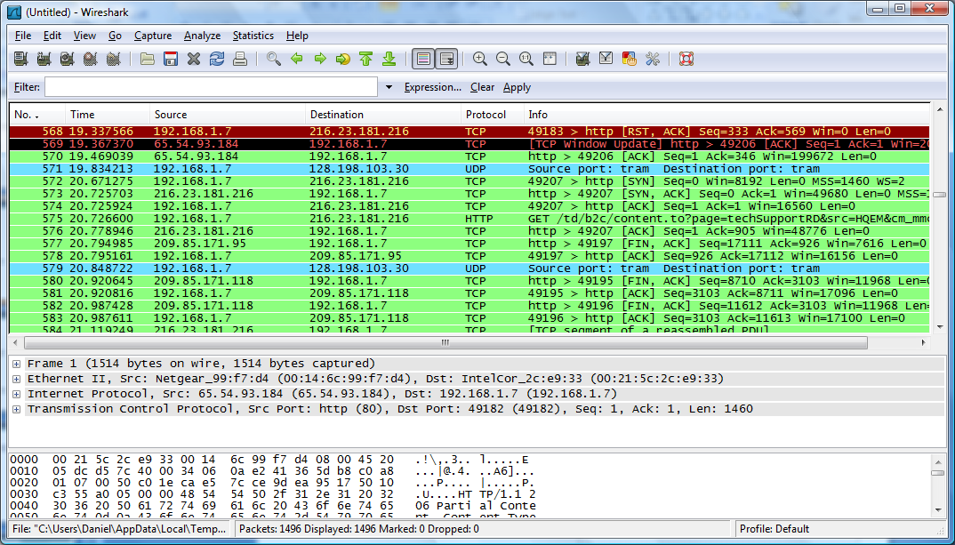
WireShark
Best Open Source Packet Analyzer available today
Used in ICTF
Multi-platform runs on Linux, Window, OS X and many others
Live capture and offline analysis
Much Much More!!!

Slide 4
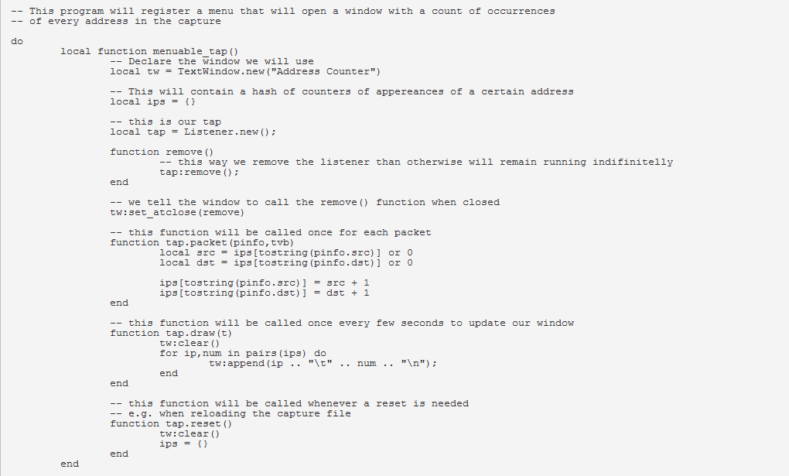
Lua
Lua is a powerful light-weight programming language designed for extending applications
Very is to use API
Allows for scripting in Wireshark
Lua can be used to write dissectors, post-dissectors and taps.

Slide 5
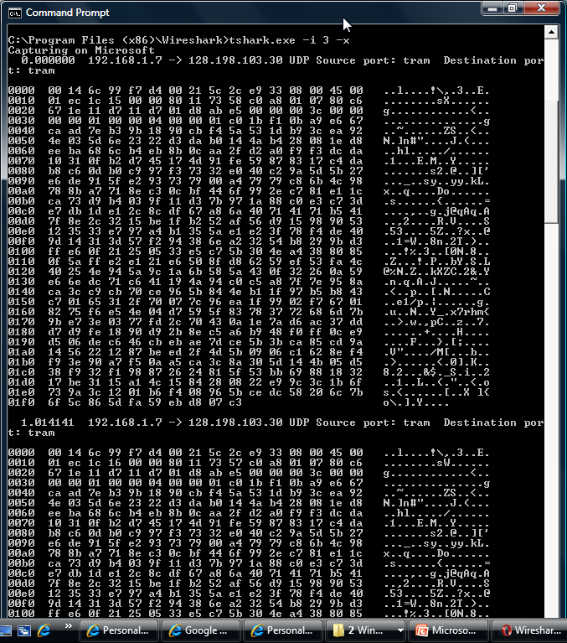
Analyzing Packets
Tshark is able to detect, read and write the same capture file that are supported by WireShark
To detect
Tshark.exe –i eth0 –x
To read
Tshark.exe –r “file” –x
To write
Tshark.exe –i eht0 –x –w “file”
Understand the software tools before writing them yourself!

Slide 6
Pictures and Packets
Good Packet
Malicious Packet

Slide 7
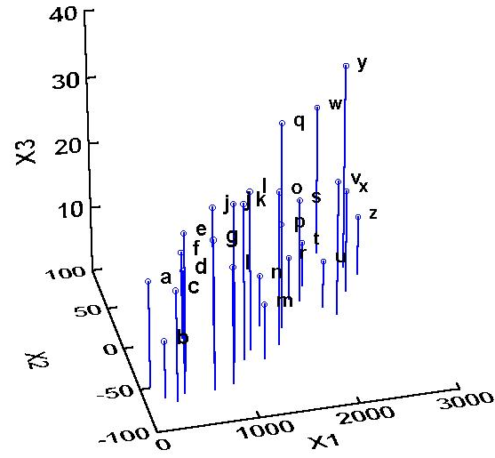
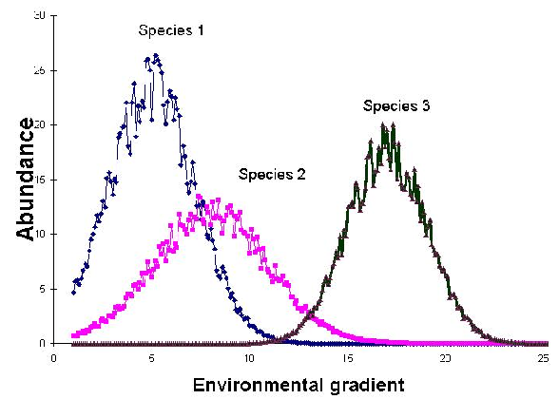
Principle Component Analysis
Data Cloud
Use PCA instead of convolution with FFT
PCA takes your cloud of data points, and rotates it such that the maximum variability is visible (most important gradients).
Maximum variability is found by the Eigen values of each packet
Packets with malicious data should have different gradients than those with good data
Gradient Abundance

Slide 8
Improvements
Use Neural Network to recognize malicious Eigen values
Investigate Wavelet PCA
PCA and FFT convolution speed analysis

Slide 9
Questions?

