Slide 1
Secure Smart Grids
Edward Chow
Professor of Computer Science
University of Colorado at Colorado Springs

Slide 2
Outline of the Talk
Security Related Projects at UCCS
  iCTF cyber war competition, you are wanted!
  Rocky Mountain Secure Smart Grid Initiative

Slide 3



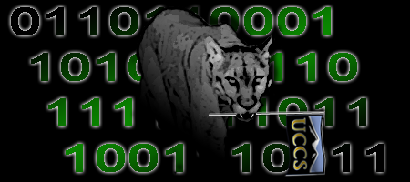
All UCCS students
All levels are welcome
Brand new Blade Server System!!
Come Join U-C-Lion Team
Every Monday Night EN101 6:30-7pm
iCTF 2009 Competition 12/4 Friday 9am-5pm@SENG A210
International Capture The Flag Cyberwar Competition
Visit U-C-Lion Team Wiki Site: http://athena.uccs.edu/ictf/
Learn Neat Tricks/Analysis for Cyber Attacks/Defenses
Contact Info: Prof. Edward Chow, chow@eas.uccs.edu

Slide 4

iCTF 09
GO! UC LIONS!

Slide 5
What is Smart Grid?
automated, widely distributed energy delivery network
characterized by a two-way flow of electricity and information,
capable of monitoring/responding to changes in power plants, customer preferences individual appliances.
Enable new opportunities and support innovations:
  nationwide use of plug-in hybrid electric vehicles,
  ability to return stored energy to the grid;
  seamless integration of renewable energy sources like wind and solar;
  enabling consumer choice;
  integration of green building practices with the grid;
  Large-scale energy storage

Slide 6
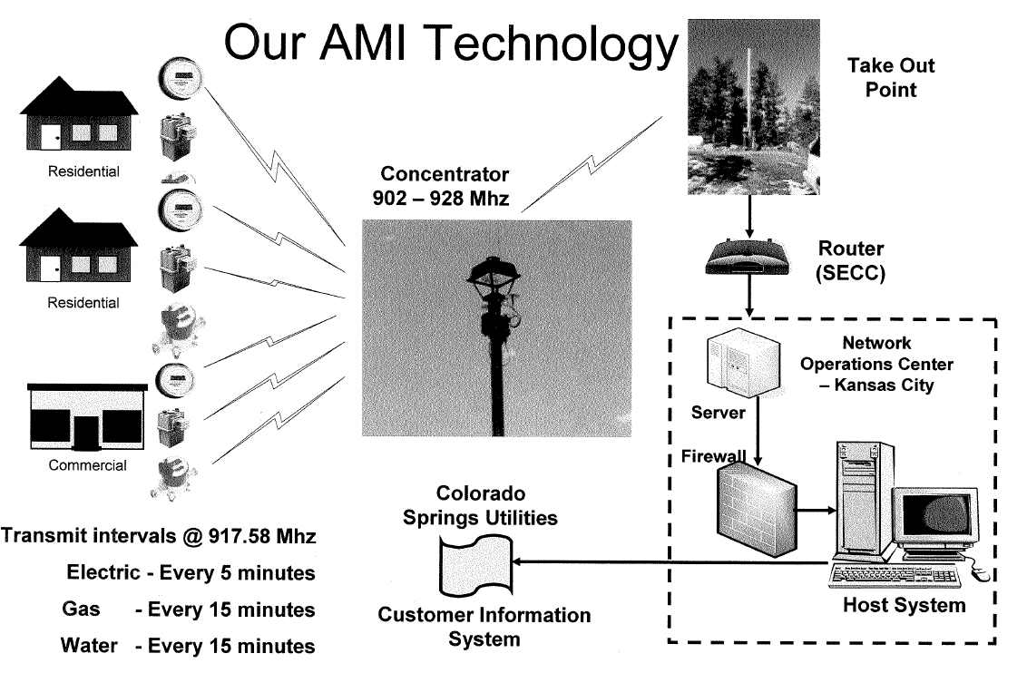
Colorado Springs Utilities
Advanced Meter Infrastructure

Slide 7
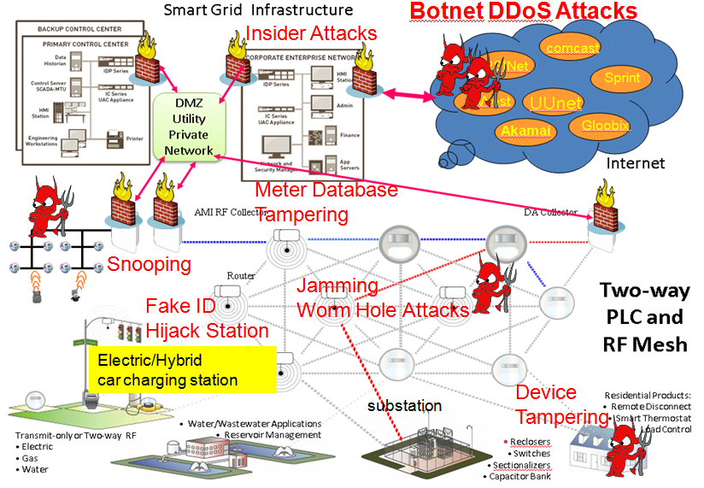
Local Smart Grid Security
Electric/Hybrid
car charging station
substation

Slide 8
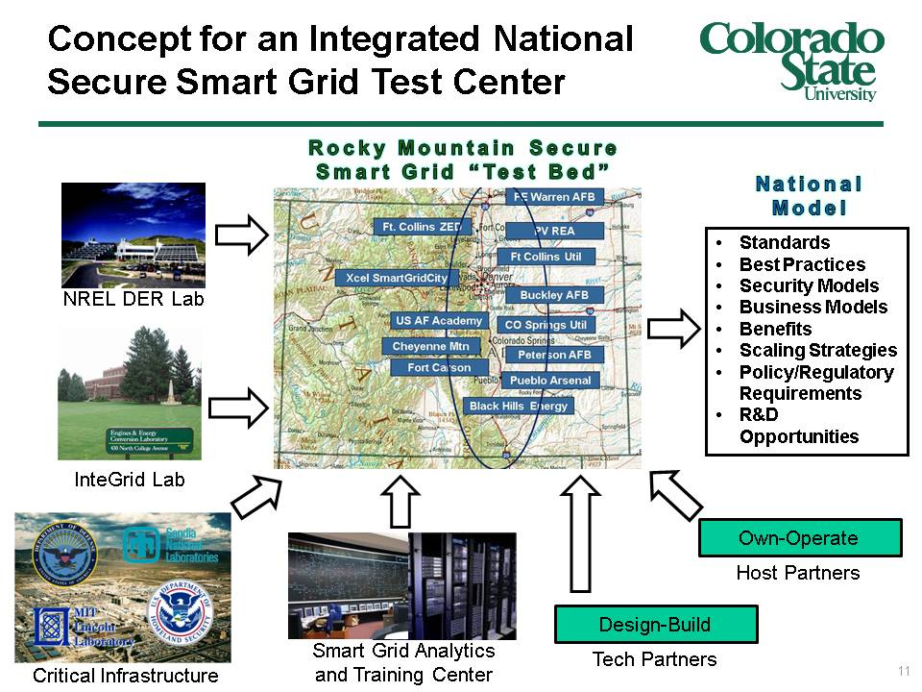
RMSSGI Regional Solution

Slide 9
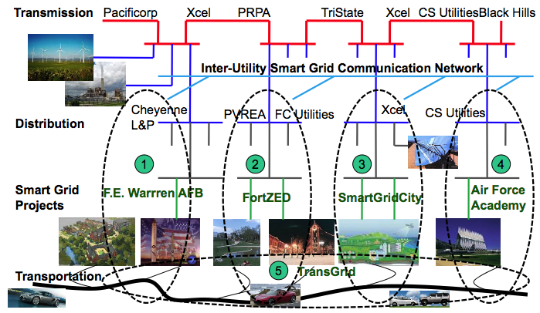
RMSSGI Systems Approach

Slide 10
Trans-Smart Grid Security
Inter-operabilities:
  Key Management Systems/KMIP
Coordinated Intrusion detection and handling (DDoS attacks)
Coordinated disaster recovery and outage management
Protect security access to systems providing new smart grid services/feature
  proposed energy storage system
  Hybrid/electric charging station (Mutual authentication; authentication of keys issued by different utilities/vendors)

Slide 11
Secure Smart Grid Challenges
Utilization of Internet and related IP and wireless technologies→ expose the system to easy, remote, extern cyber threats such as DDoS attacks from North Korea.
immense areas to be monitored and physically secured.
infrastructure security and cyber security need to be addressed.
Threats can come from hostile governments, terrorist groups, disgruntled employees, malicious intruders, complexities, accidents, natural disasters as well as malicious or accidental actions by insiders.

Slide 12
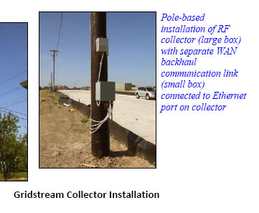
What is wrong with this picture?
Real picture from a SG vendor's brochure:-)

Slide 13
RMSSGI Security Program
Mission:
“Improve the security of national smart grid infrastructure and impact future security standards for smart grids through coordinated large scale multi-utilities demo projects.”
Program Team Members:
  Dr. Edward Chow (Cyber Security) Project Co-Lead
  Dr. Ray Tretcher (Infrastructure Security) Co-Lead.
  23 Researchers from MIT Lincoln Lab, Sandia, UCB, UCCS, CSU, DHS, LM, Bell Lab, CS Utilities, Northcom, Merrick, NISSSC
See web site: http://athena.uccs.edu/ssg/

Slide 14
SSG Program Concepts
Ensure ability to ensure the three basic security service availability, integrity, and confidentiality (CIA) of smart grids.
Incorporate the new physical/cyber security technologies and best practices in security → guarantee the uninterrupted service delivery even under DDoS or malicious worm attacks,
Monitor, locate, isolate, and respond to physical attacks,
Ensure the integrity of the operation and data collection,
Protect the privacy of its customers/employees and the confidentiality of the system data and programs.

Slide 15
Program Concepts/Demo Projects
Cross Domain Secure Information Sharing For DDoS Defense and Coordinated Disaster Recovery
Key Management and Distribution
Secure Collective Smart Grid Defense
Secure SCADA and Efficient Multi End Point Security
Biotope based Biometric Authentication Infrastructure
Meter Data Integrity for Peak/Outage Management
Penetration Testing, Software Scanning, and Vulnerability Analysis
STRATPOWER-M: Strategic Power Deployment (Mobile)
Last Count: $200M RMSSGI proposal
Security program portion: $38M;
UCCS: $7.3M
Sturman Industry: $3M

Slide 16
Security Standards for Smart Grids
In RMSSG demo projects, the following standards and suggested best practices apply:
NIST SP 800-82, Guide to Industrial Control Systems (ICS) Security.
NIST SP 800-53, Recommended Security Controls for Federal Information Systems
FIPS 200, Minimum Security Requirements for Federal information and Information System.
NIST SP 800-30, Risk Management Guide for Information Technology Systems,
NIST SP 800-37, Guide for the Security Certification and Accreditation of Federal Information Systems
NIST Smart Grid Interoperability Standards Framework, Release 1.0
NIST: AMI-SEC System Security Requirements
FERC/NERC Critical Infrastructure Protection Standards
DHS: Catalog of Control Systems Security: Recommendations for Standards Developers

Slide 17
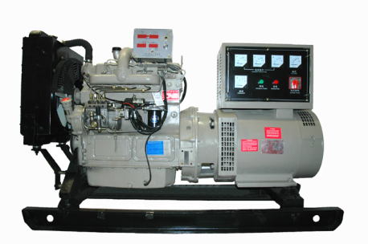
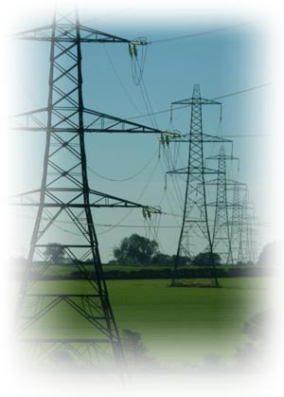
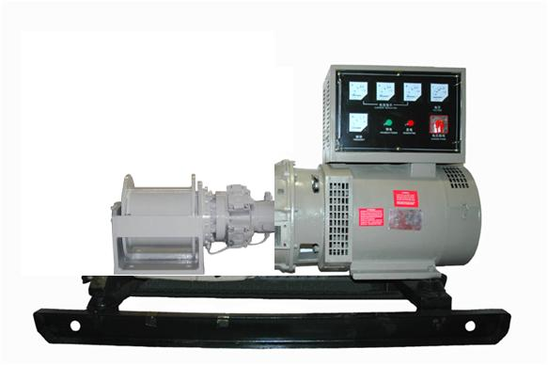
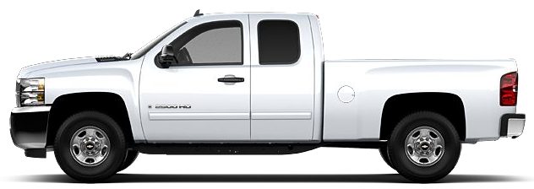
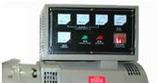
Strategic Power Deployment
Sturman‘s Digital Engine technology uses advanced closed loop controls to optimize fuel efficiency and engine power generation from clean renewable fuels to meet the demands of Utility Providers (Natural Gas) , Military (JP8 / Jet A, Diesel), and Commercial Customers (Biodiesel, Ethanol.)
Back-up power generation are equipped with the same fully flexible advanced multi-fuel engine used in vehicles
The generator is driven by the same Digital Engine that powers transportation vehicles to take advantage of high volume engine production and reduce costs
Utility vehicles can be deployed to drive stationary generators that are tied to the Smart Grid for emergency back-up power generation
(The electric generator is driven by the vehicles primary Digital Engine eliminating the need for a redundant engine at the generator site)
Deployment of mobile power generation can be connected to the Smart Grid at strategic locations
(The electric generator is driven by the vehicles primary Digital Engine)

Slide 18
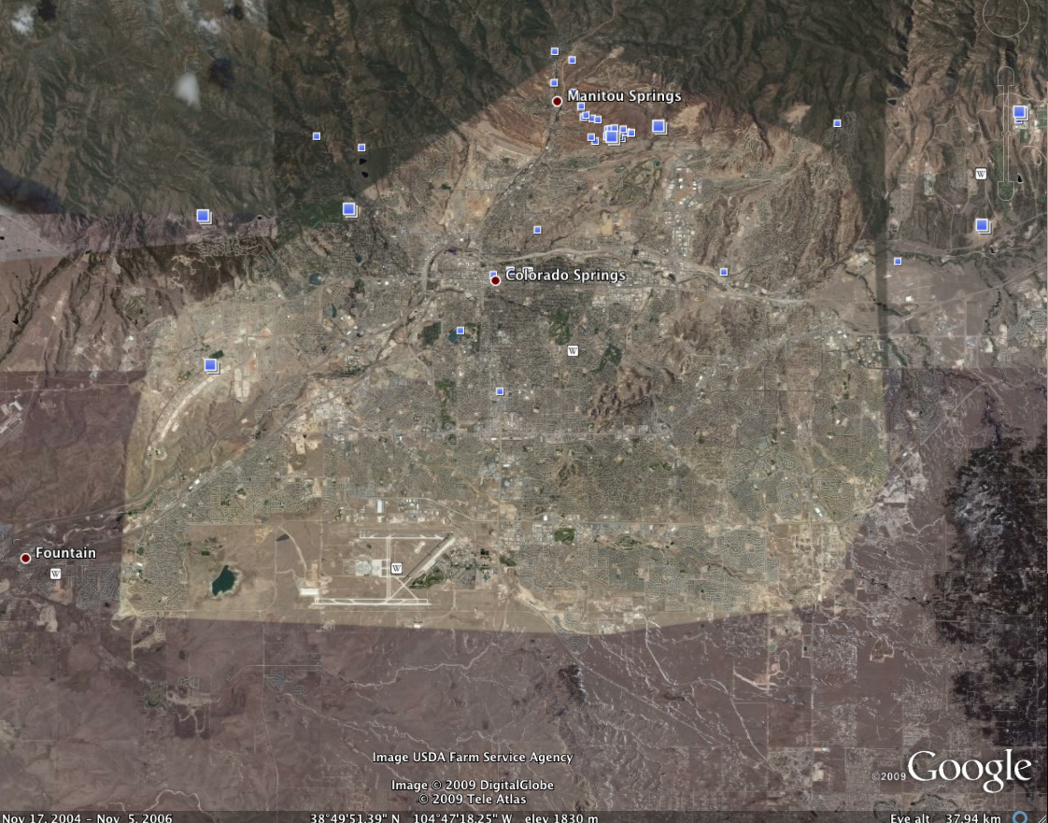
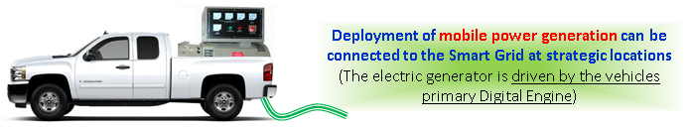


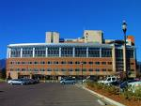

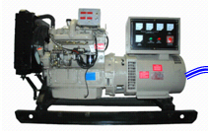
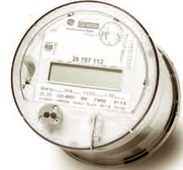

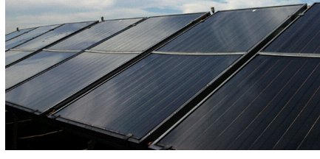
STRATPOWER-M: Strategic Power Deployment-Mobile
Disaster Recovery
Emergency Response
Hospitals
Backfeeding Colorado Springs Utilities Power Grid
UCCS Secure Smart Grid Lab
Backup power for server room
UCCS MicroGrid
Advanced Meters+Optimal Control
Renewable Energy Integration
Low carbon footprint, efficient multi- fuel backup power generation based on
Sturman’s digital engine technology

