Slide 1
Firewall
C. Edward Chow
Chapter 18, Sec. 18.3.2 of Security Engineering
Page 451, Section 7.4 of Security in Computing Linux Iptables Tutorial 1.2.2 by Oskar Andreasson

Slide 2
Outline of The Talk
Definition
Perimeter Defense and Firewall
Implement Firewall using Linux iptables

Slide 3
Firewall
Here is how Bob Shirey defines it in RFC 2828.
Firewall:
(I) An internetwork gateway that restricts data communication traffic to and from one of the connected networks (the one said to be "inside" the firewall) and thus protects that network's system resources against threats from the other network (the one that is said to be "outside" the firewall). (See: guard, security gateway.)

Slide 4
Perimeter Defense and Firewall
DMZ
Intranet
Internet
DNS
Mail
Web
Intra2(win2003)
Server
Server
Server
Firewall
Firewall
SW
Outer Firewall Router
Inner Firewall Router
SW
SW
IDS
Honeypot
IDS
Intra1 (XP)
IDS

Slide 5
Intrusion Prevent System (IPS) combining Firewall with IDS
DMZ
Intranet
Internet
DNS
Mail
Web
Intra2(win2003)
Server
Server
Server
Firewall
Firewall
SW
SW
SW
IPS Outer
IPS
Inner
IDS
Honeypot
IDS
Intra1 (XP)

Slide 6
Unauthorized Wireless/Dialup Access Problems in Perimeter Defense
DMZ
Intranet
Internet
DNS
Mail
Web
Intra2(XP)
Server
Server
Server
Firewall
Firewall
SW
SW
SW
IPS Outer
IPS
Inner
IDS
Honeypot
IDS
Intra1 (XP)

Slide 7
Firewall related Terminology: DMZ .. Application Firewall
DeMilitarized Zone: a portion of a network that separate a purely internal network from an external network.
Guard (Firewall): a host that mediates access to a network, allowing/disallowing certain types of access on the basis of a configured policy.
Filtering firewall: firewall that performs access control based on the attributes of packet headers, rather than the content.
Proxy: an intermediate agent or server that acts on behalf of an endpoint without allowing a direct connection between two end points.
Proxy (Application Level) Firewall: firewall that uses proxies to perform access control. It can based on content and header info.
Content Switch/Sock Server are typical examples.

Slide 8
Design Principles for Secure Mechanisms
Least Privileges
Fail-Safe Defaults
Economy of Mechanism
Complete Mediation
Open Design
Separation of Privilege
Least Common Mechanism
Psychological Acceptability

Slide 9
Security Policies
The DMZ servers are typically not allowed to make connections to the intranet.
Systems in Internet not allowed to directly contact any systems in the intranet.
Systems in Intranet not allowed to directly contact any systems in the Internet.
Systems in DMZ serve as mediator (go-between). Password/certificate/credential are presented for allowing mediating services.
No dual interface from DMZ servers directly to systems Intranet except the inner firewall.
Intranet system typically uses Private LAN addresses: 10.x.y.z/8; 172.a.x.z (16<=a<32)/16; 192.168.x.y/24.

Slide 10
Security Policy
Complete Mediation Principle: inner firewall mediate every access involves with DMZ and Intranet.
Separation of privileges; with different DMZ server running different network functions; firewall machines are different entities than the DMZ servers; inner firewall and outer firewall enforce different security policies.
It is also related to least common mechanism principle.
The outer firewall allows HTTP/HTTPS and SMTP access to DMZ server. Need to detect virus, malicious logic (how about inner firewall?)

Slide 11
Linux Iptables/Netfilter
In Linux kernel 2.4/2.6 we typically use the new netfilter package with iptables commands to setup the firewall for
Packet filtering
Network Address and Port Translation (NAT|NAPT)
Packet mangling.
The old package called IP chains (even older ipfwadm) will be deprecated.
http://www.netfilter.org/ is main site for the package.
walrus are using iptables 1.4.7. 1.4.10 released.
Tutorial and HOW-TO manual is available there.
http://www.netfilter.org/documentation/index.html#documentation-howto

Slide 12
Netfilter and Iptables
netfilter is a set of hooks inside the Linux kernel that allows kernel modules to register callback functions with the network stack. A registered callback function is then called back for every packet that traverses the respective hook within the network stack.
iptables is a generic table structure for the definition of rulesets. Each rule within an IP table consists of a number of classifiers (iptables matches) and one connected action (iptables target/jump).
Tables; commands; classifiers; actions
netfilter, ip_tables, connection tracking (ip_conntrack, nf_conntrack) and the NAT subsystem together build the major parts of the firewall framework.

Slide 13
What can I do with netfilter/iptables?
build internet firewalls based on stateless and stateful packet filtering
use NAT and masquerading for sharing internet access if you don't have enough public IP addresses. (SNAT service; outgoing traffic/internal initiated)
use NAT to implement transparent proxies. Here it means clients does not know how and where the request is served. (DNAT service; incoming traffic/external requests)
aid the tc (traffic control) and iproute2 (utility for controlling TCP/UDP networking and traffic control) systems to build sophisticated QoS and policy-based routing
do further packet manipulation (mangling) like altering
Type of Service (TOS; 2nd Byte in IP header for QoS RFC791)
Differential Service Control Point (DSCP upper 6bits of TOS field; RFC2474)
Explicit Congestion Notification (ECN bit 6 and 7 of TOS field; RFC3168)
bits of the IP header.

Slide 14
Firewall Exercise
Intranet (10.0.n.0/24)
(FC13)
Internet
DNS
Mail
Web
Server
Server
Server
Firewall
Firewall
eth0
eth1
eth0
eth1
VMnet3 SW
VMnet2 SW
Outer FW (FWout)
Inner FW (FWin)
DMZ (172.16.n.0/24)
Intra1 (xpup)

Slide 15
Incoming Packet Journey through Linux Firewall
NIC to Internet (eth0)
nat Table PREROUTING Chain
iptables -t nat -A PREROUTING -p TCP -i eth0 -d 128.168.60.12 --dport 80 -j DNAT --to-destination 192.168.10.2
Routing Decision
filter Table FORWARD Chain
iptables -A FORWARD –p ALL -s 128.199.66.1 -j REJECT iptables -A FORWARD -p ALL -s 128.200.0.2 -j LOG --log-prefix "bad guy:" iptables -A FORWARD -p ALL -s 128.200.0.2 -j DROP
nat Table POSTROUTING Chain
NIC to Intranet

Slide 16
DNAT and Iptables command
DNAT: Destination Network Address Translation.
Deal with packets from Internet to our Internet exposed servers.
It translates the destination (external) IP addresses to the corresponding internal IP address of DMZ servers.
iptables -t nat -A PREROUTING -p TCP -i eth0 -d 128.168.60.12 --dport 80 -j DNAT --to-destination 192.168.10.2
-t specify the type of tables -A Append to a specific chain -p specify the protocol -i specify the incoming interface -d specify the matched destination IP address in packet -j specify the “target” or operation to be performed. --to-destination substitute the destination IP address.

Slide 17
Outgoing Packet Journey through Linux Firewall
NIC to Intranet
nat Table PREROUTING Chain
Routing Decision
filter Table FORWARD Chain
iptables -A FORWARD -s 192.168.10.10 -j REJECT Certain system in Intranet not allowed out
nat Table POSTROUTING Chain
iptables -t nat -A POSTROUTING -o eth0 -j MASQUERADE
NIC to Internet (eth0)

Slide 18
SNAT vs. MASQUERADE
SNAT which translates only the IP addresses, the port number is preserved unchanged.
However, it requires that you have the equal number of outgoing IP addresses as IP address in your intranet that are carrying in the source address field of the outgoing packets.
Since it does not have to search for the available port or available IP address, SNAT is faster than MASQUERADE.
For smaller organization which only have a few static IP addresses, MASQUERADE is the typically method.

Slide 19
Incoming Packet Journey to Server in Firewall
NIC to Internet (eth0)
nat Table PREROUTING Chain
iptables -t nat -A PREROUTING -p TCP -i eth0 -d 128.168.60.11 --dport 53 -j DNAT --to-destination 192.168.10.1
Routing Decision
filter Table INPUT Chain
Example: A VPN gateway running on firewall alpha.uccs.edu
Local Process

Slide 20
Outgoing Packet Journey from Inside Firewall
Local Process
nat Table OUTPUT Chain
filter Table OUTPUT Chain
nat Table POSTROUTING Chain
NIC to Internet (eth0)

Slide 21
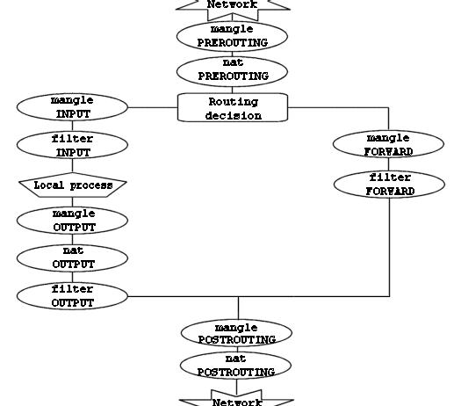
IP Tables and Packet Journey

Slide 22
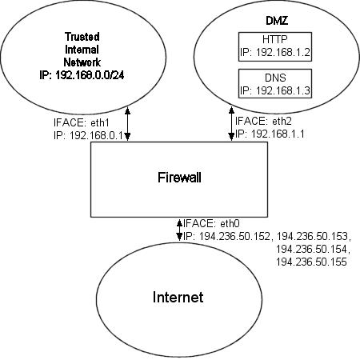
DMZ Example
See http://iptables-tutorial.frozentux.net/iptables-tutorial.html#RCDMZFIREWALLTXT

Slide 23
Turtle Firewall
Turtle Firewall is a software which allows you to realize a Linux firewall in a simply and fast way.
It's based on Kernel 2.4.x and Iptables. Its way of working is easy to understand: you can define the different firewall elements (zones, hosts, networks) and then set the services you want to enable among the different elements or groups of elements. You can do this simply editing a XML file or using the comfortable web interface Webmin.
Turtle Firewall is an Open Source project written using the perl language and realeased under GPL version 2.0 by Andrea Frigido (Frisoft).

Slide 24
SmoothWall
SmoothWall Express is an open source firewall distribution based on the GNU/Linux operating system.
“SmoothWall is configured via a web-based GUI, and requires absolutely no knowledge of Linux to install or use” (scary statement!)
It integrates with firewall, DHCP, VPN, IDS, Web proxy, SSH, Dynamic DNS.
http://downloads.smoothwall.org/pdf/2.0/admin.pdf

Slide 25
Sonicwall Pro 300 Firewall
A firewall device with 3 ports: Internet, DMZ, Intranet.
http://www.sonicwall.com/products/pro330.html
Restriction: NAT does not apply to servers on DMZ. Need to use public IP address.
You can use one-to-one NAT for systems in Intranet.
Support VPN. IPSec VPN, compatible with other IPSec-compliant VPN gateways
Bundled with 200 VPN clients for remote users
Supports up to 1,000 VPN Security Associations*
3 DES (168-Bit) Performance: 45 Mbps
ICSA Certified, Stateful Packet Inspection firewall
Unlimited number of users
Concurrent connections: 128,000
Firewall performance: 190 Mbps (bi-directional)

Slide 26
Stateful Firewall
The most common firewall now.
It checks the state of the connections, say TCP. and discards packets with incorrect msg types.
With netfilter, we can use –m state option of iptables
$IPTABLES -A bad_tcp_packets -p tcp --tcp-flags SYN,ACK SYN,ACK \ -m state --state NEW -j REJECT --reject-with tcp-reset $IPTABLES -A bad_tcp_packets -p tcp ! --syn -m state --state NEW -j LOG \ --log-prefix "New not syn:" $IPTABLES -A bad_tcp_packets -p tcp ! --syn -m state --state NEW -j DROP
iptables -A FORWARD -i $DMZ_INTERFACE -m state --state NEW -j LOG --log-prefix "Violate DMZ to Intranet “
How can we implement the security policy #1 in viewgraph #9 “The DMZ servers are not allowed to make connections to the intranet. “
http://iptables-tutorial.frozentux.net/iptables-tutorial.html#TCPCONNECTIONS

Slide 27
Lab Testbed for Exercise
(fc13)
Intranet (10.0.n.0/24)
Internet
DNS
Mail
Web
bt4r1)
Server
Server
Server
10.0.n.3
172.16.n.3
128.198.161.n
128.198.161.(n+1)
Firewall
Firewall
172.16.n.1
172.16.n.3
10.0.n.1
VLAN 36n SW
dvswitch 24 bits
dvswitch 20 bits
Outer FW (u10.10)
Inner FW (u10.10)
10.0.n.2
DMZ (172.16.n.0/24)
Intra1 (xpup)

Slide 28
Firewall Facts
(C) A firewall typically protects a smaller, secure network (such as a corporate LAN, or even just one host) from a larger network (such as the Internet). The firewall is installed at the point where the networks connect, and the firewall applies security policy rules to control traffic that flows in and out of the protected network.
(C) A firewall is not always a single computer. For example, a firewall may consist of a pair of filtering routers and one or more proxy servers running on one or more bastion hosts, all connected to a small, dedicated LAN between the two routers. The external router blocks attacks that use IP to break security (IP address spoofing, source routing, packet fragments), while proxy servers block attacks that would exploit a vulnerability in a higher layer protocol or service. The internal router blocks traffic from leaving the protected network except through the proxy servers. The difficult part is defining criteria by which packets are denied passage through the firewall, because a firewall not only needs to keep intruders out, but usually also needs to let authorized users in and out.

