Slide 1
XEN HYPERVISOR
By Abdullah Almuryh
Course: CS5260 Spring 2012 UCCS
Instructor: Dr. Edward Chow

Slide 2
Outline
Virtualization overview
Definitions
Types
Virtual Guests
Hypervisors
Principles
Xen Hypervisor
Architecture
Design
Performance comparisons
XenServer
Xen Cloud Platform
Demo

Slide 3
Virtualization Overview
What is Virtualization?
“The virtual world” is different from “the real world” only in human life, while possessing a similar principle or effect.
a virtual environment is the same as that of a real environment, though the underlying mechanisms are formally different.
Virtualization can be defined as a processing on physical servers to create logical partitions of virtual servers to handle other applications and distribute workloads
“host” is the physical machine runs guests
“guest” is used to refer to the virtualized operating system
virtualization is simulation?
virtualization is cloud?
Logical (Sharable) Resources
Abstraction (Virtualization) Layer
Physical(Dedicated) Resources

Slide 4
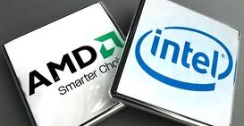
Types of virtualization
Native Virtualization: hardware support for virtualization within a processor.
was added to x86 processors (Intel VT-x or AMD-V) in 2006.
Known as:
hardware-assisted virtualization
accelerated virtualization
hardware virtual machine HVM
Emulation: a technique for allowing full systems or applications to run on different types of hardware architectures.
User-mode emulation: allows a process built for one hardware architecture to be executed on another architecture.
System-mode emulation: allows emulation unmodified guest operating systems to run on different hardware architectures
QEMU : (Quick EMUlator) an open source machine emulator and virtualizer.
Runtime dynamic translator
Converts instructions for a(guest) CPU to the (host) CPU
Very useful to other types of virtualization
works on Linux, Windows, FreeBSD and Mac OS X.
QEMU supports the emulation of various architectures (Alpha,ARM,Blackfin,CRIS,HPPA,LatticeMico32,m68k,Microblaze,MIPS,PowerPC,S390x,SH4,SPARC,x86,and Xtensa.)

Slide 5
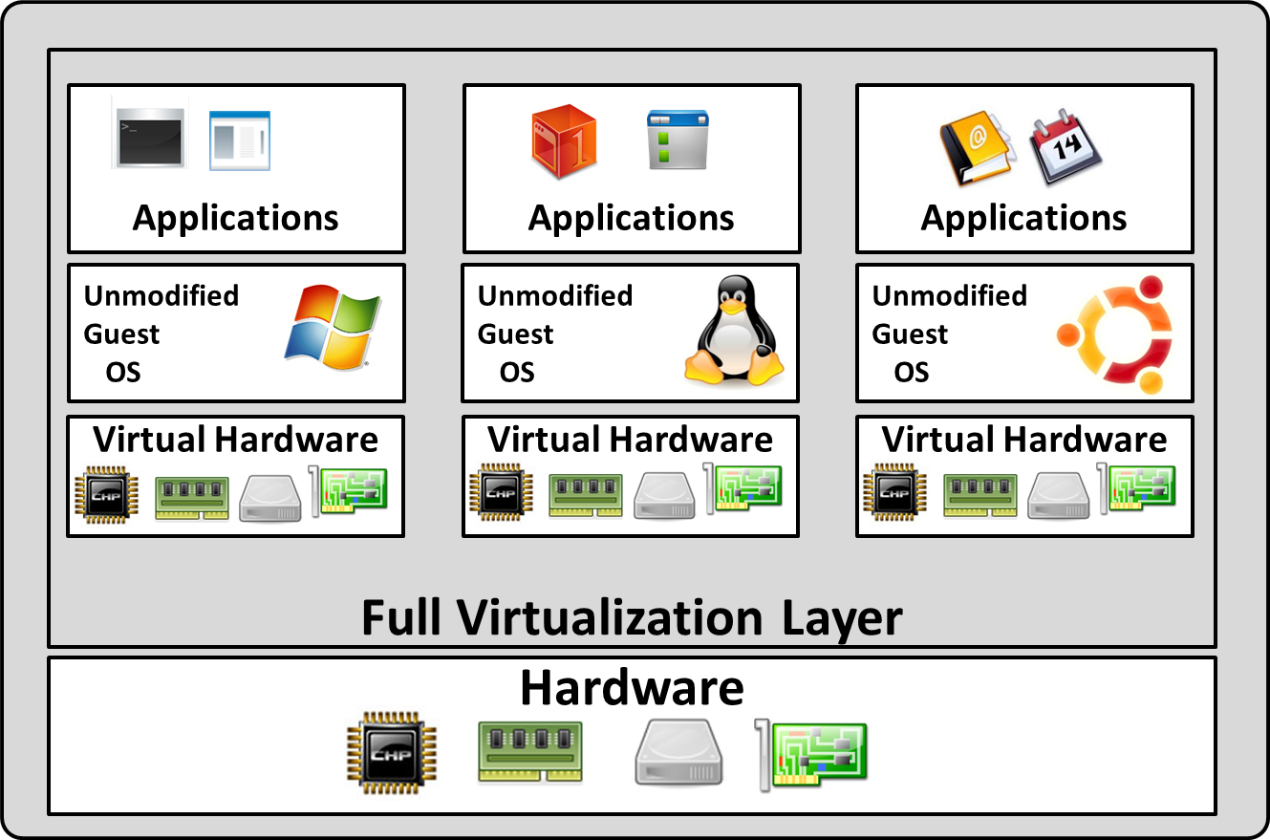
Types of virtualization
Full Virtualization: early complete emulation of the actual hardware to allow unmodified guest operating system. e.g. Vmware
Relies on Binary Translations: Sequences of instructions are translated from the source to the target instruction set

Slide 6
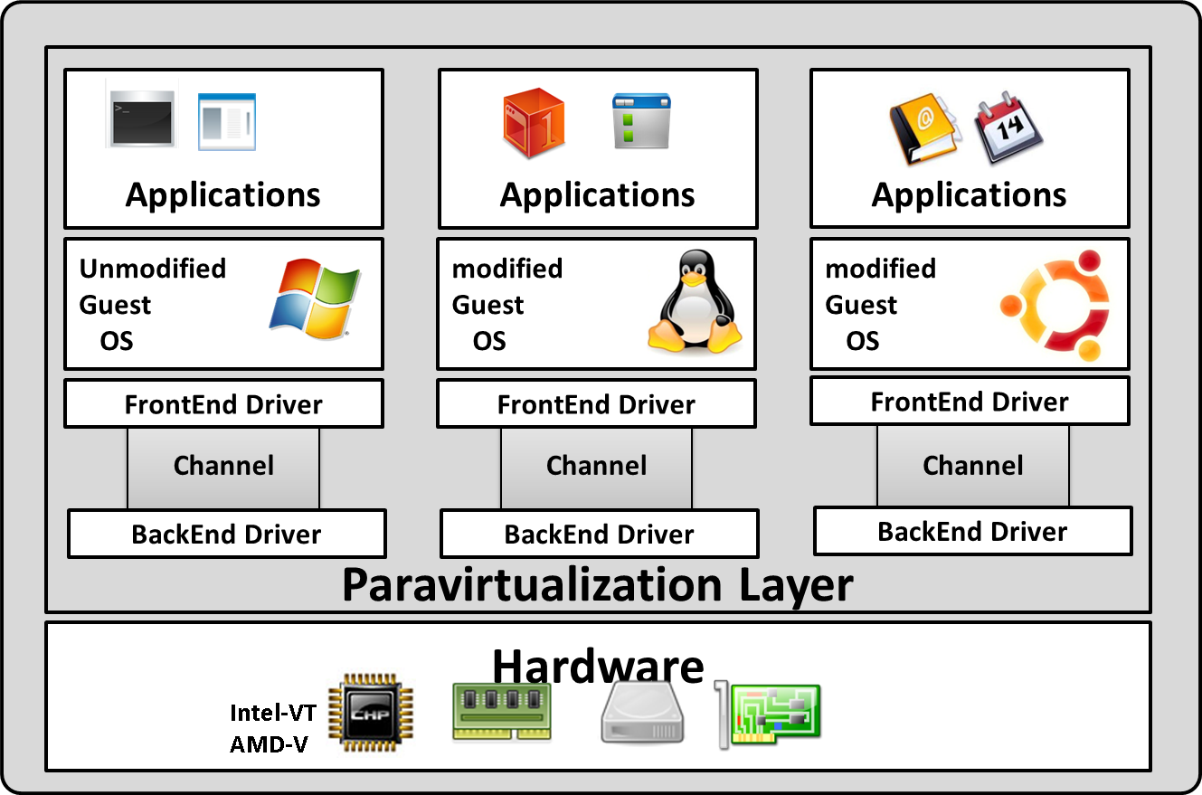
Types of virtualization
Paravirtualization: referred to as partial virtualization .
It requires some modification for the guest operating system to be aware that it is running virtually to eliminate considerable overhead of emulation e.g. Xen.

Slide 7
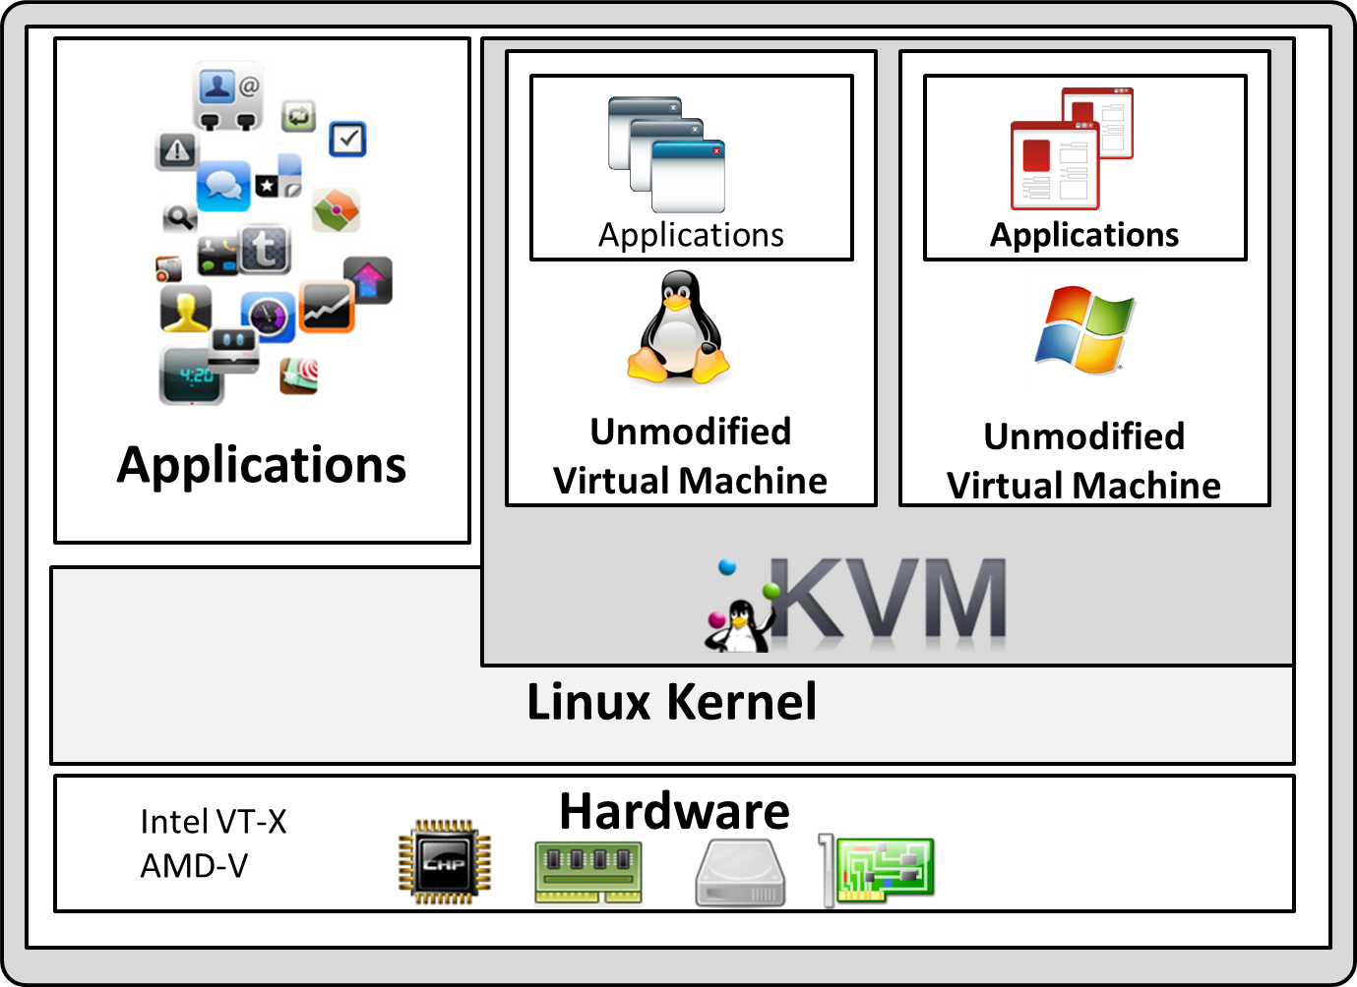
Types of virtualization
Kernel-based Virtual Machine: KVM is a full virtualization solution for Linux on x86 hardware virtualization (Intel VT or AMD-V).
Using KVM, one can run multiple virtual machines running unmodified Linux or Windows images. e.g. Redhat virtualization

Slide 8
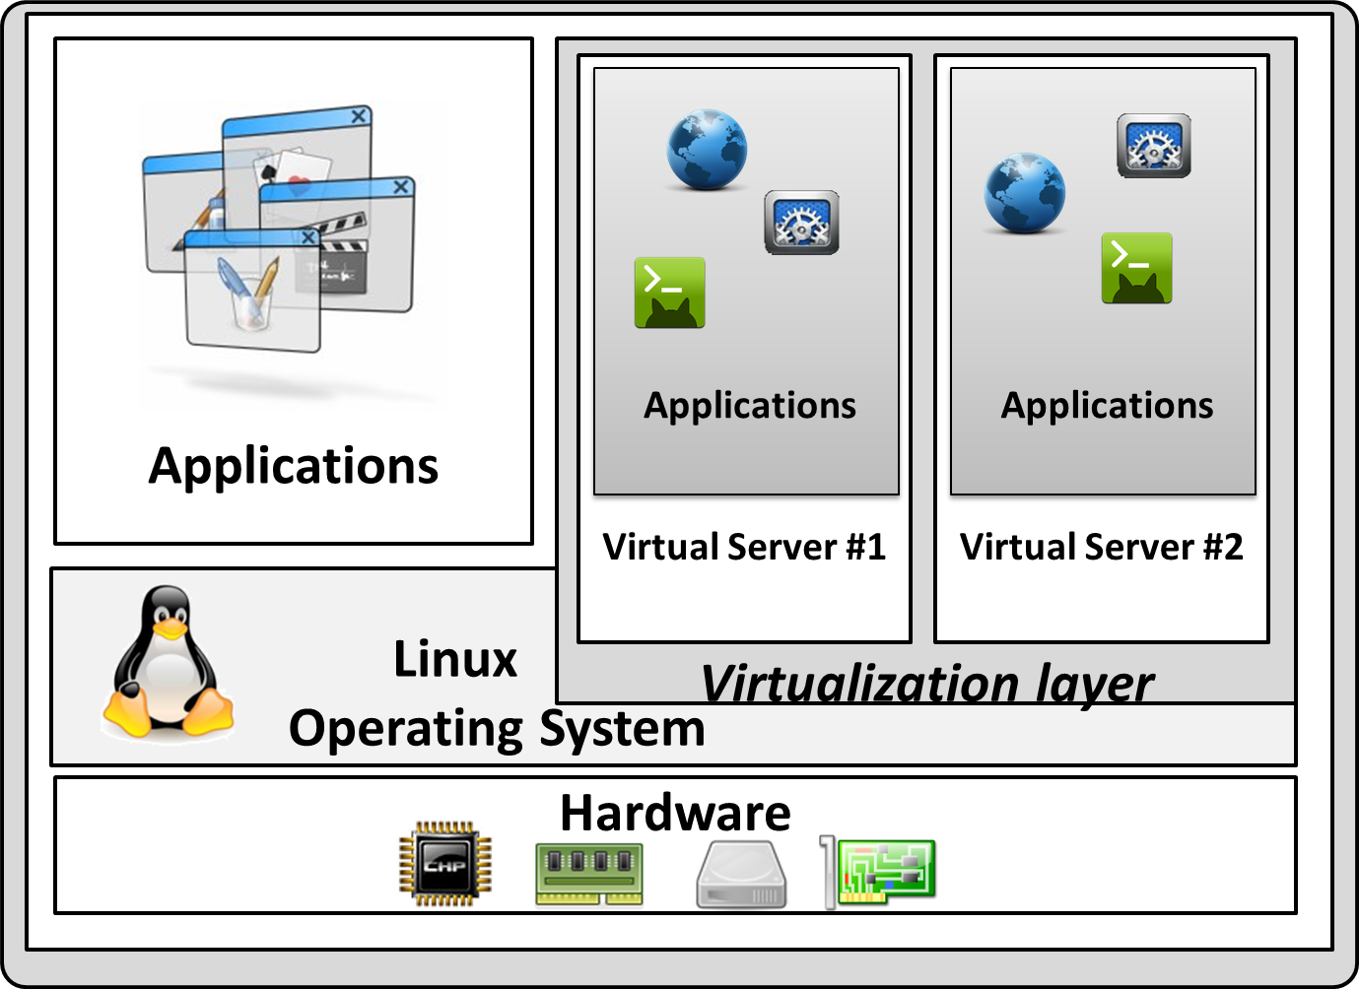
Types of virtualization
Operating system-level virtualization: referred to as a virtual private server (VPS). All virtual private servers share a single kernel. E.g. OpenVZ

Slide 9
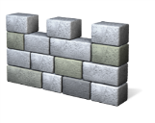
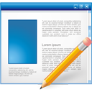
Guest as a heavyweight Process
Active processes
Virtual Machine
Virtual Machine
Background processes
Virtualization
Host Operating System
Hardware

Slide 10
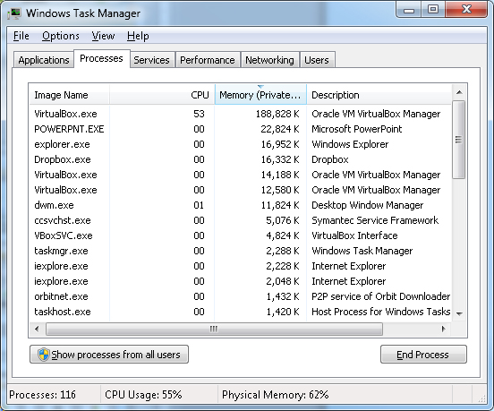
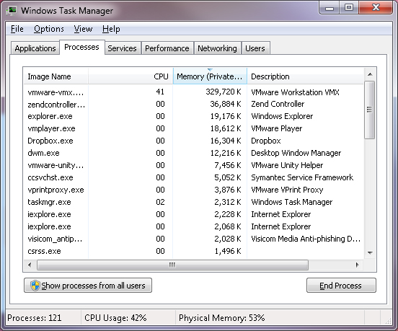
Guest as a heavyweight Process

Slide 11
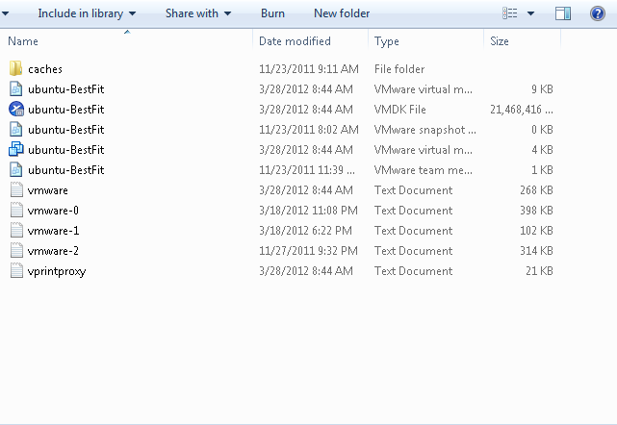
Guest as a large file

Slide 12
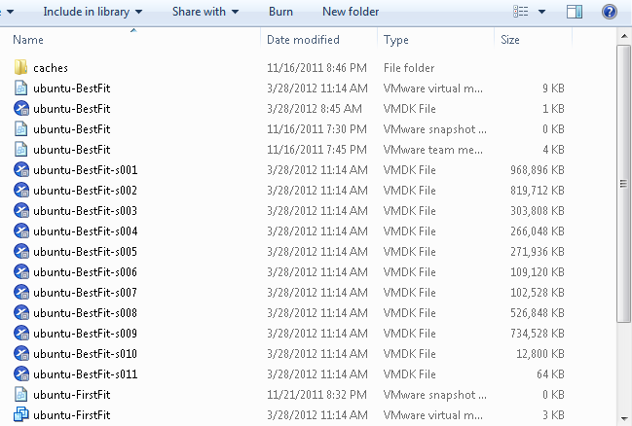
Guest as a large file

Slide 13
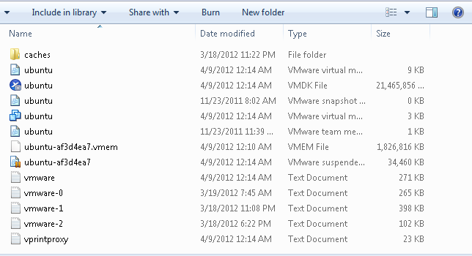
Guest as a large file

Slide 14
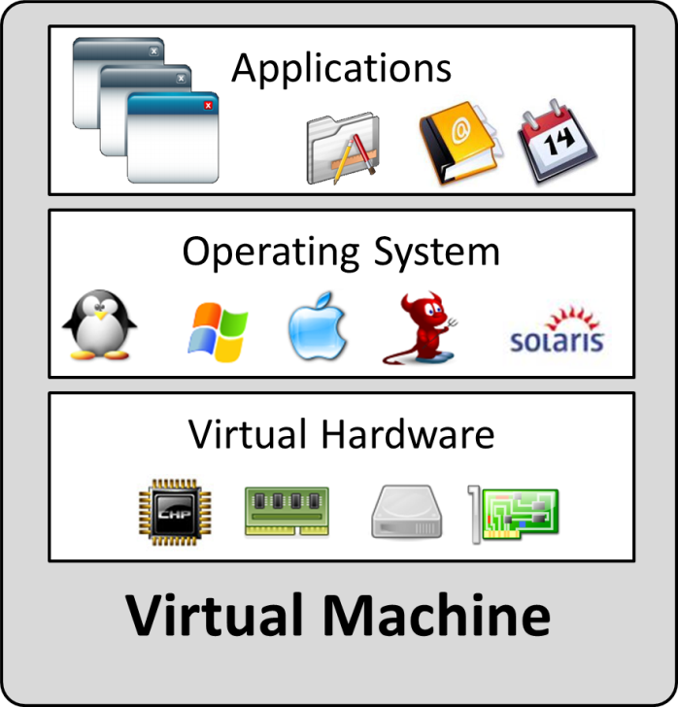
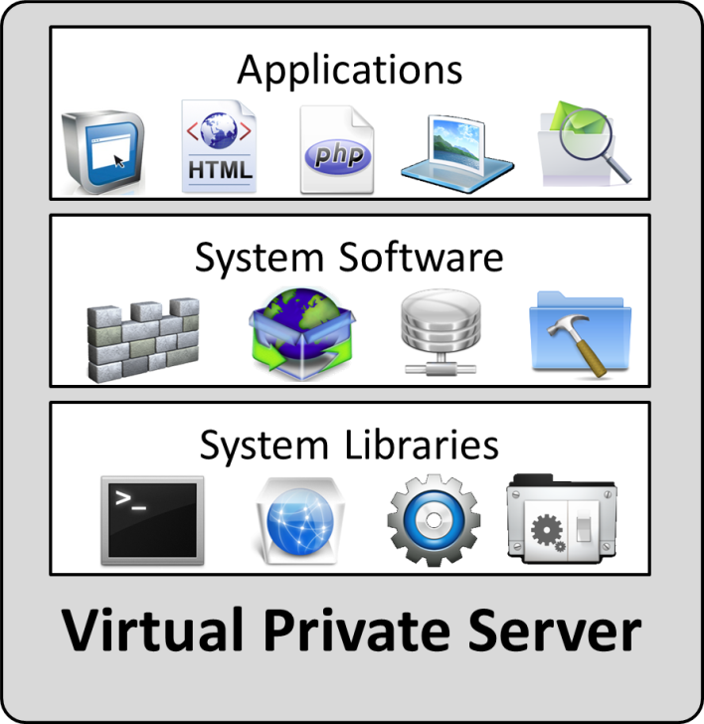
Virtual Guest
Two terms of virtualization:
Virtual Machine VM
Virtual Private Server VPS
They are known as the guest in a virtualized environment
VM has its own guest operating system, no matter which kind of host operating system.
VPS uses the kernel of host operating system. (referred to a lightweight VM)

Slide 15
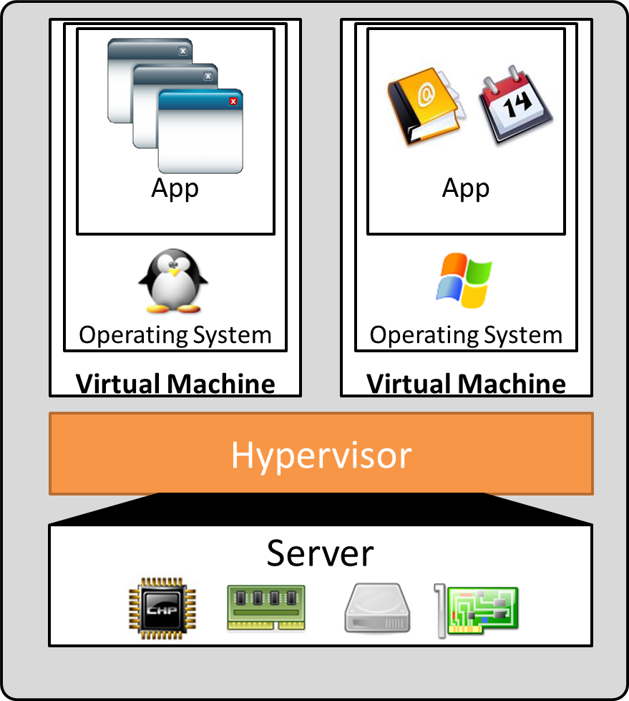
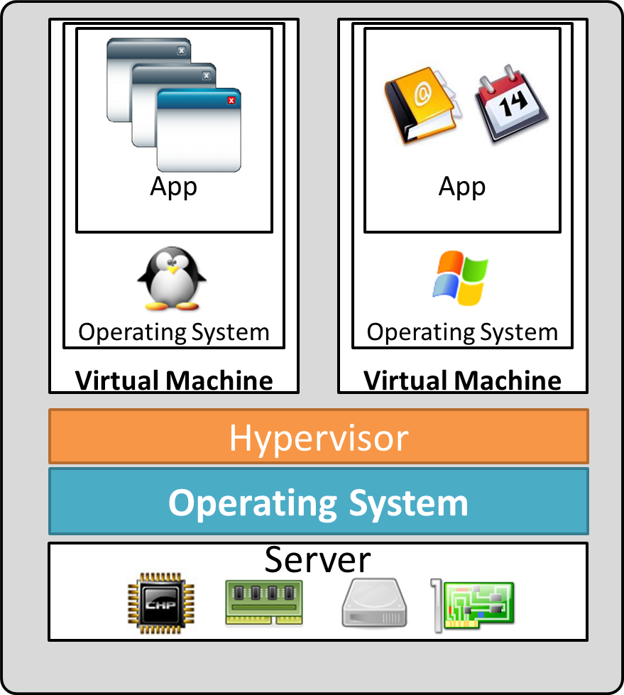
Hypervisor types:
Native : a layer installed directly on hardware, such as Xen Hypervisor.
Hosted : software installed on top of a desktop operating system, such as Oracle VirtualBox.
Native Hypervisor
Hosted Hypervisor

Slide 16
Virtualization Principles
Isolation and consolidation
Separation and division
Encapsulation
Availability and Reliability
Safety and Integrity
Resource allocation
Live migration
Efficient utilization
Power Efficiency
What about: Usability, less requirements

Slide 17
Xen Hypervisor
introduction to Xen
Xen is a paravirtualization Hypervisor.
[1990s] Created by Keir Fraser and Ian Pratt at Cambridge University As part of the Xenoserver research, [2003] deployed.
Runs directly on computer hardware.
Replaces the operating system allowing the computer hardware to run multiple guest operating systems concurrently
Provided as a part of most of the major Linux distributions
Developed and maintained by the Xen.org community.
Free solution licensed under the General Public License (GNU).
Xen 1.x, Xen 2.x , Xen 3.x , Xen 4.x, current version is Xen 4.1.2
Commercial implementations:
Citrix XenServer
Oracle VM
Sun xVM
Thinsy Corporation

Slide 18
Xen hypervisor components:
Xen hypervisor
runs directly on the hardware
the interface for all hardware requests for the guest OS
manages security and independency of the guest.
Domain 0 Guest:
has exclusive privileges to access the Xen hypervisor
manage all aspects of Guests
Interacts with the Xen hypervisor by xend (Xen daemon)
Supplies device and I/O services by running(backend device drivers
Domain Guests:
independently operate on the system
launched and controlled by the Dom0
Paravirtualizion Guests: run with a special modified operating system
Fullvirtualizion Guests: un-modified operating systems leveraging special virtualization hardware such as Intel VT and AMD-V
Management Tools:
CLI: Xen Manager (xm) a client application to send commands to xend
GUI: XenMan, Virt-Manager, Virtual Machine Manager(VMM) SolusVM, Xen Tools (simple perl scripts), Ganeti, Perl-based MLN, Web-based HyperVM and FluidVM, Web-based Cloudmin, OpenNebula cloud management toolkit, …

Slide 19
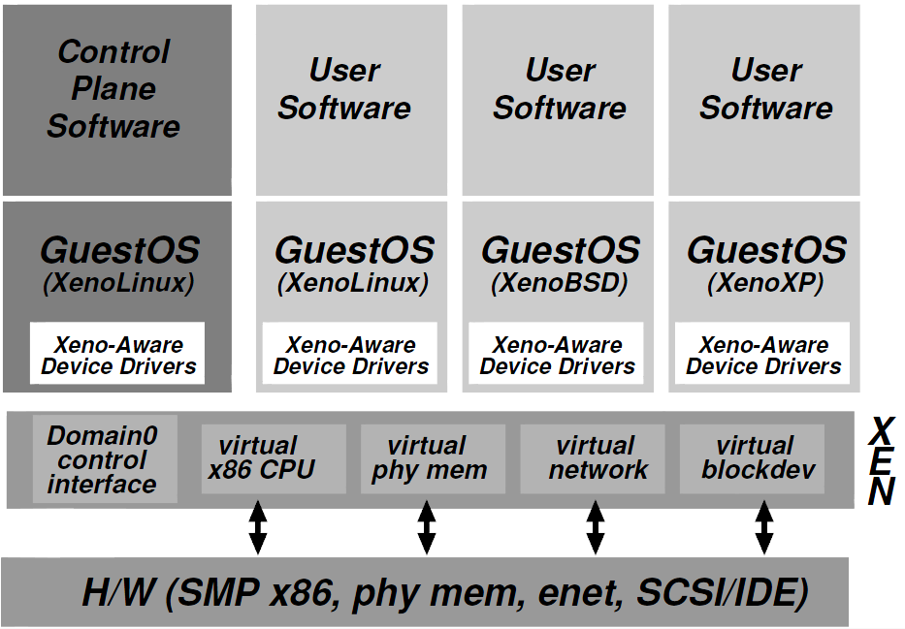
Xen Environment:

Slide 20
Xen Terminologies:
VM: Virtual Machine can run applications on its own operating system.
VMM: Virtual Machine Monitor provides the ability to run virtual machines.
Domain: The term used by Xen to refer to a virtual machine instance.
dom0: The primary domain in a Xen system.
domU: All the other domains in a Xen system.
Host: The system that provides the environment for running virtual machines.
Guest: The virtual machine instance that runs on a host system.
PVM: Paravirtualized Virtual machine where the Xen domains can only run modified operating systems.
HVM: Hardware Virtual Machine where the Xen domains can run unmodified operating systems such as Microsoft Windows.

Slide 21
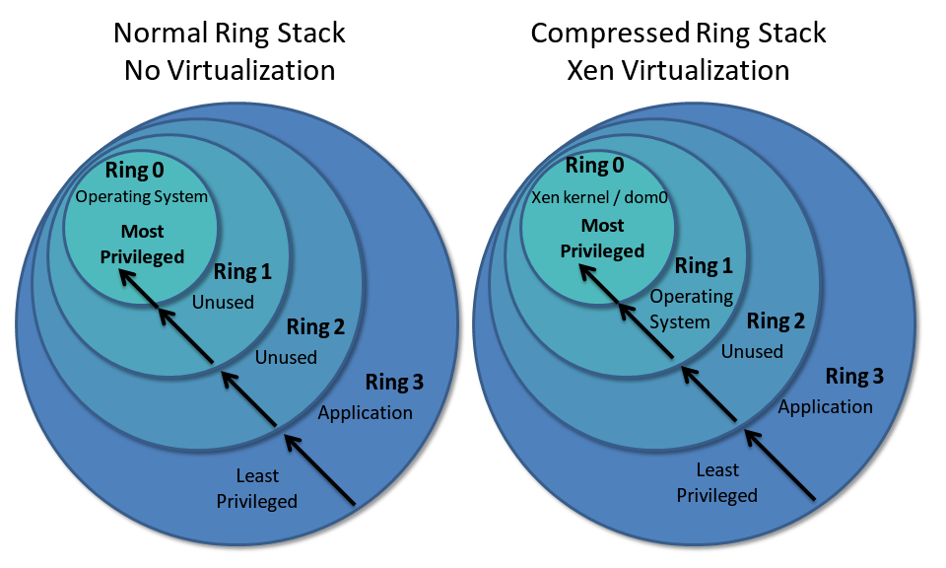
Xen hypervisor Architecture:
Xen runs in ring 0, the most privileged ring
Guest runs in a ring higher than 0 is called "ring deprivileging".

Slide 22
Challenges:
Virtual machines must be isolated, particularly true when virtual machines are owned by mutually untrusting users.
It is necessary to support a variety of different operating systems.
Overhead is small.
Considerations:
Xen must be involved in data-path aspects
E.g. scheduling the CPU between domains, filtering network packets before transmission, enforcing access control
There is no need for Xen to be involved or aware of, higher level issues.
E.g. admission control is a domains responsibility not Xen
Design principles:
Virtualizing all architectural features required by existing standard ABIs is a must. syscall
Supporting full multi-application operating systems is a need. e.g Virtual desktop
Paravirtualization is necessary to obtain high performance and strong resource isolation
Hiding the effects of resource virtualization from guests risks correctness and performance.

Slide 23
Memory Management:
Initial memory allocation for each domain is specified statically.
Provides strong isolation.
Claiming additional memory pages from Xen is up to reservation limit.
A domain can save resources by releasing memory pages back to Xen.
Xen disallow guests to overlap with the top end of the linear address space.
Read: guest has direct read access
Xen supports hardware-to-physical mapping by providing a shared translation array.
Update: guest cannot update pages directly.
Xen batches and validates the updates to protect the pages.

Slide 24
CPU Schedulers:
BVT: Borrowed Virtual Time
Proportional share via setting different domain weights
Dom1: weight 1 (20%), Dom2: weight 3 (80%)
Work conserving: if only one domain has work to do, it gets all the CPU
Fair-share scheduler
SEDF: Simple Earliest Deadline First
Dynamic scheduling algorithm used in real-time operating systems.
It places processes in a priority queue.
the process closest to its deadline will be processed
No global load balancing
CPU1: dom1 – 80% CPU usage , CPU2: dom2 --- 80% CPU usage
dom3 with 30% CPU usage can not be allocated and served.

Slide 25
CPU Schedulers:
Credit scheduler
Fair-share scheduler
Support for both work-conserving and non work-conserving modes using weights
Global load balancing
Now we can allocate dom1 (80%), dom2 (80%) and
dom3 (30%) on 2-way CPU machine.

Slide 26
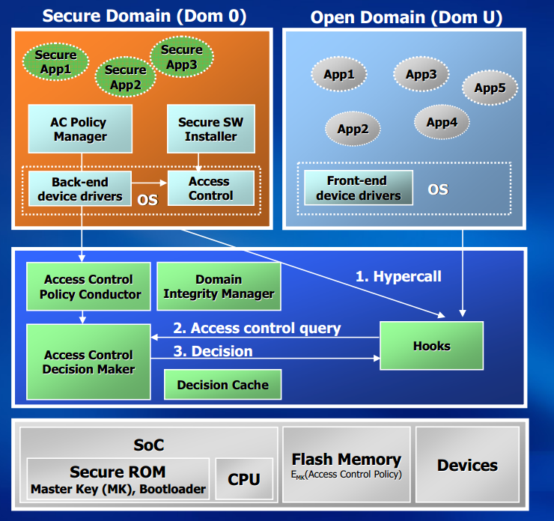
Control Transfer:
hypercall:
Software trap from DomU to Xen
Quitely similar to system call
hypercall is synchronous
hypercall is validated by Xen
E.g. page table update.
Event
Interrupt from Xen to DomU
Event is asynchronous
E.g. receiving new data from network device for DomU

Slide 27
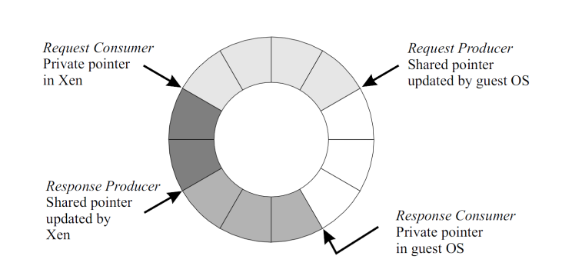
Data Transfer:
I/O Rings: Xen uses asynchronous circular queue of descriptors to transfer data between itself and guests.
producer-consumer pointers:
Domains place requests on a ring, advancing a request producer pointer
Xen removes these requests for handling, advancing an associated request consumer pointer.
Responses are placed back on the ring similarly by Xen as the producer and the guest OS as the consumer.
Descriptor: contains reference to data
request
Descriptor0
Descriptor1
Descriptor2
Descriptor3
Descriptor4
producer
consumer
handling
queue

Slide 28
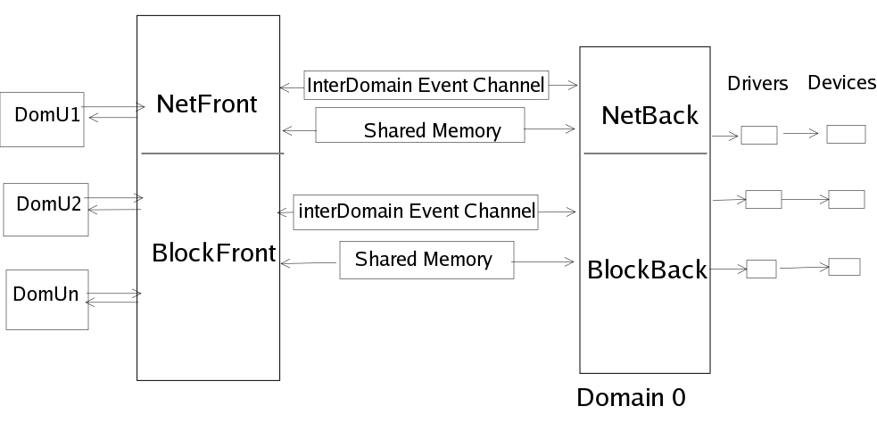
Xen hypervisor Device Drivers:
Domain 0 has special rights to access physical I/O resources
Drivers are included in Domain 0 as Backend Drivers
The Network Backend Driver communicates directly with the local networking hardware to process all virtual machines requests coming from the Domain U.
The Block Backend Driver communicates with the local storage disk to read and write data from the drive based upon Domain U requests.
A Domain U PV Guest contains Frontend Drivers for network and disk access

Slide 29
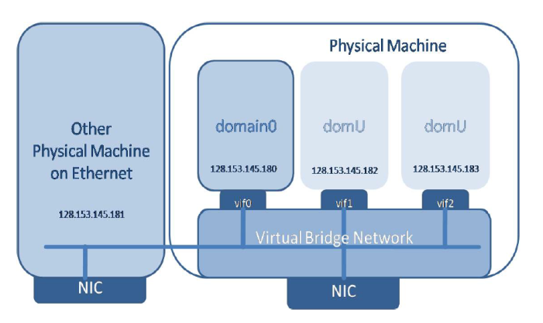
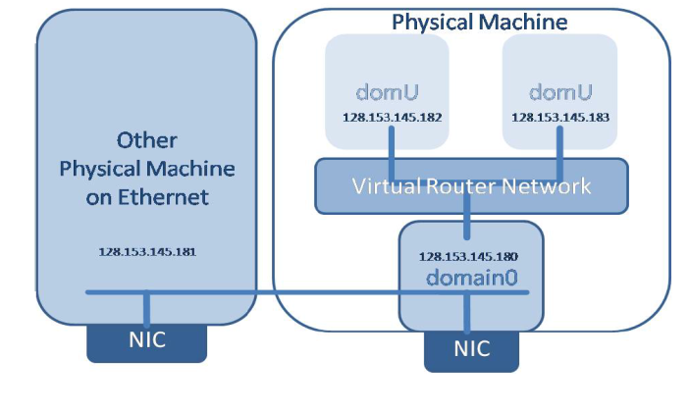
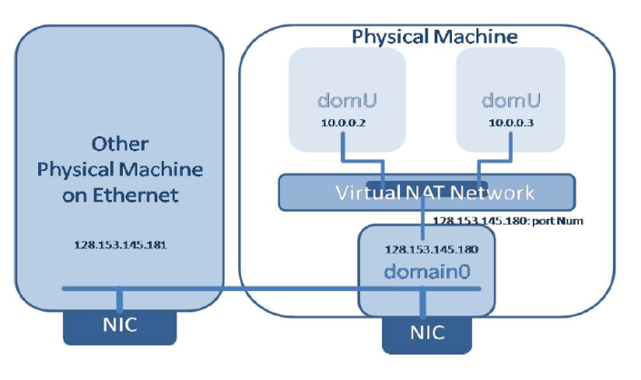
Networking Modes:
Bridged : Guest domains are on the same network as Dom0.
Routed : Dom0 becomes the central point that routes all of the traffic for the guests.
NAT: Dom0 uses NAT to send requests to a Virtual Local Network.
Xen Hypervisor Deployment, Management, and Cloud Computing Tools
Todd Deshane and Patrick F. Wilbur
Clarkson University

Slide 30
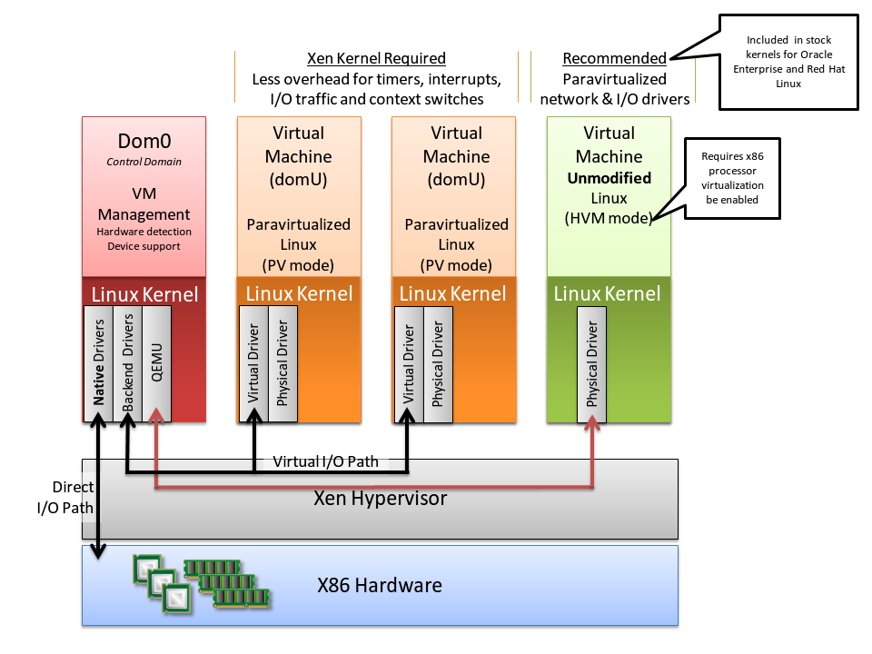
Xen hypervisor Architecture:

Slide 31
Xen Hypervisor
Xen Boot Process:
GRUB starts
GRUB starts
Kernel
Kernel
Hypervisor starts
Hypervisor starts
Module
Module
Domain0 starts
Domain0 starts
Daemon
Daemon
Xend starts
Xend starts
xm
xm
Guest domain starts
Guest domain starts

Slide 32
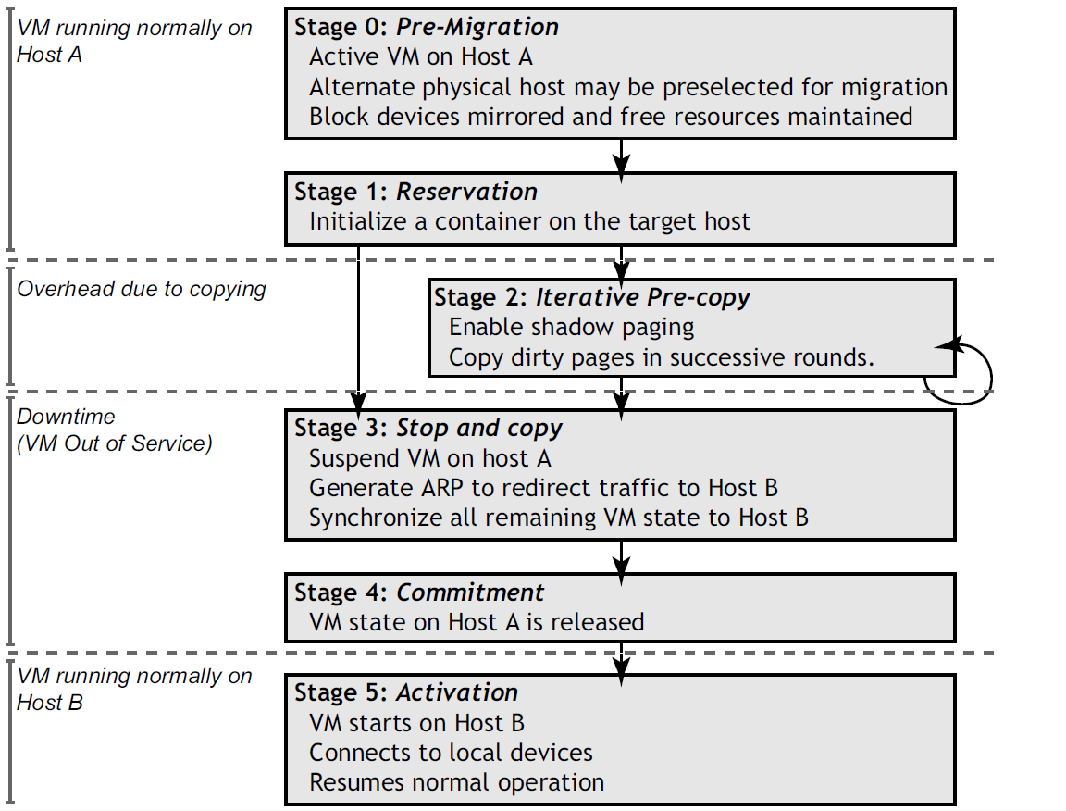
Xen Hypervisor
Xen hypervisor migration:
http://www.cl.cam.ac.uk/research/srg/netos/papers/2005-migration-nsdi-pre.pdf

Slide 33
Xen Hypervisor
Supported Limits in Xen :
Supported Limits for Virtual Host Server
VHS Limits | Xen 4.1
Max. physical CPUs | 64
Max. dom0 virtual CPUs | 64
Max. physical memory | 500 GB (dom0), 2 TB (Xen)
Max. block devices | 12,000 SCSI logical units
Max. iSCSI devices | 128
Max. network cards | 8
Max. virtual machines per CPU core | 8
Max. virtual machines per VM host | 64
Max. virtual devices per VM host | 2,048
Max. virtual network cards | 64 across all virtual machines in the system
Supported Limits per Virtual Machine
VM Limits | Xen 4.1
Max. virtual CPUs | 32 PV, 16 FV
Max. memory | 256 GB
Max. virtual network devices | 8
Max. virtual block devices | 100 PV, 4 FV (100 with PV drivers)
http://doc.opensuse.org/products/draft/SLES/SLES-xen_sd_draft/cha.xen.vhost.html

Slide 34
Xen Hypervisor
Running Xen :
Pre-built Xen: Installing Xen from binary packages and their dependencies.
install the following:
Xen hypervisor
dom0 kernel
Xen libraries and Python modules
User space tools for interacting with Xen from dom0 (e.g. xm)
Linux kernel 2.6.37 contains the most significant parts of Xen
in the in early 2011, several distributions are again considering dom0 support.
Linux kernel 3.0 supports dom0 and domU in the mainline kernel.
Xen Source: building Xen by compiling Xen source code, available on xen.org.
Before compiling Xen requirements
gcc: for compiling C code.
standard C libraries: glibc-devel, libgomp, glibc-headers, ncurses-devel, openssl-devel, zlib-devel, xorg-X11-proto-devel, python-devel,xen-devel, and tetex-latex.

Slide 35
Xen Hypervisor
Managing Xen :
Creation of guest images
Manipulation of guest domains
Generation of guest configuration files
Monitoring resource usage by guests
Existing Tools:
Virtual Machine Manager: desktop tool.
Convirt: Third-party tool.
Zentific: Web-based tool.

Slide 36
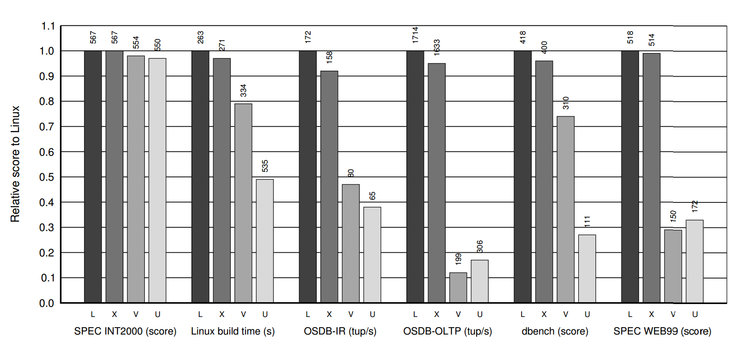
Xen Hypervisor
Xen Comparisons:
The SPEC CPU2000 Integer suite
PostgreSQL: multiuser Information Retrieval (IR) and On-Line Transaction Processing (OLTP) benchmark
The dbench 2.0 file system single user benchmark
Apache 1.3.27 being exercised by the SPECWeb99 benchmark
Relative performance on:
Native Linux (L)
Xen/Linux (X)
VMware Workstation (V)
User Mode Linux (U)

Slide 37
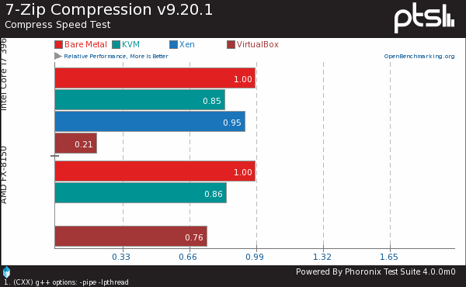
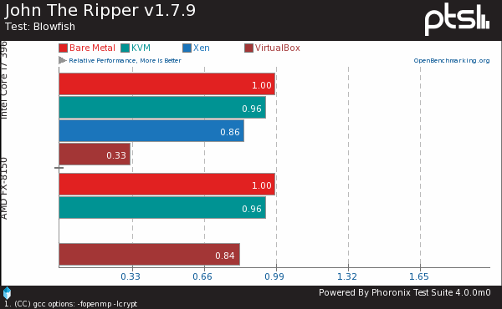
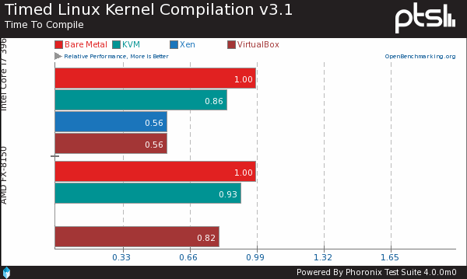
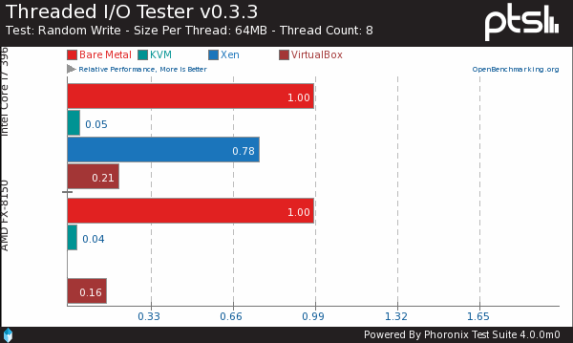
Xen Hypervisor
Xen Comparisons:

Slide 38
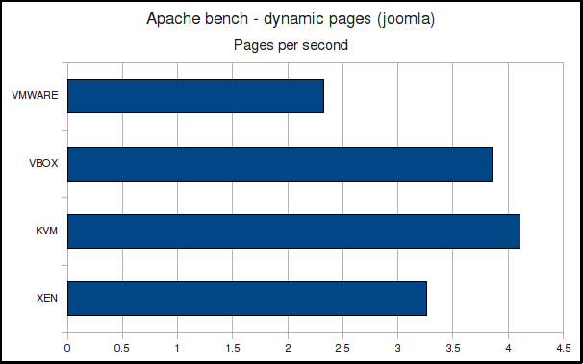
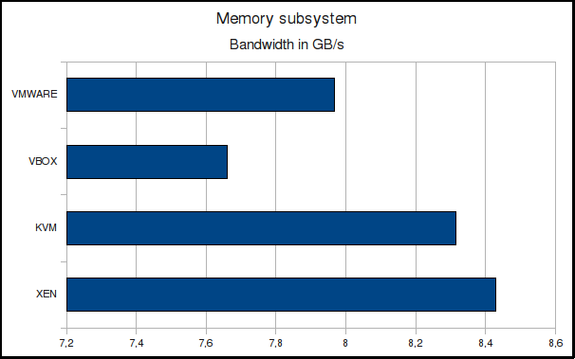
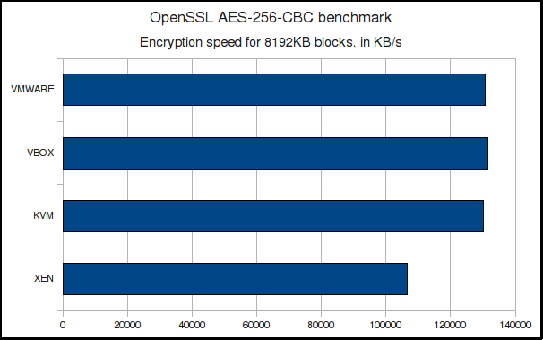
Xen Hypervisor
Xen Comparisons:

Slide 39
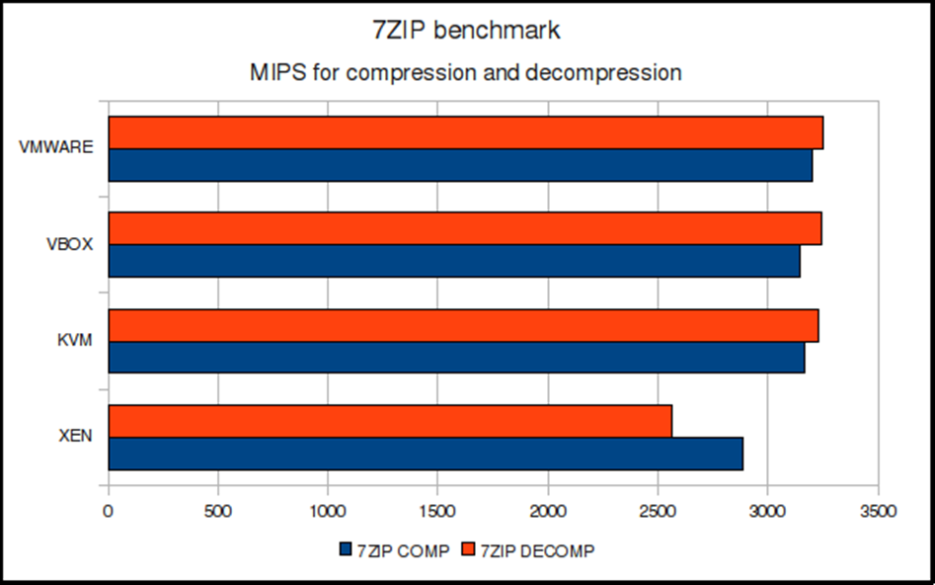
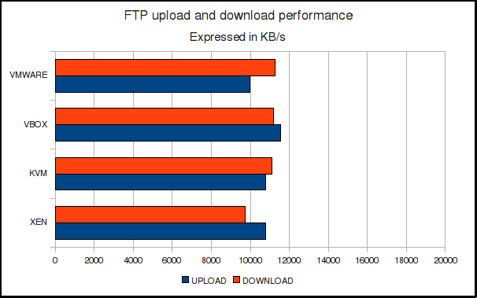
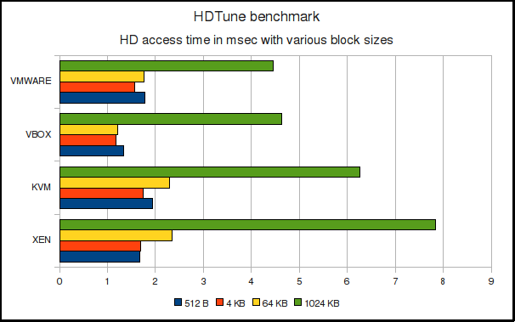
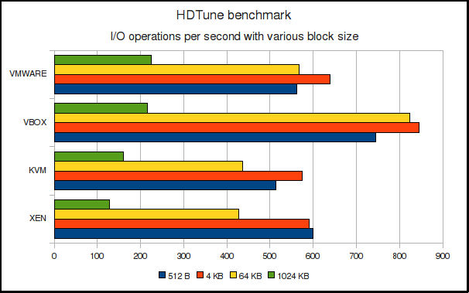
Xen Hypervisor
Xen Comparisons:

Slide 40
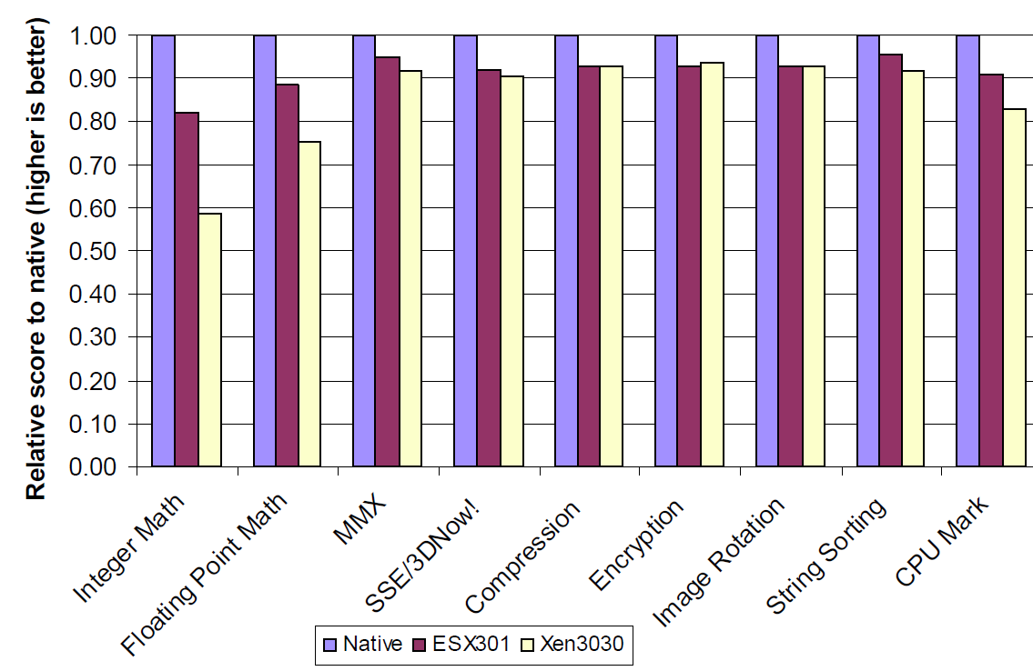
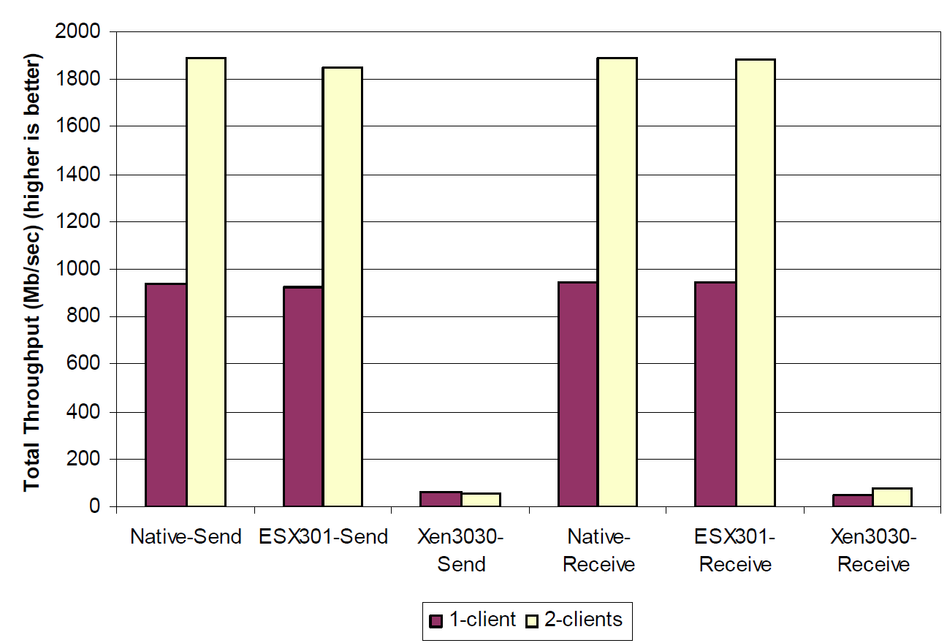
Xen Hypervisor
Xen Comparisons:
The total throughput in Mb/sec scales from one client to two clients for both send and receive tests.
By:Vmware 2007

Slide 41
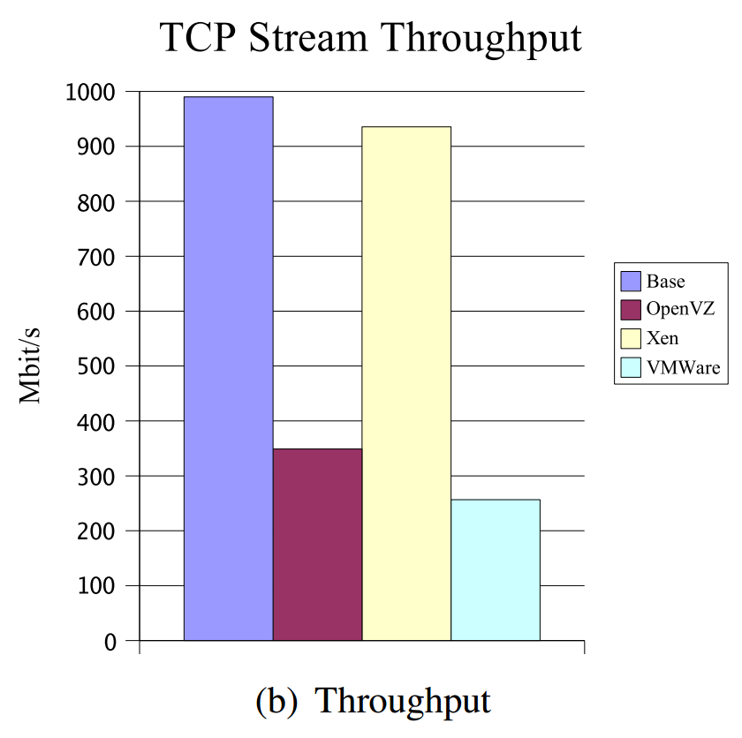
Xen Hypervisor
Evaluated virtualization platforms
# | Platform | Type | Version
1 | VMWare Server | full virtualization | 1.0.21
2 | Xen | paravirtualization | 3.0.4.1
3 | OpenVZ | OS-level virtualization | 2.6.16
Cited from:
A Comparison of Virtualization Technologies for HPC
2008 IEEE

Slide 42
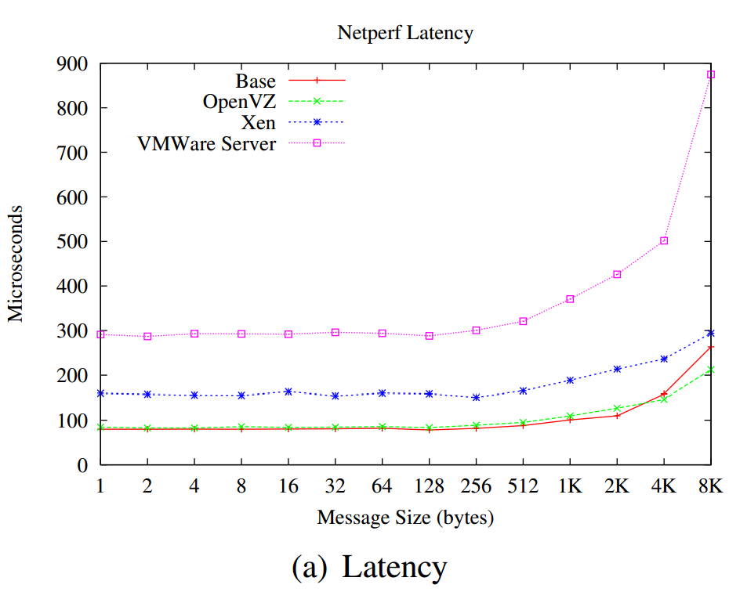
Xen Hypervisor
Evaluated virtualization platforms
Cited: A Comparison of Virtualization Technologies for HPC

Slide 43
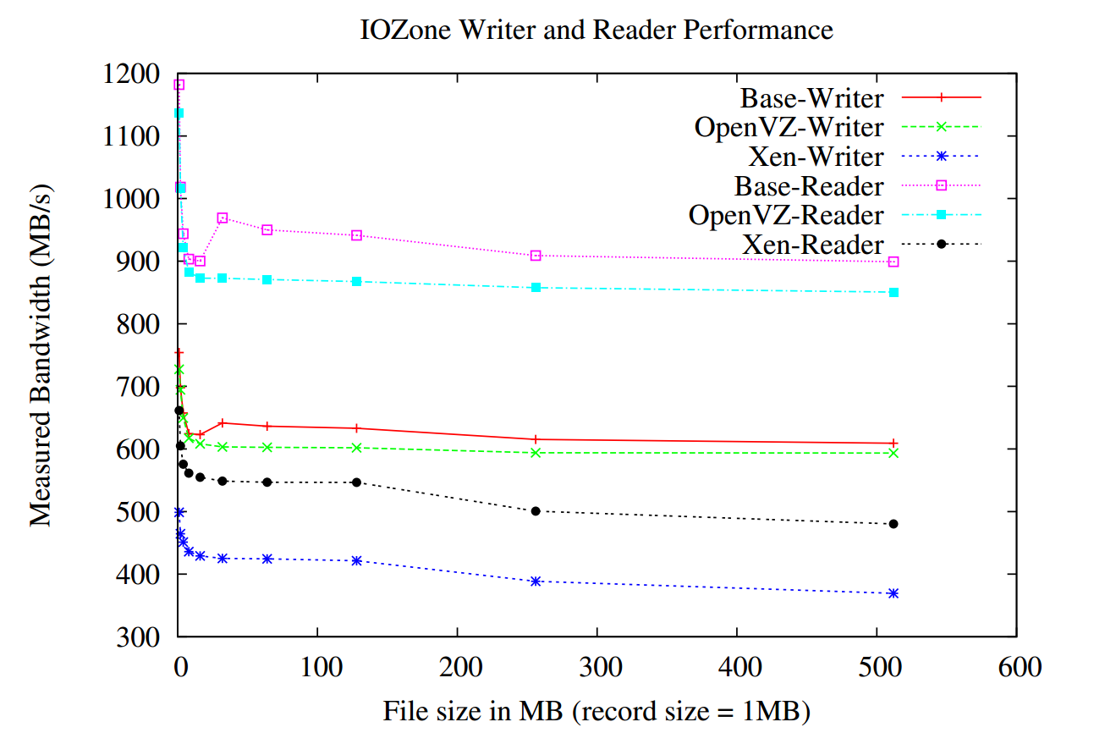
Xen Hypervisor
Evaluated virtualization platforms
Cited: A Comparison of Virtualization Technologies for HPC

Slide 44
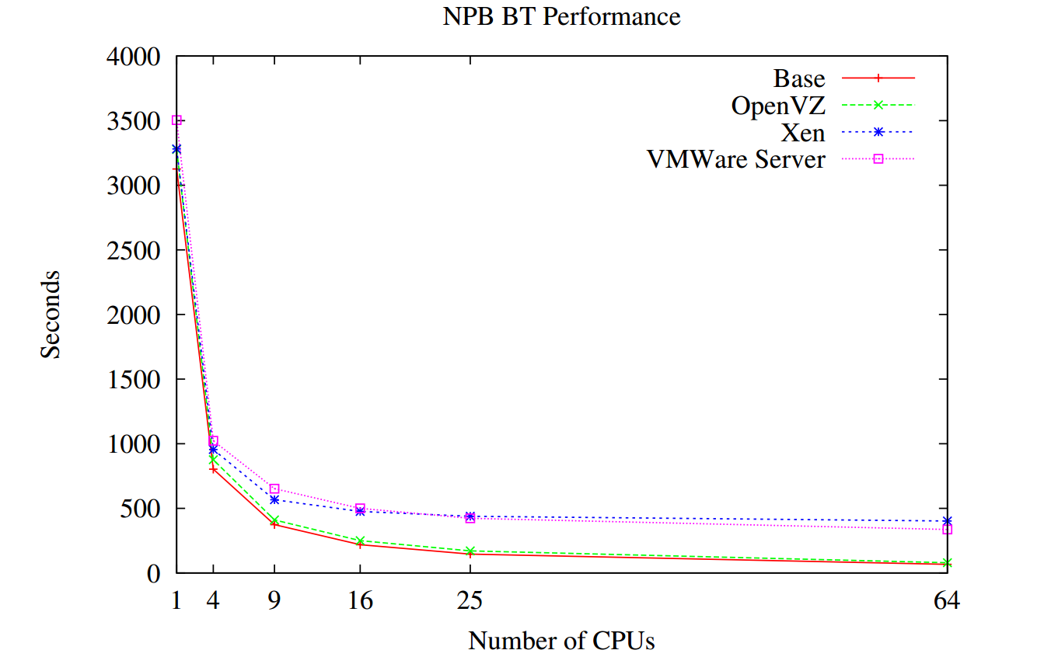
Xen Hypervisor
Evaluated virtualization platforms
Cited: A Comparison of Virtualization Technologies for HPC

Slide 45
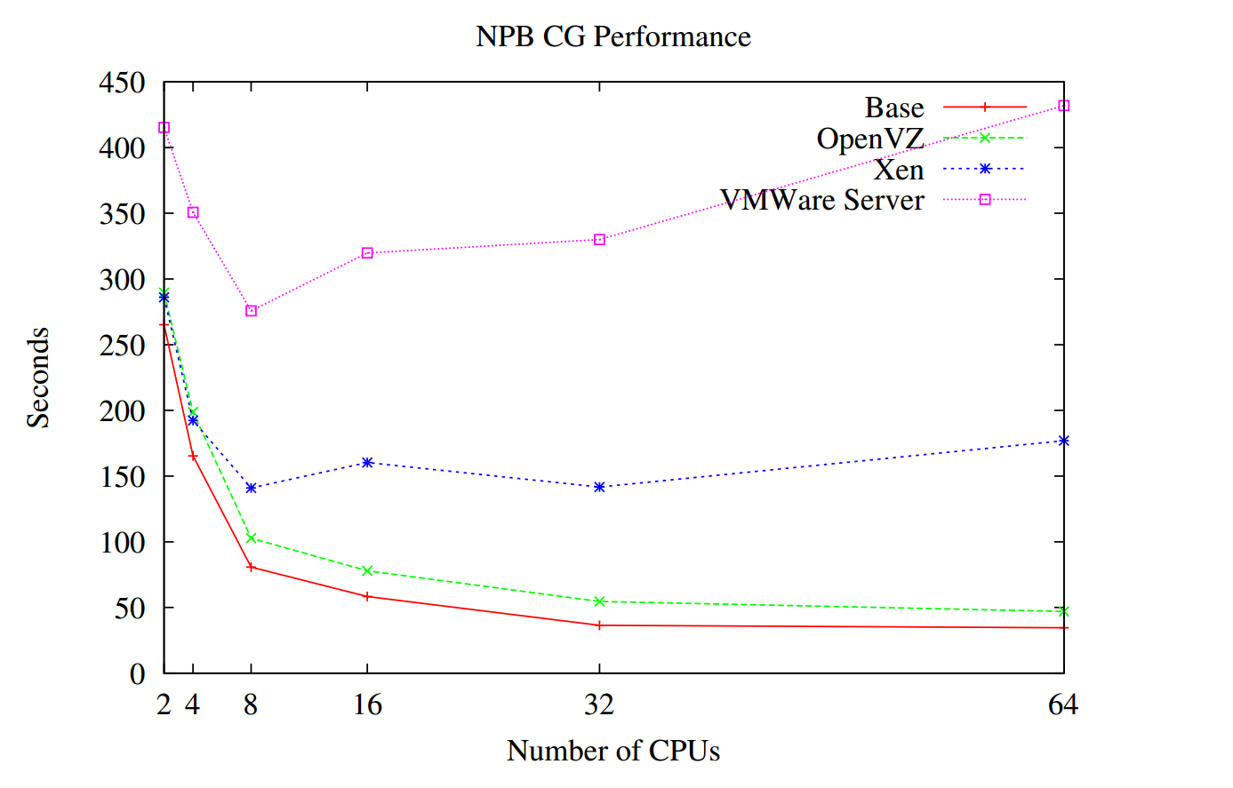
Xen Hypervisor
Evaluated virtualization platforms
Cited: A Comparison of Virtualization Technologies for HPC

Slide 46
XenServer
Introduction:
Citrix Systems developed Xen Source
October 2007, Citrix Systems completed its acquisition of XenSource
October 2009, Citrix further announced their non-commercial XenServer
XenServer, the free edition, is fully open-source
Xenserver Editions:
Free Edition : delivers uncompromised performance, scale, and flexibility at no cost
Advanced : Key high availability and advanced management tools
Enterprise : Essential integration and optimization capabilities for production deployments of virtual machines.
Platinum : Data protection and resiliency for enterprise-wide virtual environments.

Slide 47
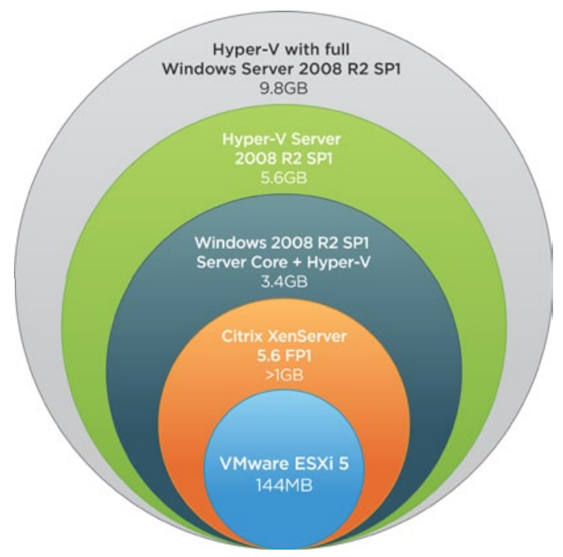
XenServer
XenServer Code size:
Vmware ,2011
http://www.vmware.com/files/pdf/vmware_advantage.pdf

Slide 48
Xen Cloud Platform
Xen Cloud Platform (XCP)
XCP Combines the Xen hypervisor with enhanced security, storage, and network virtualization technologies to offer a rich set of virtual infrastructure cloud services.
Aimed to support private and public cloud deployments.
open-source and free
XCP was originally derived from Citrix XenServer
XCP includes:
Open-source Xen hypervisor
XenAPI (XAPI) management tool stack
Support for Open vSwitch

Slide 49
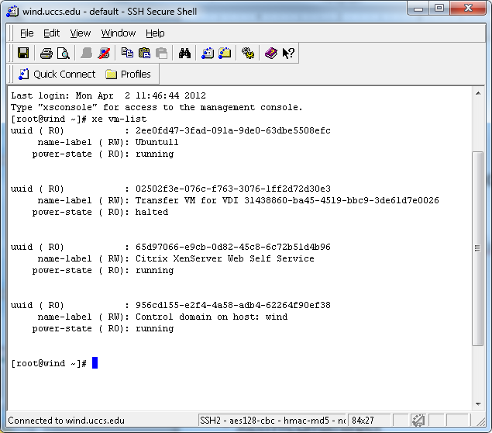
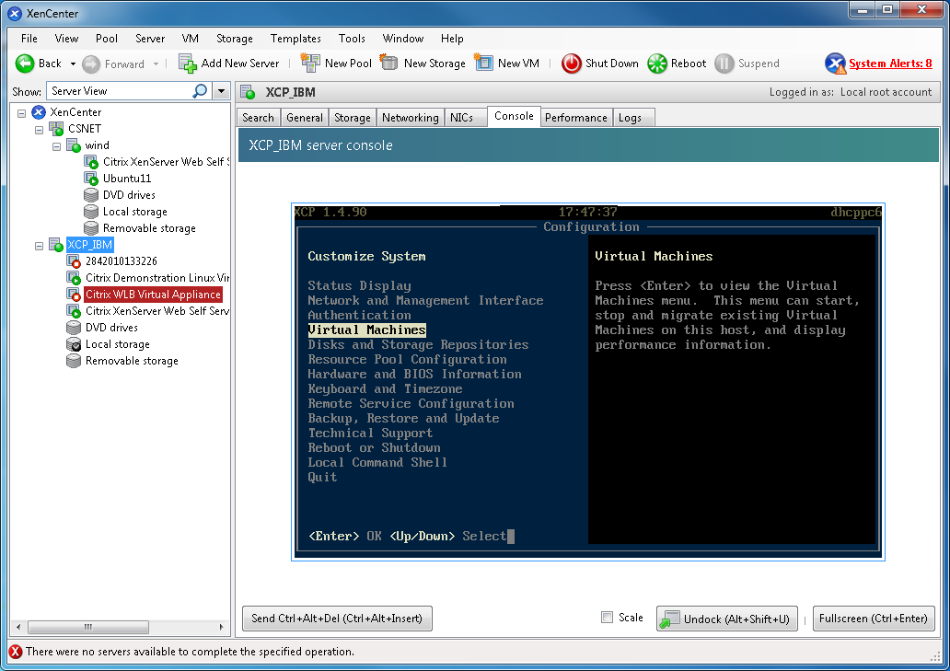
XCP APIs
Integrated tools:
XCP's xsconsole (SSH or Local)
XCP's XAPI Viewer
Xe: SSH or Local CLI e.g (xe vm-list)
Desktop-based tools:
Citrix XenCenter
OpenXenManager
Web-based tools:
XenWebManager
Xen VNC Proxy (XVP)
Xen Cloud Control System (XCCS)
XEN Module (Xenica)
XVP - Web-based VM

Slide 50
XCP APIs
Command Line Interface:
XE Basics
XAPI includes a powerful command-line interface (xe).
Commands may be issued with Dom0 or from remote hosts.
the 'xe' CLI needs be to installed on another Linux box.
Basic xe Syntax
Local xe command:
xe <command-name> <argument=value>
xe vm-start vm=Ubuntu11
Remote xe command:
xe –s <host> -u <username> -pw <password> <command-name> <argument=value>
xe –s wind.uccs.edu -u root -pw ****** vm-start vm=Ubuntu11
Why learning xe is important to us?

Slide 51
Useful Links
http://wiki.xensource.com/xenwiki/
http://www.xen.org/community/xenpapers.html
http://en.wikipedia.org/wiki/Comparison_of_platform_virtual_machines
http://www.it20.info/misc/virtualizationscomparison.htm
http://www.virtualizationmatrix.com/matrix.php
http://www.phoronix.com/scan.php?page=article&item=ubuntu_1204_virt&num=7
http://www.ilsistemista.net/index.php/virtualization/1-virtual-machines-performance-comparison.html?start=7
http://wiki.xensource.com/xenwiki/Command_Line_Interface
http://www.xen.org/files/Marketing/HowDoesXenWork.pdf
http://wiki.xensource.com/xenwiki/Scheduling
http://www.datamation.com/netsys/article.php/3884091/Virtualization.htm
http://dl.acm.org/citation.cfm?id=1168860
http://www.ibm.com/developerworks/linux/library/l-qemu/
http://wiki.qemu.org/Main_Page

