Slide 1
Security Issues in Wireless Sensor Networks
B. Kretschmer
CS 526

Slide 2
WSN Characteristics
Monitor (sense) the surrounding environment. Applications include environmental, building safety and surveillance monitoring.
Hundreds - potentially thousands - of low cost resource constrained (memory / processing / bandwidth / energy) sensor nodes deployed over a geographic region.
Self organize into an ad-hoc wireless peer-to-peer network.
Potentially deployed into an open areas subject to interaction with the environment and people.
Sensor nodes are vulnerable to capture and modification. Node transmissions can be intercepted, altered, or fabricated.
Security techniques associated with traditional computing networks are different and don’t easily apply to wireless sensor networks.

Slide 3
WSN Security Goals
Confidentiality – This is the ability to conceal a message from a passive attacker, where the message communicated on sensor networks remains confidential.
Integrity – This is the ability to ensure data has not been tampered with as it travels from node-to-node within the sensor network.
Authentication – This is ability to determine if the message originated from the node the message claims it originated from.
Availability – The sensor network must be available for legitimate node message exchange.

Slide 4
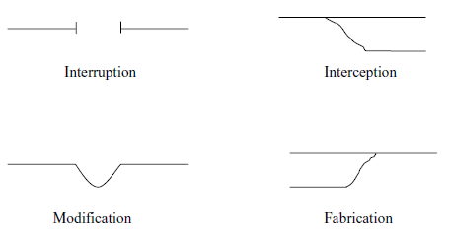
Security Classes
Interruption – a communication link becomes lost or unavailable. Node capture and message corruption are examples of this type of threat.
Interception – this threat occurs when an attacker gains access to the sensor node or the data within it. An example is node capture.
Modification – occurs when an attacker gains access to the data and then tampers with it. Examples include modification of data packets being transmitted or flooding the network with bad data.
Fabrication – the attacker adds false data making the entire network unreliable.

Slide 5
WSN Security Requirements
The Security Design Must Handle:
Message Corruption: Attacks against the integrity of a message occur when an intruder inserts itself between the source and destination and modifies the contents of the message.
Denial of Service: A denial of service attack may take many forms. Such an attack may consist of jamming the radio link, exhausting resources, misrouting data. Denial of service attacks are commonly made against WSN routing protocols.
Traffic Analysis: Even with encrypted communications, an analysis of communications patterns and sensor activity could reveal enough information to allow an attacker to defeat the mission of the WSN.

Slide 6
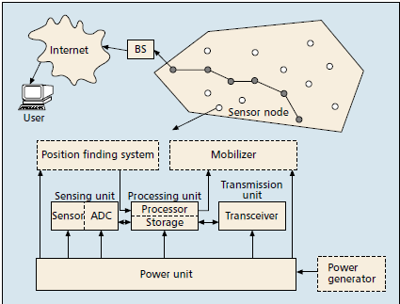
WSN Communication Architecture
Network Layers
Application
Transport
Applies To
SECURITY
Network
Link
Physical

Slide 7
Sensor Node Constraints
Computation: the embedded processors in WSNs are typically not as powerful as those in nodes in wired networks. This makes cryptographic techniques difficult to deploy.
Memory: This consists of both program memory to hold application code and memory to hold sensor observation data. Even with today’s MICA 2 mote from Crossbow, program memory is constrained to 128K and measurement memory to 512K. [11] This makes robust cryptographic techniques based on public key cryptography impractical to implement in WSNs.
Transmission Range: the transmission range of sensor nodes is limited both technically and by the need to conserve power. Transmission range in a WSN is further influenced by environmental and weather conditions.
Energy Supply: Most sensor nodes have a finite (battery) energy supply. Some nodes may be equipped to scavenge energy from the environment. (solar cells)

Slide 8
WSN Threats
Passive Information Gathering: If communications between sensors, or between sensors and intermediate nodes are in the clear, then an intruder with a powerful receiver and well designed antenna can passively pick off the data stream.
Subversion of a Node: If a sensor node is captured it may be tampered with, interrogated electronically, and perhaps comprised. Once comprised it may expose cryptographic keying material allowing the attacker access sensor functionality and communication within the WSN.
False Node: An intruder might add a node to a WSN and feed false data or block the passage of true data. Countermeasures to node impersonation for now are too computational intensive to be feasible within WSNs.
Node Malfunction: A node in the WSN may malfunction and generate inaccurate or false data.
Node Outage: If the node serves as a data collection or data aggregation point what happens if the node stops functioning? The protocols

Slide 9
Attacks in WSNs
Attacks on secrecy and authentication: standard cryptographic techniques can protect the communication channels from intruder attacks such as passive info gathering, packet replay and modification of packets.
Attacks on network availability: commonly referred to as denial-of-service (DoS) attacks. This type of attack may target any layer of a sensor network.
Attacks against service integrity: the goal is to get the sensor network to accept false or bogus data values.

Slide 10
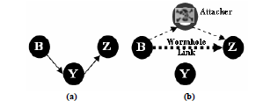
Attacks in WSNs
Attacks can occur at any
network layer.
Wormhole Attack – This is an attack where the attacker records the packets at one location in the network and tunnels them to another location.
Application
Transport
SECURITY
Network
Link
Physical
When node B broadcasts the routing request packet the attacker receives this packet and replays it in its neighborhood. Each neighboring node receiving this replayed packet will consider itself to be in the range of node B and will mark this node as its parent. Consequently if the victim nodes are multi-hop away from B, the attacker has convinced the victim nodes they are only a single hop away from node B – thus creating a wormhole.

Slide 11
Cryptography in WSNs
Cryptography is used to secure communications between sensor nodes.
Public Key Cryptography (PKC) is difficult to implement due to the limited processing power of current sensor nodes. PKC algorithms such as Elliptical Curve Cryptography (ECC) have been demonstrated, but are still resource intensive. RSA algorithms are not feasible as they subject the entire WSN to resource exhaustion and potential denial-of-service attacks.
Most cryptography employed is based on Symmetric Key Cryptography. (SKC)
Several encryption algorithms exists and algorithm selection can be dependent upon the microcontroller. (8bit, 16bit, 32bit)
Significantly less computational and transmission resources are required as compared to PKC.
Management of keys becomes issue with SKC
Global key for the entire network?
Probabilistic allocation of keys to nodes.
Node keys for all nodes assigned to each node.

Slide 12
Conclusion
Security design must consider the constraints imposed by the intended WSN application and technologies available.
Security should be addressed at all network layers during WSN design.
Attacks on WSNs can occur at any network layer. Most attacks occur at the network layer during routing of messages between sensor nodes.
Secure node-to-node transmission within a WSN is challenging given sensor node hardware constraints, bandwidth limitations, encryption algorithms, and encryption key management schemes.

Slide 13
References
Yong Wang; Attebury, G.; Ramamurthy, B.; , "A survey of security issues in wireless sensor networks," Communications Surveys & Tutorials, IEEE , vol.8, no.2, pp.2-23, Second Quarter 2006
Pathan, A.S.K.; Hyung-Woo Lee; Choong Seon Hong; , "Security in wireless sensor networks: issues and challenges," Advanced Communication Technology, 2006. ICACT 2006. The 8th International Conference , vol.2, no., pp.6 pp.-1048, 20-22 Feb. 2006
Avancha, S. et al. “Wireless Sensor Networks. Kluwer Academic / Springer Verlag Publishers 2003
C.P. Fleeger, Security in Computing, 3rd edition, Prentice-Hall Inc., NJ, 2003
E. Shi and A. Perrig, “Designing Secure Sensor Networks”, Wireless Commun. Mag., vol. 11, no. 6, Dec 2004, pp. 38-43.

