Slide 1
DDoS Defense Mechanism: Packet Marking
By Rod Lykins

Slide 2
Discussion Topics
Brief DDoS Introduction
Packet Marking Overview
Other DDoS Defense Mechanisms

Slide 3
Packet Marking Overview
Goal:
Insert traceback data into an IP header
Mark packet from attack source to victim host at various routers
Attack source/path determined according to the traceback data
Two Types
Probabilistic (PPM)
Requires all routers along attack path to mark
Requires higher computation load, high false positive spoofed marking, more packets to rebuild source
Deterministic (DPM)
Marks only first ingress edge router
Much Simpler to implement
Typically utilizes a Bloom filter to store data
Important questions…
Maximum # packets needed to reconstruct a source
Maximum # of sources that can be identified

Slide 4
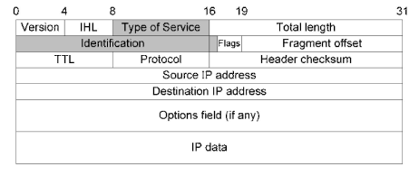
IP Header Information

Slide 5
Other DDoS Defense Mechanisms
Passive Defense
Over-Provisioning
Bandwidth Allocation
Roaming Honeypots
Active Defense
Ingress and Egress Filtering
IP Hopping

Slide 6
Conclusion
Various approaches
Most require collective teamwork
Few can be handled by the victim alone
None are 100% effective

Slide 7
References
A Taxonomy of DDoS Attack and DDoS Defense Mechanisms
IP Traceback with Deterministic Packet Marking
Flexible Deterministic Packet Marking: An IP Traceback System to Find the Real Source of Attacks
Topology-Assisted Deterministic Packet Marking for IP Traceback
Deterministic Packet Marking Based on the Coordination of Border Gateways
Modified Deterministic Packet Marking for DDoS Attack Traceback in IPv6 Network
Towards Stateless Single Packet IP Traceback
On the (In)Effectiveness of Probabilistic Marking for IP Traceback under DDoS Attacks
Linear and Remainder Packet Marking for Fast IP Traceback

