Slide 1
Web Application with AJAX
CS 526 advanced interned and Web system
Presenters
Faris Kateb
Mohammed AbdulAziz
Omar Alzahrani

Slide 2
Agenda
Introduction
Background
What is Ajax?
Security Vulnerabilities

Slide 3
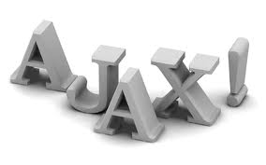
History
What is “web application”?
Client side scripts.
Common Gateway Interface (CGI).
Servlets.
ASP, PHP …etc.
AJAX.

Slide 4
AJAX
- What’s AJAX?
Asynchronous Javascript And XML
- Is AJAX a technology by itself?
- The XMLHttpRequest Object
Base object for AJAX
Allows your javascript code……
Available in most browsers
ThroughThe XMLHttpRequest object you can :

Slide 5
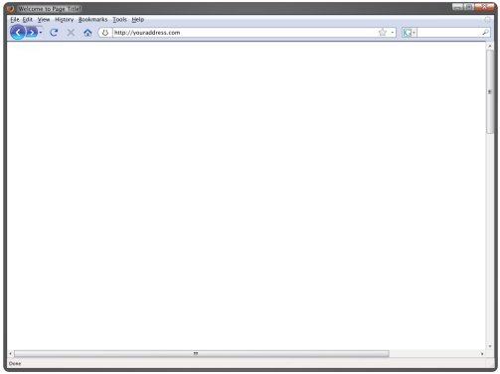
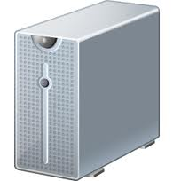
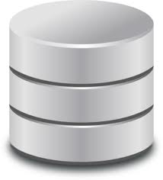
Before AJAX
- Country :
USA
- Country :
USA
- Country :
USA
- State :
- State :
- State :
CO
- State :
CO
CO
- City :
- City :
- City :
- City :
Denver
Denver
Server
Database

Slide 6
After AJAX
- Country :
USA
- State :
CO
- City :
Denver
Server
Database

Slide 7
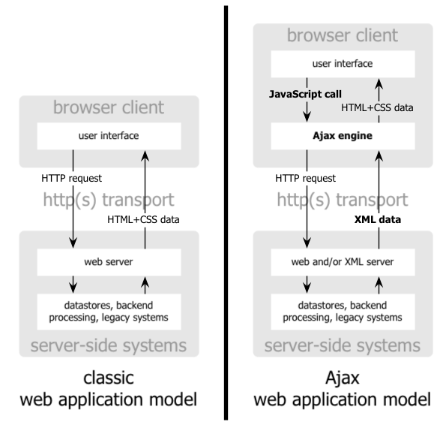
General Technique

Slide 8
Ajax vulnerabilities
There are many vulnerabilities
Our concentration are the security holes
A list of these security holes included in our research
JS Array poisoning
Flash-based cross domain access
Malformed JS Object serialization
JSON pair injection
Manipulated XML stream
Script injection in DOM

Slide 9
JS Array poisoning
popular object for serialization
Easy and effective
Poisoning a JS array spoils the DOM context.
A JS array can be exploited with simple cross-site scripting in the browser.
example
new Array(“Android”, “iphone”, “Tmobile”, “900$”, “28 years”)
Notes:
easy to port across platforms and is effective in a cross-language framework.
Poisoning a JS array spoils the DOM context. A JS array can be exploited with simple cross-site scripting in the browser. Here is a sample JS array.
E.g
This array is passed by an auction site for a used laptop. If this array object is not properly sanitized on the server-side, a user can inject a script in the last field. This injection can compromise the browser and can be exploited by an attack agent.

Slide 10
Flash-based cross domain access
It is possible to make GET and POST requests from JavaScripts within a browser by using a Flash plugin’s Ajax interface.
This also enables cross-domain calls to be made from any particular domain.
Example
Notes:
To avoid security concerns, the Flash plugin has implemented policy-based access to other domains. This policy can be configured by placing the file crossdomain.xml at the root of the domain. If this file is left poorly configured – as is quite often the case – it opens up the possibility of cross-domain access.

Slide 11
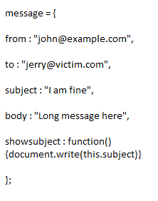
Malformed JS Object serialization
JavaScript supports (OOP).
Allows the user to create an object using
"New Object()“.
Object can be serialized using Ajax and used by JavaScript code.
Attacker can sends a malicious “subject” line embedded with script then it makes the receiver a victim of XSS.
[3]

Slide 12
JSON pair injection
JavaScript Object Notation (JSON) is a simple data exchange format which can contain object.
Attacker can inject a malicious script in either "Link" or "Desc" (XSS).
Another way to serialize malicious content to the user.
[3]

Slide 14
REFERENCES
[1] http://www.asp.net/ajax.
[2] http://www.w3schools.com/ajax/ajax_intro.asp.
[3] Ajax Security Holes and Driving Factors http://www.net-security.org.
[4] SC Magazine, Article: Hot or not: AJAX vulnerabilities, http://www.scmagazine.com
[5] What is AJAX? http://www.youtube.com/watch?v=tJXLRLDWjn4
[6] Article: AJAX Vulnerabilities: How Big the Threat?, http://www.about.com

