Slide 1
CS526 Presentation
An in depth review of ad hoc mobile network & cloud security concerns
Josh Alcorn
Larry Brachfeld

Slide 2
Agenda
Overview of Ad Hoc Mobile and Cloud Networks– Josh
Overview of Security Concerns– Larry
Attack Methods & Vulnerabilities- Josh
Overview of Specific Security Proposals– Larry
Future Work - Josh

Slide 3
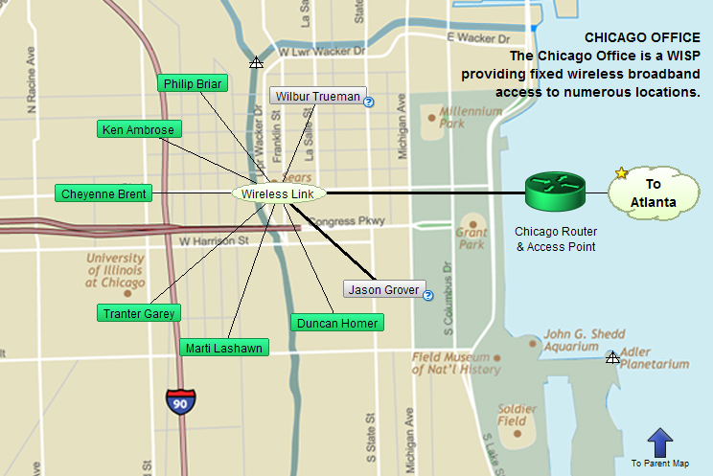
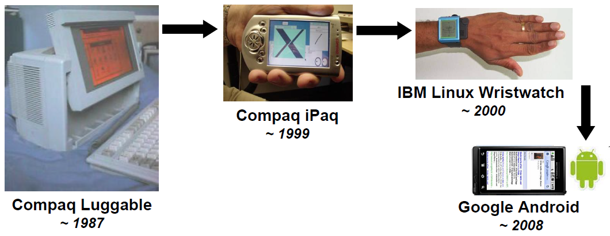
Overview of Ad Hoc Mobile and Cloud Networks
Self-configuring infrastructureless network of clouds/mobile devices connected by wireless links.
The emergence of cloud-based computing, where storage and CPU are outsourced to multiple 3rd parties across the globe, implies large collections of highly distributed and continuously evolving data points.
Notes:
Each must forward traffic unrelated to its own use, and therefore be a router.
The primary challenge in building a MANET is equipping each device to continuously maintain the information required to properly route traffic.
Mobile link to the Cloud - iCloud

Slide 4
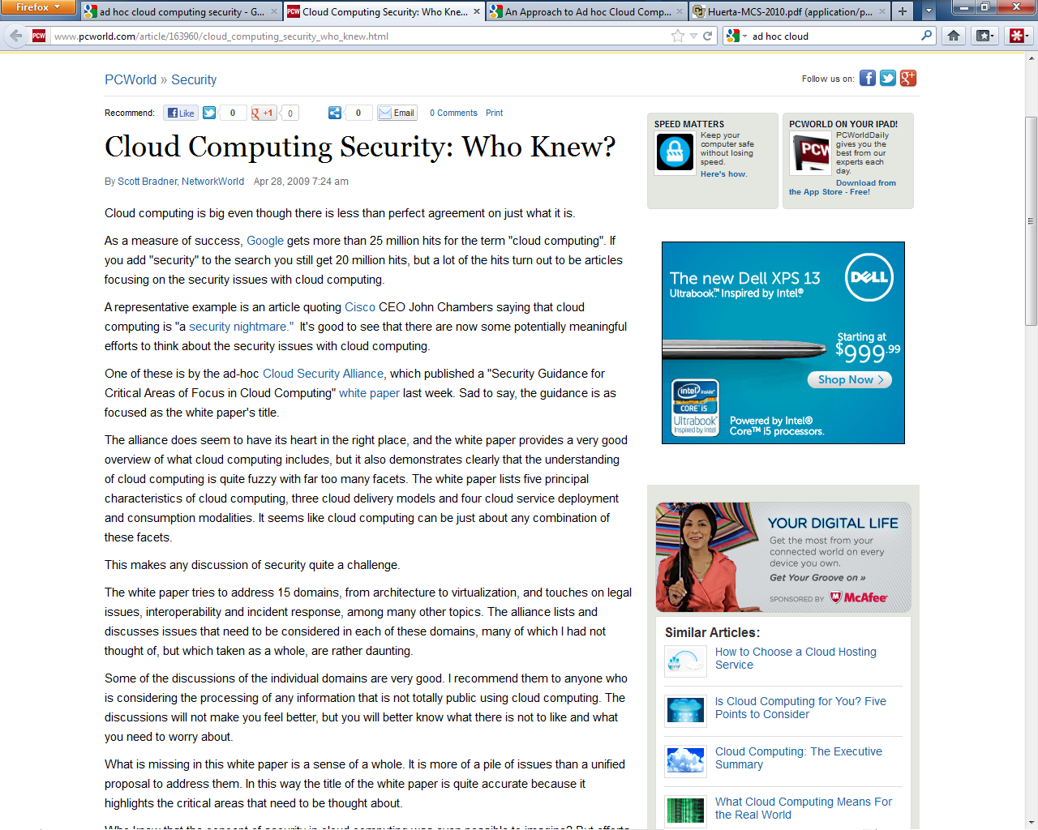
Overview of Ad Hoc Mobile and Cloud Networks
Ensure the infrastructure is secure and the clients’ data and applications are protected. While the customer must ensure that the provider has taken the proper security measures to protect their information.

Slide 5
Cloud Computing Scenarios

Slide 6
Overview of Security Concerns
Because mobile ad hoc networks have many more vulnerabilities than a traditional wired network, security is much more of a challenge in the mobile ad hoc network environment.
On a wireless network, an adversary is able to eavesdrop on all messages within the emission area, by operating in promiscuous mode and using a packet sniffer

Slide 7
Overview of Security Concerns (Cont)
Furthermore, due to the limitations of the medium, communications can easily be perturbed; the intruder can perform this attack by keeping the medium busy sending its own messages, or just by jamming communications with noise.

Slide 8
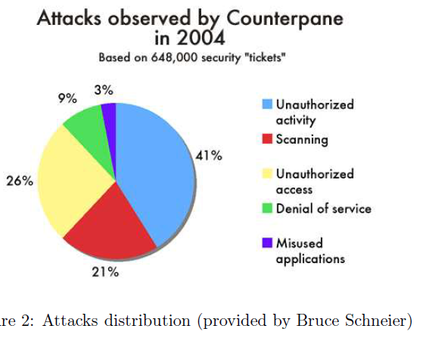
Attack Methods & Vulnerabilities
Vulnerabilities:
  Lack of Secure Boundaries
  Compromised Nodes
  Lack of Centralized Management/Standards
  Restricted Power Supply*
  Scalability
Attack Methods
  DoS
  Impersonation
  Eavesdropping
  Attacks Against Routing

Slide 9
Overview of Security Proposals
CloudSEC proposes a new architecture for composing collaborative security-related services in clouds, such as correlated intrusion analysis, anti-spam, anti-DDOS, automated malware detection and containment.
CloudSEC is modeled as a dynamic peer-to-peer overlay hierarchy with three types of top-down architectural components.

Slide 10
Overview of Security Proposals
Based on this architecture, both data distribution and task scheduling overlays can be simultaneously implemented in a loosely coupled fashion, which can efficiently retrieve data resources from heterogeneous network security facilities, and harness distributed collection of computational resources to process data-intensive tasks.

Slide 11
CLoudSec Architecture
Notes:
A CloudSEC System is comprised of three sets of components: administration group, collaboration groups and peripheral entities. All communication between the nodes of administration group and collaboration group is encrypted. A description of each follows:
1) Administration group. Administration Group is the kernel component of the CloudSEC architecture, which is an overlay organized by those peers called task coordinator. Each task coordinator is in charge of a dynamic administrative domain, which contains a collection of
autonomous security agents. Task coordinators are responsible for making security policy decisions, managing collaboration tasks as well as distributing analytical results across multiple administrative domains.
2) Collaboration groups. Each collaboration group is organized to compose a certain security service by carrying out a collaborative task. CloudSEC harnesses the distributed nature of cloud computing to enable dynamic and strategic organizing of overlay networks in proximity to the service users. Therefore, collaboration groups are the vital components of CloudSEC’s “Providing Services on Demand” characteristic. The first security agent joining a collaboration group is called task initiator, which is the direct correspondent between the collaboration group and its task coordinator. It obtains collaborative tasks and instructions from task coordinator, and in turn reports back task status and final results. In this way, collaboration groups are preserving hierarchical attributes toward the administration group, such that every security agent has the potential to
efficiently route all messages within the entire CloudSEC architecture, simply through the forwarding mechanism of task coordinators.
3) Peripheral entities. Peripheral entity is a functionality abstraction summarizing all service contributors and users. These nodes don’t implement the CloudSEC protocol, and have no access authority to any architectural overlay. Rather, these nodes could install various heterogeneous security facilities and client software, and simply supply and consume data resources through a combination of push and pull mechanism. Extensions to
provide support for CloudSEC would be implemented as plug-ins for these systems.

Slide 12
PKI to Secure User Data

Slide 13
SecureCloud
Notes:
SecureCloud provides a data encryption layer within a virtual machine image to decrypt customer data in
real-time after the appropriate credentials have been validated. Likewise, SecureCloud encrypts customer
data in real time when putting the information back into data storage.
When the virtual machine image boots up, it uses the Runtime Agent to provide its credentials to
SecureCloud and request an encryption key along with the appropriate information to connect to data
storage. For example, a virtual machine image could be required to report items like malware pattern file
version, last full scan, network services, and location of the instance to SecureCloud during the request.
This identifying information helps to ensure that the instance meets security and environmental criteria set
by the administrator in order to run certain applications. Data is only decrypted within the virtual machine;
this ensures that data at rest within or traversing the cloud infrastructure remains encrypted at all times.

Slide 14
Notes:
The vCloud API is used by SecureCloud to determine the identity of a machine image in the vCloud
environment. The vCloud API is also used by SecureCloud to learn what data storage devices in the
vCloud environment are available for encryption.

Slide 15
Vcloud API
Notes:
Another important aspect to the vCloud API is the security. With security in mind, the vCloud API has
been designed and implemented with an access model that represents a User API, which provides a pure
virtual REST API focused on self-provisioning and the use of OVF for VMs and vApp configuration and
reconfiguration. An Admin API provides pure virtual REST APIs targeted at and used by System
Organization administrators. And Admin API Extensions include all VMware specific REST APIs
targeted to system administrators who want to build in extensibility. Another important aspect of the
vCloud API is that VMware has submitted its vCloud API specification to the DMTF and is the lead on the
work going on with OVF.

Slide 16
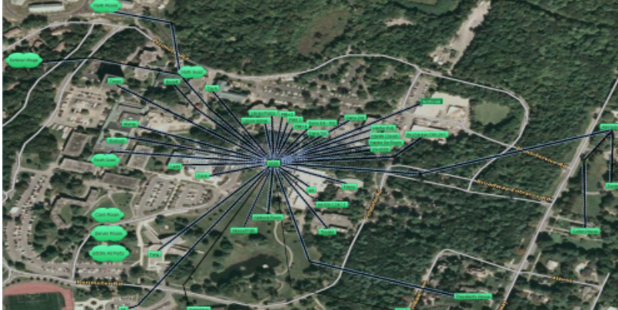
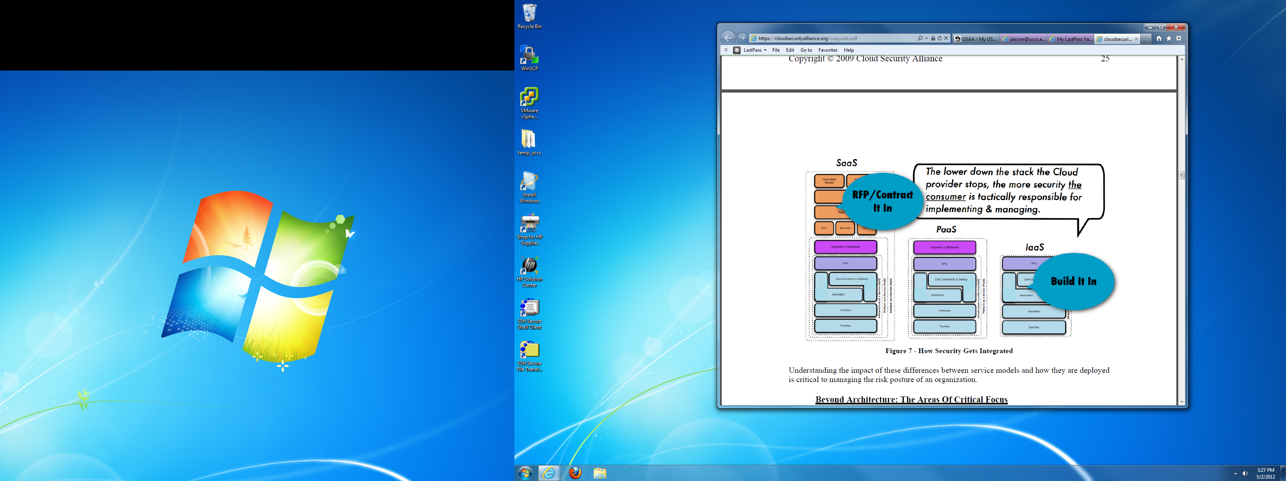
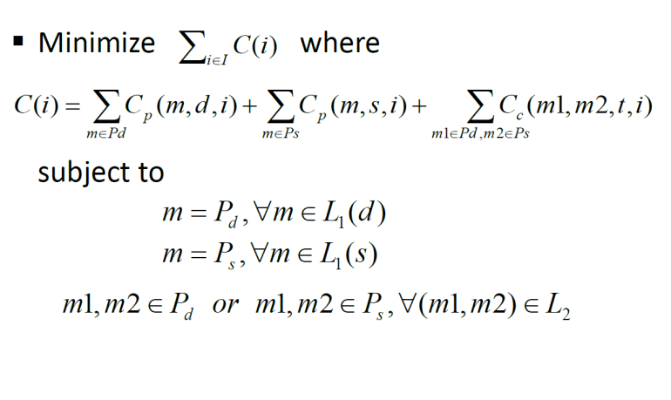
Future of Ad Hoc Mobile & Cloud Security
Collaborative Mobile Environment
Better Network Mapping/Utilization Tools
Jurisdiction & Provider Integrity
Notes:
Mobile device: giant untapped sensor network, needs partitioning scheme, 25% current usage, incentive
Resource Aware Collaborative Execution (RACE): UC Davis
Network Mapping: (Intermapper, WhatsUpGold, OpManagerPro)
Real-time mapping
Application monitoring
Security
Assign Tasks
Traffic Analysis

Slide 17
Questions ?

