Slide 1
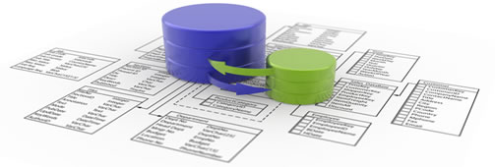
Shared Web hosting:
(VPD) Virtual Private Database Technique
Hessah Hassan Al_kaoud

Slide 2
Agenda
What Is VPD?
Shared web hosting /VPD.
How VPD works ?
Implantation.
Enhancement.
Security.

Slide 3
What is VPD?
It is a technique that enables different users to work in the same schema but the access control will make each user feel like they are accessing their own schema .
Provided by: Oracle.

Slide 4
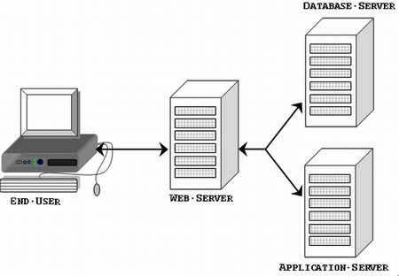
Generally
Notes:
http://biomed.uninet.edu/2007/n2/bolboaca.html. Picture source
We are taking care of Database part. Database need to be secure and to be consedered on the total cost of the website.

Slide 5
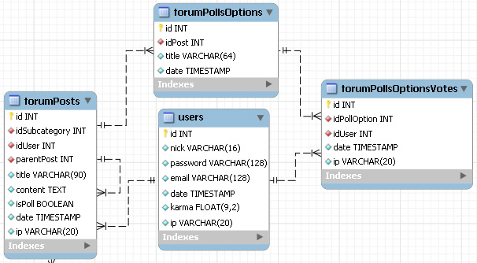
www.forum1.com
www.forum2.com
www.forum3.com
Forums share same common tables..
But different content.
Notes:
http://yensdesign.com/2008/10/making-mysql-forum-database-from-scratch/ Picture source
Forums as an example.
So, each forum need a database to control its data. Most of the forums tables look like this diagram.

Slide 6
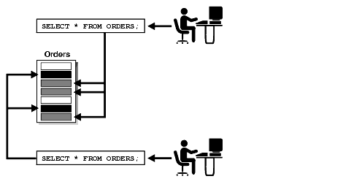
Shared Web hosting /VPD
Posts ;
Posts
Posts ;
VPD: Virtual Private Database is physically one DB but virtually many.
Notes:
http://docs.oracle.com/cd/B12037_01/network.101/b10774/intro.htm Picture source
Shared Web hosting can take advantages of VPD technique. Database is actually one DB but virtually many. VPD provides physical data separation.

Slide 7
How VPD works?
user send a SQL request to a table,
DBMS automatically adds a where clause to the query as a security action.
DBMS
SELECT * FROM Posts
WHERE Forum_NM = “ forum 1 ”;
Notes:
How each forum access its rows not others data.

Slide 8
Implementation
Additional attributes required.
PL/SQL programing language used for creating a function.
VPD policy defined and assigned to the table.

Slide 9
Enhancement
Shared Database/Limited resources
Lower cost.
Security.
Notes:
Limiting the resources is always a goal for the organizations.
Lower the cost whether it is database ownership cost or database using costs in the sharing web hosting.

Slide 10
Security
Data level security not Application level.
Row level security.
Security is powerful because it is enforced by the DBMS.
Elimination of the application security problem.

Slide 11
References ..
http://www.cgisecurity.com/database/oracle/pdf/VPD9ir2twp.pdf
http://docs.oracle.com/cd/B12037_01/network.101/b10774/intro.htm
http://www.dba-oracle.com/art_dbazine_9i_sec.htm

Slide 12
Thank you for listening Hessah Hassan Al_kaoud

