Slide 1
Mobile Development
Cross Platform Development Techniques
Adam Best
4/30/12

Slide 2
Advancements
Location based apps
Social networking
Games
Data Sharing
Data Synchronization

Slide 3
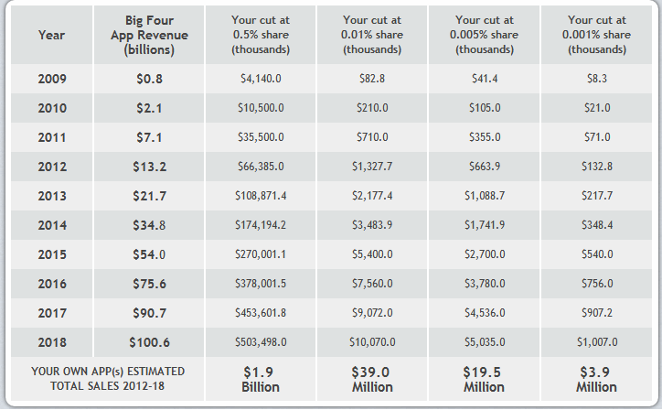
Projected Sales

Slide 4
Challenges
Multiple SDKs
Have to develop across multiple platforms.
Lack of standardization
Device modules
Tablets, phones, & iPods
Interface development
Displaying information from a website to a mobile screen.
Connection challenges
The device will not always be connected.

Slide 5
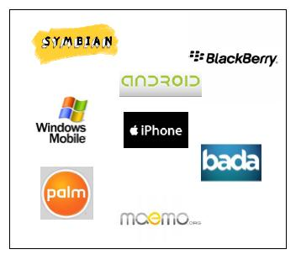
Multiple Operating Systems

Slide 6
Mobile Device Challenges
Different capabilities
Input/Output devices
Processor type
Resolution
Storage
Connection speed/type

Slide 7
Cross Platform Tools
RhoMobile
Ruby-based framework
Appcelerator
Java, PHP, Python, Ruby, & HTML
WidgetPad
CSS3, HTML5, Java
PhoneGap
Java & HTML
MoSync
C/C++, Java, Ruby, PHP, Python

Slide 8
Choosing a Tool
What language are you most comfortable with?
What type of budget constraint are you on?
What operating systems are you shooting for?
What type of device features are you wanting to use?

Slide 9
Resources
Gasimov, A.; Chuan-Hoo Tan; Chee Wei Phang; Sutanto, J.; , "Visiting Mobile Application Development: What, How and Where," Mobile Business and 2010 Ninth Global Mobility Roundtable (ICMB-GMR), 2010 Ninth International Conference on , vol., no., pp.74-81, 13-15 June 2010 doi: 10.1109/ICMB-GMR.2010.20 URL: http://ieeexplore.ieee.org/stamp/stamp.jsp?tp=&arnumber=5494784&isnumber=5494761
http://developer.smartface.biz/challenges-of-mobile-application-developement-n74.html
http://mashable.com/2010/08/11/cross-platform-mobile-development-tools/
http://www.biginnovations.com/development/appdevelopmentconsultants.html

