Slide 1
CS5260 advanced internet and web systems Securing Web Services with SamL
Carl A. Foster

Slide 2
What is SAML?
What is SAML?
Security Assertion and Markup Language is an XML-based standard for exchanging authentication and authorization between security domains.
Why is it Important?
SAML abstracts the security away from platform architectures and vendor implementations.

Slide 3
History of SAML
Three Versions of SAML have been released
SAML 1.0 - November 2002
SAML 1.1 – September 2003
SAML 2.0 – March 2005
Originally a Product of OASIS Security Services Technical Committee
SAML 2.0 Implements Much Stronger Federation Identity Management
Liberty Alliance and Shibboleth Initiatives contributed to version 2.0

Slide 4
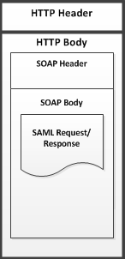
SAML 2.0 Anatomy
Protocols
Assertion Query and Request Protocols
Authentication Request Protocol
Artifact Resolution Protocol
Name Identifier Management Protocol
Single Logout Protocol
Bindings
SAML SOAP Binding
Reverse SOAP Binding
HTTP Artifact Binding
SAML URI Binding
Profiles
SSO Profile – Most important

Slide 5
How Web Services Interact
Web Service Choreography
Relationships between web services are dynamic
Decisions are made between individual web services
No single web service is in control
Typically used when web services share information between domains
Web Service Orchestration
Frequently Unified
Typical design for web services within a domain.
One Web Service typically in control of others

Slide 6
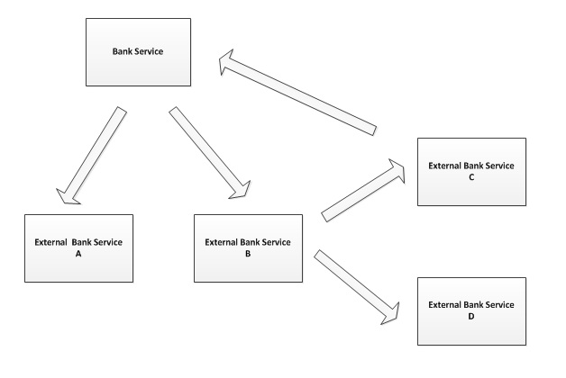
Web Service Choreography

Slide 7
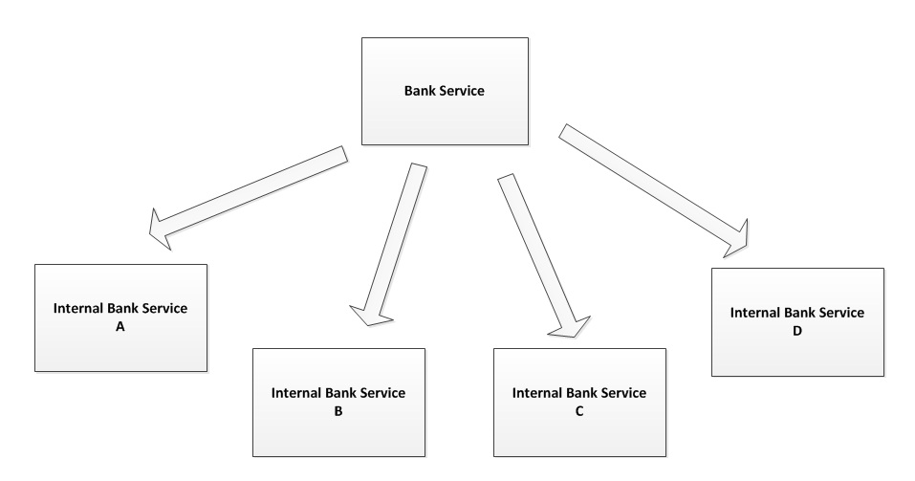
Web Service Orchistration

Slide 8
SAML Use Case – SAML 2.0
1. Request a Resource
https://my.bank.com/myAccount
2. Respond With Form
<form method="post" action="https://idp.example.org/SAML2/SSO/POST" ...>
<input type="hidden" name="SAMLRequest" value="request" />
... ………………..
<input type="submit" value="Submit" />
</form>
3. Request the SSO Service at Identity Provider
User agent issues POST Request to SSO Service
SSO service processes authentication request
User is Identified

Slide 9
SAML Use Case – SAML 2.0
4. XHTML For is Given as Response
<form method="post" action="https://sp.example.com/SAML2/SSO/POST" ...>
<input type="hidden" name="SAMLResponse" value="response" />
...
<input type="submit" value="Submit" />
</form>
5. Request Assertion Consumer Service at SP
User Agent issues POST request at the service provider.
Value of SAMLResponse parameter is read from XHTML
6. User Agent is Redirected to Target Resource
Process Response
Create Security Context at SP
Redirect user agent to Target Resource

Slide 10
SAML Use Case – SAML 2.0
7. Second Request of Resource at SP
https://my.bank.com/myAccount
8. Request Assertion Consumer Service at SP
Security Context Exists
Resource is Returned to the User Agent
NOTE: Example of SAML Security Policy Bound to service
<wsp:PolicyReference URI="oracle/wss11_saml20_token_with_message_protection_service_policy"
orawsp:category="security" orawsp:status="enabled"/>

Slide 11
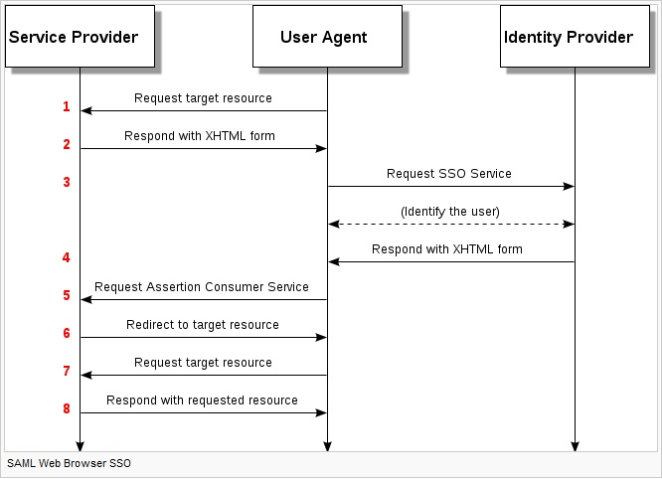
SAML Use Case – SAML 2.0

Slide 12
SAML Conclusions
Nothing Mandated – Only Recommendations
Service Providers all need to agree upon the same standards
Mixed versions of SAML may be used
Hard to Determine the impacts of Change
Hard to test from a security standpoint.
Difficult to configure
Lots of moving pieces, hardware, software, keystore, and business elements.

Slide 13
Future Work
Automate large scale on demand systems with web services secured by SAML.
Further Investigate Shibboleth SSO use with SAML
Become fluent the various ways to secure web services using security policies in cloud computing environments.

Slide 14
Primary References
NIST:
Guide to Secure Web Services
http://csrc.nist.gov/publications/nistpubs/800-95/SP800-95.pdf
OASIS:
Authorization Context for the OASIS Security Service Markup Language (SAML) V2.0
http://docs.oasis-open.org/security/saml/v2.0/saml-authn-context-2.0-os.pdf
PAPERS:
Information Assurance Challenges and Stratagies for Securing SOA Environments and Web Services
IEEE SysCon 2009 —3rd Annual IEEE International Systems Conference, 2009
Vancouver, Canada, March 23–26, 2009
Combining Identity Federation With Payment:
The SAML Based Payment Protocol
2010 IEEE/IFIP Network Operations and Management Symposium - NOMS 2010

