Slide 1
WiMAX 802.16 Study Through OPNET Modeler
Michael Menozzi
CS526

Slide 2
Overview
Introduction
Types of WiMAX
Coverage
Components of WiMAX
Colorado Springs Plan
The experiment
Future work
References

Slide 3
Introduction
WiMAX (Worldwide Interoperability for Microwave Access
Term created by the WiMAX forum
Provide continuity, interoperability and uniformity
Emerging technology – last mile/first mile application
Service providers
Mobile internet users
475 WiMAX networks deployed in 140 countries

Slide 4
Types of WiMAX
Fixed and mobile WiMAX
802.16d for fixed
Smaller coverage area – high gain-low portability uni-directional antennas
802.16e for mobile
Larger coverage area – low gain-high portability omni-directional antennas

Slide 5
Types of WiMAX, cont.
Non-line-of-sight – similar to WiFi
Frequency range – 2 GHz to 11 GHz
Line-of-sight – Fixed dish antenna that points to the WiMAX tower
Frequency range – 66 GHz maximum – less interference and fewer errors

Slide 6
Coverage
Theoretical – Provide broadband speeds over 30 miles with a single base station
Realistically
4-5 miles/no Line-of-Site (LOS)
10 miles/Line-of-Site (LOS)

Slide 7
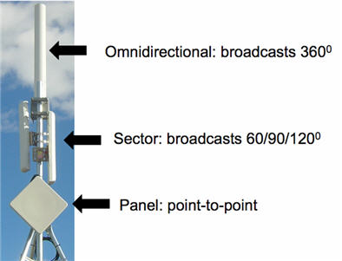
Components
Simplistically
WiMAX tower
Connect directly to the Internet using a terrestrial connection or by way of a LOS microwave link
Omni-directional – users near the antenna
Sector – better – use multiple ones for 360
Panel – point-to-point
WiMAX receiver
Small box or PCMCIA card or built into the computer –similar to WiFi
Similar in concept to a cell-phone tower – provide coverage to a large area
In the neighborhood of 3,000 square miles

Slide 8
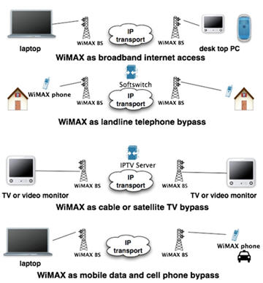
The Threat
The obvious threat is to WiFi, cable and local phone companies
WiMAX has the capability of providing:
Voice over Internet Protocol (VoIP)
Cable television
Internet
Plus on the go – mobile internet service
True triple-play PLUS mobile for the home user

Slide 9
Who is providing it?
Clear – Formally known as Clearwire
Consists now of Sprint, Google, Intel, Comcast, Bright House and Time Warner
Technology | 4G | 3G | DSL | Cable
Mobility | Mobile + Home | Mobile + Home | Home Only | Home Only
Speed | 3-6 Mbps download; upload up to 1 Mbps | 600Kbps - 1.4 Mbps download; upload up to 600Kbps | 700Kbps - 1.5 Mbps download; upload up to 384Kbps | 12-16+ Mbps
Download 4MB song | 5 seconds | 21 seconds | 21 seconds | 2.5 seconds
Download 200MB video | 4 minutes | 18 minutes | 18 minutes | 3 minutes
Cost | ~$40/Month | ~$40/Month | ~$35/Month | ~$43/Month

Slide 10
Locally?
Colorado Springs explored a citywide solution in 2007 to provide WiFi
Decided to eventually wait – no company would engage without city monies
In 2009 Clearwire announced it would offer WiMAX in Colorado Springs
The Telecommunications Policy Advisory Committee (TPAC) provided little information
Their mission is to bring technology to the Springs
Should be the end of 2010, Gazette running legal ads for their towers

Slide 11
Future Work
IEEE 802.20
Global Area Network (GAN)
Similar to cell phone capabilities
Nationwide coverage
Similar to cable provider
Speeds equivalent to cable modem
OPNET – Run traffic across the model (Springs) to demonstrate the research and development usage
No results yet – compile issues in regard to the software

Slide 12
References
http://www.techpluto.com/wimax-in-detail/
http://computer.howstuffworks.com/wimax1.htm, page 1
http://computer.howstuffworks.com/wimax1.htm, page 2
http://www.motorola .com , WiMAX_E_vs._D__White_Paper.PDF
http://en.wikipedia.org/wiki/FFT
http://www.networksystemsdesignline.com/howto/199202160
http://newsroom.clearwire.com/phoenix.zhtml?c=214419&p=irol-newsArticle&ID=1404906&highlight=
http://www.clear.com/discover/compare-clear
http://findarticles.com/p/articles/mi_qn4191/is_20070919/ai_n21036084/
http://findarticles.com/p/articles/mi_qn4191/is_20091210/ai_n45771414/
http://www.wimax.com/education/wimax/what_is_wimax
http://www.wimax.com/education/wimax/antennas

Slide 13
Questions?

