Slide 1
Bypassing Firewalls Using Negotiation Server and Port Prediction
Negotiating Unsolicited Connections to a Service Listening Behind a Firewall
Ben Stroud
CS525
Spring 10

Slide 2
Presentation Outline
So What is the Problem Anyway?
How Port Prediction Works
Implementation Issues
Success Rates
Not Covering
Alternative Solutions
Security Concerns
Questions

Slide 3
What is the Problem?
Firewalls will generally not allow unsolicited connections from the outside world into the “protected zone”.
To participate in peer to peer networks users have to open ports.
How to keep users from having to manually configure routers?

Slide 4
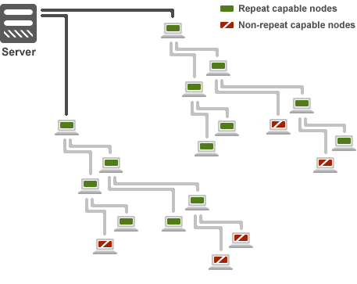
Our Company
Live Online Streaming of Television Via a Distributed Network

Slide 5
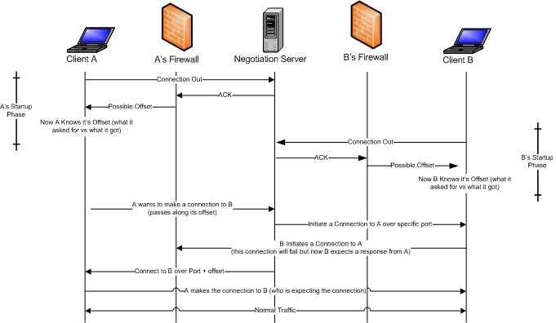
Our Solution
Notes:
Client B is established in the network. Client A is trying to Join.

Slide 6
Implementation Considerations
For Large Networks Negotiation Server Must be very Robust
Overlapped I/O with large pool of sockets
UDT
TCP has additional considerations
Implementation this is based on used UDP
We still needed TCP delivery guarantees
TCP + UDP = UDT

Slide 7
Success Rates
Able to bypass 95% of consumer level routers
Failures due to port prediction or bad connections?
Unable to predict random offsets
Won’t work on the Most Restrictive Networks
Confined to HTTP for inbound traffic

Slide 8
Questions?

Slide 9
References
See Full Report

