Slide 2
Overview
Introduction
VPS Understanding
VPS Architecture
VPS Performance
VPS Features
VPS Enhancements
Conclusion
References
Questions
5/1/2010
VPS
A.Almurayh

Slide 3
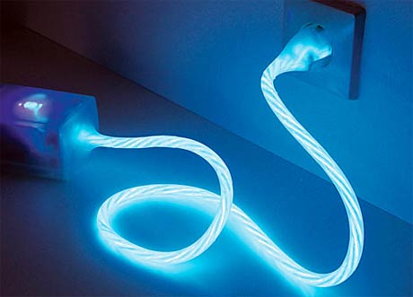
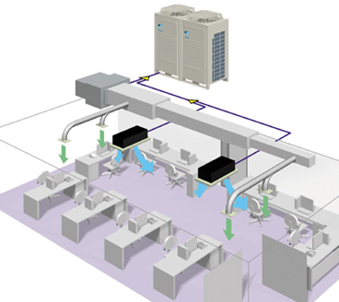
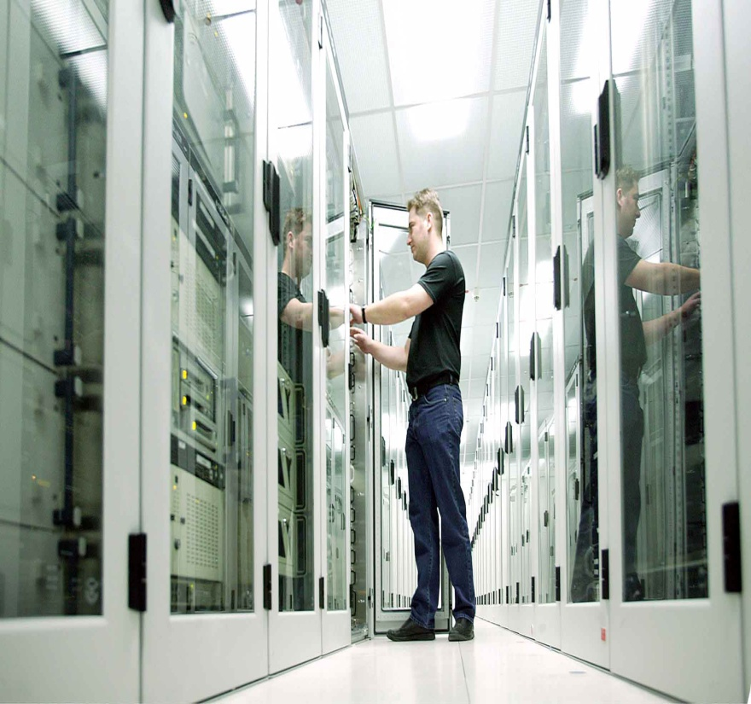
Introduction
Individuals and organizations started demanding:
Independency
Isolation
Freedom
More capacity
5/1/2010
VPS
A.Almurayh

Slide 4
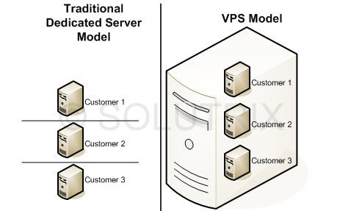
VPS Understanding
Easy!
Merge these servers into one server !
5/1/2010
VPS
A.Almurayh

Slide 5
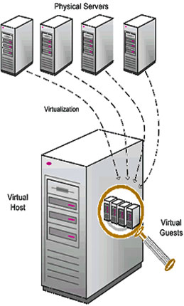
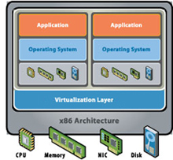
VPS Understanding
Web Servers on top of a physical web server
VPS web servers share only a certain amount of resources
Overloaded VPS web servers cannot affect neighboring VPS web servers
VPS web servers can only consume what they are given
Virtualization systems run most operating systems, no matter what physical hardware is used
5/1/2010
VPS
A.Almurayh

Slide 6
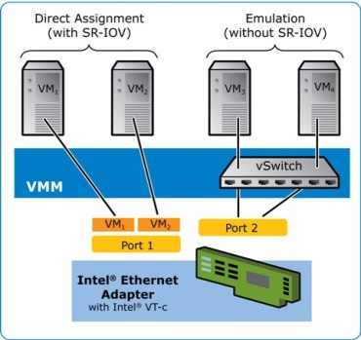
VPS Architecture
Three prime elements:
Operating system-level virtualization
Networking Virtualization
Resource Management
5/1/2010
VPS
A.Almurayh

Slide 7
VPS Architecture
VPS1
VPS2
VPS3
VPS4
VPS(n)
User
User
User
User
User
User
User
User
User
User
User
User
User
User
User
User
User
User
User
User
User
User
User
User
User
User
User
User
User
Virtualization System Layer
Operating System Layer
Hardware Layer
5/1/2010
VPS
Network Layer
A.Almurayh

Slide 8
VPS Performance
Performance effective factors
The specifications of the Physical Server
CPU, RAM, OS, Storage, Buses, NIC … etc
Virtualization Systems
Requirements, Resources Consumption, Response, Compatibility…
The specifications of VPS servers
Amount of CPU, RAM, OS, Storage, networking… etc
Network
Speed, Capacity, Visualization support …
Applications
Services, Security, Web Services, …
5/1/2010
VPS
A.Almurayh

Slide 9
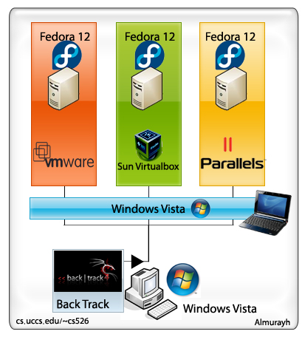
VPS Performance
VPS Performance Comparison:
CPU: 2.5 GHz , 1 Core
RAM: 512 MB
HDD: 10 GB
Service: Web(httpd)
5/1/2010
VPS
A.Almurayh

Slide 10
VPS Performance
VPS Performance Comparison:
5/1/2010
VPS
A.Almurayh

Slide 11
VPS Performance
VPS Performance Comparison:
5/1/2010
VPS
A.Almurayh

Slide 12
VPS performance
VPS Performance Comparison:
-76%
5/1/2010
VPS
That’s not always true!
A.Almurayh

Slide 13
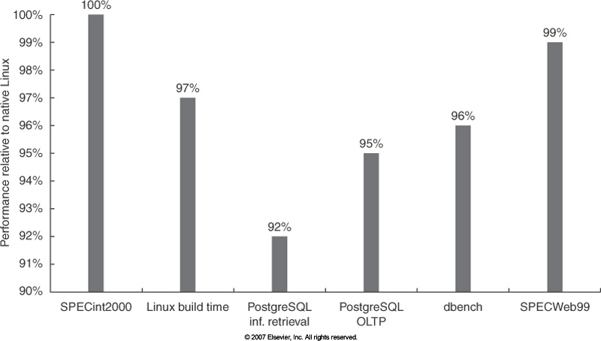
VPS Performance
VPS Performance Comparison:
5/1/2010
VPS
A.Almurayh

Slide 14
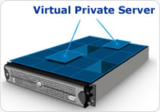
VPS Features
Isolation
Dynamicity
Flexibility
Security
Scalable and Upgradeable
Performance
End User control
Disaster Recovery
Host Unlimited Websites
Incredible savings:
Cost
Power
Nature
5/1/2010
Space
VPS
A.Almurayh

Slide 15
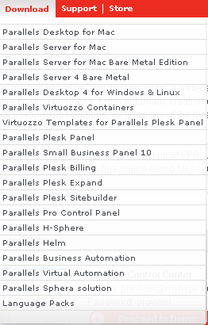
VPS Automation
VPS automation definition:
Additional software that controls the resource flow and manage the activities of the VPS servers based on the permissions and setting that they are given.
Virtual Automation
Configuration, Policies, resources, Library,
OS Templates, statistics, Real-time monitoring,
migration VPS across physical servers…
Billing Automation
Bills production, reporting, Resources limitation …
Hosting Automation
Software that automates common tasks for web hosting or other services that are provided online
Provider Control panel → Total managements of VPS servers and websites
Reseller Control Panel → Limited managements of websites
Client Control Panel → A Website managing
5/1/2010
VPS
A.Almurayh

Slide 16
VPS Automation
VPS1
VPS2
VPS3
VPS4
VPS(n)
User
User
User
User
User
User
User
User
User
User
User
User
User
User
User
User
User
User
User
User
User
User
User
User
User
User
User
User
User
Virtualization System Layer
Operating System Layer
Hardware Layer
5/1/2010
VPS
Network Layer
A.Almurayh

Slide 17
VPS Enhancement
VPS Still performs slowly!
5/1/2010
VPS
A.Almurayh

Slide 18
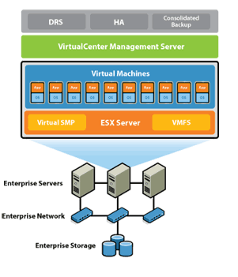
VPS Enhancement
Storage computation:
Performance with High Speed Storage
SSD Technology
Caching
Temporary Storing
Faster buses
5/1/2010
VPS
A.Almurayh

Slide 19
VPS Enhancement
Distribution System:
Distribute the workload to other VPS servers.
Get faster response time.
5/1/2010
VPS
A.Almurayh

Slide 20
VPS Enhancement
Data isolation
Isolate data from VPS server system physically
External data backup
VPS
System Files
Users’ Data
Back up
5/1/2010
VPS
A.Almurayh

Slide 21
VPS Enhancement
VPS server optimization:
Disabling useless system services
Configuring MySQL and Apache for optimal resources utilization
Disabling unnecessary modules or plug-ins
Disabling unnecessary control panels
Uninstalling useless applications
Installing VPS optimized services, control panels, modules
5/1/2010
VPS
A.Almurayh

Slide 22
Conclusion
VPS becomes more popular
The solution is being adopted more
It will be interesting to see how security, performance, flexibility, and cost will be affected
The benefit of a VPS appears to decrease the problems experienced with physical servers
Some users are still resistant to change
Expect greater acceptance by those considering hosting services
5/1/2010
VPS
A.Almurayh

Slide 23
References
[1] About Akamai, http://www.akamai.com
[2] Virtual Machine Definitions, http://en.wikipedia.org/wiki/Virtual_machine
[3] Why VPS and not shared hosting?, http://www.eukhost.com/forums/f29/why-vps-not-shared-hosting-1118/
[4] Virtual private server, http://en.wikipedia.org/wiki/Virtual_private_server
[5] Operating system-level virtualization, http://en.wikipedia.org/wiki/Operating_system-level_virtualization
[6] Virtual Private Servers, https://www.caro.net/vps
[7] Managed Virtual Private Server ( VPS ) Hosting, http://www.galaxyvisions.com/vps_hosting.php
[8] VPS Performance Comparison, http://journal.uggedal.com/vps-performance-comparison
[9] 5 Linux VPS Performance Tips, http://linuxconsultant.info/tutorials/5-linux-VPS-performance-tips.html
[10] Parallels Desktop® 4 for Windows & Linux http://download.parallels.com/desktop/v4/wl/docs/en/PD4fWL_Datasheet.pdf
[11] Your CPU does not support hardware virtualization http://www.parallels.com/products/novt/
[12] Parallels® Virtuozzo Containers http://www.parallels.com/r/pdf/ds/PVC_Maximum_efficiency_for_servers.pdf
[13] What is a VPS?, http://www.powervps.com/cpanel-plesk-vps_what.aspx
[14] Billing and automation software, http://www.webhostingtalk.com/wiki/Billing_and_automation_software
[15] cPanel and WHM, http://www1.cpanel.net/products/cpanelwhm/index.html
[16] Parallels Virtual Automation, http://www.parallels.com/products/pva45/
[17] Parallels® Business Automation – Standard, http://www.parallels.com/r/pdf/ds/parallels_business_automation_standard.pdf
5/1/2010
VPS
A.Almurayh

Slide 24
Questions
5/1/2010
VPS
A.Almurayh

