Slide 1
SQL Injection
Peter Torres, Tim Poley
CS526
Spring 2009

Slide 2
Presentation Outline
What is SQL Injection?
Basic Example
Case Studies
Defensive Techniques
Demo

Slide 3
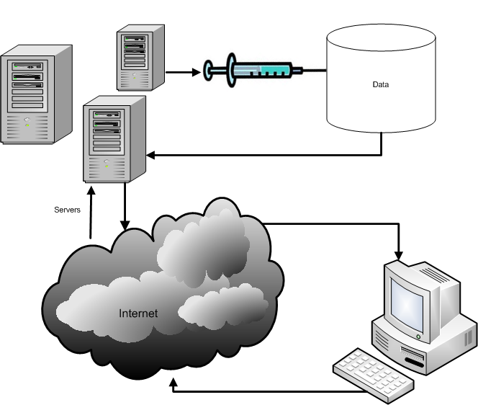
What is SQL Injection?
SQL Injection is a code injection technique that exploits a security vulnerability at an applications database access layer.

Slide 4
Basic Example
Statement = "SELECT * FROM users WHERE name = '" + userName + "';"
Substitute “a' or 't'='t” instead of a real username
SELECT * FROM users WHERE name = 'a' OR 't'='t';

Slide 5
Case Study: USC
In July of 2005, Erin McCarty hacked the University of Southern California’s application website
Used the user login page to send commands directly to the school database
Access to names, birth dates, addresses, and social security numbers of any student who filled out an online application
McCarty faces a possible 10yr prison sentence

Slide 6
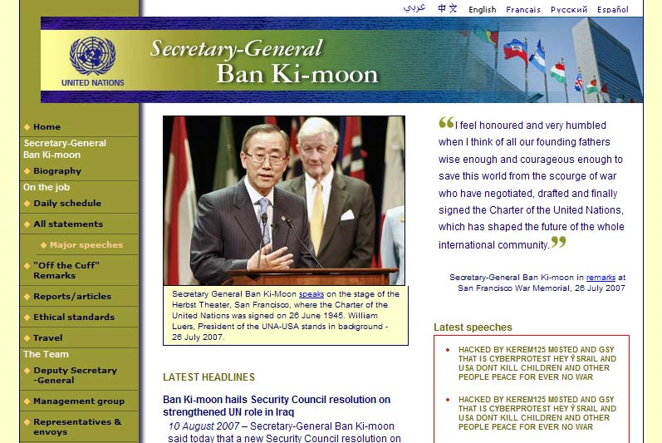
Case Study: U.N.
On August 12th, 2007 the United Nations website was defaced by hackers

Slide 7
Defenses
Type Checking
Make sure an 8 digit number is an 8 digit number
Escaping Special Characters
; ‘ -
Data Hashing
Error Suppression
Hide information from hackers
Prepared Statements
Fix the SQL Statement before assigning user data

Slide 8
Demo

Slide 9
References
Database Programming with JDBC and Java 2nd Edition; George Reese, O’Reilly
Hackademix – United Nations vs. SQL Injection http://hackademix.net/2007/08/12/united-nations-vs-sql-injections/
Security Focus http://www.securityfocus.com/brief/191
Wikipedia – SQL Injection http://en.wikipedia.org/wiki/Sql_injection

