Slide 1
Energy Savings with Dynamic Server Scheduling using Wake On Lan
Nicholas Sterling

Slide 2
Goals
To create an efficient scheduling algorithm to dynamically start up and shut down servers. Based on:
Current Server Load
If 30% is sufficient to handle current traffic, shut down unneeded servers.
Preset Schedule
Anticipate traffic spikes and bring needed servers online
Other possible metrics?

Slide 3
Types of Servers
Application Servers
Media Conversion (Example: YouTube.com)
Proxy Sites
HTTP(S)
SSH
Remote Desktop Hosting
Anything that requires minimal data persistence

Slide 4
Implementation
Small scale (Proof of Concept)
Networked 6 Dell Optiplex 950 PC’s on two separate switches
One on “Main Network”(10.1.10.x)
To simulate primary network traffic
Second on “Backend Network” (192.168.0.x)
To simulate internal backend processes
Rsync
WOL Magic Packets

Slide 5
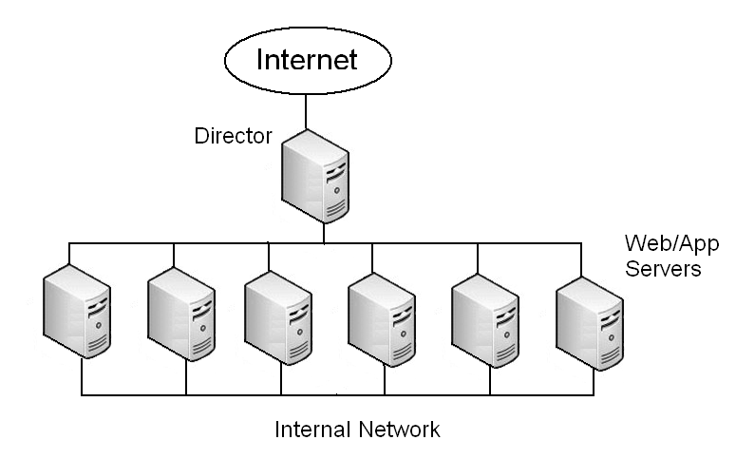
Implementation (Cont)

Slide 6
Implementation (Cont)
Problems…
WOL on some Optiplex machines was unreliable.
Three of the Six machines responded to WOL packets.
Sample set of WOL capable machines was not large enough for accurate results.
Is it worth more research?
Yes… so let’s try something larger!

Slide 7
Implementation (Yes, more…)
“Large Scale”
Wrote a threaded server simulator in Python.
Could create “n” threads. Each representing a running server. Each “server” could respond to a certain number of requests per second.
Second python script acted as a “Director”.
Round Robin Scheduling

Slide 8
Assumptions
Assumptions:
High traffic between 0900 and 1500
Between 70% and 80% of total server capacity
Minimal traffic between 2300 and 0600
Between 10% and 30% of total server capacity
Energy Usage
Varies highly by manufacturer/type of server/current load/etc…
For this one example, we assume an average of 305W of power consumption per server. (See AMD link in Resources)

Slide 9
Results
Using ONLY the scheduling algorithm:
Servers ran on average at 63.75% of normal capacity.
Simulation ran 18 servers at 300w each
Run (on average) of 12 servers
Would save 15,724 kWh of power per year

Slide 10
Results (Cont)
Using Scheduling Algorithm AND “On-Demand Traffic”
Created simulated artificial traffic spikes to overload current servers.
On average it would take 55 seconds to bring server online and ready to accept traffic.
Some traffic during the initial traffic spike was lost due to timeout errors
(New resources had not yet been brought online)
With simulated traffic, total server capacity went up to aprox 75%

Slide 11
Problems
Servers with dynamic content would have to sync before being used.
Load every few hours and sync?
Is it even practical for Database servers?
Traffic spikes would cause some timeout issues
Less than 1% though…
This is a problem if you want “High Availability”
Wake on LAN does fails when server shut down improperly.

Slide 12
Analysis
Is it worth the effort?
Well…
YES if you are concerned about power consumption and/or environmental issues
NO if high availability is a primary concern
Security Concerns
Leaving Wake-On-LAN can be a potential security problem…
Power Cycling Hardware
Consensus says power cycling hardware a few times a day will not be detrimental…
However not much has been done on dozens of power cycles per day…

Slide 13
Future Research
Creating a more efficient scheduling program based on:
Better traffic pattern analysis
Weighted LRU instead of Round Robin?
Holidays/sporting events/current events
Server room temperature
Could you use this to lower server room temperatures and therefore cooling costs?
Do excessive power cycles hurt hardware lifecycles?
Is that a concern when servers are upgraded every X years?

Slide 14
REFERENCES
Koomey (2007). Estimating Total Power Consumption By Servers In The U.S. and the World. (http://enterprise.amd.com/Downloads/svrpwrusecompletefinal.pdf)

