Slide 1
Project HEROIC What Online Informal Communications Reveal About Social Structure and Process in Disaster
Jeannette Sutton
Trauma Health and Hazards Center
February 23, 2011
Notes:
Who am I?
Where did I come from?
What is my training?
What will this talk be about?

Slide 2
Introductory Thoughts…
The public is a liability
The public is a resource
Rumoring is malicious and harmful
Rumoring is a process of sensemaking and information sharing
Social media use is a waste of time
Social media is a window into social milling activities
Officials can control information flow
Officials may become irrelevant

Slide 3
Project HEROIC Goals
Using a longitudinal and comparative approach, this project examines the content, structure, and dynamics of online interaction in response to multiple events, across multiple hazards.

Slide 4
Research Motivations
Informal exchange of information, including gossip and rumor, is a characteristic human behavior (Dunbar 1997).
Actors in crisis settings use their social networks to obtain factual information regarding imminent hazards (Drabek 1969)
Social media technologies aid in collecting and disseminating disaster-relevant information
In addition, they allow individuals to reach much larger numbers of contacts over greater distances
Relatively little is known about the dynamics of informal online communication in response to extreme events.

Slide 5
Core Project HEROIC Activities
Intensive data collection efforts (UCI)
Modeling conversation volume and local structural properties (UCI)
Content analysis of conversation streams (UCCS)

Slide 6
Social Media Research
Virginia Tech School Shooting (2007)
Southern California Wildfires (2007)
Democratic National Convention (2008)
Tennessee Valley Coal Ash Disaster (2008)
How do members of the public make use of social media technologies to communicate in disaster events?

Slide 7
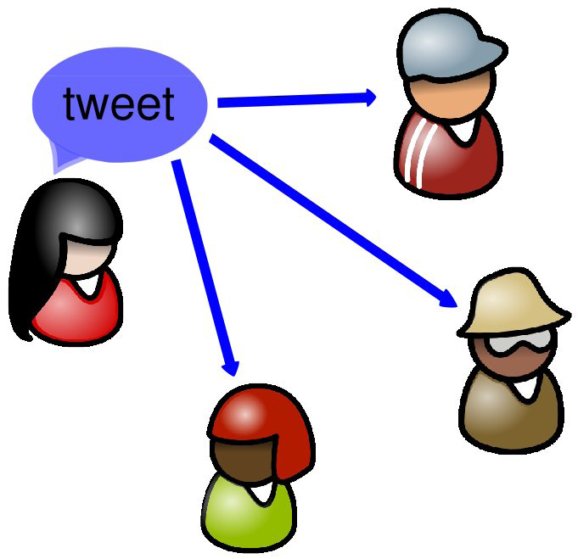
Twitter
Twitter is a popular microblogging service with 190 million visitors monthly.
Users exchange short 140 characters and maintain a directed social network of friends and followers.
Large scale, dynamic online communication network.
Publicly available and particularly well-suited to rapid information dissemination and informal communication

Slide 8
Project HEROIC Data Collection
Begin with a list of control (Ogden’s Basic English core word list) and hazard or event related keywords
Capture all public tweets containing the given set of keywords
For a sample of users capture social ties daily for a period of one week
User covariates are also collected
Notes:
Ask Emma what she means by user covariates.

Slide 9
Dataset Statistics
6 different hazard types (and adding more)
163 keywords tracked
300 million tweets since 10/15/2009
550 million social ties from 30,000 unique users

Slide 10
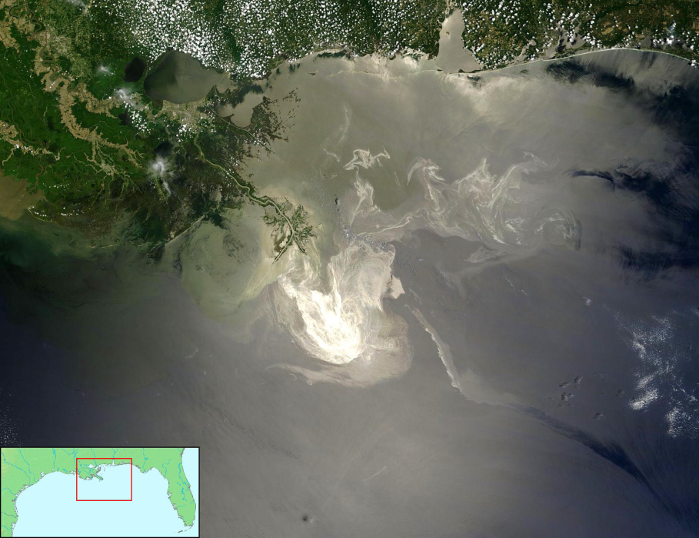
Deepwater Horizon Oil Spill 2010
On 20 April 2010, an explosion on the Deepwater Horizon offshore drilling rig killed 11 crewmen and resulted in an massive oil spill. It is the largest accidental marine oil spill in the history of the petroleum industry.

Slide 11
Deepwater Horizon Oil Spill Dataset
10 week period immediately following the event: May 6-July 15 2010
8 week period post event: August 27-November 23, 2010
Oil Spill Event keywords: oil spill, coast guard, oil slick, environmental disaster, cleanup, BP, ocean, wildlife, gulf, deepwater horizon, spillcam, blacktide, disaster, bpdisaster, bpspillmap

Slide 12
Oil Spill Research
What kind of rumoring activity can be found?
When does rumoring activity differ?
How does rumoring activity differ?
Rumor definition:
An unverified proposition for belief that bears topical relevance for persons actively involved in its dissemination
Factual, lacking authenticity
Current or topical issues of importance for a group

Slide 13
Rumoring Research
Allport and Postman (1945)
Perceived importance of the information shared
Degree of cognitive unclarity surrounding the information
Suggested behavioral change resulting from information
Anxiety leads to increased rumor activity (Anthony 1973)
On the other hand Caplow (1947) argued that the presence of “official” information tends to suppress rumoring
Notes:
Consider where this belongs in the slide set…

Slide 14
Oil Spill Tweet Content
Content analysis for key points within the time series
Dates correspond with official press releases that were provided by the Joint Information Center and describe:
May 6, 2010: Efforts to cap or reduce the flow of the oil using a containment dam
May 19, 2010: Reports from NOAA on the spread of the oil into the Loop Current
All tweets posted 3 hours immediately following the event containing the phrase oil spill are considered
Basic content analysis using coding schema developed by Chew and Eysenbach (2010)
Tweets are coded as on topic: showing some relationship to the content of the press releases
Notes:
What was the primary topical content? See Matt’s work

Slide 15
Rumor Coding
Rumor coding adapted from Bordia and DiFonzo (2004) “Rumor Interaction Analysis System (RIAS)”
1. Prudent (Pr) - cautionary and qualifying statements: “I am not sure if
this is true or not“
2. Apprehensive (Ap) - fearful or threatened statements: “I am scared that
this will occur“
3. Authenticating (Au) - adds credence: “I read it in the Wall Street Journal"
4. Interrogatory (I) - seeking information: “what will happen if a hurricane
hits the gulf coast?"
5. Providing information (PI) – “it happened in Exxon Valdez"
6. Belief statements (B) – “opinion oriented statements: \it's true"
7. Broadcast (Br) – “information sharing
8. Disbelief statements (Di) - opinion oriented statements: “don't believe it"
9. Sensemaking (SM) - analyzing, disputing, disagreeing with: “what could
be happening is"
10. Directive(Dr) - action oriented statements: “pls retweet"
11. Sarcastic (S) - ridiculing someone else's beliefs or comments; humor or
parody
12. Wish statements (W) – “I hope this works."
13. Personal involvement (P) – “my friend lives on the gulf coast"
Notes:
Talk about how this differs from sentiment analysis.

Slide 16
Event Comparison
Most of the tweets will be what we call “broadcast“ information resource/information
Not retweets (RT), but linked directly to a news item (it appears that they come from "share this" type of mechanisms on different articles by major news outlets)
Loop Current Event |  | Containment Dome Event
RIAS Category | Percent | RIAS Category | Percent
Apprehensive Broadcast Interrogatory Providing information Sarcastic Sensemaking Wish | 6.0 84.0 1.0 1.0 5.0 2.0 1.0 | Apprehensive Broadcast Interrogatory Providing information Sarcastic Sensemaking Wish | 0.0 84.0 1.0 1.0 5.0 1.0 1.0
Notes:
Why might these differences exist in the type of information that is shared in response to different events?
Is it the nature of the event?
Trust in the officials who share information?
The direct or indirect impact on populations?
Is this kind of information sharing activity specific to disaster events in general? To this kind of disaster event in specific?
Next steps – to finish coding a third time series event; to code “off topic” tweets using the RIAS scheme for all three events; to code a set of control keywords in comparison with the oil spill event tweets.

Slide 17
Comparative Analysis
Scale: Local, National, International
Hazard Type: Natural, technological disaster, human induced, public health
Location: Rural, suburban, urban
Timing: short fuse, long lead time

Slide 18
Implications
Methodological:
Rumors are fleeting, temporal phenomena that leave little trace. Online research changes this.
Theoretical:
Indications of “serial transmission” (i.e. “broadcast”) in disaster events
Practical:
May result in different types of online informal communication
May require different official communication strategies
Design:
Technological solutions coupled with social solutions

Slide 19
Humanitarian Aid and Disaster Relief
Spurred by the Haiti Disaster and crowdsourcing activities that occurred in response.
Crisis Mapping, Ushahidi, and CrisisCommons as exemplifiers of organized crowdsourcing
How do you share information across government, non government, military, academic, and volunteer communities?
May 25-26, 2011

Slide 20
HADR Tech Participants
Domestic and International Humanitarian Aid Agencies
Defense Agencies and Combatant Commands
Federal Partners
Volunteer Technology Communities
Academics
Foundations and Sponsors
For Profit Technology Companies
Student Volunteers needed!

