Slide 1
Server Cluster and LVS based Cluster
C. Edward Chow

Slide 2
Outline of the Talk
Taxonomy of Locally distributed Web Server Systems
Linux-based Virtual Server
High Available Cluster

Slide 3
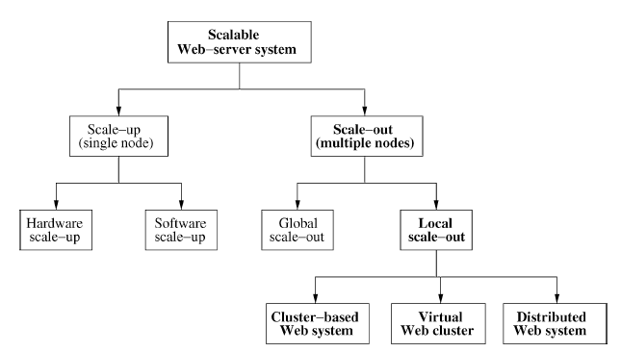
Architecture solutions for scalable Web-server systems (Fig. 1)

Slide 4
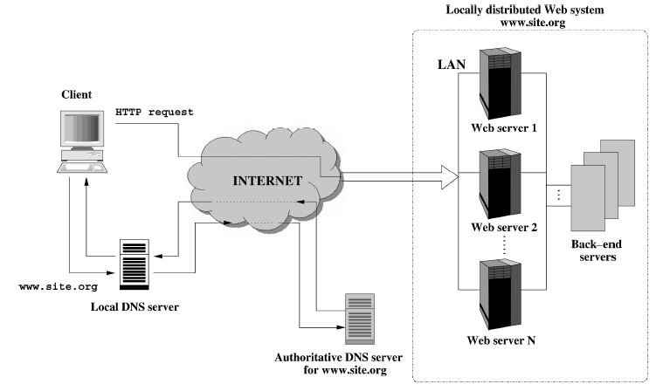
Model architecture for a Locally Distributed Web system

Slide 5
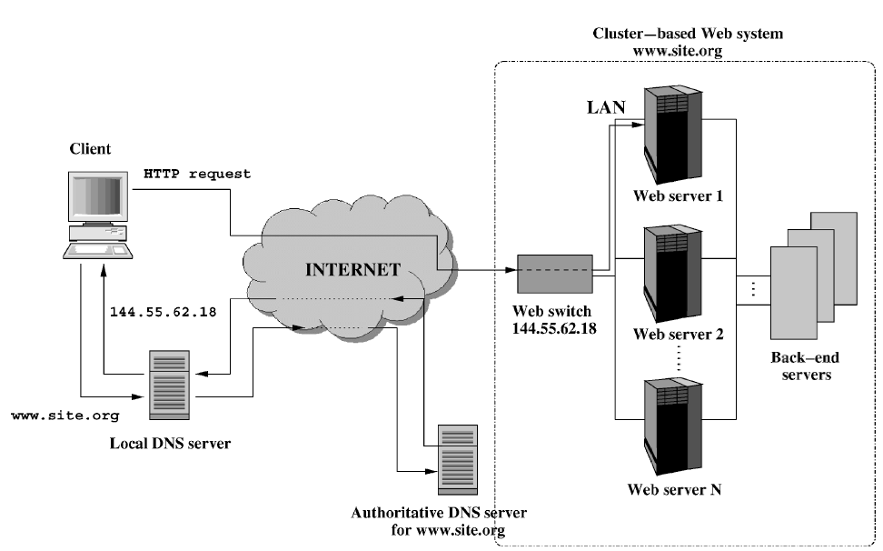
Cluster-Based Web System

Slide 6
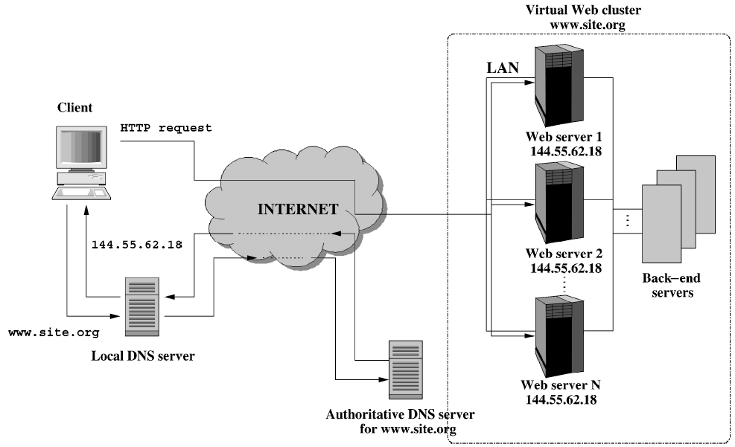
Virtual Web Cluster Architecture

Slide 7
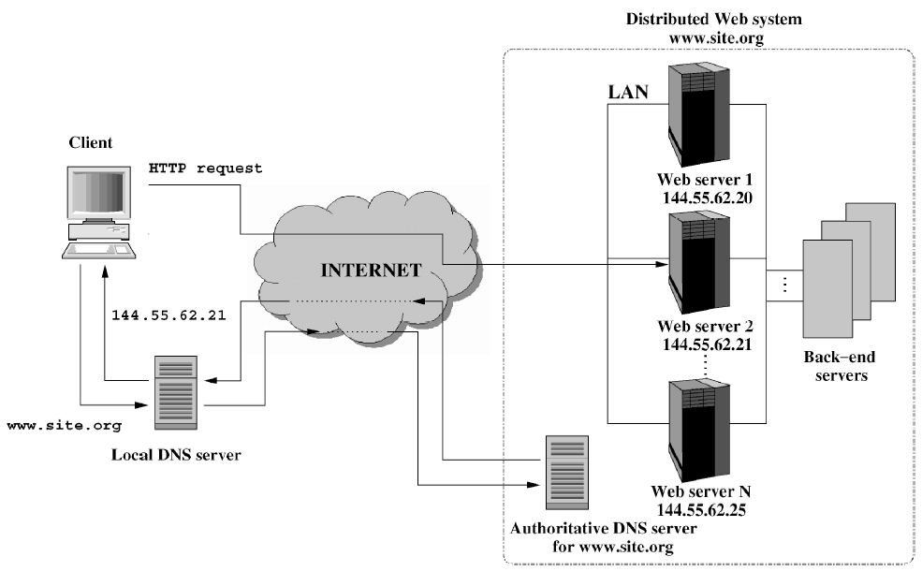
Distributed Web System

Slide 8
Web Server Cluster
Load balancer can run at
Application Level — Reverse Proxy
Kernel level — Linux Virtual Server
Real Server
Real Server
Load Balancer
or
Content Switch
Real Server
Load balancer can distribute requests based on
Layer 3-4 info — fixe field/fast hash
Layer 3-7 info — var. length/slow parsing
Real Server

Slide 9
Comparison of Load Balancers
Reverse Proxy runs as application process requires more memory/packet copying.
Linux Virtual Server runs in kernel → more efficient
Name | Type | Level | Layer Info
Reverse Proxy/ Apache/Tomcat/Servlet | SW | Application | 3-7
Linux Virtual Server | SW | Kernel | 3-4
Linux Content Switch | SW | Kernel | 3-7
Layer4 Switch (narrow def.) | HW | Embedded OS | 3-4
Content/Web Switch | HW | Embedded OS | 3-7

Slide 10
Linux Virtual Server (LVS)
“Virtual server is a highly scalable and highly available server built on a cluster of real servers. The architecture of the cluster is transparent to end users, and the users see only a single virtual server” with Virtual IP address (VIP).
Http://www.linuxvirtualserver.org/
RIP1
Real Server1
WAN/ LAN
RIP2
Internet
Real Server2
VIP
CIP
RIP3
Load Balancer/Director
Linux Box
Real Server3
Client
CIP: Client IP Address
VIP: Virutal IP Address
RIP: Real Server IP Address

Slide 11
LVS-NAT Configuration (Network Address Translation)
All return traffic go through Director→Slow
Modify IP addr/port #/Checksum at Director
Director and real servers at same LAN
No modification needed on real-servers
Port remapping: real web server can run on 8080
RIP1
Real Server1
RIP2
Internet
Real Server2
VIP
CIP
Director
Switch
RIP3
Client
Real Server3

Slide 12
LVS-NAT Configuration Step 2. Director routes Pkt
Based on CIP, source port#, VIP and dst port#, director selects one of the real servers
Change the dst IP addr or port # of pkt.
CIP VIP
2. Scheduling/ Rewrite packet
RIP1
Real Server1
CIP RIP1
1. request
RIP2
Internet
Real Server2
VIP
CIP
Director
Switch
RIP3
ipvsadm cmd
Client
LVS Routing Scheduling Rules
Real Server3

Slide 13
LVS-NAT Configuration Step 3. Real Server Replies
Real server retrieves response.
All real servers set default gateway to Director; like any other NAT or IP masquerade setup
Packet will be sent back to Director.
3. Process
Request
CIP VIP
2. Scheduling/ Rewrite packet
RIP1
Real Server1
CIP RIP1
1. request
RIP1 CIP
RIP2
Internet
Real Server2
VIP
CIP
Director
Switch
RIP3
Client
Real Server3

Slide 14
LVS-NAT Configuration Step 4. Director rewrites reply
Director changes the dst IP addr. (RIP1) of pkt to VIP
Modify port # if needed.
Modify the checksum; send back pkt.
3. Process
Request
CIP VIP
2. Scheduling/ Rewrite packet
RIP1
Real Server1
CIP RIP1
1. request
RIP1 CIP
RIP2
Internet
Real Server2
VIP CIP
VIP
CIP
Director
Switch
RIP3
Client
4. Rewrite reply
Real Server3

Slide 15
LVS-NAT Configuration (Network Address Translation)
All return traffic go through Director→Slow
Modify IP addr/port #/Checksum at Director.
Director and real servers at same LAN
3. Process
Request
CIP VIP
2. Scheduling/ Rewrite packet
RIP1
Real Server1
CIP RIP1
1. request
RIP1 CIP
RIP2
Internet
Real Server2
VIP CIP
VIP
CIP
Director
Switch
RIP3
Client
4. Rewrite reply
Real Server3
5. Receive reply

Slide 16
LVS-NAT Setup Commands
# make the director forward the masquerading packets
echo 1 > /proc/sys/net/ipv4/ip_forward
ipchains -A forward -j MASQ -s 172.16.0.0/24 -d 0.0.0.0/0
# Add virtual service and link a scheduler to it
ipvsadm -A -t 202.103.106.5:80 -s wlc (Weighted Least-Connection scheduling)
ipvsadm -A -t 202.103.106.5:21 -s wrr (Weighted Round Robin scheduling )
#Add real servers and select forwarding method and weight
ipvsadm -a -t 202.103.106.5:80 -R 172.16.0.2:80 -m
ipvsadm -a -t 202.103.106.5:80 -R 172.16.0.3:8000 -m -w 2
ipvsadm -a -t 202.103.106.5:21 -R 172.16.0.2:21 -m

Slide 17
LVS-Tunnel Configuration (IP Tunneling)
Real Servers need to handle IP over IP packets.
Real Servers can be geographically separated and return traffic go through different routes.
Security implication!
RIP1
Real Server1
2. Scheduling/ Put packet in IP Tunnel
IP Tunnel
3. Process
Request
1. request
CIP VIP
RIP0
IP Tunnel
RIP2
RIP0 RIP2
Real Server2
Internet
CIP VIP
VIP
Load Balancer
Linux Box
CIP
RIP3
IP Tunnel
Client
Real Server3
4. Receive reply
VIP CIP

Slide 18
LVS-Tunnel Setup Commands
#The load balancer (LinuxDirector), kernel 2.2.14
echo 1 > /proc/sys/net/ipv4/ip_forward ipvsadm -A -t 172.26.20.110:23 -s wlc ipvsadm -a -t 172.26.20.110:23 -r 172.26.20.112 -i
#The real server 1, kernel 2.2.14
echo 1 > /proc/sys/net/ipv4/ip_forward
# insert it if it is compiled as module insmod ipip ifconfig tunl0 172.26.20.110 netmask 255.255.255.255 broadcast 172.26.20.110 up route add -host 172.26.20.110 dev tunl0 echo 1 > /proc/sys/net/ipv4/conf/all/hidden echo 1 > /proc/sys/net/ipv4/conf/tunl0/hidden

Slide 19
LVS-DR Configuration (Direct Routing)
Real servers need to configure a non-arp alias interface with virtual IP address and that interface must share same physical segment with load balancer.
Only Director’s interface replies to VIP ARP request.
Director only rewrites server MAC address; IP packet not changed→ Fast!
2. Scheduling/ Rewrite packet
VMAC
Director
RMAC1
Real Server1
CIP VIP
1. request
GMAC VMAC
RMAC2
Internet
Real Server2
CIP VIP
VMAC RMAC3
CIP
RMAC3
Route/Switch
Real Server3
Client
GMAC: Gateway MAC address

Slide 20
LVS-DR Configuration Step 3. Process Request
Real server returns request.
Request goes directly through switch/router; not Director.
2. Scheduling/ Rewrite packet
VMAC
Linux Director
RMAC1
Real Server1
CIP VIP
1. request
GMAC VMAC
RMAC2
Internet
Real Server2
CIP VIP
VIP CIP
VMAC RMAC3
CIP
RMAC3
Switch
3. Process
Request
Client
Real Server3
VIP CIP
RMAC3 GMAC
4. Receive reply
GMAC: Gateway MAC address

Slide 21
LVS-DR Configuration (Direct Routing)
Real servers need to configure a non-arp alias interface with virtual IP address and that interface must share same physical segment with load balancer.
Load balancer only rewrites server MAC address; IP packet not changed→ Fast!
2. Scheduling/ Rewrite packet
VMAC
Linux Director
RMAC1
Real Server1
CIP VIP
1. request
GMAC VMAC
RMAC2
Internet
Real Server2
CIP VIP
VIP CIP
VMAC RMAC3
CIP
RMAC3
Switch
3. Process
Request
Client
Real Server3
VIP CIP
RMAC3 GMAC
4. Receive reply
GMAC: Gateway MAC address

Slide 22
LVS-DR Setup Commands
#The load balancer (LinuxDirector), kernel 2.2.14 or later echo 1 > /proc/sys/net/ipv4/ip_forward ipvsadm -A -t 172.26.20.110:23 -s wlc ipvsadm -a -t 172.26.20.110:23 -r 172.26.20.112 –g
#The real server 1, 172.26.20.112, kernel 2.2.14 or later
echo 1 > /proc/sys/net/ipv4/ip_forward ifconfig lo:0 172.26.20.110 netmask 255.255.255.255 broadcast 172.26.20.110 up route add -host 172.26.20.110 dev lo:0 echo 1 > /proc/sys/net/ipv4/conf/all/hidden echo 1 > /proc/sys/net/ipv4/conf/lo/hidden

Slide 23
Persistence Handling in LVS
Sticky connections Examples:
FTP control (port21), data (port20) For passive FTP, the server tells the clients the port that it listens to, the client initiates the data connection connecting to that port. For the LVS/TUN and the LVS/DR, LinuxDirector is only on the client-to-server half connection, so it is imposssible for LinuxDirector to get the port from the packet that goes to the client directly.
SSL Session: port 443 for secure Web servers and port 465 for secure mail server, key for connection must be chosen/exchanged.
Persistent port solution:
First accesses the service, LinuxDirector create a template between the given client and the selected server, then create an entry for the connection in the hash table.
The template expires in a configurable time, and the template won't expire until all its connections expire.
The connections for any port from the client will send to the server before the template expires.
The timeout of persistent templates can be configured by users, and the default is 300 seconds

Slide 24
High Available Cluster
Reduce the downtime of the cluster
Metrics: e.g. three 9 reliability 99.9% (MTTF); No loss of connections/requests? (Lost of requests)
Typical solution→ Redundant components; Fault-tolerant; Failover Protection.
Sources of failures in LVS cluster:
Network Failures/DoS Attacks →Provide alternate/multiple paths
Director Failures →Use Master/Slave directors; heartbeat protocol monitoring; graceful takeover
Real Server Failure →Monitor Server hardware/Server processes; reconfigure cluster/reroute requests

Slide 25
HA-LVS Configuration HA: High Available
Client
MON
CIP
Real Server1
Internet
Linux Director
Heart
Beat
Real Server2
1. When Backup Director detects Linux Director failure through heart beat protocol,
“graciously negotiate”
the take-over of VIP
→ Provide fault-tolerant
MON
Real Server3
Backup Director
2. Monitor server processes
run on real servers
→ Route requests to server processes that are alive. Initiate restart/repair

Slide 26
Performance of LVS-based Systems
“We ran a very simple LVS-DR arrangement with one PII-400 (2.2.14 kernel)directing about 20,000 HTTP requests/second to a bank of about 20 Web servers answering with tiny identical dummy responses for a few minutes. Worked just fine.” Jerry Glomph Black, Director, Internet & Technical Operations, RealNetworks
“I had basically (1024) four class-Cs of virtual servers which were loadbalanced through a LinuxDirector (two, actually -- I used redundant directors) onto four real servers which each had the four different class-Cs aliased on them.” "Ted Pavlic" <tpavlic@netwalk.com>

Slide 27
LVS Usage Survey 2/15/2001 Lorn Key
# of Cluster | 20 | 1 | 2 | 2 | 2
Directors Per Cluster | 2 | 2 | 2 | 2 | 2
Total Real Servers | 170 | 12 | 4 | 15 | 6
Routing Methods | DR/NAT | DR | NAT | DR | NAT
Schedule Methods | RR/WLC | WRR | LC | WLC | WLC
Types of Real Servers | RH6.2 | Linux | Win Linux | Linux Solaris | RH
Service Offered | WWW | WWW/other | WWW DB | WWW SMTP | WWW
File System Replication | rsync | rsync | Coda NFS | Custom | rsync custom
Monitoring Software | Heartbeat ldirectord | Nanny/ Pulse | Heartbeat Mon | Nanny Pulse | Clusters

