Slide 1
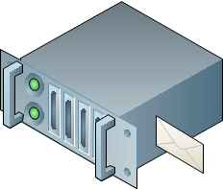
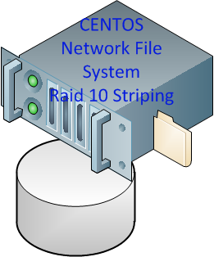
virtual machine fail over protection
VM1a
VM2a
VM1b
VM2b
MS 2008 File Server
MS Exchange Mail Server
MS 2008 File Server
MS Exchange Mail Server
VMWare vShpere ESX Server b
VMWare vShpere ESX Server a
10 Gbps link
10 Gbps link
Data are duplicated through data mirror operation at server level
Server image1
B
A
ECC Mem
Server image2
EAS IT Server System Architecture

