Slide 1
Apple iPhone/iPod Touch Streaming Media Capability and Impact to your Network
CS525
Michael Menozzi

Slide 2
Overview
Introduction
Issues
AT&T and the FCC
Why not allow it?
Testing and analysis
Future work
References

Slide 3
Introduction
Streaming video has been an application available for customers with a number of service providers
Streaming to the internet
Live broadcasts (near live) on your Twitter or Facebook account or to the vendors site
Stream live video phone to phone
Cross platforms (droid, iPhone)
iPhone can stream via WiFi and 3G
Newly released; as of 2010
Some issues; depends on the application function

Slide 4
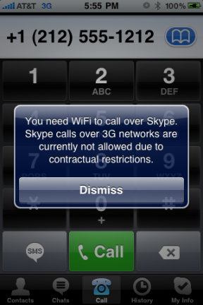
Issues
Since other providers allow 3G it would be expected that AT&T would allow this over the iPhone
For some apps; not so as seen here →
AT&T allows other smartphones to Skype –just not the iPhone
Recently AT&T approved 3G for streaming – Nov 2009
Skype says coming soon – Feb 2010
Nothing yet – Skype provides “crippled” software for WiFi on iPhone

Slide 5
The FCC
AT&T and the FCC reached an agreement with AT&T allowing 3G streaming
Nothing for Skype yet
Could be because the FCC announced it was extending internet openness rules to wireless networks
Caused some angst with wireless carriers

Slide 6
Why not allow it?
AT&T’s issues has everything to do with the success of the iPhone and it’s highly criticized network
13 million subscribers with iPhone service
25% of current wireless revenue for AT&T
15% of AT&T subscribers have an iPhone
AT&T plans to upgrade their network soon

Slide 7
Test
Used Knocking Live Video
First phone on AT&T and an iPhone
Second phone on Verizon and a HTC Eris
Established a Knocking connection between the two phones via WiFi
Less than a second delay between the sender and receiver

Slide 8
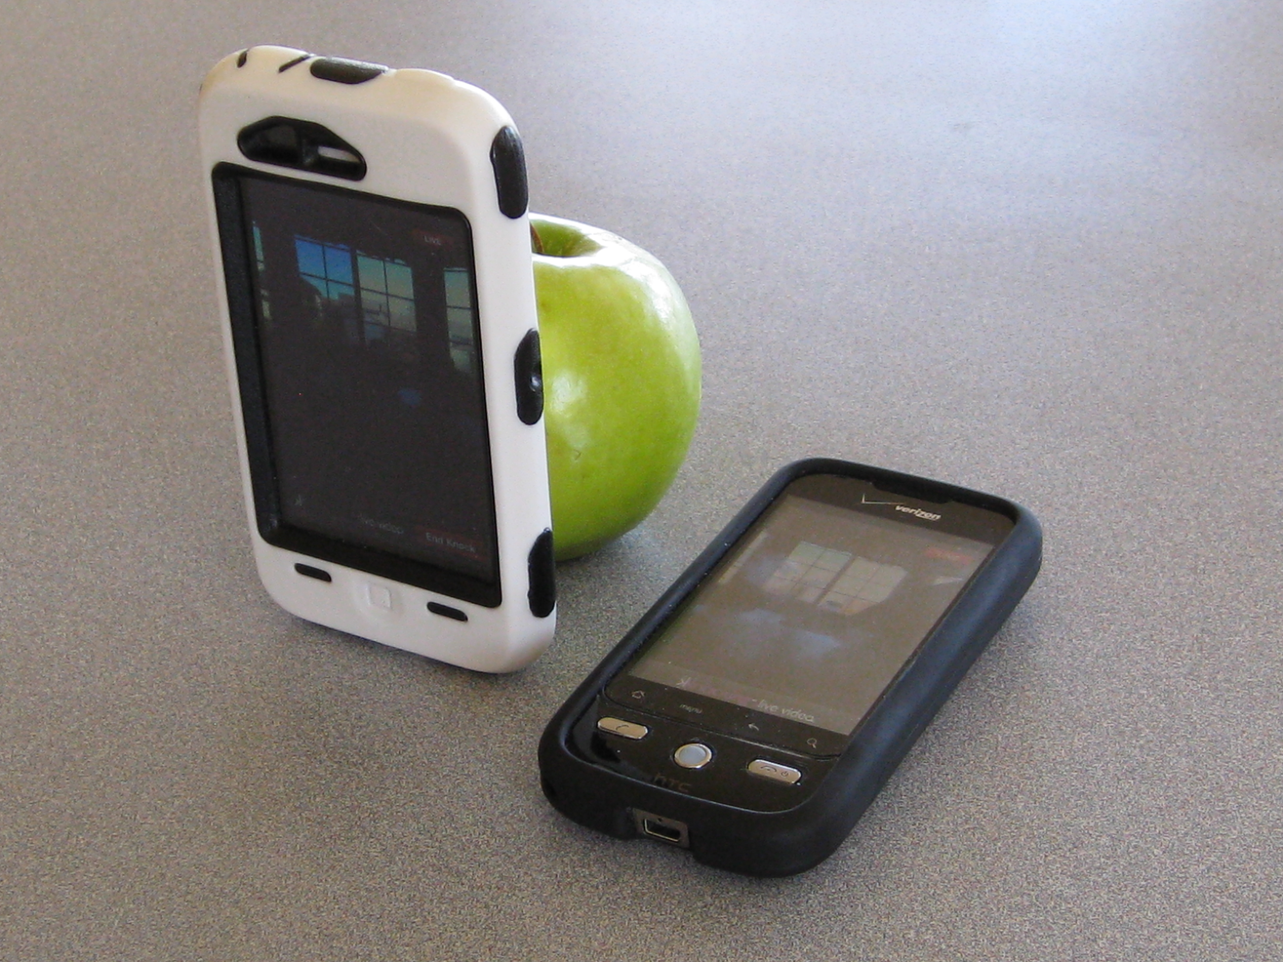
Screenshots

Slide 9
Analysis
Analysis
Approximately 3 minutes captured
Walked around the house with the phones
> 1 Mb/sec
Not a real impact to your local network
However, pushing that over 3G with a large subscriber base could cause significant delay
Packets | 29109
Duration (min) | 3.097433333
Avg. packets/sec | 156.629
Avg. packet size | 875.235 bytes
Bytes | 25477215
Avg. bytes/sec | 137087.534
Avg. Mbit/sec | 1.097

Slide 10
Another Test
Realized the iPhone was connected to 3G after my first test
This has approximately 4 second delay between sending and receiver

Slide 11
Future Work
Get the captures imported into ACE Analyst to get a more robust report and analysis
Look into more live video streaming options

Slide 12
References
https://support.skype.com/faq/FA10062/Can-I-use-Skype-over-3G;jsessionid=0CF58C6FAD0F204D5BE31E37E8319F06
http://www.wired.com/epicenter/2009/10/iphone-att-skype/
http://seekingalpha.com/article/199104-at-t-iphone-makes-up-25-of-mobile-revenue

Slide 13
Questions?

