Slide 1
Increasing Self Efficacy through Social Modeling using Multimedia Authoring
Erica Kirkbride

Slide 2
References
Self Efficacy: The Exercise of Control
By: Albert Bandura (1997)
GNU Image Manipulation Program (GIMP)
http://www.gimp.org/
Flash Slideshow Maker Professional
http://www.flash-slideshow-maker.com/
SMIL
http://cs.uccs.edu/~cs525/smil/smil.htm
MIDI
http://cs.uccs.edu/~cs525/midi/midi.html

Slide 3
Overview
Background:
Joint research project
Website for teenagers with PTSD
Objective: Multimedia presentations for social modeling
Relatable character(s) and dialogue
Model correct steps in common situations
Include background music (MIDI, using SMIL)
Class Topics Covered:
Multimedia Authoring
Synchronized Multimedia Integration Language (SMIL)
Musical Instrument Digital Interface (MIDI)

Slide 4
Plan to Reach Objective
Step 1. Brainstorm and choose presentation topic
Step 2. Create character in GIMP
Step 3. Create script
Step 4. Create scenes following script in GIMP
Step 5. Create MIDI music files
Step 6. Put it together using SMIL

Slide 5
Step 1: Brainstorm and Choose
Some Examples of Modeling Ideas:
Social Support
Unhelpful Coping
Self Talk
Relaxation
Chose Social Support
Social Modeling to show how to:
Identify that you need support
Feel confident and comfortable asking for support
Prepare yourself

Slide 6
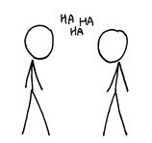
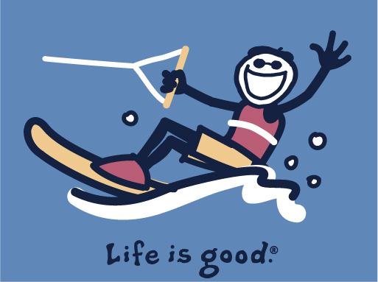
Step 2: Create Character
Using GIMP, wanted to create “simple” character that a young teenager could relate to.
Results:

Slide 7
Step 3: Create Script
Steps:
1. Write script
2. Get feedback from psychology team members
3. Refine
4. Repeat
Results:
Good, simple script for presentation
Probably could use more finalizing in the future

Slide 8
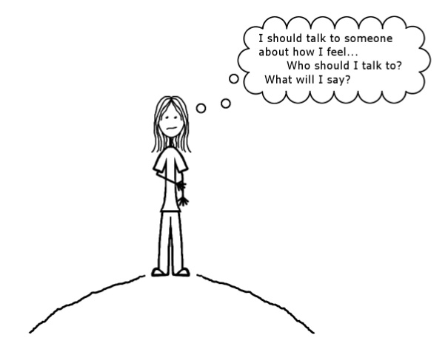
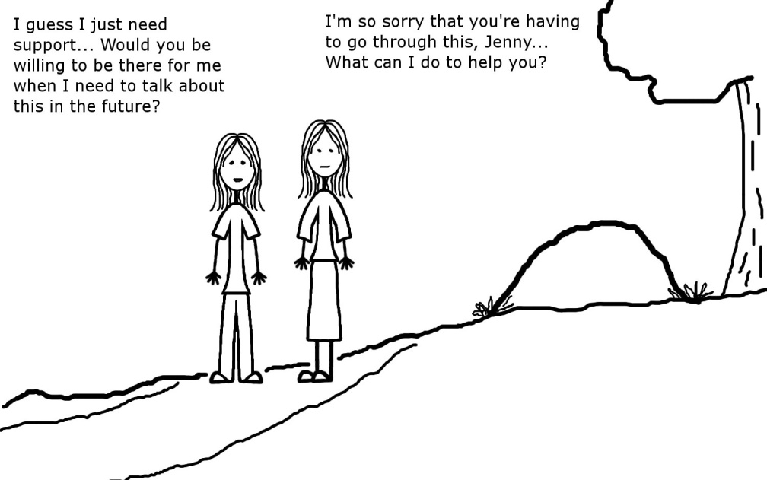
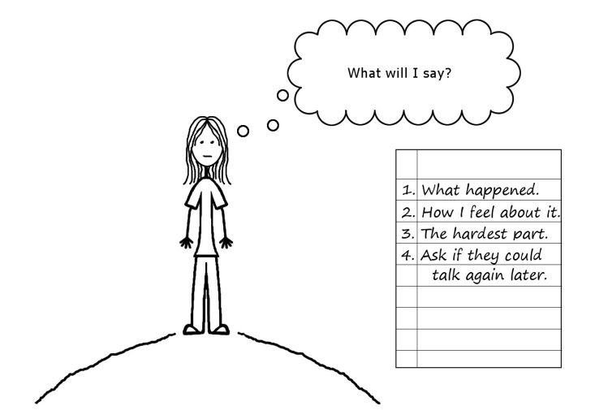
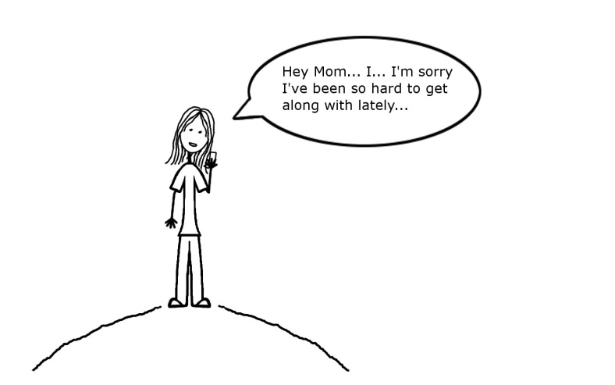
Step 4: Create scenes for script
Procedure:
Split script into steps with one scene each
Create scenes one by one until perfected
Create slideshow movie with correct timing
Results:

Slide 9
Step 5: Create MIDI music files
Procedure:
Walk through slideshow video, choose key points for music to reflect “feel” of video
Compose music for each need
Progression of emotion from “negative” to “positive”
Depressed, Calm, Cheery, Celebration, Etc.
RESULTS:

Slide 10
Step 6: Put it together using SMIL
Finishing touches for sequence and timing of:
MIDI files
Video slideshow
Script
Final Result:
Multimedia presentation
Social modeling tool for PTSD recovery

Slide 11
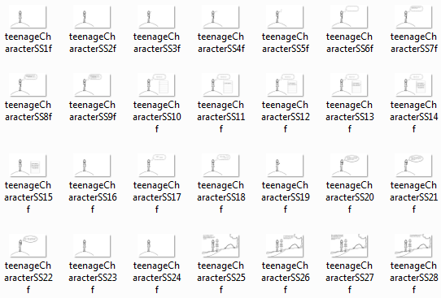
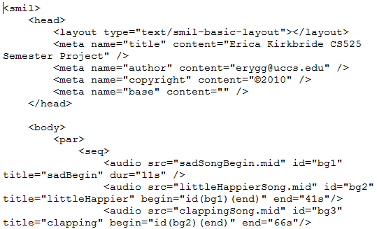
Screenshots

