Slide 1
HTTP Pseudo-streaming with Shoutcast
Nathan Archer
CS 525 Spring 2008

Slide 2
Streaming Audio
Objective: Secure, scalable media broadcast
Real-time oriented solutions:
RTP, RTSP, etc. over UDP
Reliable-delivery solutions:
HTTP Pseudo-streaming over TCP
Includes SHOUTCast, Icecast, Helix, etc.

Slide 3
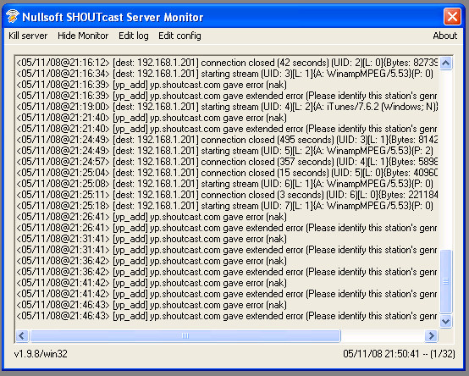
Shoutcast Streams
Developed by Nullsoft in 1998
Supports MP3, AAC audio, proprietary Nullsoft Video (NSV)
Free DNAS server supports distributed content sources
Uses ICY Protocol – a slight tweak of HTTP

Slide 4
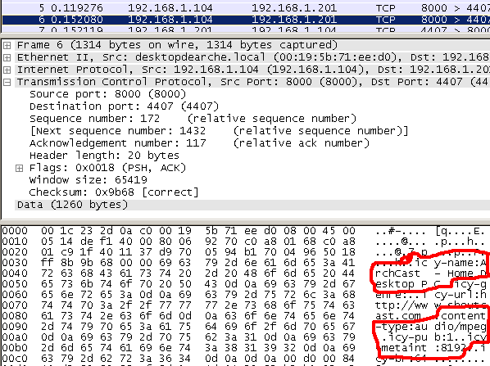
Shoutcast Metadata (1/2)
After the HTTP:GET’s ACK response, a header tells us:
Stream name: “ArchCast – Home Desktop PC”
Media type: “mpeg”
Metadata interval: “8192”
Indicating there will be a metadata packet after every 8192 bytes of audio to update textual information.

Slide 5
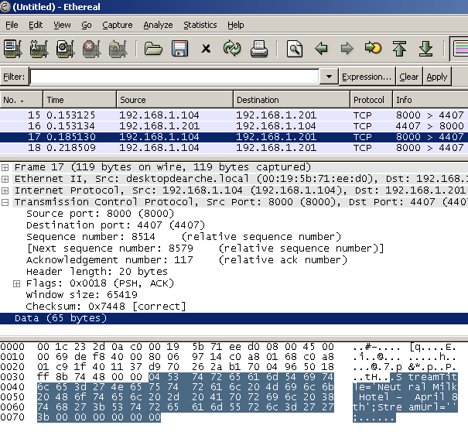
Shoutcast Metadata (2/2)
As promised, after 8192 bytes, a metadata tag says:
StreamTitle=‘NeutralMilkHotel – April 8th’;
(Sometimes the metadata tag is of length zero, so updates may be less often!)
The remaining data is an HTTP file transfer of the MP3 frames (not IDv3 tags!).
The client streams the other (audio) payload bytes to the MP3 codec.

Slide 6
Distributed Content Sources
Central server bandwidth limits scalability
Many content sources per server
Typical MP3 audio broadcast:
50-150 kbps / stream → only ~20 listeners per T1!
Source 1
Listener
Streaming Media Server
Source 2
Listener
Source 3
Listener

Slide 7
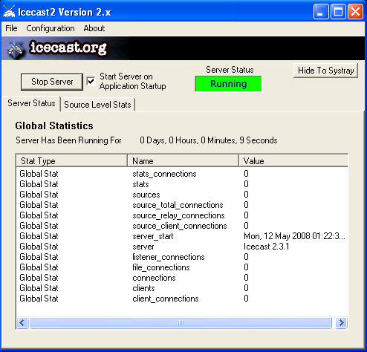
Icecast Streams
Icecast packets appear similar to Shoutcast’s ICY protocol (several identical fields)
Software available under GNU Public License for several platforms
XMMS Player
Oddcast Winamp plug-in
Icecast Streaming Server

Slide 8
Advantages of Pseudo-streaming
Free & easy-to-set-up (esp. Shoutcast)
Commonly available client software on all major platforms
(iTunes, Winamp, Windows Media Player, XMMS)
Distributed content sources
Open source code (Icecast)

Slide 9
Disadvantages of Pseudo-streaming
HTTP does not scale content to bandwidth of connection
Solution: offer several streams at varied bitrates.
No interactive / real-time features
Re-transmission of lost packets exacerbates effect of packet losses
Solution: large receiver buffer (2-5 sec. delay on my LAN)
Lack of IP Multicast support
Weak security for DRM purposes
AAC better than MP3, but both are crackable

Slide 10
Abridged References
Details on Shoutcast metadata parsing:
www.smackfu.com/stuff/programming/shoutcast.html
Shoutcast DNAS server download & setup:
www.shoutcast.com/download/serve.phtml
Cox, Kerry. “Icecast Installation and Management”
www.gnuware.com/icecast/chap_01.html
Icecast:
www.icecast.org
Comparison of streaming media systems:
en.wikipedia.org/wiki/Comparison_of_streaming_media_systems

Slide 11
Demonstration
Open the following port in your web browser:
75.70.160.163:8000
Click “Listen” to load an automatically-generated playlist with a reference to the stream.

