Slide 1



Intrusion Tolerance and Cloud
C. Edward Chow
Department of Computer Science
Notes:
----- Meeting Notes (12/5/14 14:25) -----
Thanks for the invitation. It is great to come back the familar place where my family benefit tremendous. My daughter and son attended the Chinese Classes and dance/culture class offered by Colorado Spring Chinese Language School from 1992-2008, sponsored by CC, my wife taught a few blocks on Chinese to prepare students who travel to Taiwan. I learned Lion Dance here from a CC student under Dance Professor Yunyu Wang and got a grant from CC to work on Human Motion Tracking project, 8 year ago.

Slide 2
Outline of the Talk
UCCS CS Programs/Network Security Lab
Brief Overview of Distributed Denial of Services (DDoS)
Intrusion Tolerance with Multipath Routing
  Secure DNS with Indirect Queries/Indirect Addresses
  Multipath Indirect Routing
Intrusion Tolerance and IPv6
Intrusion Tolerance and Cloud
Conclusion
Notes:
----- Meeting Notes (12/5/14 14:29) -----
IPv6 128 bit address space.

Slide 3
UCCS CS Programs (apply or collaborate)
PhD Engineering Degree (CS/Security Tracks)
MSCS, MEIA, MESE Degrees
BSCS, BI(CS, CS Security, Game Design/Development) Degrees
NSF Funded Projects ~$4M active projects.
  $1.5M, PI Dr. Boult, on “Learning and Sensory-based Modeling for Adaptive Web-Empowerment Trauma Treatment”
  $450K, PI Dr. Boult, on “Open Vision - Tools for Open Set Computer Vision and Learning” 9/13-8/16
  $400K, PI. Dr. Zhou, on “Moving MapReduce into the Cloud: Flexibility, Efficiency, and Elasticity” 10/14-9/17
  $478K, PI. Dr. Yi, on “Specializing Compilers For High Performance Computing Through Coordinated Data and Algorithm Optimizations” 8/14-7/17
  $250K, PI. Dr. Yi, on “Programming Interface And Runtime For Self-Tuning Scalable C/C++ Data Structures” 6/12 – 5/15
  $300K, PI. Dr. Rao, on “System and Middleware Approaches to Predictable Services in Multi-Tenant Clouds” 09/13 – 08/16
  $200K, PI. Dr. Yue, on “Investigating Elderly Computer Users' Susceptibility to Phishing” 2/14-1/16
  $333K, PI. Dr, Yue, on “A Security-Integrated Computer Science Curriculum for Intensive Capacity Building” 9/14-8/17

Slide 4
Network System Research Lab at UCCS
Overview of Network/System Security Research Projects at Network/System Lab headed by Dr. Chow
  Proximity Based Encryption, sponsored by Northrop Grumman
  RAMCAP Review and Enhancement, sponsored by DHS S&T
  Secure Collective Internet Defense (SCOLD): an Intrusion Tolerance System, sponsored by AFOSR
  Asymmetric IPSec for Secure Backup Storage Systems, sponsored by AFOSR.
  Secure Information Sharing, sponsored by AFOSR
  Advanced Content Switch Design, sponsored by CCL
  Human Motion Tracking and Reasoning, sponsored by CC, Dance Prof. Yunyu Wang
  Small Data Center Lab funded by AFOSR $1.25M equipment grant, dedicated for Cyber/Physical/Homeland Security Research.

Slide 5

DDoS: Distributed Denial of Service Attack
Research by Moore et al of University of California at San Diego, 2001.
  12,805 DoS in 3-week period
  Most of them are Home, small to medium sized organizations
Handler
(
Middleman
Client
)
(
Attack Commander
)
Agent
(
Attacker
)
DDoS Victims:
Yahoo/Amazon 2000
CERT 5/2001
DNS Root Servers 10/2002
(4up 7 cripple 80Mbps)
Akamai DDNS 5/2004
White House 7/2009
Dept. Treasure
Federal Trade Commission
Bank of the West 12/2012
Agent
(
Attacker
)
Agent
(
Attacker
)
Handler
Agent
(
Attacker
(
)
Middleman
)
DDoS Tools:
Stacheldraht
Trinoo
Tribal Flood Network (TFN)
Mastermind
Agent
Intruder
(
Attacker
)
Notes:
Paul Vixie, architect of BIND (Berkeley Internet Name Domain) and president of the Internet Systems Consortium, charged that Akamai’s proprietary approach to DNS makes it a single point of failure. He added that the 13 DNS root servers, which weathered a vicious DDoS attack in 2002, are even more defensible today than they were back then. The root servers are resilient, Vixie said, because their operators embrace diversity. “We deliberately use different operating systems, different name server implementations, different kinds of routers, different kinds of switches, different kinds of CPUs, and especially, different operational procedures,” Vixie told Internetnews.com.
It appears that websites that use Akamai's distribution system are currently not reachable. Security related web sites effected are symantec.com and trendmicro.com. Virus updates may fail as a result.

Slide 6
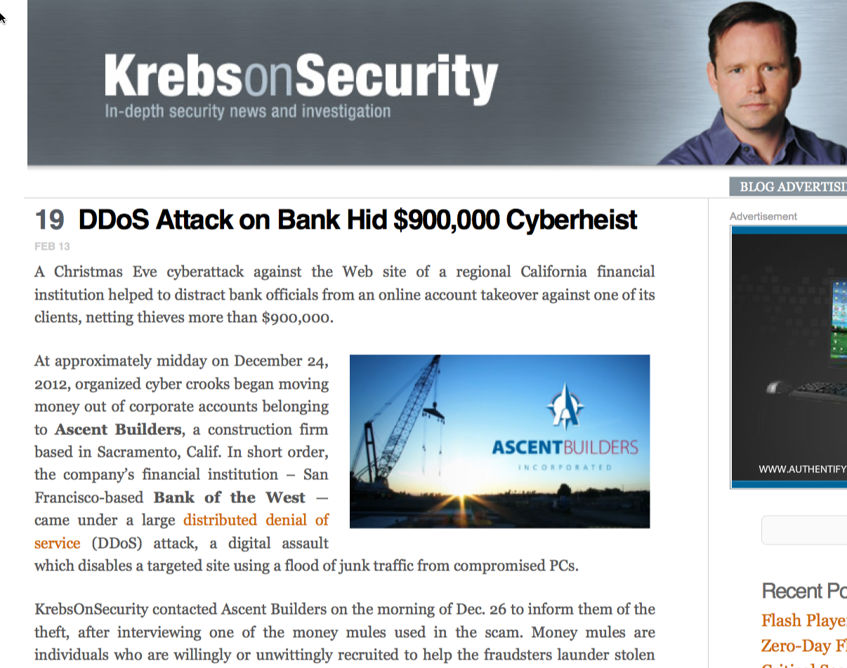

Slide 7
Challenges in DDoS Defenses
Difficult to trace
Usually IP addresses are spoofed.
Donot give up yet!
Cross ISP/Countries boundaries.
Need collaboration!
By the time we reach compromised hosts, master mind already long gone.
Variants of DDoS: Reflective; Degraded
Even reserving a bit in IP/TCP header for cyber defense take years in standards (not approved yet)!

Slide 8
DDoS Defense Techniques
Intrusion Prevention
  General Security Policy
  Ingress/Engress Filtering
Intrusion Detection
  Anomaly Detection
  Misuse Detection
Intrusion Response
  Source Identification: Traceback. Need a lot of cooperation.
  Network Forensic.
  Intrusion pushback (require mutual authentication and correlation along the path)
  Intrusion Tolerance (your are in control)

Slide 9
Wouldn’t it be Nice to Have Alternate Routes?
net-a.mil
net-b.mil
net-c.mil
...
A
A
A
...
A
...
A
A
A
...
A
DNS1
DNS2
DNS3
R
R
R
How to reroute clients
traffic through R1-R3?
Multi-homing
R
DNS
R2
R1
R3
DDoS Attack Traffic
Alternate
Gateways (cable/adsl/satellite)
Client Traffic
Victim

Slide 10
Implement Alternate Routes
net-a.mil
net-b.mil
net-c.mil
...
A
A
A
...
A
...
A
A
A
...
A
DNS1
DNS2
DNS3
R
R
R
Need to Inform Clients or
Client DNS servers
about these new route!
Some Clients
may be compromised!!
How to hide
IP addresses of
Alternate Gateways?
R
DNS
R2
R1
R3
DDoS Attack Traffic
Alternate
Gateways
Client Traffic
Victim

Slide 11
Possible Solution for Alternate Routes
net-a.mil
net-b.mil
net-c.mil
...
A
A
A
...
A
...
A
A
A
...
A
DNS1
DNS2
DNS3
R
R
R
New route via Proxy3 to R3
Proxy1
Proxy2
Proxy3
Blocked by IDS
block
R2
R
R1
R3
IDS triggers Step 1.
Sends Reroute Command
with DNS/IP Addr. Of
Proxy and Victim
Victim
Distress Call

Slide 12
SCOLD
Phase1
net-a.mil
net-b.mil
net-c.mil
...
A
A
A
...
A
...
A
A
A
...
A
DNS1
DNS2
DNS3
R
R
R
Proxy2
Proxy3
Proxy1
block
block
R1
R
R2
R3
Reroute
Coordinator
Attack Traffic
1. IDS detects intrusion
Blocks Attack Traffic
Sends distress call to Reroute Coordinator
Client Traffic
Victim

Slide 13
SCOLD
Phase 2
net-a.mil
net-b.mil
net-c.mil
...
A
A
A
...
A
...
A
A
A
...
A
DNS1
DNS2
DNS3
R
R
R
Proxy2
Proxy3
Proxy1
2. Sends Reroute Command with
(DNS Name, IP Addr. Of victim,
Proxy Server(s)) to DNS
block
R1
R
R2
R3
Reroute
Coordinator
Attack Traffic
1. IDS detects intrusion
Blocks Attack Traffic
Sends distress call to Reroute Coordinator
Client Traffic
Victim

Slide 14
SCOLD
Phase3
net-a.mil
net-b.mil
net-c.mil
...
A
A
A
...
A
...
A
A
A
...
A
3. New route via
Proxy1 to R1
3. New route via
Proxy2 to R2
3. New route via
Proxy3 to R3
DNS1
DNS2
DNS3
R
R
R
Proxy2
Proxy3
Proxy1
block
2. Sends Reroute Command with
(DNS Name, IP Addr. Of victim,
Proxy Server(s)) to DNS
R1
R
R2
R3
Reroute
Coordinator
Attack Traffic
Client Traffic
Victim

Slide 15
SCOLD
Phase4
net-a.mil
net-b.mil
net-c.mil
...
A
A
A
...
A
...
A
A
A
...
A
3. New route via
Proxy1 to R1
3. New route via
Proxy2 to R2
3. New route via
Proxy3 to R3
DNS1
DNS2
DNS3
R
R
R
Proxy2
Proxy3
Proxy1
block
4. Attack traffic detected by IDS
blocked by Firewall
4a. Attack traffic detected by IDS
blocked by Firewall
R1
R
R2
R3
Reroute
Coordinator
Attack Traffic
Client Traffic
Victim

Slide 16
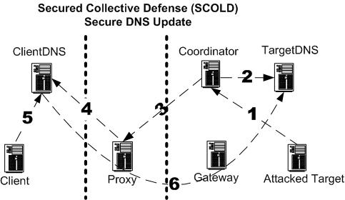
SCOLD Secure DNS Update with New Indirect DNS Entries
Client
Domain
Trusted Domain
WAN
DMZ
Modified
Bind9
Modified
Bind9
proxy2
IP Tunnel
Modified
Client
Resolve
Library
IP Tunnel
(target.targetnet.com, 133.41.96.7, ALT 203.55.57.102)
203.55.57.103
185.11.16.49
New DNS Entries:
A set of alternate proxy servers for indirect routes

Slide 17
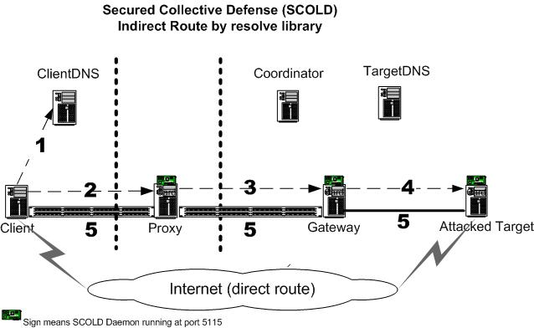
SCOLD Indirect Routing
IP tunnel
IP tunnel

Slide 18
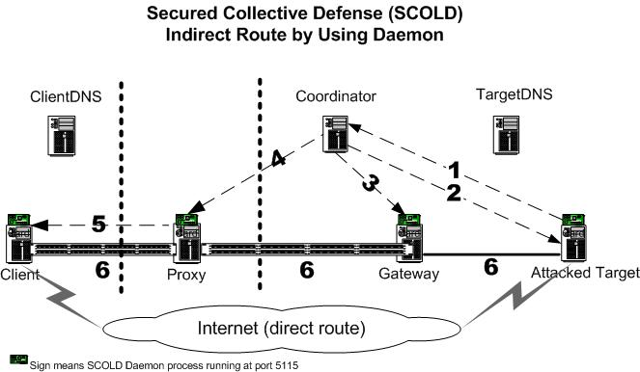
SCOLD Indirect Routing with Client running SCOLD client daemon
IP tunnel
IP tunnel
Notes:
With client running a scold daemon, we do not have to modify the client resolve libary

Slide 19
Performance of SCOLD v0.1
Table 1: Ping Response Time (on 3 hop route)
Table 2: SCOLD FTP/HTTP download Test (from client to target)
No DDoS attack direct route | DDoS attack direct route | No DDoS attack indirect route | DDoS attack indirect route
0.49 ms | 225 ms | 0.65 ms | 0.65 ms
Notes:
As we can see from the above testing data, there is overhead associated with IP tunnel. The overhead occurs in the indirect route include more hop, more protocol processing (it goes through proxy server; and IP over IP overhead related to fragmentation and reassembly). But when the main gateway got attacked, the performance on the direct route will go from seconds to days or infinity. Therefore the IP tunnel overhead is still acceptable.

Slide 20
Secure Collective Defense
Main Idea→Explore secure alternate paths for clients to come in; Utilize geographically separated proxy servers.
Goal:
  Provide secure alternate routes
  Hide IP addresses of alternate gateways
Techniques:
  Multiple Path (Indirect) Routing
  Enhanced Secure DNS extension: how to inform client DNS servers to add new DNS entries with alternate routes (Not your normal DNS name/IP address mapping entry).
  Utilize a consortium of Proxy servers with IDS that hides the IP address of alternate gateways.
    How to pick and choose proxy servers? (NP complete problem)
    How to utilize CDN and Cloud Computing?
  Partition clients to come in at different proxy servers.
  → can help identify the origin of spoofed attacks!
  How clients use the new multiple path indirect DNS entries and route traffic through proxy servers?
  → Use Sock protocol, modify resolver library

Slide 21
Benefits of Secure Collective Defense
Security
  When attacked, users switch to different routes dynamically
  Urgent/critical packets sent over multiple routes simultaneously
  Encrypted content sent over multiple routes
  Information on DDoS attacks used to isolate source of attacks
Reliability:
  Users can choose most reliable route dynamically
  Packet content can spread over multiple routes reduce delay variance.
  Use redundant transmission or error correction to assurance critical traffic arrived in their destination.
Performance:
  Striping cross multiple indirect routes could provide additional bandwidth
  Can be used for dynamic bandwidth provisioning

Slide 22
New SCOLD Research Directions
How not to hide the alternate gateways.
  Utilize IP v6 address space and random hops.
  Utilize BGP to drop attack traffic
How to traceback and push DDoS using Software Defined Networks (SDN) devices
How to utilize cheap virtual machines from Cloud Providers
  Cyber Resilience Concept (Defend with Diversity)
    Load balancing vms on different cloud providers different regions
    N-cloud Storage (striping/pipelining redundant data chunks to different data centers)
    Redundant OS/Critical Libraries/PL/DB
    Migrate app among servers/clients (mobile devices or browsers)

Slide 23
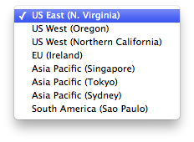
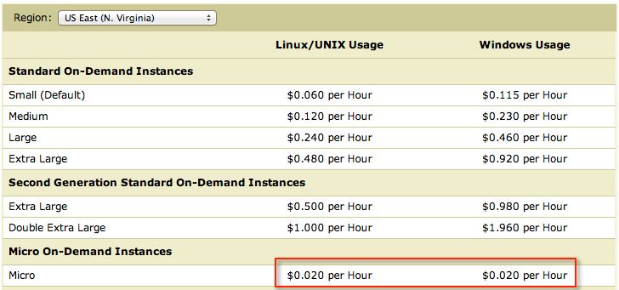
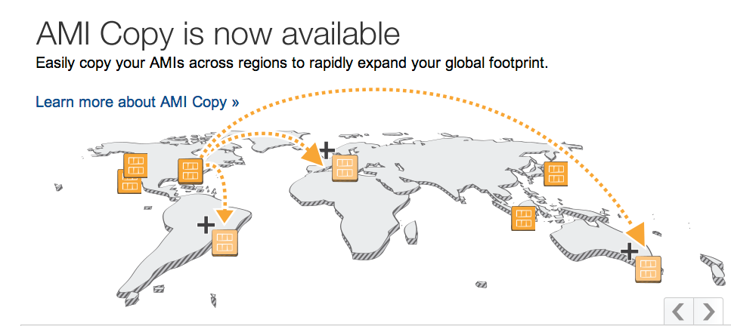
How low cost is Amazon AWS EC2 2013?

Slide 24
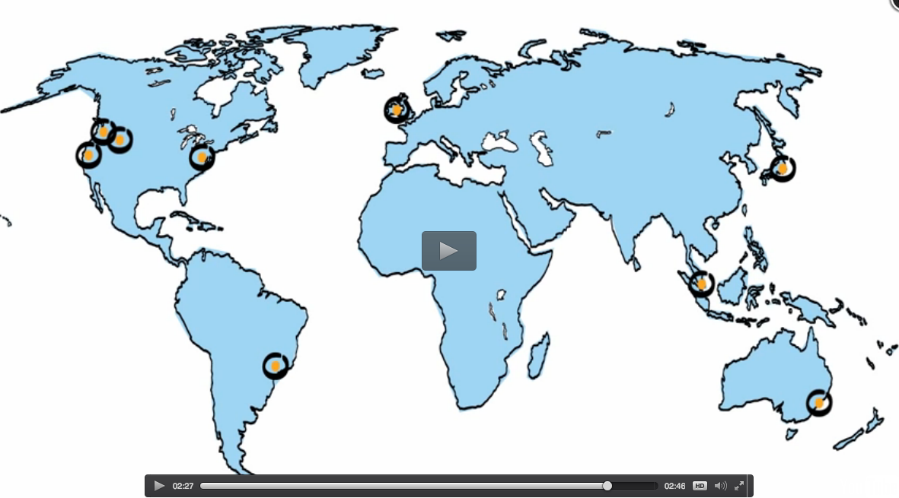
How low cost is Amazon AWS EC2 now?
North Virginia
Region
1 year
3 years
No upfront cost:
Power
Air Cond
Security Guard
Building
Rack
9 Regions
World Wide
Up in minutes
Notes:
Free Tier for new AWS customer: Each month 750 Hours of EC2 Linux/RHEL/SELS t2.micro instance uage; 750 hours of Elastic Load Balancing + 15 GB data processing
30 GB Elastic Block Storage, 2 M I/Os and 1GB snapshot storage, 15 GB of bandwidth out aggregated across all AWS services
1GB Regional Data Transfer.

Slide 25
Building Secure Systems with Cheap Cloud Resources
Provide load balancing support for vm groups on different cloud providers and different regions
N-cloud Storage (striping/pipelining redundant data chunks to different data centers) [HPSR13]
Redundant OS/Critical Libraries/PL/DB with real-time threat detection and switching.
Migrate apps among servers/clients including running apps standalone on mobile devices or browsers

Slide 26
Conclusion
Opportunities exist on design new secure IP protocols/systems.
Tackle hard problem→ Big payoff.
  Develop multipath indirect routing/enhanced DNS
  → better security, better bandwidth, better reliability.
Fundamental solution to DDoS requires
  Global Cooperation (legal, internet standards, ISP) and
  Information Assurance Awareness (avoid become a botnet unit; patching diligently, Do not click that alumni gathering picture in email attachment!)
Cloud Computing/CDN/SDN is our next fun playground.

